Slide 1
Module 8 MVVM Toolkit
IoT Project Cost Estimator
Notes:
Open the matching Word tutorial after the exercise overview. Source: Module 8 Word tutorial.

Slide 2
What you will build
Add CommunityToolkit.Mvvm.
Generate observable properties and commands.
Keep validation rules explicit.
Notes:
Give students the outcome before they start. Source: Module 8 Word tutorial.

Slide 3
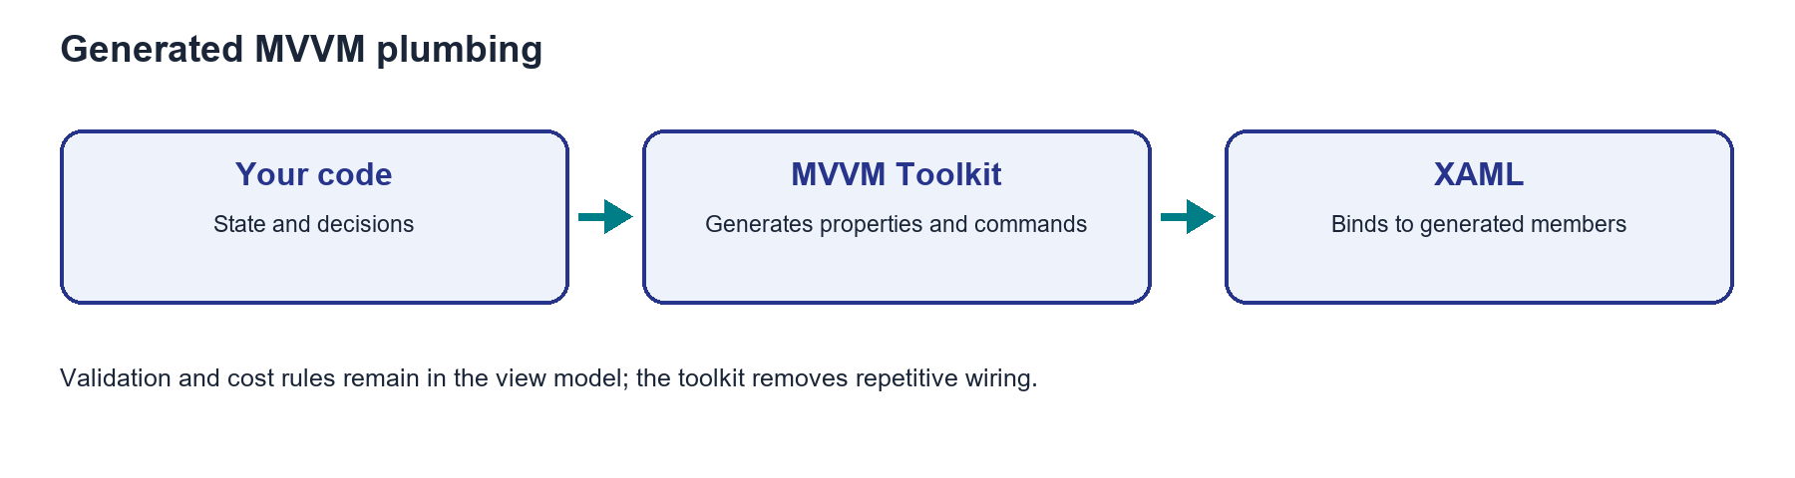
Source generation removes repeated MVVM code
ObservableProperty creates a public notifying property.
RelayCommand creates a command from a method.
Your validation rules remain ordinary C# code.
Notes:
Explain the framework idea before the first exercise step. MAUI documentation: https://learn.microsoft.com/dotnet/communitytoolkit/mvvm/generators/overview

Slide 4
From C# to the screen
The class is partial so generated code can join it.
A change hook runs when a generated property changes.
NotifyCanExecuteChanged updates a Button state.
Notes:
Ask students to identify the C# object, the XAML control, and the connection between them. Source: Module 8 Word tutorial. MAUI documentation: https://learn.microsoft.com/dotnet/communitytoolkit/mvvm/generators/overview

Slide 5
Step 1: Generated plumbing
The toolkit generates repeat notification code.
It does not choose validation rules.
Notes:
Before tutorial Step 1: explain these concepts. Ask students to predict what the change will do. Then open Step 1 in the Word tutorial. Source: Module 8 Word tutorial. Related MAUI documentation: https://learn.microsoft.com/dotnet/communitytoolkit/mvvm/generators/overview

Slide 6
Step 1: What changed?
The project builds with the package.
App behavior stays the same.
Notes:
After tutorial Step 1: run the app or inspect the code. Ask students to explain the observed result. Source: Module 8 Word tutorial.

Slide 7
Step 2: ObservableProperty
Mark state for generated properties.
Keep binding names stable.
Notes:
Before tutorial Step 2: explain these concepts. Ask students to predict what the change will do. Then open Step 2 in the Word tutorial. Source: Module 8 Word tutorial. Related MAUI documentation: https://learn.microsoft.com/dotnet/communitytoolkit/mvvm/generators/overview

Slide 8
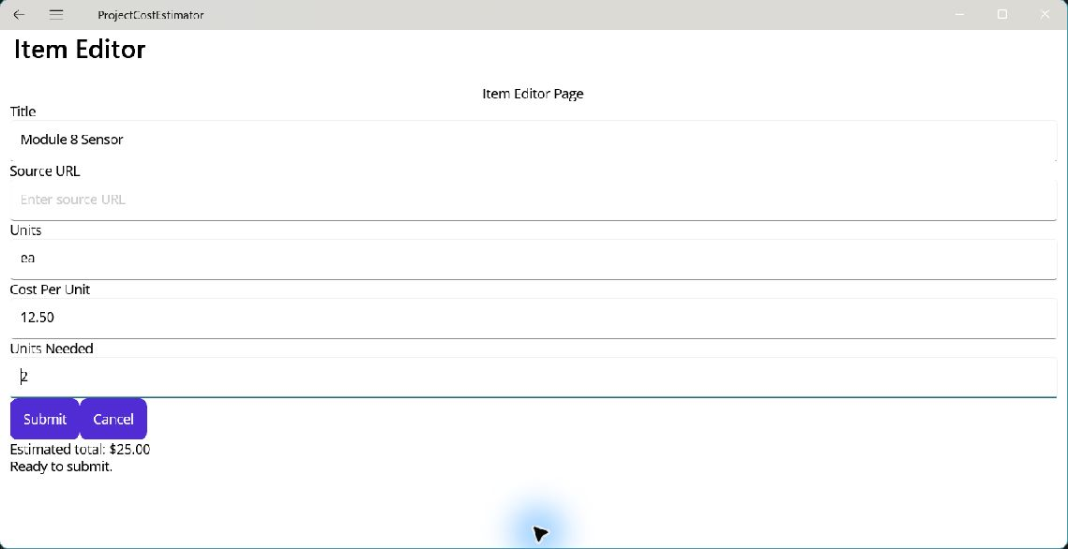
Step 2: What changed?
Typing still updates the form.
The live total still changes.
Notes:
After tutorial Step 2: run the app or inspect the code. Ask students to explain the observed result. Source: Module 8 Word tutorial.

Slide 9
Step 3: Change hooks
A generated property can call a change hook.
Use hooks to update validation and total.
Notes:
Before tutorial Step 3: explain these concepts. Ask students to predict what the change will do. Then open Step 3 in the Word tutorial. Source: Module 8 Word tutorial. Related MAUI documentation: https://learn.microsoft.com/dotnet/communitytoolkit/mvvm/generators/overview

Slide 10
Step 3: What changed?
A changed input updates the message.
Submit state follows the input.
Notes:
After tutorial Step 3: run the app or inspect the code. Ask students to explain the observed result. Source: Module 8 Word tutorial.

Slide 11
Step 4: RelayCommand
Mark an action with RelayCommand.
The toolkit generates the command property.
Notes:
Before tutorial Step 4: explain these concepts. Ask students to predict what the change will do. Then open Step 4 in the Word tutorial. Source: Module 8 Word tutorial. Related MAUI documentation: https://learn.microsoft.com/dotnet/communitytoolkit/mvvm/generators/overview

Slide 12
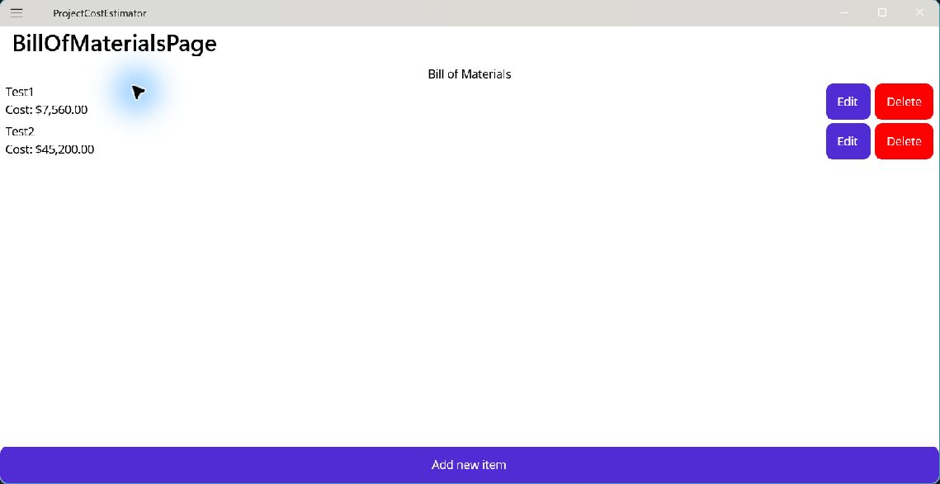
Step 4: What changed?
Submit and Cancel still work.
The BOM commands still change rows.
Notes:
After tutorial Step 4: run the app or inspect the code. Ask students to explain the observed result. Source: Module 8 Word tutorial.

Slide 13
What you can now explain
I can find a generated property from its field.
I can trace a RelayCommand method to XAML.
I can separate generated plumbing from business rules.
Notes:
Use the final tutorial checklist. Ask students to explain the module concept without reading code. Source: Module 8 Word tutorial.

Slide 14
Read more in MAUI documentation
MVVM Toolkit generators
Search Microsoft Learn for this topic.
Try one example in a small test page.
Notes:
Student reading: MVVM Toolkit generators. https://learn.microsoft.com/dotnet/communitytoolkit/mvvm/generators/overview

