Slide 1
Module 9 UI Boundaries
IoT Project Cost Estimator
Notes:
Open the matching Word tutorial after the exercise overview. Source: Module 9 Word tutorial.

Slide 2
What you will build
Inject the editor view model.
Move navigation and alerts behind an interface.
Test BOM decisions without a page.
Notes:
Give students the outcome before they start. Source: Module 9 Word tutorial.

Slide 3
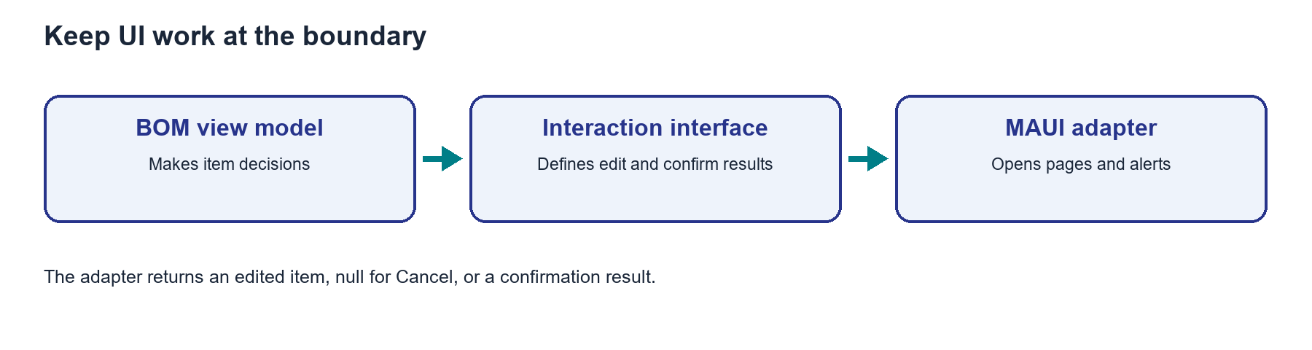
A UI boundary returns a useful result
The BOM view model asks an interface for UI work.
A MAUI adapter opens the page or alert.
The result tells the view model what the user chose.
Notes:
Explain the framework idea before the first exercise step. MAUI documentation: https://learn.microsoft.com/dotnet/maui/xaml/fundamentals/mvvm

Slide 4
From C# to the screen
Submit returns an item to the caller.
Cancel or Back returns no item.
A test can supply the result without opening a page.
Notes:
Ask students to identify the C# object, the XAML control, and the connection between them. Source: Module 9 Word tutorial. MAUI documentation: https://learn.microsoft.com/dotnet/maui/xaml/fundamentals/mvvm

Slide 5
Step 1: Editor injection
The container creates the editor view model.
The page binds to that injected instance.
Notes:
Before tutorial Step 1: explain these concepts. Ask students to predict what the change will do. Then open Step 1 in the Word tutorial. Source: Module 9 Word tutorial. Related MAUI documentation: https://learn.microsoft.com/dotnet/maui/xaml/fundamentals/mvvm

Slide 6
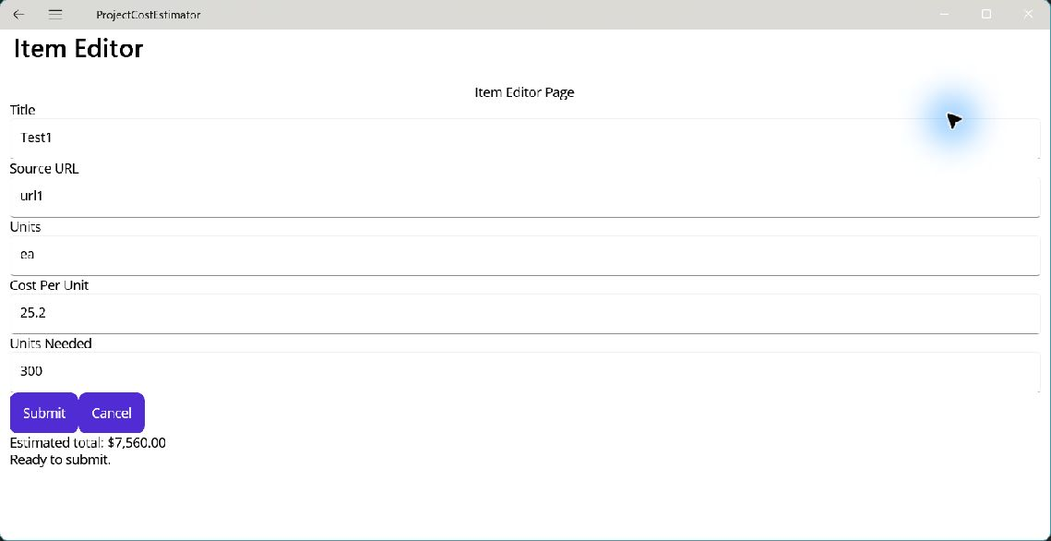
Step 1: What changed?
Add starts with an empty editor.
Edit starts with selected values.
Notes:
After tutorial Step 1: run the app or inspect the code. Ask students to explain the observed result. Source: Module 9 Word tutorial.

Slide 7
Step 2: Interaction results
The interface returns an item after Submit.
Null means Cancel or Back.
Notes:
Before tutorial Step 2: explain these concepts. Ask students to predict what the change will do. Then open Step 2 in the Word tutorial. Source: Module 9 Word tutorial. Related MAUI documentation: https://learn.microsoft.com/dotnet/maui/xaml/fundamentals/mvvm

Slide 8
Step 2: What changed?
Cancel does not change the BOM.
Submit returns the edited item.
Notes:
After tutorial Step 2: run the app or inspect the code. Ask students to explain the observed result. Source: Module 9 Word tutorial.

Slide 9
Step 3: MAUI adapter
The adapter opens pages and alerts.
The view model uses its result.
Notes:
Before tutorial Step 3: explain these concepts. Ask students to predict what the change will do. Then open Step 3 in the Word tutorial. Source: Module 9 Word tutorial. Related MAUI documentation: https://learn.microsoft.com/dotnet/maui/xaml/fundamentals/mvvm

Slide 10
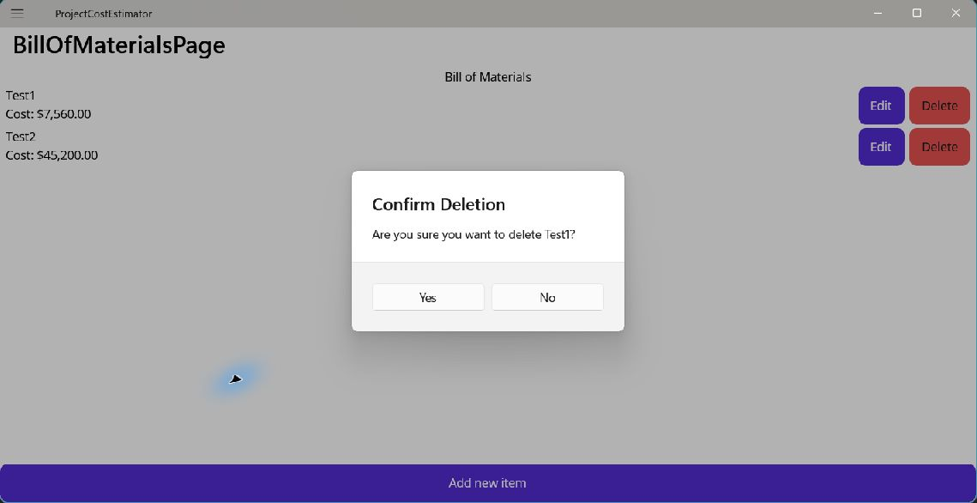
Step 3: What changed?
Delete shows a confirmation alert.
No leaves the row in place.
Notes:
After tutorial Step 3: run the app or inspect the code. Ask students to explain the observed result. Source: Module 9 Word tutorial.

Slide 11
Step 4: BOM decisions
The BOM view model decides Add, Edit, and Delete.
The adapter performs UI work.
Notes:
Before tutorial Step 4: explain these concepts. Ask students to predict what the change will do. Then open Step 4 in the Word tutorial. Source: Module 9 Word tutorial. Related MAUI documentation: https://learn.microsoft.com/dotnet/maui/xaml/fundamentals/mvvm

Slide 12
Step 4: What changed?
The page has no BOM decision code.
All user actions still work.
Notes:
After tutorial Step 4: run the app or inspect the code. Ask students to explain the observed result. Source: Module 9 Word tutorial.

Slide 13
What you can now explain
I can identify the UI adapter and its interface.
I can trace Submit and Cancel to different results.
I can test a BOM decision without MAUI controls.
Notes:
Use the final tutorial checklist. Ask students to explain the module concept without reading code. Source: Module 9 Word tutorial.

Slide 14
Read more in MAUI documentation
Dependency injection and MVVM
Search Microsoft Learn for this topic.
Try one example in a small test page.
Notes:
Student reading: Dependency injection and MVVM. https://learn.microsoft.com/dotnet/maui/xaml/fundamentals/mvvm

