Slide 1
Module 1 Build the IoT Estimator
IoT Project Cost Estimator
Notes:
Introduce Module 1. Open the matching Word tutorial after the exercise overview.

Slide 2
Exercise overview
Change the MAUI template for the estimator.
Add a model and an item editor page.
Validate text and numbers before calculation.
Notes:
Explain the work for Module 1. Show the expected app result before students start. Source: Module 1 Word tutorial.

Slide 3
Step 1 MAUI project files
XAML defines the visible page.
C# code handles page behavior.
Resources holds images and app artwork.
Notes:
Before tutorial Step 1: explain these concepts. Ask students to predict what the change will do. Then open Step 1 in the Word tutorial. Source: Module 1 Word tutorial.

Slide 4
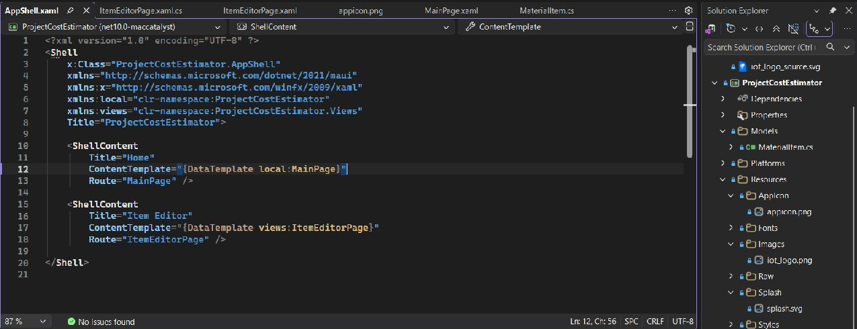
Step 1 Check
Find MainPage, AppShell, and Resources.
Explain the job of each file.
Notes:
After tutorial Step 1: run the app or inspect the code. Ask students to explain the observed result. Source: Module 1 Word tutorial.

Slide 5
Step 5 Image resources
Export the logo as a transparent PNG.
Keep the app icon square.
Notes:
Before tutorial Step 5: explain these concepts. Ask students to predict what the change will do. Then open Step 5 in the Word tutorial. Source: Module 1 Word tutorial.

Slide 6
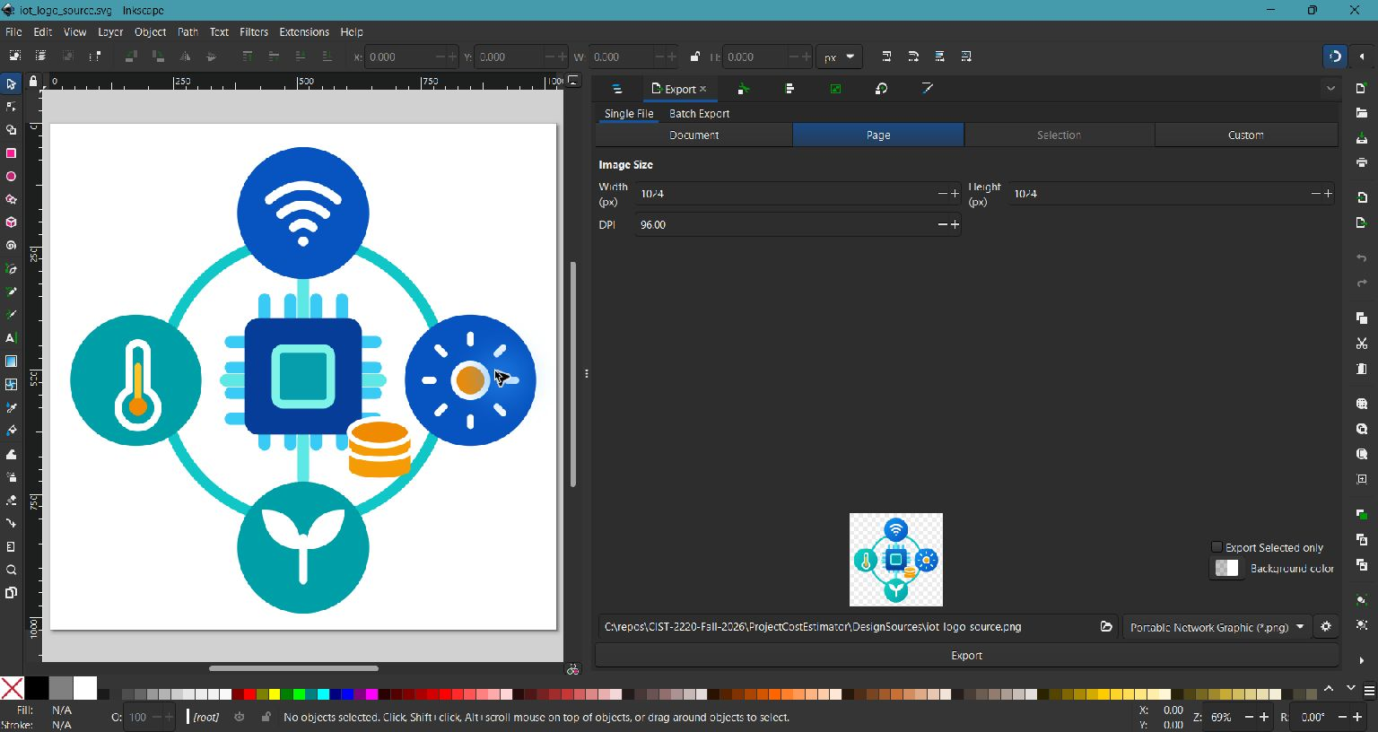
Step 5 Check
The transparent logo is ready for the app.
The Home page can show it in Step 6.
Notes:
After tutorial Step 5: run the app or inspect the code. Ask students to explain the observed result. Source: Module 1 Word tutorial.

Slide 7
Step 12 MaterialItem model
A model stores one material item.
TotalCost uses cost and quantity.
Notes:
Before tutorial Step 12: explain these concepts. Ask students to predict what the change will do. Then open Step 12 in the Word tutorial. Source: Module 1 Word tutorial.

Slide 8
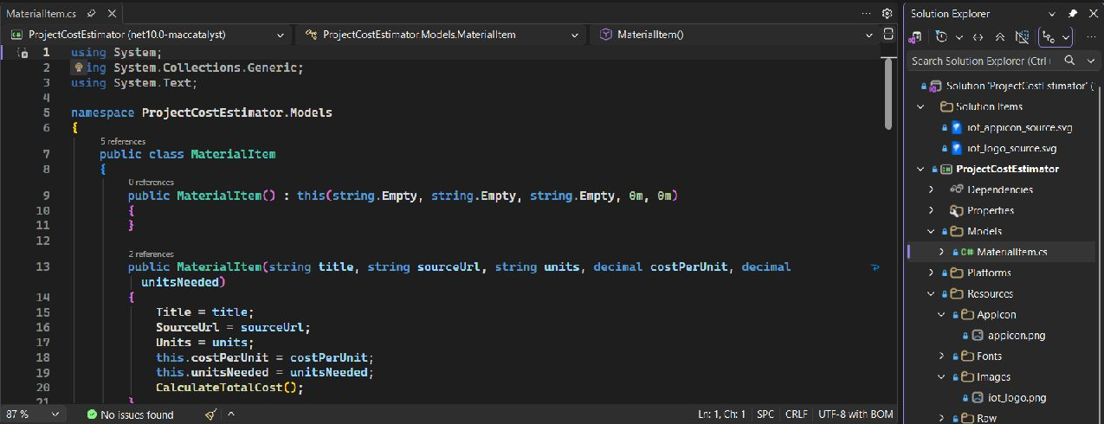
Step 12 Check
Create one item with the required values.
Check its calculated total.
Notes:
After tutorial Step 12: run the app or inspect the code. Ask students to explain the observed result. Source: Module 1 Word tutorial.

Slide 9
Step 16 Editor page layout
A vertical layout stacks the inputs.
A ScrollView keeps the form usable.
Notes:
Before tutorial Step 16: explain these concepts. Ask students to predict what the change will do. Then open Step 16 in the Word tutorial. Source: Module 1 Word tutorial.

Slide 10
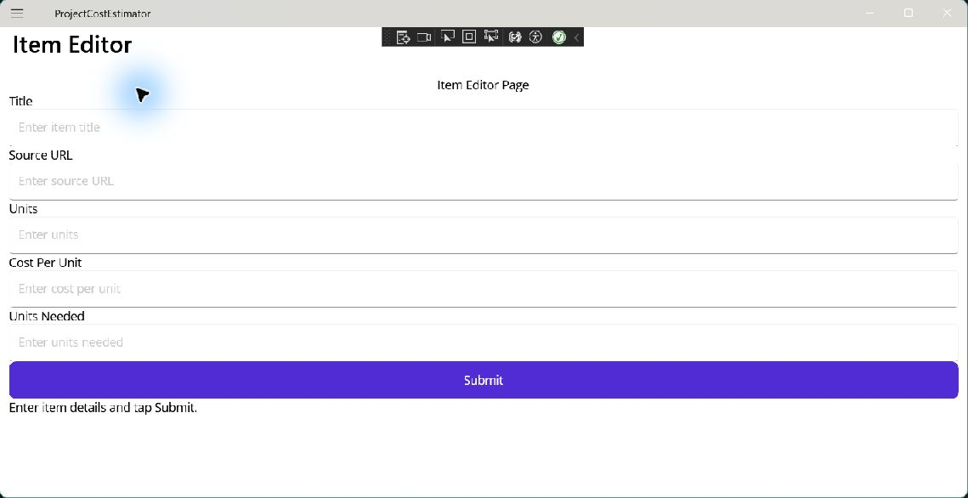
Step 16 Check
The Item Editor shows every input.
The Submit button appears below the form.
Notes:
After tutorial Step 16: run the app or inspect the code. Ask students to explain the observed result. Source: Module 1 Word tutorial.

Slide 11
Step 20 Shell navigation
Shell lists the app destinations.
A route opens the editor page.
Notes:
Before tutorial Step 20: explain these concepts. Ask students to predict what the change will do. Then open Step 20 in the Word tutorial. Source: Module 1 Word tutorial.

Slide 12
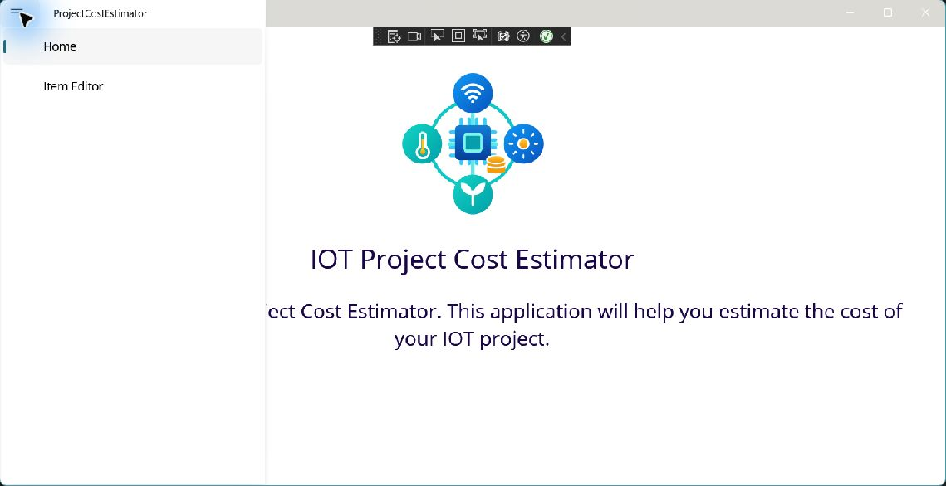
Step 20 Check
Open the editor through Shell.
Use Back to return to Home.
Notes:
After tutorial Step 20: run the app or inspect the code. Ask students to explain the observed result. Source: Module 1 Word tutorial.

Slide 13
Step 21 Input validation
Check required text before calculation.
Use TryParse for numeric input.
Notes:
Before tutorial Step 21: explain these concepts. Ask students to predict what the change will do. Then open Step 21 in the Word tutorial. Source: Module 1 Word tutorial.

Slide 14
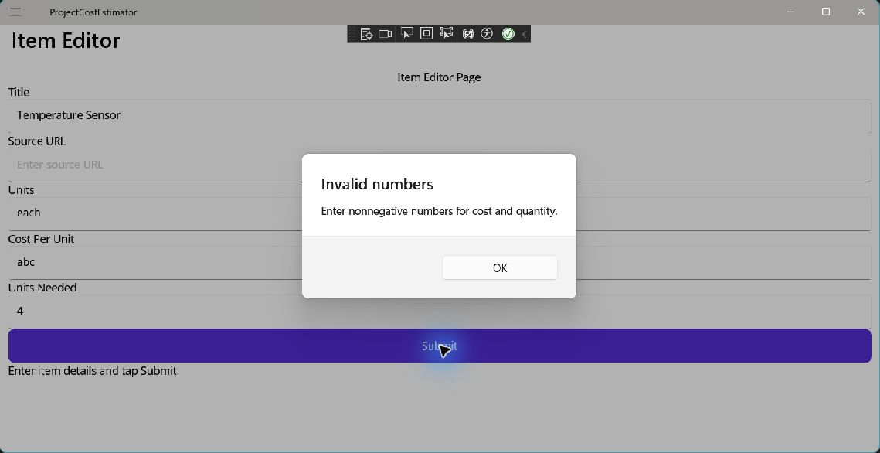
Step 21 Check
Invalid input shows an alert.
Valid input produces a total.
Notes:
After tutorial Step 21: run the app or inspect the code. Ask students to explain the observed result. Source: Module 1 Word tutorial.

Slide 15
Module review
Show the completed app workflow.
Explain which responsibility changed.
Check the result before the next module.
Notes:
Use the final tutorial checklist. Ask students to explain the module concept without reading code. Source: Module 1 Word tutorial.

