Slide 1
Module 3 Item Editor Binding
IoT Project Cost Estimator
Notes:
Introduce Module 3. Open the matching Word tutorial after the exercise overview.

Slide 2
Exercise overview
Move form values into a view model.
Bind the Entries to those values.
Show a live cost total.
Notes:
Explain the work for Module 3. Show the expected app result before students start. Source: Module 3 Word tutorial.

Slide 3
Step 2 BindingContext
BindingContext names the data source.
A two-way binding moves an Entry value both ways.
Notes:
Before tutorial Step 2: explain these concepts. Ask students to predict what the change will do. Then open Step 2 in the Word tutorial. Source: Module 3 Word tutorial.

Slide 4
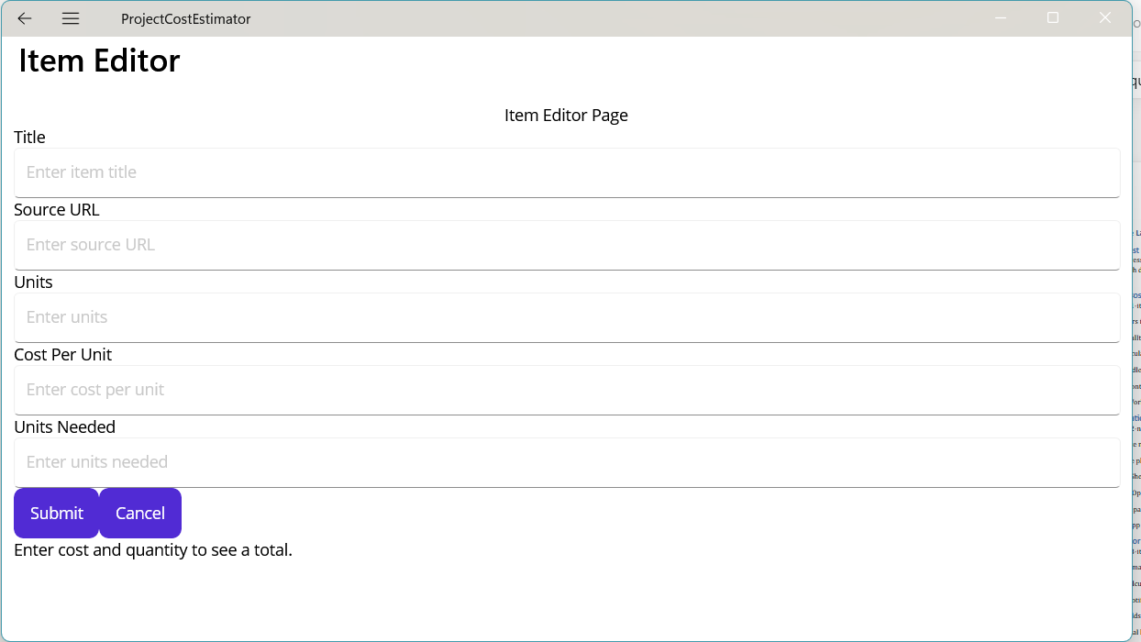
Step 2 Check
Title appears in the bound property.
The page still looks the same.
Notes:
After tutorial Step 2: run the app or inspect the code. Ask students to explain the observed result. Source: Module 3 Word tutorial.

Slide 5
Step 3 Property notification
A changed C# value must notify the view.
INotifyPropertyChanged sends that notice.
Notes:
Before tutorial Step 3: explain these concepts. Ask students to predict what the change will do. Then open Step 3 in the Word tutorial. Source: Module 3 Word tutorial.

Slide 6
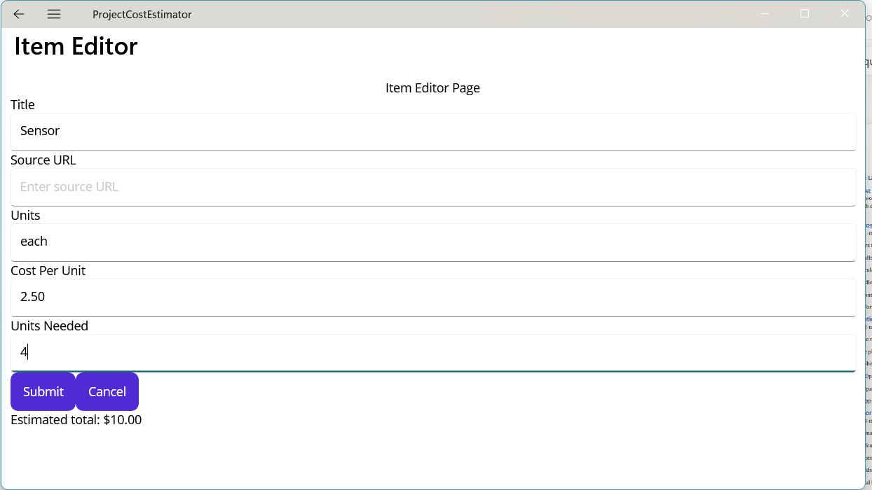
Step 3 Check
The view reflects a changed property.
Typing still changes the view-model value.
Notes:
After tutorial Step 3: run the app or inspect the code. Ask students to explain the observed result. Source: Module 3 Word tutorial.

Slide 7
Step 5 Edit prefill
Copy the selected item into the view model.
Bindings put those values in the Entries.
Notes:
Before tutorial Step 5: explain these concepts. Ask students to predict what the change will do. Then open Step 5 in the Word tutorial. Source: Module 3 Word tutorial.

Slide 8

Step 5 Check
Edit opens with the row values.
Cancel leaves the original item.
Notes:
After tutorial Step 5: run the app or inspect the code. Ask students to explain the observed result. Source: Module 3 Word tutorial.

Slide 9
Step 6 Live total
Calculate after cost or quantity changes.
Notify the TotalText binding.
Notes:
Before tutorial Step 6: explain these concepts. Ask students to predict what the change will do. Then open Step 6 in the Word tutorial. Source: Module 3 Word tutorial.

Slide 10

Step 6 Check
The total changes while the user types.
Invalid numbers show a helpful message.
Notes:
After tutorial Step 6: run the app or inspect the code. Ask students to explain the observed result. Source: Module 3 Word tutorial.

Slide 11
Step 8 Typed bindings
x:DataType checks binding names at build time.
A wrong property name becomes a build issue.
Notes:
Before tutorial Step 8: explain these concepts. Ask students to predict what the change will do. Then open Step 8 in the Word tutorial. Source: Module 3 Word tutorial.

Slide 12
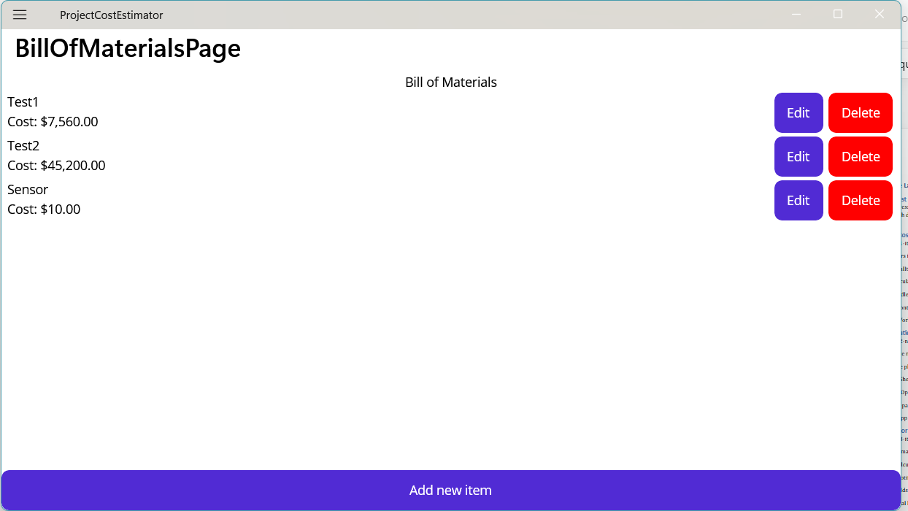
Step 8 Check
The page builds with typed bindings.
All five Entries still bind.
Notes:
After tutorial Step 8: run the app or inspect the code. Ask students to explain the observed result. Source: Module 3 Word tutorial.

Slide 13
Module review
Show the completed app workflow.
Explain which responsibility changed.
Check the result before the next module.
Notes:
Use the final tutorial checklist. Ask students to explain the module concept without reading code. Source: Module 3 Word tutorial.

