Slide 1
Module 4 Commands and Validation
IoT Project Cost Estimator
Notes:
Introduce Module 4. Open the matching Word tutorial after the exercise overview.

Slide 2
Exercise overview
Replace button click handlers with commands.
Keep form validation in the view model.
Disable Submit when values are invalid.
Notes:
Explain the work for Module 4. Show the expected app result before students start. Source: Module 4 Word tutorial.

Slide 3
Step 1 Submit command
A command represents an action in the view model.
XAML binds the button to that command.
Notes:
Before tutorial Step 1: explain these concepts. Ask students to predict what the change will do. Then open Step 1 in the Word tutorial. Source: Module 4 Word tutorial.

Slide 4
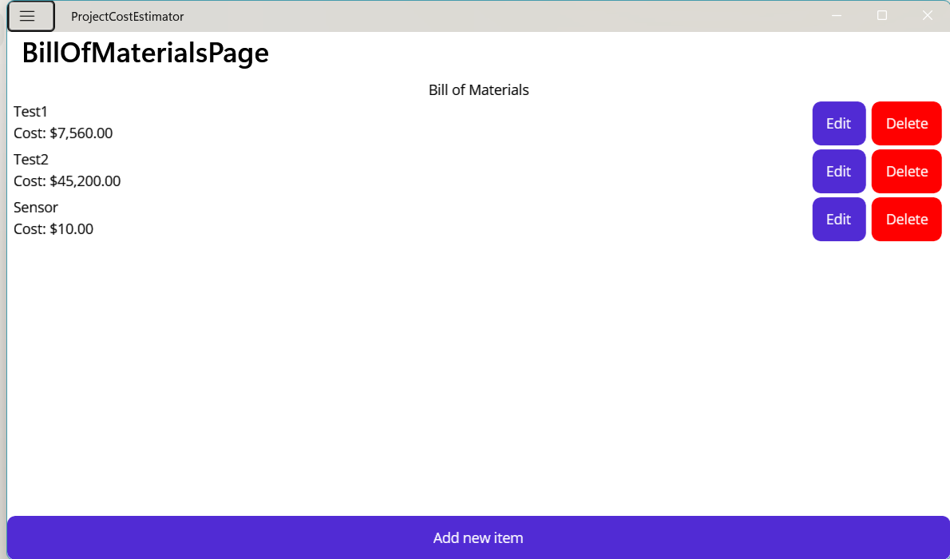
Step 1 Check
Submit still creates an item.
The button has no Clicked handler.
Notes:
After tutorial Step 1: run the app or inspect the code. Ask students to explain the observed result. Source: Module 4 Word tutorial.

Slide 5
Step 2 Validation rules
Keep validation beside the form values.
Create an item only when all values pass.
Notes:
Before tutorial Step 2: explain these concepts. Ask students to predict what the change will do. Then open Step 2 in the Word tutorial. Source: Module 4 Word tutorial.

Slide 6
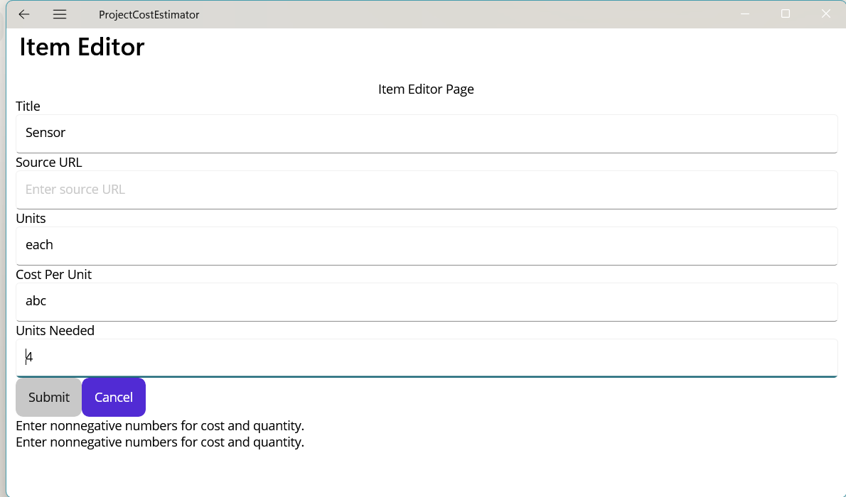
Step 2 Check
Invalid values do not create an item.
Valid values produce the expected total.
Notes:
After tutorial Step 2: run the app or inspect the code. Ask students to explain the observed result. Source: Module 4 Word tutorial.

Slide 7
Step 3 Validation message
Bind a message under the form.
Tell the user which value needs work.
Notes:
Before tutorial Step 3: explain these concepts. Ask students to predict what the change will do. Then open Step 3 in the Word tutorial. Source: Module 4 Word tutorial.

Slide 8
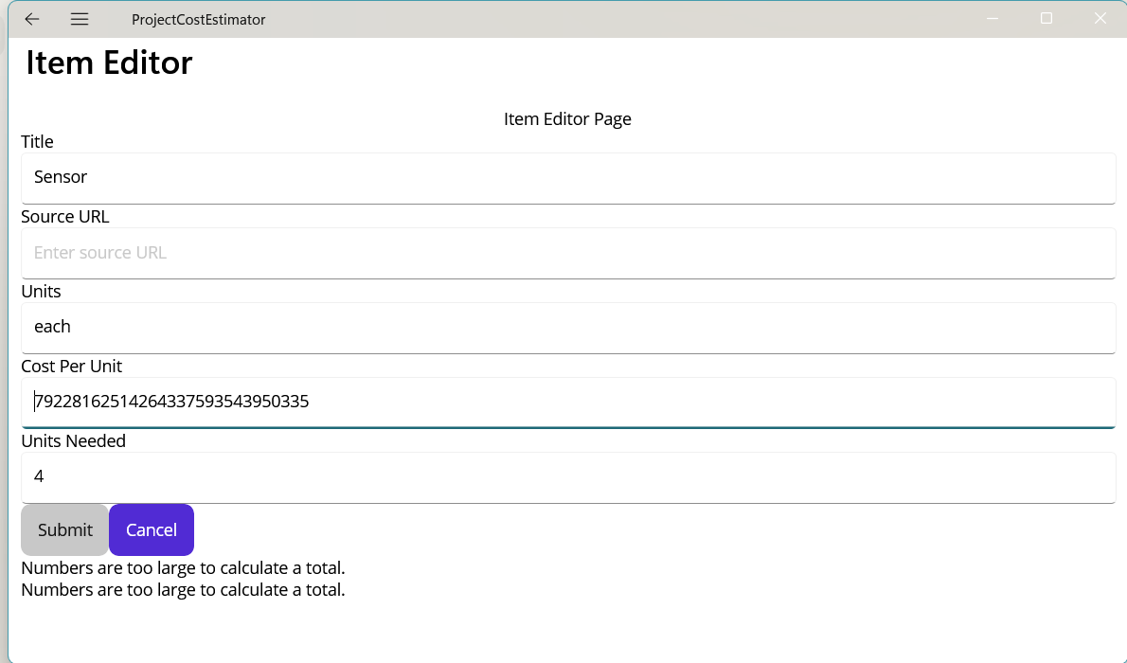
Step 3 Check
A bad value shows a specific message.
A valid form shows its total.
Notes:
After tutorial Step 3: run the app or inspect the code. Ask students to explain the observed result. Source: Module 4 Word tutorial.

Slide 9
Step 4 CanExecute
CanExecute controls whether a command can run.
Notify the command when input changes.
Notes:
Before tutorial Step 4: explain these concepts. Ask students to predict what the change will do. Then open Step 4 in the Word tutorial. Source: Module 4 Word tutorial.

Slide 10
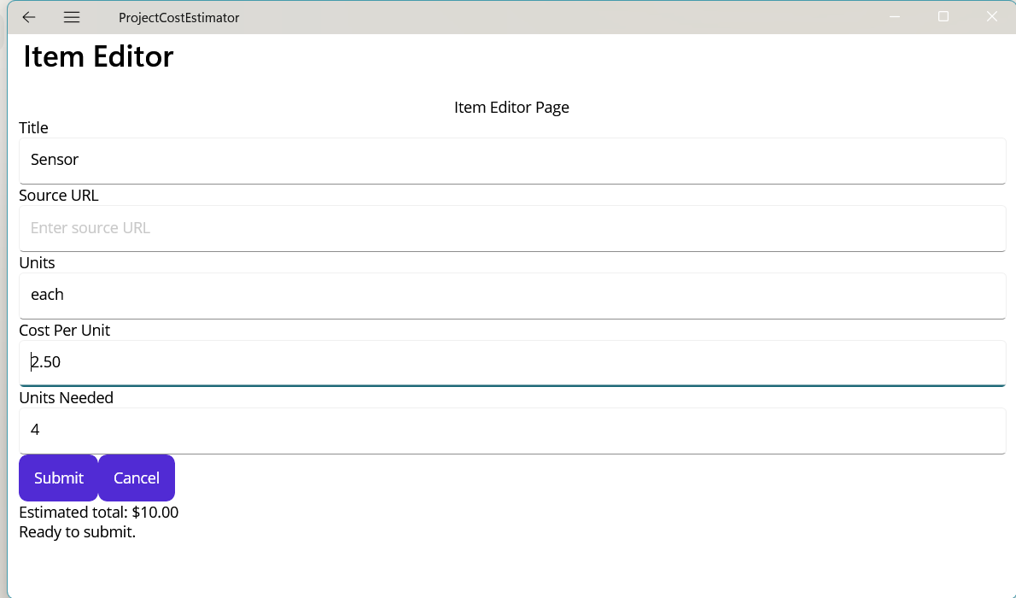
Step 4 Check
Submit is disabled for invalid data.
Submit enables when the form is valid.
Notes:
After tutorial Step 4: run the app or inspect the code. Ask students to explain the observed result. Source: Module 4 Word tutorial.

Slide 11
Step 5 Cancel command
Cancel is a command with no validation rule.
The page still handles navigation.
Notes:
Before tutorial Step 5: explain these concepts. Ask students to predict what the change will do. Then open Step 5 in the Word tutorial. Source: Module 4 Word tutorial.

Slide 12
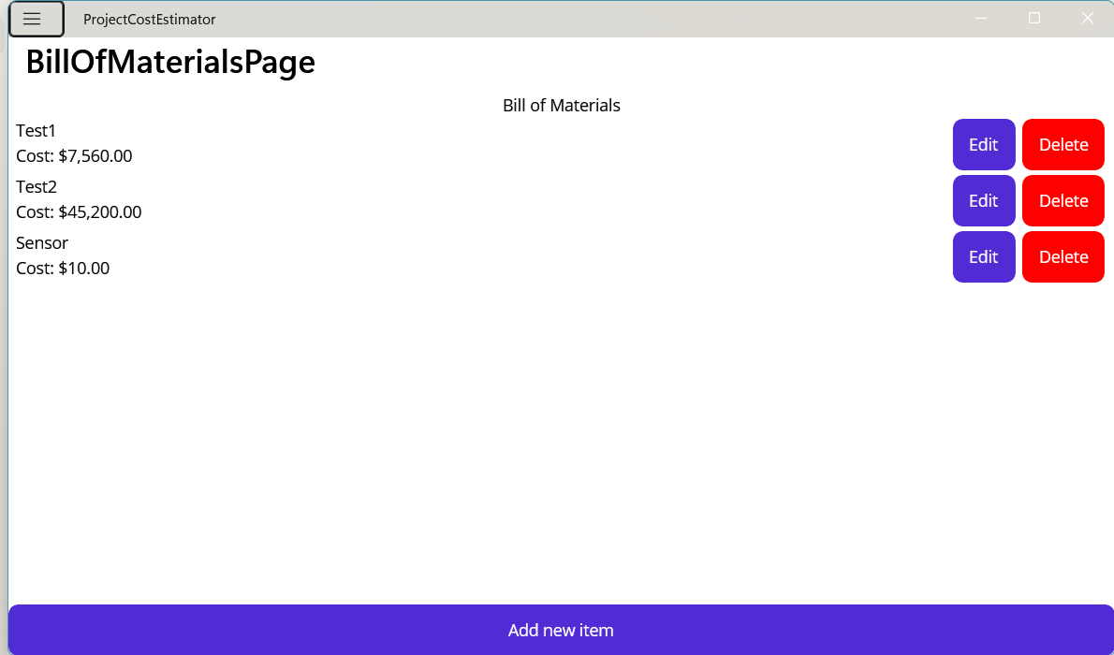
Step 5 Check
Cancel closes the editor.
The original item stays unchanged.
Notes:
After tutorial Step 5: run the app or inspect the code. Ask students to explain the observed result. Source: Module 4 Word tutorial.

Slide 13
Module review
Show the completed app workflow.
Explain which responsibility changed.
Check the result before the next module.
Notes:
Use the final tutorial checklist. Ask students to explain the module concept without reading code. Source: Module 4 Word tutorial.

