Slide 1
Module 7 Services and DI
IoT Project Cost Estimator
Notes:
Introduce Module 7. Open the matching Word tutorial after the exercise overview.

Slide 2
Exercise overview
Move BOM data into a service.
Register the service and view models.
Inject dependencies through constructors.
Notes:
Explain the work for Module 7. Show the expected app result before students start. Source: Module 7 Word tutorial.

Slide 3
Step 1 Data ownership
The view model currently holds the list.
A service can own shared BOM data.
Notes:
Before tutorial Step 1: explain these concepts. Ask students to predict what the change will do. Then open Step 1 in the Word tutorial. Source: Module 7 Word tutorial.

Slide 4
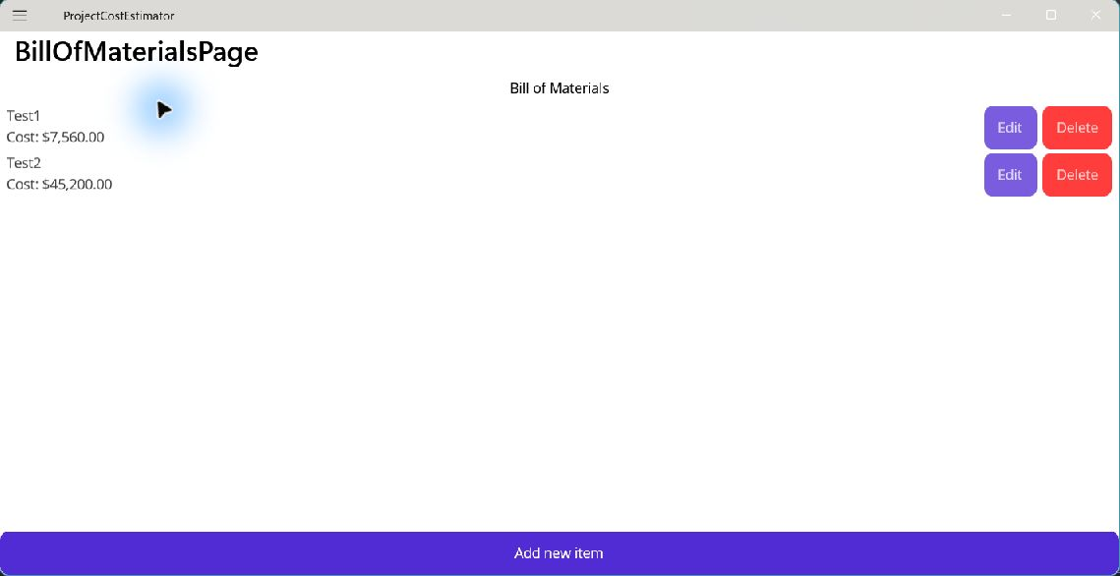
Step 1 Check
Name the owner of Items.
Keep commands in the view model.
Notes:
After tutorial Step 1: run the app or inspect the code. Ask students to explain the observed result. Source: Module 7 Word tutorial.

Slide 5
Step 2 Service contract
IBomService states the available operations.
The view model depends on the contract.
Notes:
Before tutorial Step 2: explain these concepts. Ask students to predict what the change will do. Then open Step 2 in the Word tutorial. Source: Module 7 Word tutorial.

Slide 6
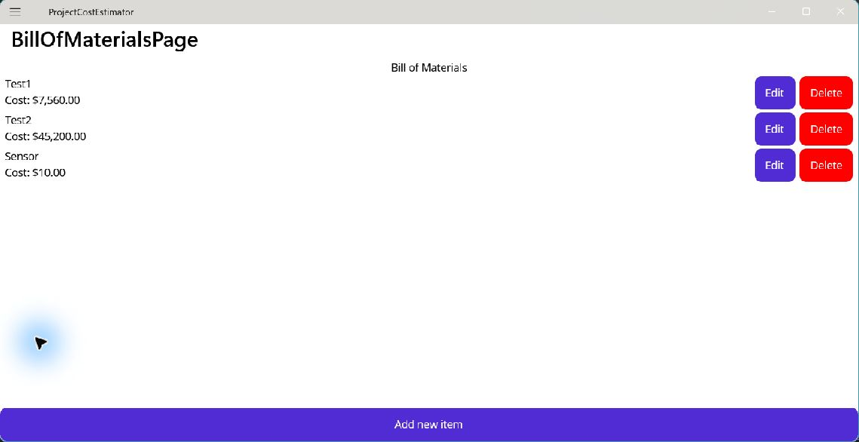
Step 2 Check
The interface has Items and change methods.
It has no page or dialog code.
Notes:
After tutorial Step 2: run the app or inspect the code. Ask students to explain the observed result. Source: Module 7 Word tutorial.

Slide 7
Step 3 In-memory service
InMemoryBomService implements the contract.
It keeps the BOM for the current app run.
Notes:
Before tutorial Step 3: explain these concepts. Ask students to predict what the change will do. Then open Step 3 in the Word tutorial. Source: Module 7 Word tutorial.

Slide 8

Step 3 Check
Add and Replace use the service.
CollectionView shows the changed data.
Notes:
After tutorial Step 3: run the app or inspect the code. Ask students to explain the observed result. Source: Module 7 Word tutorial.

Slide 9
Step 4 Dependency injection
Register each service in MauiProgram.
The container passes dependencies to constructors.
Notes:
Before tutorial Step 4: explain these concepts. Ask students to predict what the change will do. Then open Step 4 in the Word tutorial. Source: Module 7 Word tutorial.

Slide 10
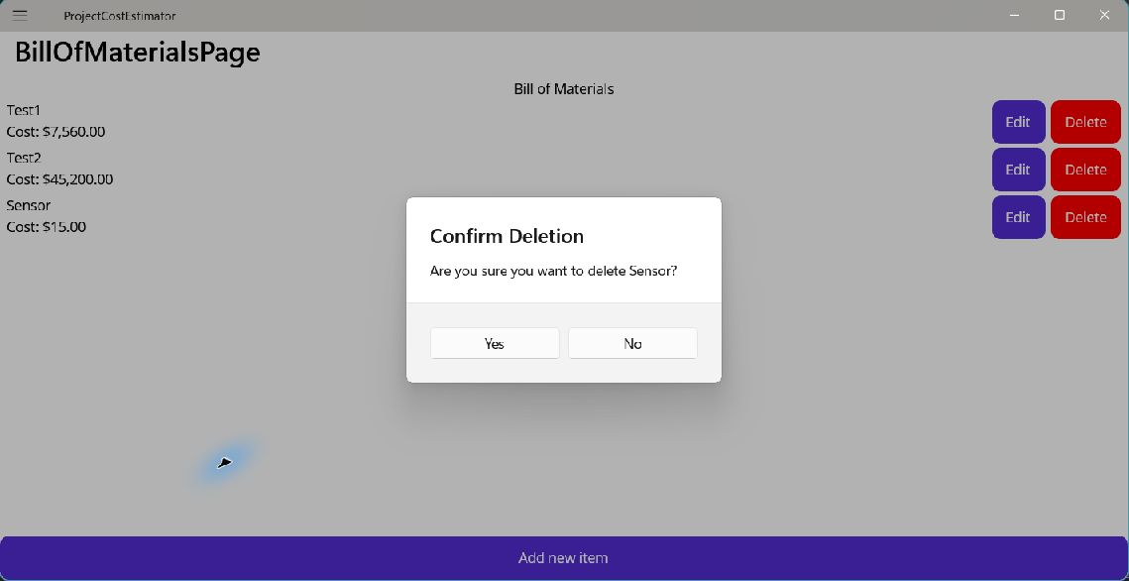
Step 4 Check
MAUI creates the page and view model.
The BOM workflow still works.
Notes:
After tutorial Step 4: run the app or inspect the code. Ask students to explain the observed result. Source: Module 7 Word tutorial.

Slide 11
Module review
Show the completed app workflow.
Explain which responsibility changed.
Check the result before the next module.
Notes:
Use the final tutorial checklist. Ask students to explain the module concept without reading code. Source: Module 7 Word tutorial.

