Slide 1
DIFFUSION IN CLAY

Slide 2
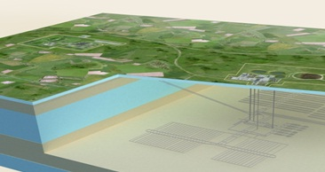
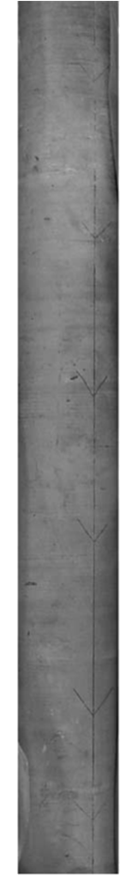
Low water content / porosity values
Fine-grained rocks

Slide 3
Radionuclide migration prediction
Retention model
Transport model
Coupling
Altmann et al., App. Geoch., 2008
+ Other coupled processes (see presentation at COUFRAC meeting)

Slide 4
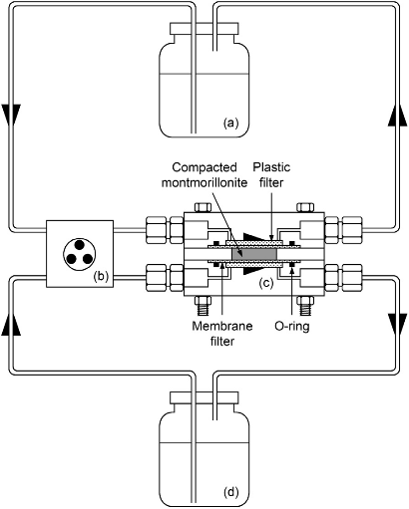
Exercise 11: Diffusion in Clay
Experimental setup
High concentration reservoir
Low concentration reservoir

Slide 5
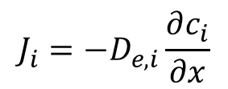

Example of results
$$J_{i}={−D}_{e,i}\frac{∂c_{i}}{∂x}$$
Fick’s 1st law of diffusion
$$D_{e,i}=φ{∙D}_{p,i}=φ∙τ{∙D}_{0,i}$$
Pore diffusion coefficient
Geometrical factor (tortuosity)
Self diffusion coefficient
Porosity
Data from Tachi & Yotsuji, 2014

Slide 6
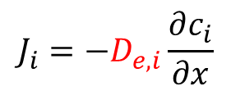

Example of results
$$J_{i}=−D_{e,i}\frac{∂c_{i}}{∂x}$$
Fick’s 1st law of diffusion
$$D_{e,i}=φ{∙D}_{p,i}=φ∙τ{∙D}_{0,i}$$
Pore diffusion coefficient
Geometrical factor (tortuosity)
Self diffusion coefficient
Porosity
The slope is proportional to the effective diffusion coefficient
Data from Tachi & Yotsuji, 2014

Slide 7
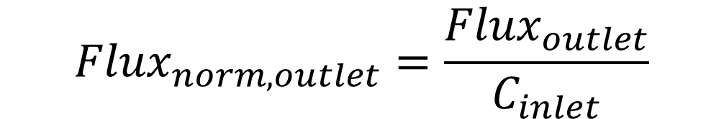
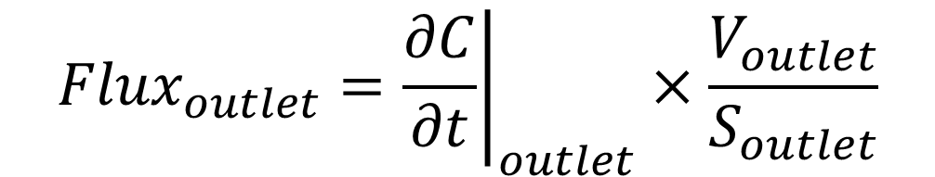
$${Flux}_{outlet}={\left.\frac{∂C}{∂t}\right|}_{outlet}×\frac{V_{outlet}}{S_{outlet}}$$
mol m⁻² s⁻¹
$${Flux}_{norm,outlet}=\frac{{Flux}_{outlet}}{C_{inlet}}$$
m s⁻¹
Data from Tinnacher et al. GCA, 2016

Slide 8
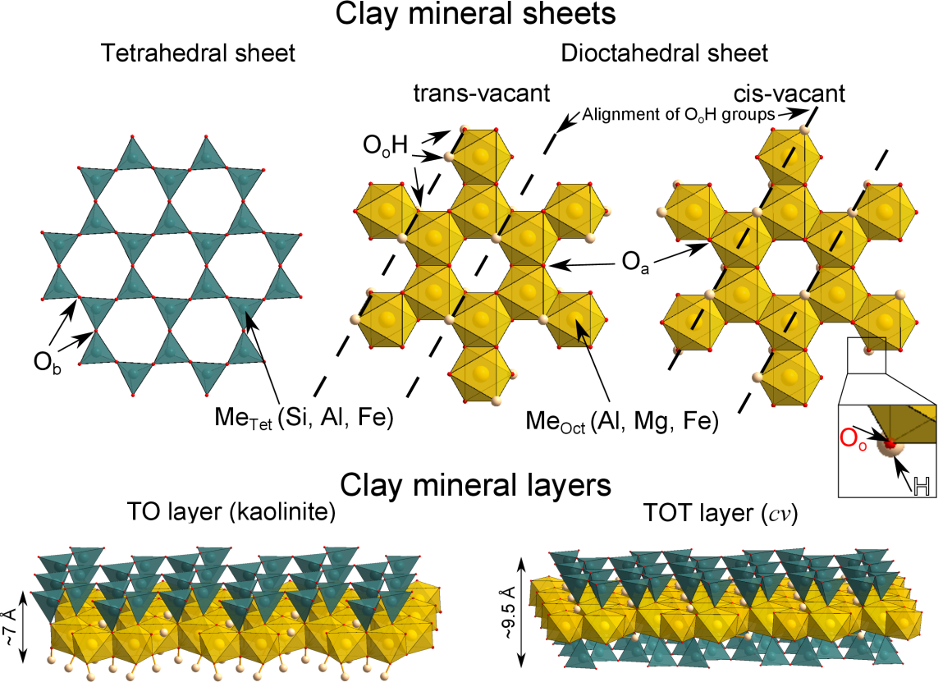
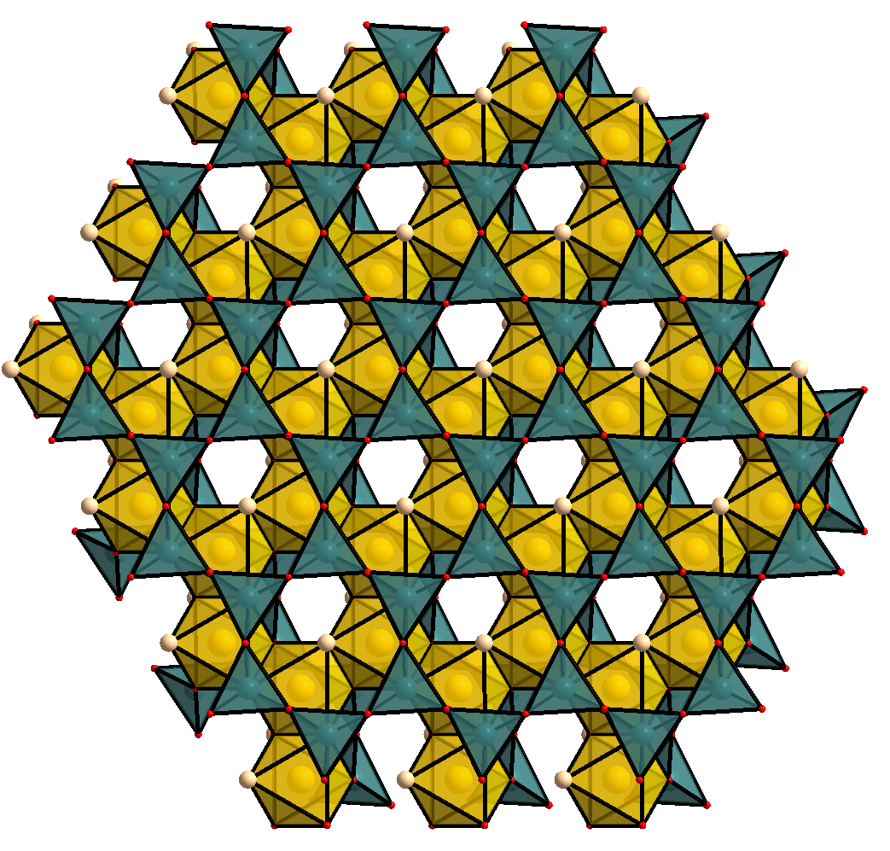
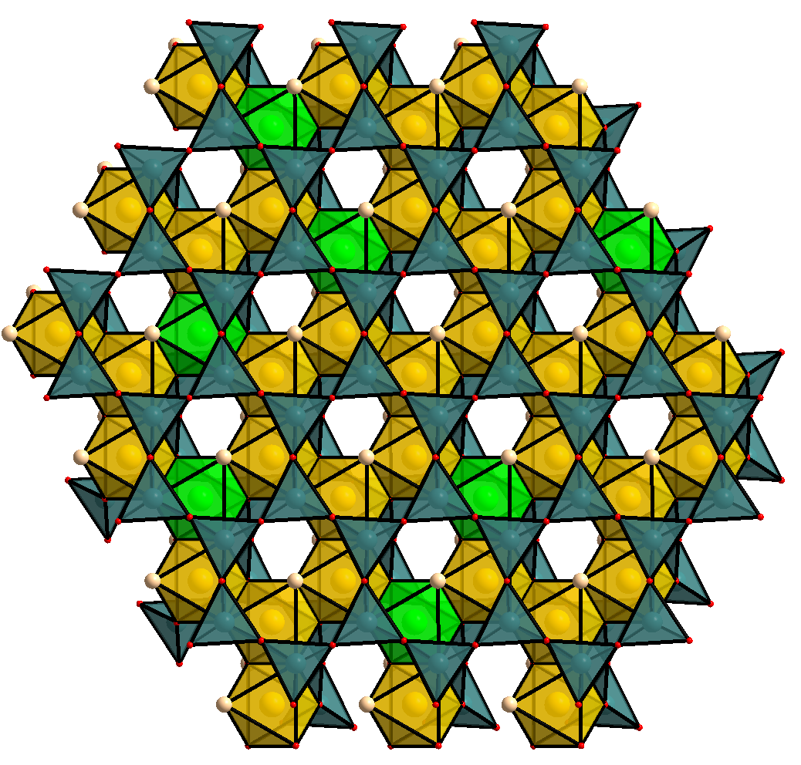
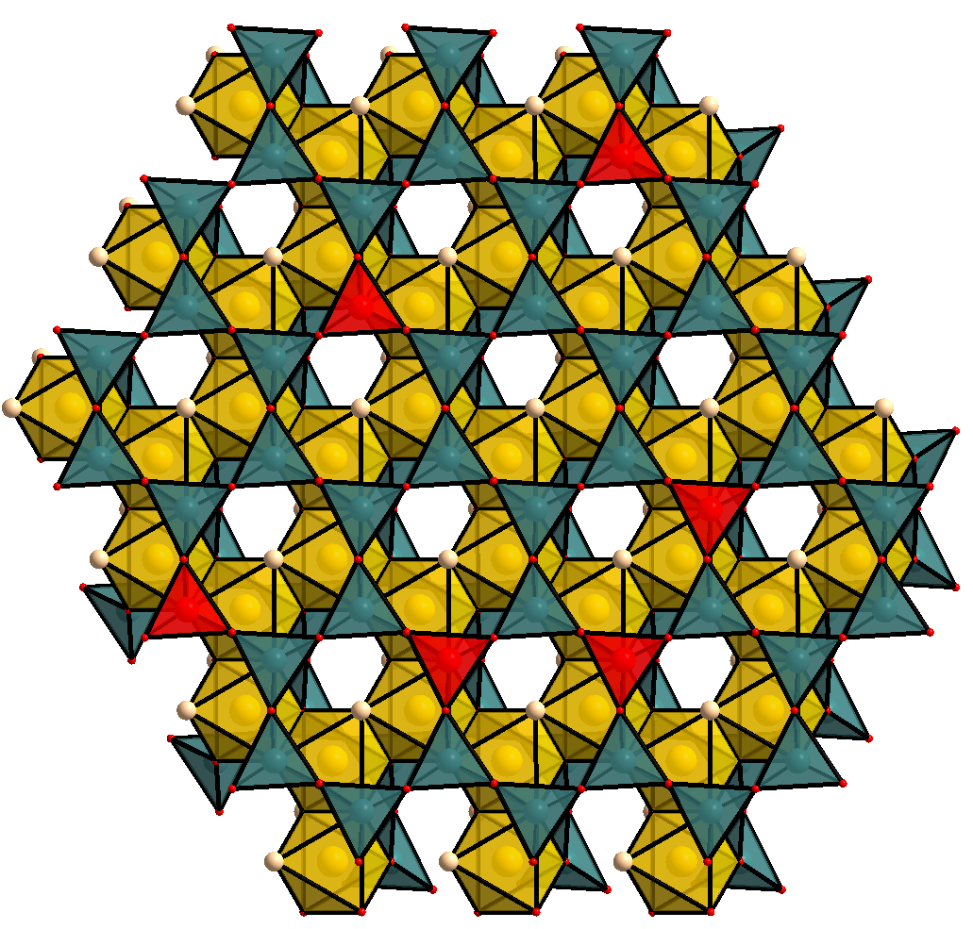

Al³⁺ ↔ Mg²⁺
Si⁴⁺ ↔ Al³⁺
Isomorphic substitutions
Negative charge of the layer
Cation exchange capacity
Anion Exclusion
Na⁺
Na⁺
Stern layer
Cl⁻
Bulk liquid
Charge screening in the electrical double layer (EDL)
2 XNa + Ca²⁺ $=$ X₂Ca + 2 Na⁺
Cl⁻
Na⁺
Cl⁻
Na⁺
Na⁺
Na⁺
Cl⁻
Diffuse layer
Na⁺
Diffuse layer
Cl⁻
Na⁺
Cl⁻
Na⁺
Na⁺
ψ
Na⁺
Na⁺
Stern layer
Na⁺
Na⁺
Na⁺
Na⁺
Na⁺
Na⁺
Na⁺
Na⁺
Na⁺
ψ_{surface} < 0
Na⁺
Na⁺
Na⁺

Slide 9
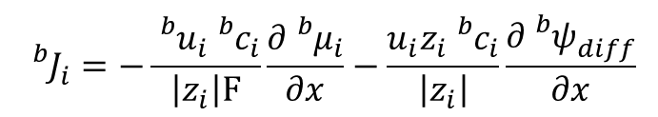
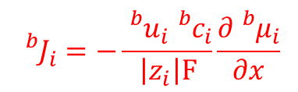
Bulk water
Chemical potential
$${}_{}^{b}{μ_{i}}={}_{}^{b}{μ_{i}^{0}}+RT\ln{{}_{}^{b}{a_{i}}}={}_{}^{b}{μ_{i}^{0}}+RT\ln{{}_{}^{b}{c_{i}}}+RT\ln{{}_{}^{b}{γ_{i}}}$$
$${}_{}^{b}{J_{i}}=−\frac{{}_{}^{b}{u_{i}}{}_{}^{b}{c_{i}}}{\left|z_{i}\right|F}\frac{∂{}_{}^{b}{μ_{i}}}{∂x}−\frac{u_{i}z_{i}{}_{}^{b}{c_{i}}}{\left|z_{i}\right|}\frac{∂{}_{}^{b}{ψ_{diff}^{}}}{∂x}$$
$${}_{}^{b}{J_{i}}=−\frac{{}_{}^{b}{u_{i}}{}_{}^{b}{c_{i}}}{\left|z_{i}\right|F}\frac{∂{}_{}^{b}{μ_{i}}}{∂x}$$
Nernst-Planck equation
Na⁺
Cl⁻
Charge balance (zero current condition) ?
The diffusion coefficient of Cl⁻ (~2.1 10⁻⁹ m² s⁻¹) is higher than that of Na⁺ (~1.3 10⁻⁹ m² s⁻¹)

Slide 10

Bulk water
Chemical potential
$${}_{}^{b}{μ_{i}}={}_{}^{b}{μ_{i}^{0}}+RT\ln{{}_{}^{b}{a_{i}}}={}_{}^{b}{μ_{i}^{0}}+RT\ln{{}_{}^{b}{c_{i}}}+RT\ln{{}_{}^{b}{γ_{i}}}$$
$${}_{}^{b}{J_{i}}=−\frac{{}_{}^{b}{u_{i}}{}_{}^{b}{c_{i}}}{\left|z_{i}\right|F}\frac{∂{}_{}^{b}{μ_{i}}}{∂x}−\frac{u_{i}z_{i}{}_{}^{b}{c_{i}}}{\left|z_{i}\right|}\frac{∂{}_{}^{b}{ψ_{diff}^{}}}{∂x}$$
Nernst-Planck equation
Na⁺
$$ψ_{diff}^{}$$
Cl⁻
Electrophoresis at zero current condition

Slide 11
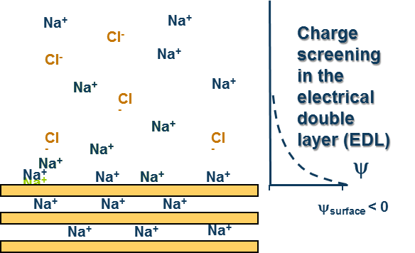




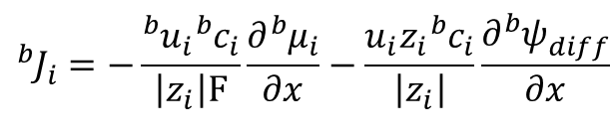
Bulk water
Chemical potential
$${}_{}^{b}{μ_{i}}={}_{}^{b}{μ_{i}^{0}}+RT\ln{{}_{}^{b}{a_{i}}}={}_{}^{b}{μ_{i}^{0}}+RT\ln{{}_{}^{b}{c_{i}}}+RT\ln{{}_{}^{b}{γ_{i}}}$$
$${}_{}^{b}{J_{i}}=−\frac{{}_{}^{b}{u_{i}}{}_{}^{b}{c_{i}}}{\left|z_{i}\right|F}\frac{∂{}_{}^{b}{μ_{i}}}{∂x}−\frac{u_{i}z_{i}{}_{}^{b}{c_{i}}}{\left|z_{i}\right|}\frac{∂{}_{}^{b}{ψ_{diff}^{}}}{∂x}$$
Nernst-Planck equation
$${}_{}^{b}{J_{i}}=−{}_{}^{b}{D_{i}}\left[\frac{∂{}_{}^{b}{c_{i}}}{∂x}+{}_{}^{b}{c_{i}}\frac{∂\ln{{}_{}^{b}{γ_{i}}}}{∂x}\right]+z_{i}{}_{}^{b}{D_{i}}{}_{}^{b}{c_{i}}\frac{\sum_{j}{z_{j}{}_{}^{b}{D_{j}}\left[\frac{∂{}_{}^{b}{c_{j}}}{∂x}+{}_{}^{b}{c_{j}}\frac{∂\ln{{}_{}^{b}{γ_{j}}}}{∂x}\right]}}{\sum_{j}{{z_{j}}^{2}{}_{}^{b}{D_{j}}{}_{}^{b}{c_{j}}}}$$
Concentration gradient term
Activity coefficient gradient term
Diffusion potential term
Diffuse layer water
Equilibrium
y
$$\ln{{}_{}^{DL}{c_{i}(x,y)}}=\ln{{}_{}^{DL}{c_{i}(x,∞)}}−\frac{z_{i}F}{RT}ψ_{DL}\left(x,y\right)=\ln{{}_{}^{b}{c_{i}\left(x\right)}}−\frac{z_{i}F}{RT}ψ_{DL}\left(x,y\right)$$
(1)
(2)
$${}_{}^{DL}{μ_{i}}\left(x,y\right)={}_{}^{b}{μ_{i}\left(x\right)}$$
x
Diffusion

Slide 12
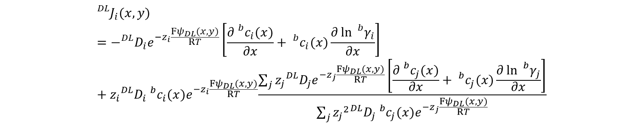
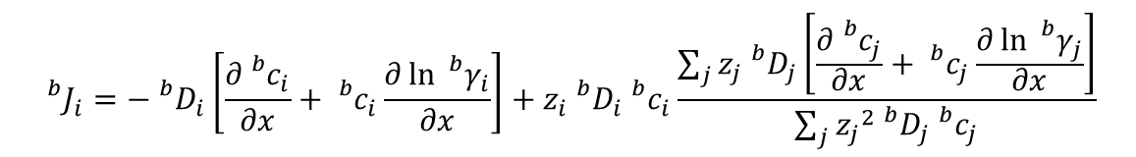
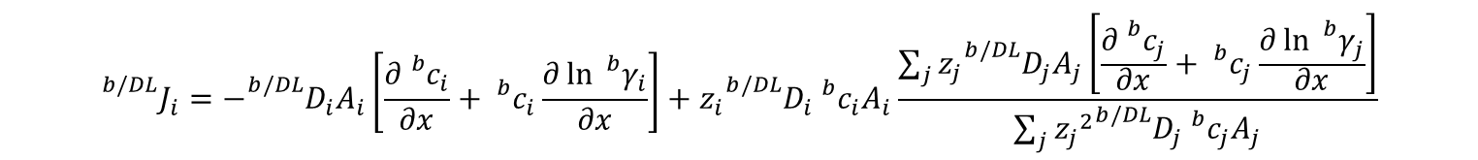
Bulk water
$${}_{}^{b}{J_{i}}=−{}_{}^{b}{D_{i}}\left[\frac{∂{}_{}^{b}{c_{i}}}{∂x}+{}_{}^{b}{c_{i}}\frac{∂\ln{{}_{}^{b}{γ_{i}}}}{∂x}\right]+z_{i}{}_{}^{b}{D_{i}}{}_{}^{b}{c_{i}}\frac{\sum_{j}{z_{j}{}_{}^{b}{D_{j}}\left[\frac{∂{}_{}^{b}{c_{j}}}{∂x}+{}_{}^{b}{c_{j}}\frac{∂\ln{{}_{}^{b}{γ_{j}}}}{∂x}\right]}}{\sum_{j}{{z_{j}}^{2}{}_{}^{b}{D_{j}}{}_{}^{b}{c_{j}}}}$$
Diffuse layer water
$${}_{}^{DL}{J_{i}(x,y)}=−{}_{}^{DL}{D_{i}}e^{−z_{i}\frac{Fψ_{DL}(x,y)}{RT}}\left[\frac{∂{}_{}^{b}{c_{i}(x)}}{∂x}+{}_{}^{b}{c_{i}(x)}\frac{∂\ln{{}_{}^{b}{γ_{i}}}}{∂x}\right]+z_{i}{}_{}^{DL}{D_{i}}{}_{}^{b}{c_{i}{(x)e}^{−z_{i}\frac{Fψ_{DL}(x,y)}{RT}}}\frac{\sum_{j}{z_{j}{}_{}^{DL}{D_{j}}e^{−z_{j}\frac{Fψ_{DL}(x,y)}{RT}}\left[\frac{∂{}_{}^{b}{c_{j}(x)}}{∂x}+{}_{}^{b}{c_{j}(x)}\frac{∂\ln{{}_{}^{b}{γ_{j}}}}{∂x}\right]}}{\sum_{j}{{z_{j}}^{2}{}_{}^{DL}{D_{j}}{}_{}^{b}{c_{j}(x)}e^{−z_{j}\frac{Fψ_{DL}(x,y)}{RT}}}}$$
Bulk water/diffuse layer water
$${}_{}^{b/DL}{J_{i}}=−{}_{}^{b/DL}{D_{i}}A_{i}\left[\frac{∂{}_{}^{b}{c_{i}}}{∂x}+{}_{}^{b}{c_{i}}\frac{∂\ln{{}_{}^{b}{γ_{i}}}}{∂x}\right]+z_{i}{}_{}^{b/DL}{D_{i}}{}_{}^{b}{c_{i}A_{i}}\frac{\sum_{j}{z_{j}{}_{}^{b/DL}{D_{j}}A_{j}\left[\frac{∂{}_{}^{b}{c_{j}}}{∂x}+{}_{}^{b}{c_{j}}\frac{∂\ln{{}_{}^{b}{γ_{j}}}}{∂x}\right]}}{\sum_{j}{{z_{j}}^{2}{}_{}^{b/DL}{D_{j}}{}_{}^{b}{c_{j}}A_{j}}}$$

Slide 13
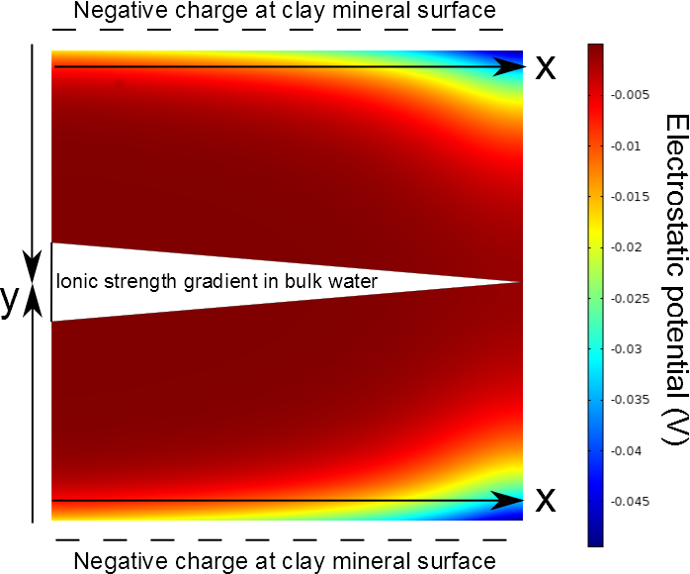
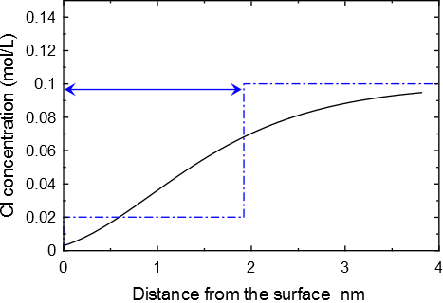
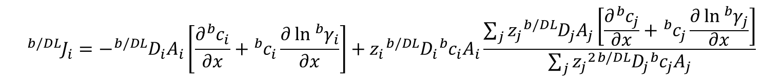

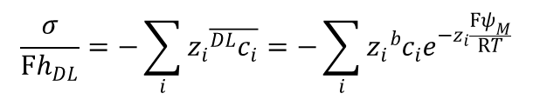
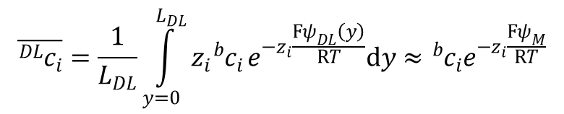
$${}_{}^{b/DL}{J_{i}}=−{}_{}^{b/DL}{D_{i}}A_{i}\left[\frac{∂{}_{}^{b}{c_{i}}}{∂x}+{}_{}^{b}{c_{i}}\frac{∂\ln{{}_{}^{b}{γ_{i}}}}{∂x}\right]+z_{i}{}_{}^{b/DL}{D_{i}}{}_{}^{b}{c_{i}A_{i}}\frac{\sum_{j}{z_{j}{}_{}^{b/DL}{D_{j}}A_{j}\left[\frac{∂{}_{}^{b}{c_{j}}}{∂x}+{}_{}^{b}{c_{j}}\frac{∂\ln{{}_{}^{b}{γ_{j}}}}{∂x}\right]}}{\sum_{j}{{z_{j}}^{2}{}_{}^{b/DL}{D_{j}}{}_{}^{b}{c_{j}}A_{j}}}$$
$$A_{i}=e^{−z_{i}\frac{Fψ_{DL}(x,y)}{RT}}$$
Simplification of the diffuse layer electrostatic potential term
h_{DL}
$$\overline{{}_{}^{DL}{c_{i}}}=\frac{1}{L_{DL}}\int_{y=0}^{L_{DL}}{z_{i}{}_{}^{b}{c_{i}}}e^{−z_{i}\frac{Fψ_{DL}\left(y\right)}{RT}}dy≈{}_{}^{b}{c_{i}}e^{−z_{i}\frac{Fψ_{M}}{RT}}$$
Mean potential model
$$\frac{σ}{Fh_{DL}}=−\sum_{i}{z_{i}\overline{{}_{}^{DL}{c_{i}}}}=−\sum_{i}{z_{i}{}_{}^{b}{c_{i}}e^{−z_{i}\frac{Fψ_{M}}{RT}}}$$

Slide 14

$${}_{}^{b/DL}{J_{i}}=−{}_{}^{b/DL}{D_{i}}A_{i}\left[\frac{∂{}_{}^{b}{c_{i}}}{∂x}\right]+z_{i}{}_{}^{b/DL}{D_{i}}{}_{}^{b}{c_{i}A_{i}}\frac{\sum_{j}{z_{j}{}_{}^{b/DL}{D_{j}}A_{j}\left[\frac{∂{}_{}^{b}{c_{j}}}{∂x}\right]}}{\sum_{j}{{z_{j}}^{2}{}_{}^{b/DL}{D_{j}}{}_{}^{b}{c_{j}}A_{j}}}$$

Slide 15
Geometry of the system, general properties
DISCRETIZATION
distance_units meters
xzones 1 0.0001 50 0.0001 1 0.0001
yzones 1 100
zzones 1 1
END
INITIAL_CONDITIONS
HReservoir 1-1 1-1 1-1
Clay 2-51 1-1 1-1
LReservoir 52-52 1-1 1-1
END
Only one grid cell for the reservoir; large volume = 10 L
BOUNDARY_CONDITIONS
X_begin HReservoir Flux
X_end Lreservoir Flux
END
FLOW
space_units meters !!Default : meters ; km, cm, mm, um
time_units seconds !!Default : years ; days, hours, minutes, seconds
constant_flow 0.0 0.0 !!Default : 0.0
END
closed closed boundary conditions, only diffusion

Slide 16
Geometry of the system, general properties
POROSITY
fix_porosity 0.5
fix_microporosity 0.5
UpdateDDL false
MultiplyPorosityTortuosity true
END
New keywords that are specific to CrunchClay (ignored in CrunchTope)
TRANSPORT
distance_units meters
time_units second
fix_diffusion 1e-9
D_25 H+ 9.31e-9
D_25 Bogus 1e-20
D_25 OH- 5.27e-9
D_25 Na+ 1.3e-9
…
D_MP H+ 9.31e-9
D_MP Bogus 1e-20
D_MP OH- 5.27e-9
D_MP Na+ 1.3e-9
…
tortuosity 1 default
tortuosity 1 zone 1-1 1-1 1-1
tortuosity 0.037 zone 2-51 1-1 1-1
tortuosity 1 zone 52-52 1-1 1-1
tortuosityMP 1 default
tortuosityMP 1 zone 1-1 1-1 1-1
tortuosityMP 0.037 zone 2-51 1-1 1-1
tortuosityMP 1 zone 52-52 1-1 1-1
END

Slide 17
Chemistry, surfaces, DL properties
Condition HReservoir
temperature 25.0
units mmol/kg
H2O 55.5
pH 7
Na+ 100
Cl- charge
Br- 1e0
Ca++ 1e0
Hto 1e0
Bogus Bogusite
Bogusite 3.1416e-8 specific_surface_area 750
>montmor- 1e-99 !!site per m2
set_porosity 0.999999999
set_microporosity 1e-10
END
Background electrolyte concentration is high compared to the concentration of the tracers.
Fake mineral with very low solubility that bears the surface
The surface charge is set to zero
Redefinition of the the bulk vs DL porosity for each of the domains
The reservoirs have a porosity value of 1

Slide 18
Chemistry, surfaces, DL properties
Condition Clay
temperature 25.0
units mmol/kg
H2O 55.5
pH 7
Na+ 100
Cl- charge
Br- 1e-27
Ca++ 1e-27
Hto 1e-27
Bogus Bogusite
Bogusite 3.1416e-8 specific_surface_area 750
>montmor- 1.2e-99
set_porosity 5.655e-8
set_microporosity 5.0895e-7
END
Constant background electrolyte concentration
Fake mineral with very low solubility that bears the surface
The surface charge is set to zero
Redefinition of the the bulk vs DL porosity for each of the domains
See explanation in input files for calculation of these values
Here bulk porosity is 10 % of the total porosity

Slide 19
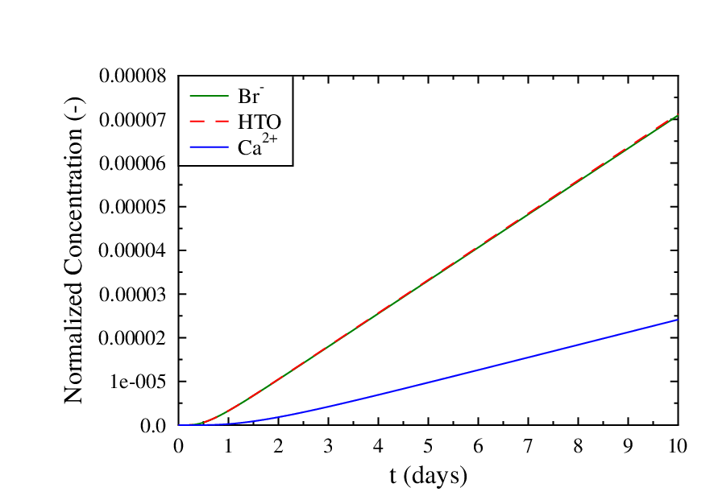
Results
Concentration in the outlet reservoir
Why do the Br and HTO concentrations increase faster than the Ca concentration?

Slide 20
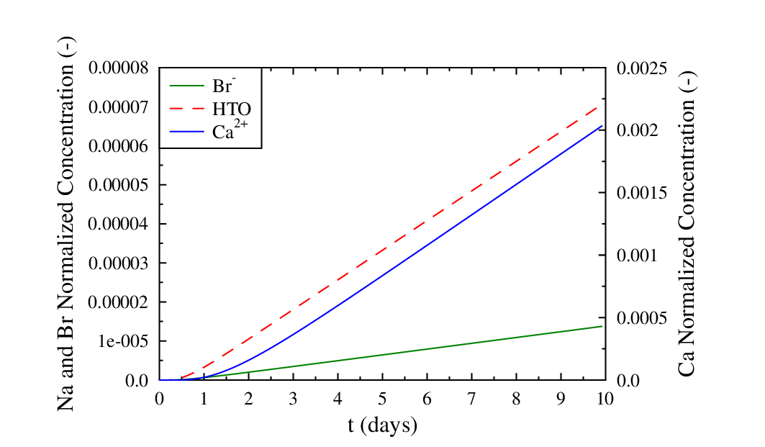
Results
Increase the surface charge in the clay plug to 0.9 mol charge/kg clay
What is the species that diffuse the fastest now ?

Slide 21
Results
Add surface complexation reactions:
>montmor- + Na+ = >montmorNa
2 >montmor- + Ca+2 = > >montmor2Ca
In database:
Begin surface complexation
'>montmorNa' 2 1.0 'Na+' 1.0 '>montmor-' -0.5 -0.5 -0.5 -0.5 -0.5 -0.5 -0.5 -0.5
'>montmor2Ca' 2 1.0 'Ca++' 2.0 '>montmor-' -1 -1 -1 -1 -1 -1 -1 -1
End of surface complexation
Begin surface complexation parameters
>montmor- -1.0
>montmorNa 0.0
>montmor2Ca 0.0
End surface complexation parameters

Slide 22
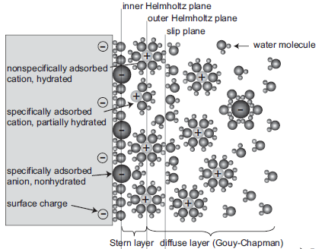
Results
Add surface complexation reactions:
>montmor- + Na+ = >montmorNa
2 >montmor- + Ca+2 = > >montmor2Ca
The surface charge is partly compensated in the Stern layer (with no diffusion of sorbed species). The remaining charge is compensated in the diffuse layer
No surface complex
With surface complexes
Total Charge in DDL (mol/m^3) = 5.6548800E-04
Total Fixed Charge (mol/m^3) = -5.6548800E-04
Microporosity = 1.470300000000000E-007
DonnanPotential = -9.386105664921650E-002
Total Charge in DDL (mol/m^3) = 2.8973120E-04
Total Fixed Charge (mol/m^3) = -2.8973120E-04
Microporosity = 1.470300000000000E-007
DonnanPotential = -7.672779885055225E-002

Slide 23
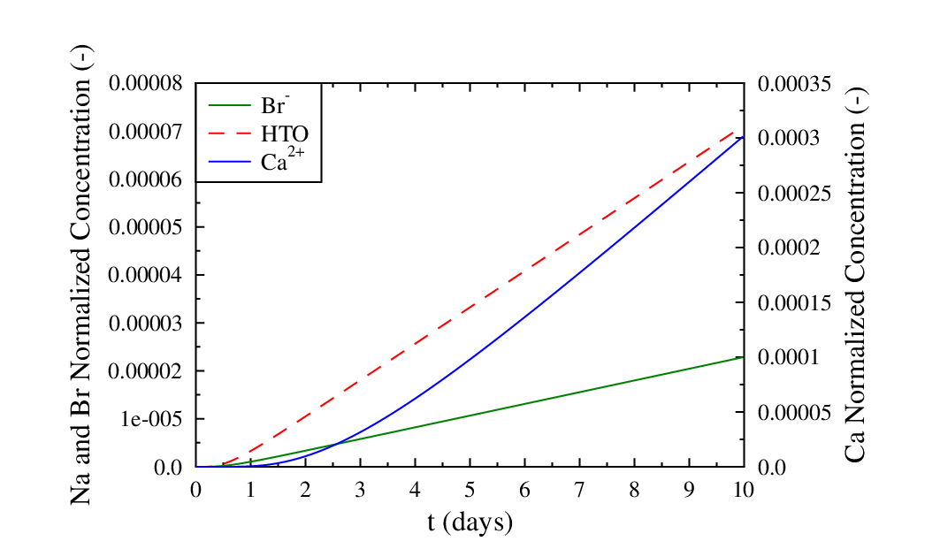
Results
Add surface complexation reactions:
What is the effect of Na and Ca surface complexation on Br and Ca diffusion?

Slide 24
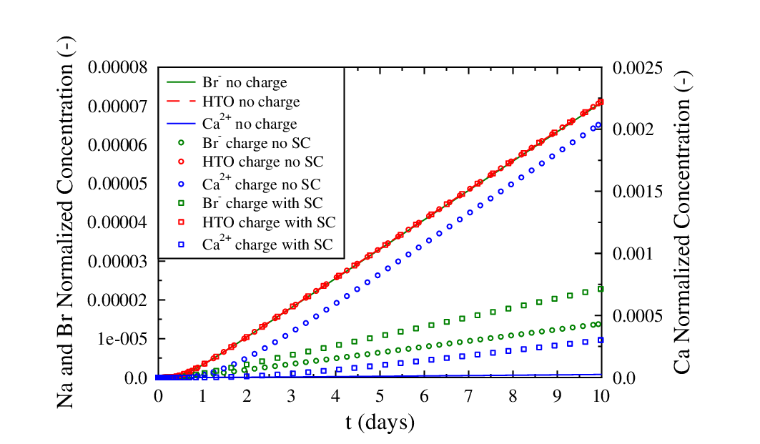
Summary

