Slide 1











CODESLAYER2k25
Chronic Coders
DevSphere
Chronic
Coders
India
Project Title : Networq
Team Name : Chronic Coders
Team Members : Ritvik Arora(Team Leader)[Full stack development], Ansh Pal
[Frontend Tools and Development expert], Arham Ahmad[Database analyst], Kartik Singh[PPT designer]
Tracks Chosen : Web2 Development
Video Link : https://drive.google.com/file/d/1lVwhq03pkG1awwdBt-gQPFyTYOCZhHil/view?usp=sharing

Slide 2

PROBLEM STATEMENT & TARGET AUDIENCE
Chronic Coders
DevSphere
India
Skill-to-Job Recommendation Engine for Rural Youth
Target Users
Rural job seekers (15– 35 years), trainers, recruiters.
Primarily B2C, but benefits B2B as well.
The rural youth in India face immense difficulties in acquiring jobs that suit their skills and aspirations.
Most lack industry-level skills, and even if trained, they struggle with job awareness and opportunities.

Slide 3
OUR UNIQUE SOLUTION
Chronic Coders
Key Features
An integrated platform bringing together job seekers, trainers, and recruiters (“TRS ecosystem”) at one place for mutual growth.
Aggregates jobs from social platforms (Google, LinkedIn) with location-specific filtering for maximum relevance.
Trainers earn by upskilling job seekers; recruiters directly connect and hire trained candidates.
DevSphere India
Your Team
Name
Why It's Different
Unlike most job boards, candidates are not only matched but actively trained and upskilled within the platform before connecting with recruiters.
Integrates multiple job boards in one place for the rural sector.
Inbuilt micro-training marketplace linking learning with earning.

Slide 4

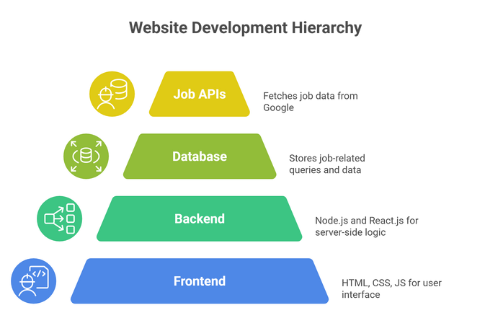
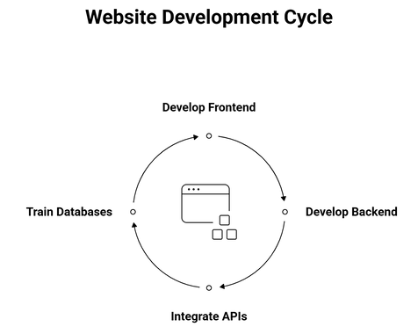
TECH STACK + ARCHITECTURE
Chronic Coders
DevSphere India
Your Team
Name
Tech Stack
Frontend: HTML, CSS, JavaScript, Framer, Wordpress. Backend: Node.js Database: Scalable NoSQL/SQL.
APIs: Google Jobs API, LinkedIn API integration.
Architecture

Slide 5

FEASIBILITY AND SHOWSTOPPERS _{DevSphere}
India
Chronic Coders
Your Team
Name
Feasibility
Team skilled in web development and API integrations.
Social platform APIs and scalable databases readily available.
Project scope designed to fit hackathon timelines with progressive scaling in mind.
Showstoppers
Possible API access limitations and low initial user engagement.
Mitigation: Backup scraping/crowdsourcing for jobs, ambassador programs for outreach.

Slide 6

USP(UNIQUE SELLING PRICE) & BUSINESS MODEL
Chronic Coders
DevSphere India
Your Team
Name
USP (UNIQUE SELLING PRICE)
Three-Sided Ecosystem: Integrates job seekers, recruiters, and trainers (trainers) in a single, shared platform, creating direct mutual value between all stakeholders.
Skill-to-Job Mapping Engine: Connects skill acquisition directly with job opportunities, using integrated APIs for precise, localized results.
BUSINESS MODEL
Trainer Revenue Share: Certified trainers pay a small platform fee from earnings, ensuring sustainable funding and incentivizing quality skill delivery.
Freemium Subscription: Free core access; premium services for job seekers include enhanced matching, featured training modules, and direct recruiter messaging. Paid upgrades unlock better outcomes and support platform growth.

