Slide 1
PHP AND MYSQL

Slide 2
What is PHP?
-> PHP stands for 'Hypertext Preprocessor'. It is an open-source server-side scripting language used for creating dynamic web pages.
-> PHP code is executed on the server, and the result is sent to the client's browser as plain HTML.

Slide 3
How to Start with PHP
-> To write and run PHP code, you need these tools:
1) XAMPP
-> These are free packages that include:
a) Apache (web server)
b) MySQL (database)
c) PHP (programming language)
d) phpMyAdmin (database manager)

Slide 4
2) Code Editor
-> Text editor are used to write PHP code. Popular options:
a) VS Code
b) Sublime Text
c) Notepad++
3) Browsers
-> you can use any modern browser (like Chrome, Firefox, Edge, etc.) to view PHP-based websites.

Slide 5
Syntax of PHP
-> A PHP script starts with <?php and ends with ?>.
-> PHP statements end with a semicolon.
-> It supports variables, control structures, functions, and classes.
-> PHP files can contain text, HTML, CSS, JavaScript, and PHP code.

Slide 6

Hello World with PHP
-> The simplest PHP script to print a message is:

Slide 7

Variables
-> A variable in PHP is a container used to store data like strings, numbers, or arrays.
-> All variables start with the $ sign followed by the name of the variable.
Example:

Slide 8
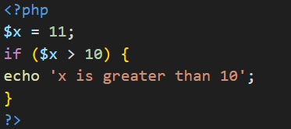
If Statement
-> The if statement is used to check if something is true. If the condition evaluates to true, the code block inside is executed.
Example:

Slide 9
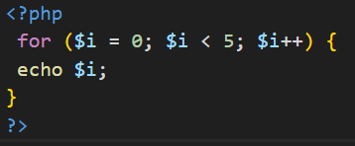
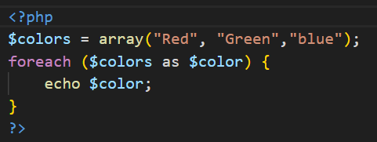
For and Foreach Loop
-> The for loop is used when the number of iterations is known.
Example:
-> The foreach loop is used to iterate through arrays.
Example:

Slide 10
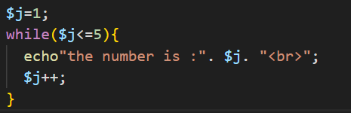
While Loop
-> The while loop executes a block of code as long as the condition is true.
Example:

Slide 11

Arrays
-> Arrays in PHP are used to store multiple values in one variable.
-> There are three types: indexed arrays, associative arrays, and multidimensional arrays.
Example:

Slide 12
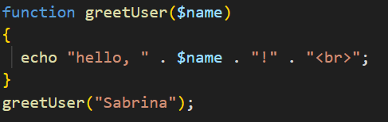
Function
-> A function is a reusable block of code that performs a specific task.
Example:

Slide 13
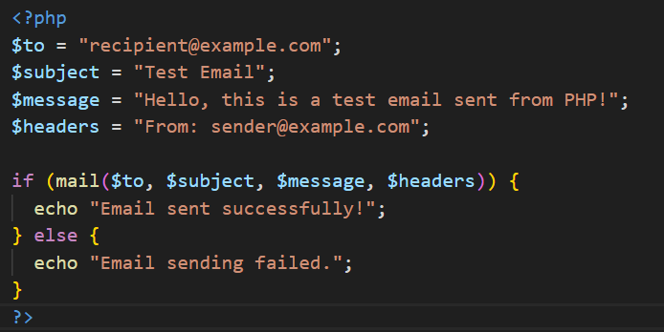
Sending Emails with PHP
-> PHP uses the mail() function to send emails. You need to specify the recipient, subject, message, and headers
Example:

Slide 14
GET and POST Variables
-> GET and POST are HTTP methods used to send form data.
-> GET
a) Sends data through the URL.
b) Best for small and non-sensitive data
-> POST
a) Sends data hidden from the URL
b) Best for sensitive or large data (like passwords)

Slide 15
What is MySQL?
-> MySQL is an open-source relational database management system (RDBMS) that uses Structured Query Language (SQL) to manage data.
-> It is used to store, retrieve, update, and manage data for web applications.
-> It works well with PHP to build database-driven websites.

Slide 16

CRUD Operations
-> CRUD refers to the four basic operations that can be performed on a database:
-> CRUD stands for Create, Read, Update, and Delete:
1. CREATE : Adds new records to a table.
Example:
2. READ : Retrieves data from a table.
Example:

Slide 17
3. UPDATE : Modifies existing records.
Example:
4. DELETE : Removes records from a table.
Example:

Slide 18
THE END

