Slide 1
MYSQL
BASIC MYSQL

Slide 2
We will talk about basic Mysql 1:introduction to mysql 2:Connecting to database on PHP 3:Retrieving data from database 4:Inserting and updating data 5:Looping through data 6:Session variables & cookies

Slide 3
Introduction to MySQL
What is MySQL?
MySQL is an open-source relational database management system (RDBMS) developed by Oracle Corporation. It is widely used for storing, managing, and retrieving data efficiently. MySQL uses Structured Query Language (SQL) to interact with databases.
KEY FEATURES OF MySQL
Open-Source: Free to use, with paid enterprise versions available.
Relational Database: Stores data in tables with rows and columns.
Security: Provides user authentication, access control, and encryption.
Cross-Platform Support: Works on Windows, Linux, and macOS.
High Performance: Optimized for fast read and write operations.
Integration: Compatible with programming languages like PHP, Java, Python, C#, and more.

Slide 4
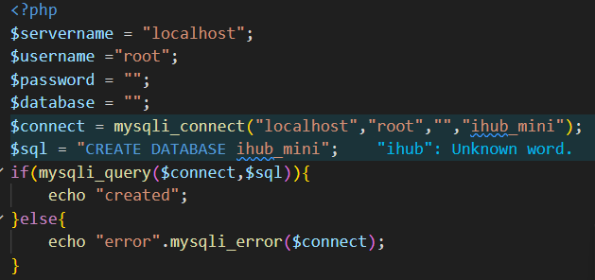
Connecting to database on PHP
To interact with a MySQL database, you need to establish a connection using a programming language or a MySQL client..

Slide 5
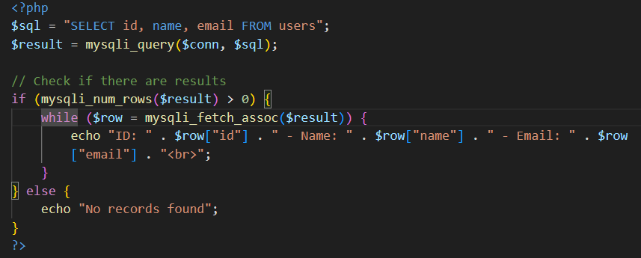
Retrieving data from database
Once you've connected to a MySQL database, you can retrieve data using MySQLi Below are different ways to fetch data from a database table.

Slide 6
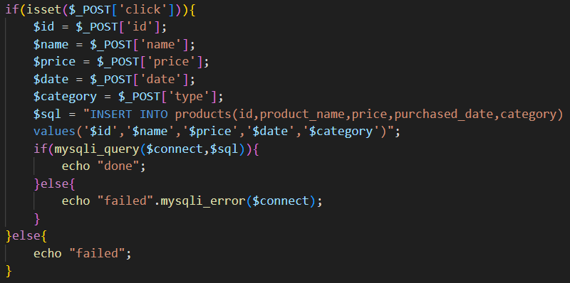
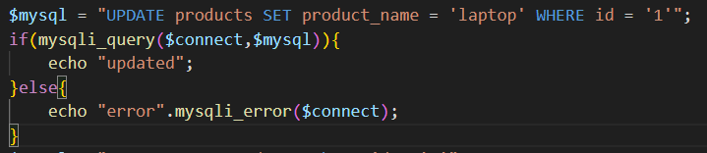
Inserting and updating data
Inserting data
Updating data

Slide 7
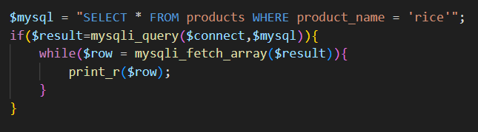
Looping through data
Looping Through Data in PHP (Fetching Multiple Rows from MySQL)
When retrieving multiple rows from a MySQL database, you need a loop to process and display the results. Below are different ways to loop through data using MySQLi and PDO.

Slide 8
Session variables
PHP Session Variables
A session is a way to store information (variables) across multiple pages. Unlike cookies, session data is stored on the server, making it more secure.

Slide 9
Cookies
Cookies in PHP
A cookie is a small piece of data stored on the client's browser, which can be used to remember information across sessions. Cookies are typically used for storing user preferences, login credentials, and tracking sessions. Unlike session variables, cookies are stored on the client-side (in the browser).

Slide 10
Thank You

