Slide 1
Return to normal operating conditions model
CE 650c

Slide 2
Project
Estimating how long an incident will impact traffic (return to normal operating condition)
Incorporating real-time traffic speeds and weather

Slide 3
Literature Review
Incident duration varies between models
Types of incident varied
No models developed for real time use
No real-time weather or speed

Slide 4
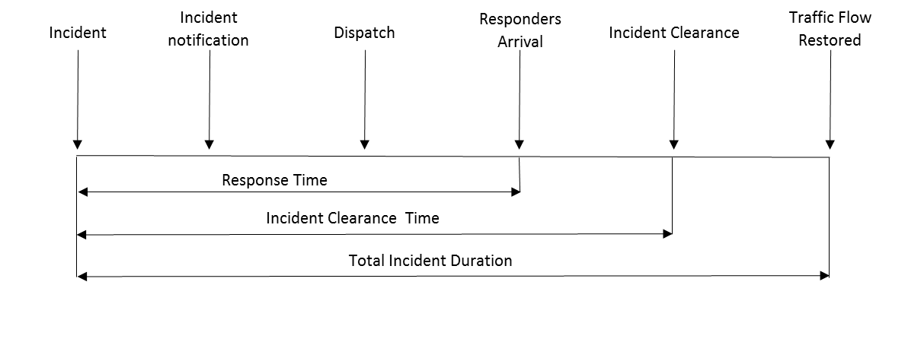
Most models focused on clearance time instead of duration because of the data available.
Most focused on accidents and hazards/stalled vehicles based on the data available. Most did not consider weather or reoccurring events.

Slide 5
Different models used
Truncated regression model
Bayesian Network
Machine Learning
Artificial Neural Networks
Classification and Regression Tree
Hazard Based Model

Slide 6
Different models used
Truncated regression model
Bayesian Network
Machine Learning
Artificial Neural Networks
Classification and Regression Tree
Hazard Based Model

Slide 7
Different models used
Truncated regression model
Bayesian Network
Machine Learning
Artificial Neural Networks
Classification and Regression Tree
Hazard Based Model

Slide 8
Minnesota DOT
Normal condition regain time
Used to estimate when traffic returns to normal during winter weather
Created speed density relationships and measured when traffic reached 80 or 90% or normal dry condition.
Looking to develop a daily and real-time tool

Slide 9
TMC Incident Information
Crash Database
Probe Speed Data
Traffic Data
Weather
Sensors
Current condtions
Forecasted condtions
Safety service patrol
Crowdsourced data
CCTV
Other
AADT
Roadway Geometry

Slide 10
Who will benefit
Traffic Management Centers
Make decisions on deploying resources and mitigation strategies
Traffic Incident Management
Use after action reviews to guide future decisions.
Maintenance
Use as a performance measure to learn how to deploy material and plows
Traveling public
Route guidance/avoidance
Safety decisions
Connected Vehicles

