Slide 1
Evaluating Lateral Position on Rural Roadways using SHRP 2 Naturalistic Driving Data
Nicole Oneyear

Slide 2
Background
Roadway departure crashes are responsible for over 50% of roadway fatalities (FHWA and FARS)
79.5% of fatal roadway departure crashes occur in rural settings (FARS)
45 of the US states Strategic Highway Safety Plans (SHSPs) include roadway departures as an emphasis area
Countermeasures are often used to reduce roadway departures, however only limited information exists on their effectiveness
Second Strategic Highway Safety Program (SHRP 2) Naturalistic Driving Study (NDS) provides an opportunity to study countermeasures effect on driver behavior (speed, lateral position, distraction)

Slide 3
Research Question
Determine the effect roadway and driver characteristics have on a drivers lateral position.
Lateral position is used as a surrogate measure since roadway departure is the consequence of failure to properly lane keep.

Slide 4
Data Description
SHRP 2 NDS data (~10,000 traces)
Time series data
Vehicle network data (speed, acceleration, pedal position, lateral position)
Accelerometer data
GPS
Forward, rear, over the shoulder and face video
Driver information
Roadway Information Database
Roadway alignment, shoulder width and type, signing, lighting, intersection locations, rumble strips, etc.

Slide 5
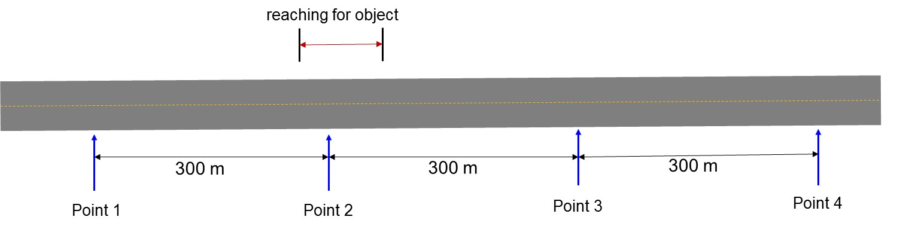
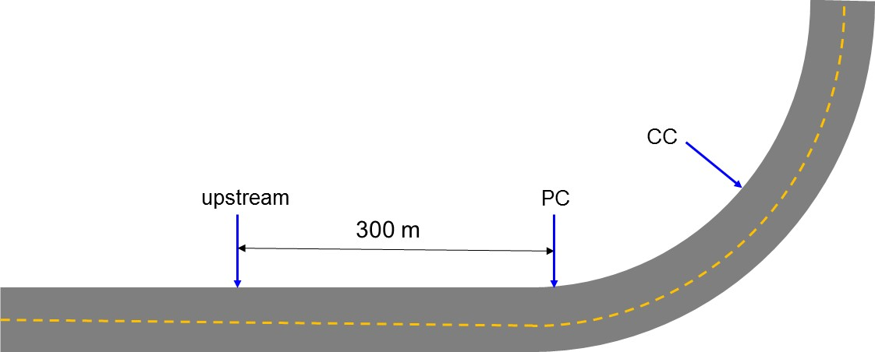
Data Analysis
Spatially correlate events and determine distance from:
Curves - location of Point of Curvature (PC)
Tangents – location of countermeasure of interest
Mine data to determine those with adequate lateral position data at:
Curves – 300 m upstream of curve, PC and Center of Curve (CC)
Tangents – 300 m upstream, at, 300 m downstream and 600 m downstream of start of countermeasure

Slide 6
Data Analysis
Lateral position will be smoothed and sampled at the intervals listed.
Roadway characteristics will be sampled from the RID at each of the interval points
Speed limit, countermeasure presence, lane width, ADT, curve radius, etc.
Additional information will be incorporated for each data point
Driver information – gender, age, driving history, education, etc.
Kinematic driver data – glance location and distraction presence (if available)
Environmental data – day/night, wet/dry/snow
Linear mixed effects model with lane offset will be developed

