Slide 1
Freeway Sensor Error Detection and Performance Evaluation
Tingting Huang and Chenhui Liu
02/09/2017

Slide 2
Motivation
Wavetronix sensors have been deployed on urban freeways in Iowa
Common Sensor Errors: missed call and wrong call
Sensor Error Causes:
Sensor malfunction
Inappropriate sensor setting
Noisy data
Transmission error
Courtesy: Iowa DOT, Office of Systems Planning

Slide 3
Literature Review
Multiple Source Validation[1,2]
Traffic Flow Theory [3]
Transformation
Fourier Transform[4]
Empirical Mode Decomposition[5]
Traffic State Estimation
Kalman Filter[6, 7]
Link-based and Vehicle-based Algorithm[8]
Temporal-spatial relationship[9, 10]

Slide 4
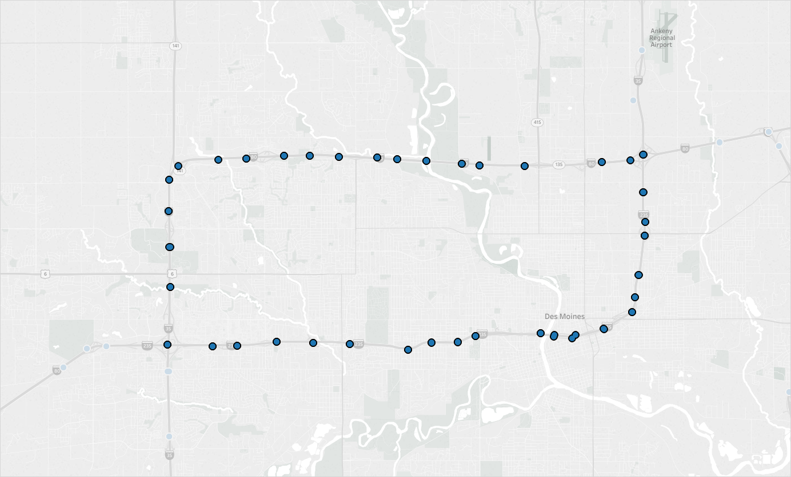
Study Scope
75 sensors on I-235 and I-35/80, Des Moines, IA
1 year (2016) Wavetronix data with 20s’ interval

Slide 5
Proposed Method
Sensor error screening procedures:
Status Monitoring
Outlier Filtering
Vehicle Length Test
High Frequency Identification
Multivariate Spatial-temporal Modeling
Video validation: For selected sensors
Expected Outcome
Identify characteristics of Wavetronix sensor errors over space and time
Get cleaned, smoothed and self-corrected sensor data

Slide 6
Reference
Wells, T.J., Smaglik, E.J., Bullock, D.M., 2008. Health Monitoring Procedures for Freeway Traffic Sensors, Volume 1: Research Report. Joint Transportation Research Program 318.
Rajagopal, R., Varaiya, P., 2007. Health of California’s Loop Detector System. California PATH Program, Institute of Transportation Studies, University of California at Berkeley.
Achillides, C.D., Bullock, D.M., 2004. Performance Metrics for Freeway Sensors.
Min, W., Wynter, L., 2011. Real-time road traffic prediction with spatio-temporal correlations. Transportation Research Part C: Emerging Technologies 19, 606–616. doi:10.1016/j.trc.2010.10.002
Han, J., 2013. Network traffic anomaly detection using EMD and Hilbert-Huang transform. Western Carolina University.
Sun, X., Muñoz, L., Horowitz, R., 2003. Highway traffic state estimation using improved mixture Kalman filters for effective ramp metering control. In Decision and Control, 2003. Proceedings. 42nd IEEE Conference on (Vol. 6, pp. 6333-6338). IEEE.
Nantes, A., Ngoduy, D., Bhaskar, A., Miska, M., Chung, E., 2016. Real-time traffic state estimation in urban corridors from heterogeneous data. Transportation Research Part C: Emerging Technologies 66, 99–118. doi:10.1016/j.trc.2015.07.005
Xu Li, Wei Shu, Minglu Li, Hong-Yu Huang, Pei-En Luo, Min-You Wu, 2009. Performance Evaluation of Vehicle-Based Mobile Sensor Networks for Traffic Monitoring. IEEE Transactions on Vehicular Technology 58, 1647–1653. doi:10.1109/TVT.2008.2005775
Lu, Y., Yang, X., Chang, G.-L., 2014. Algorithm for Detector-Error Screening on Basis of Temporal and Spatial Information. Transportation Research Record: Journal of the Transportation Research Board 2443, 40–48. doi:10.3141/2443-05
Min, W., Wynter, L., 2011. Real-time road traffic prediction with spatio-temporal correlations. Transportation Research Part C: Emerging Technologies 19, 606–616. doi:10.1016/j.trc.2010.10.002

