Slide 1
Calculating Intersection Performance Based on Travel Time with Probe Data
Trevor Kirsch / Subhadipto Poddar / Tongge Huang
CE 650C: System Data Analytics

Slide 2
Overview
Introduction.
Objective.
Literature Review.
Data Description.
Data Analysis.
Applications.
Schedule.

Slide 3
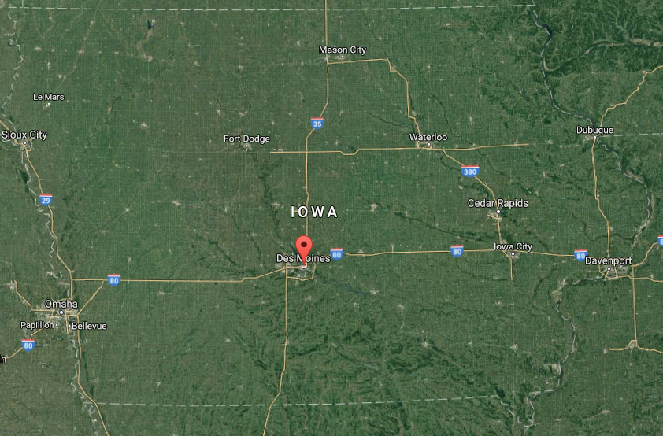
Introduction
Des Moines, Iowa
Most populous city in Iowa
State capital
Business and economic center
Arterials
Provide major throughput to and from the city
Utilized heavily most weekdays, twice a day
Largest Annual Average Daily Traffic (AADT): 15,900 vehicles

Slide 4
Introduction (continued)
Probe Data
Available
Continuous
Quantity
Reliability

Slide 5


Objective
Analyze various intersections based on travel times
Congestion
Abnormal behavior
Compare similar corridors within Des Moines
Travel time patterns for various days
Recommend improvements to stakeholders
INRIX
IowaDOT

Slide 6
Literature Review
Bavarian Road Administration’s Use of Probe Data for Large-Scale Traffic Signal Evaluation Support
Utilized GPS probe data from devices
Created geofence around intersections of interest
Measured delay based on travelled path

Slide 7
Literature Review (continued)
Performance Ranking of Arterial Corridors using Travel Time and Travel Time Reliability Metrics
Created arterial travel time methodology that considered central tendency and reliability
28 arterials with 341 signalized intersections
Greater density of traffic signals corresponds to greater average travel time

Slide 8
Data Description
Inrix data from Des Moines, Iowa.
There will be a total of five arterial corridors.
Each corridor has a series of signalized intersections ranging from 2 to 18 number per section.

Slide 9
Data Analysis
Constructing cumulative distribution plots of travel rate at various intersections.
Identifying anomalies.
Identifying the different peak and off-peak hours in a day.
Identifying the key performance indicators.
Total delays.
Delay per vehicle.
Travel time index.

Slide 10

Applications
Identifying problematic intersections and impractical signal durations
Signal timing optimization
Maintenance performance measures
Iowa DOT/Inrix

Slide 11
Schedule
Literature review (Week-6)
Extract data (Week-7)
Identify data anomalies (Week-8)
Calculate the key performance measures (Week-11)
Develop paper (Week-12)
Final review (Week-15)

Slide 12
References
Wünsch, G., Bölling, F., von Dobschütz, A., & Mieth, P. (2015). Bavarian Road Administration’s Use of Probe Data for Large-Scale Traffic Signal Evaluation Support. Transportation Research Record: Journal of the Transportation Research Board, (2487), 88-95.
Day, C. M., Remias, S. M., Li, H., Mekker, M. M., McNamara, M. L., Cox, E. D., & Bullock, D. M. (2015). Performance Ranking of Arterial Corridors Using Travel Time and Travel Time Reliability Metrics. Transportation Research Record: Journal of the Transportation Research Board, (2487), 44-54.

Slide 13
Questions?
Thanks for your time

