Slide 1
Tableau Data Visualization

Slide 2
Tableau Desktop
Provide visualization and analytics capabilities
Process and work with large datasets easily
User friendly – drag and drop functionality
Multiple chart and figures
Free for students for 1 year

Slide 3
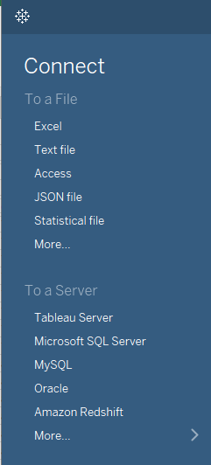
Data Sources
Variety of different data sources
Excel
Text files
Access
Servers
SQL Server
Oracle
ODBC connections

Slide 4
Before starting
Structuring data is essential!
Must be formatted so that data can be filtered and processed efficiently
If a visualization is not working properly it typically has to do with how the data is organized.

Slide 5
Single Line with multiple Measures
Multiple Lines with single measure

Slide 6
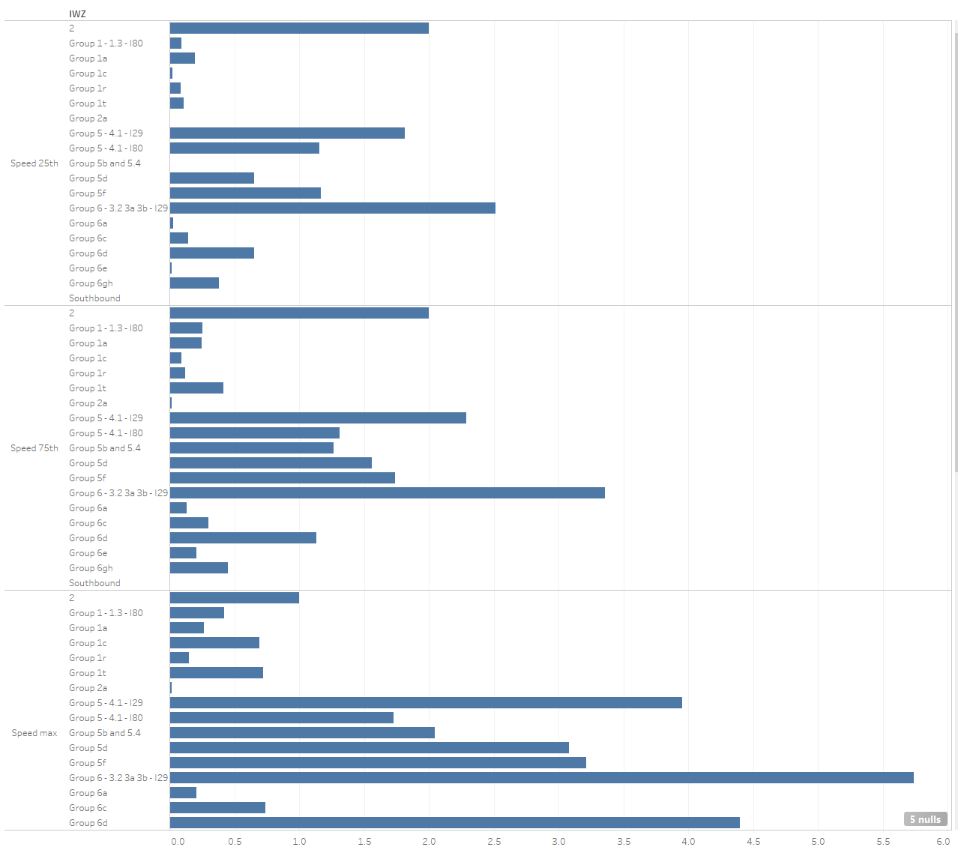
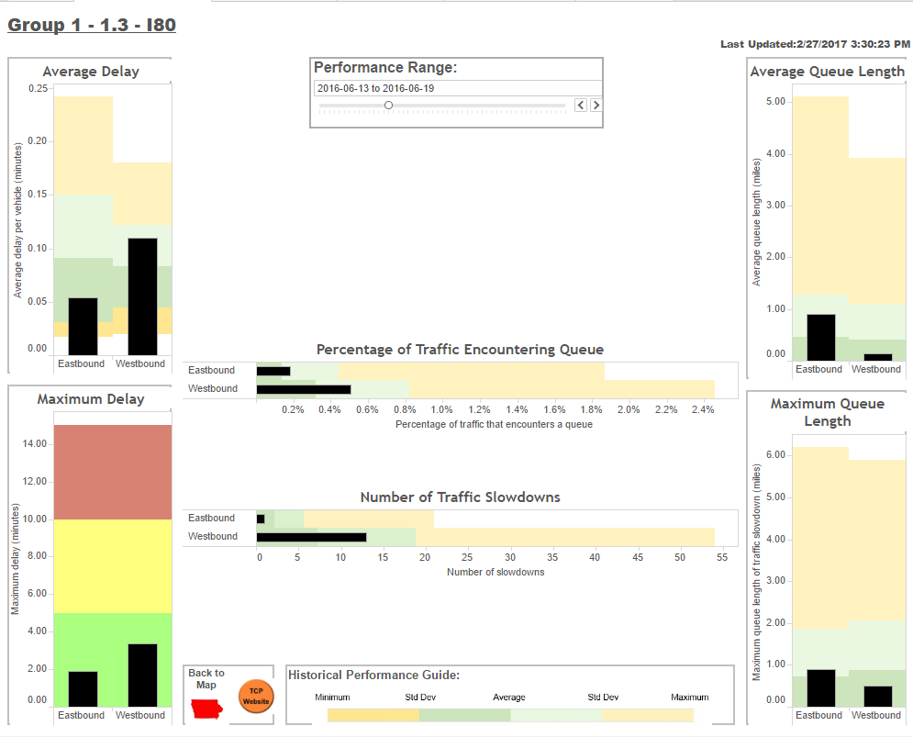
Single Line with multiple Measures

Slide 7
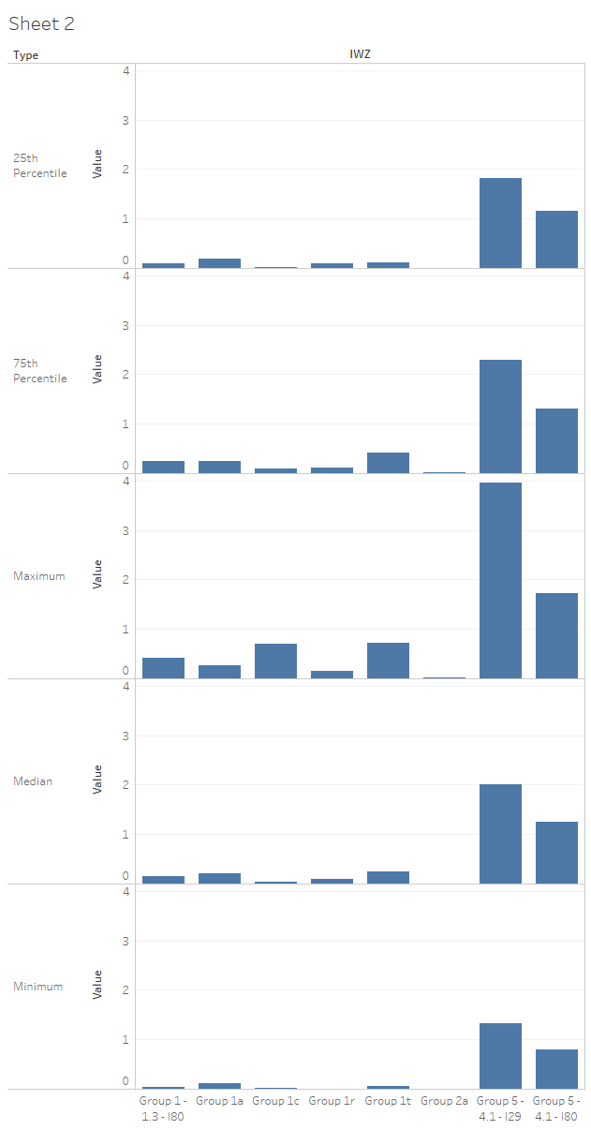
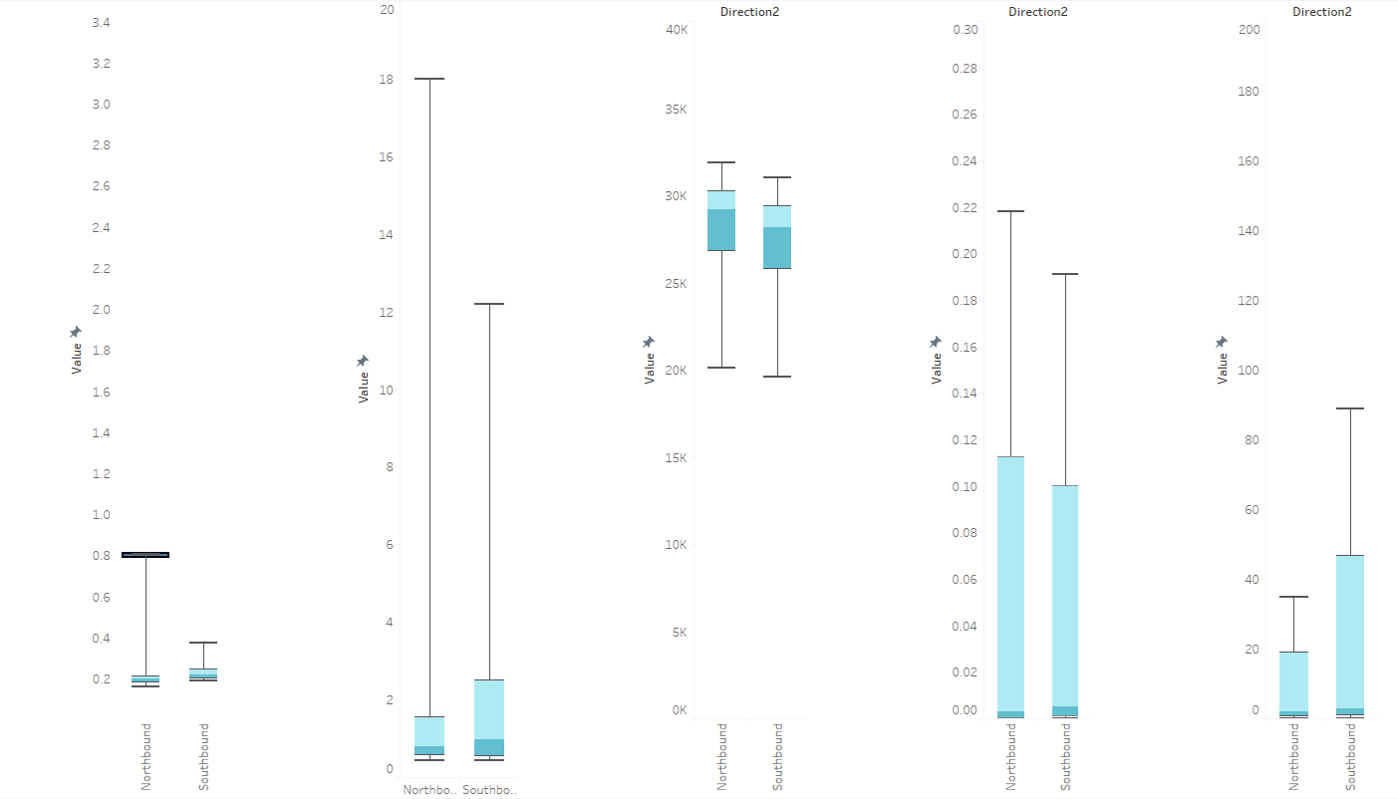
Multiple Lines with single measure

Slide 8
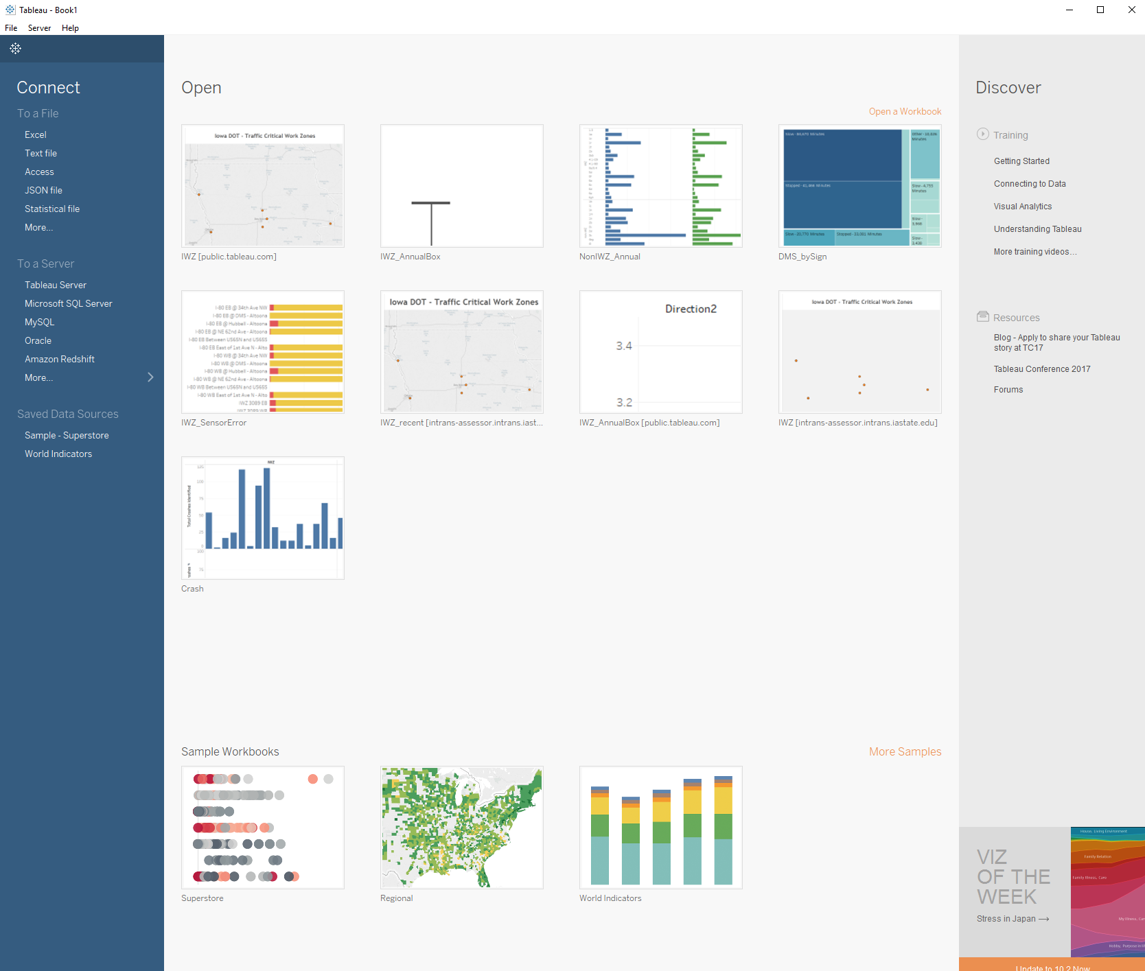
Example 1
Add delay data to Tableau

Slide 9
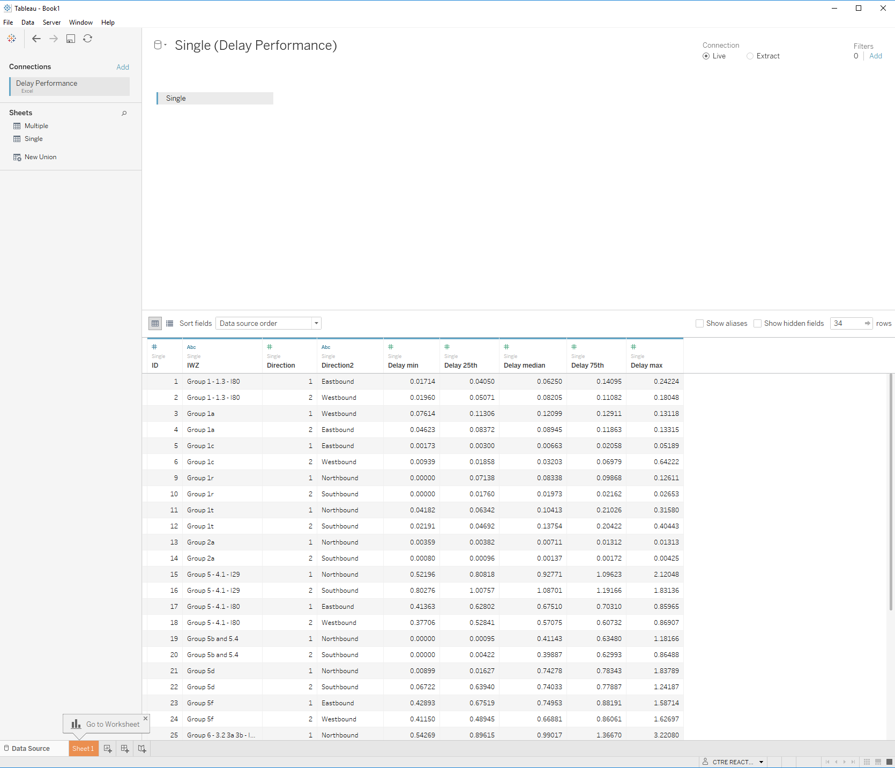
Example 1
Add delay data to Tableau

Slide 10

Navigating
Sheets – where charts and figures are created
Dashboards – where multiple charts are displayed to show interactions
Story – show “story” of data and significant points of interest

Slide 11
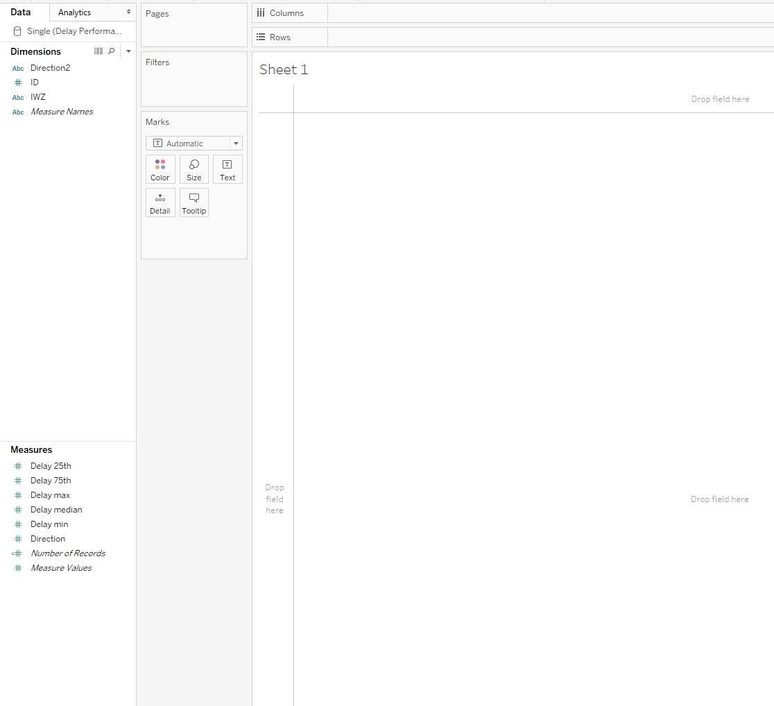
Data fields
Dimensions
Measures

Slide 12
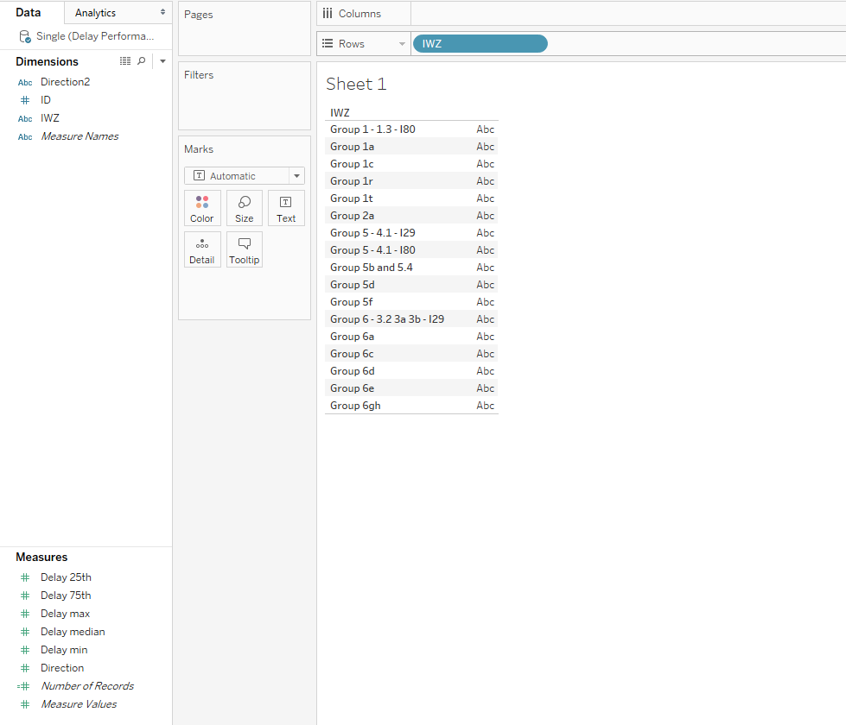
Data fields

Slide 13
Dimensions vs Measures
Dimension typically strings and dates. Usually a distinct value
Measures are typically continuous values
Can switch between the two by right clicking and selecting other type
A situation where this is useful is if you number a project/direction but what the value to be distinct instead of continuous.

Slide 14
Example 1
Add “IWZ” field to rows
Add “Delay median” field to columns
Then display by “Direction” field

Slide 15
Example 1
Add another sheet using “Multiple” sheet in excel file as another data source
Display the median delay by IWZ
Add both charts to the dashboard to compare

Slide 16
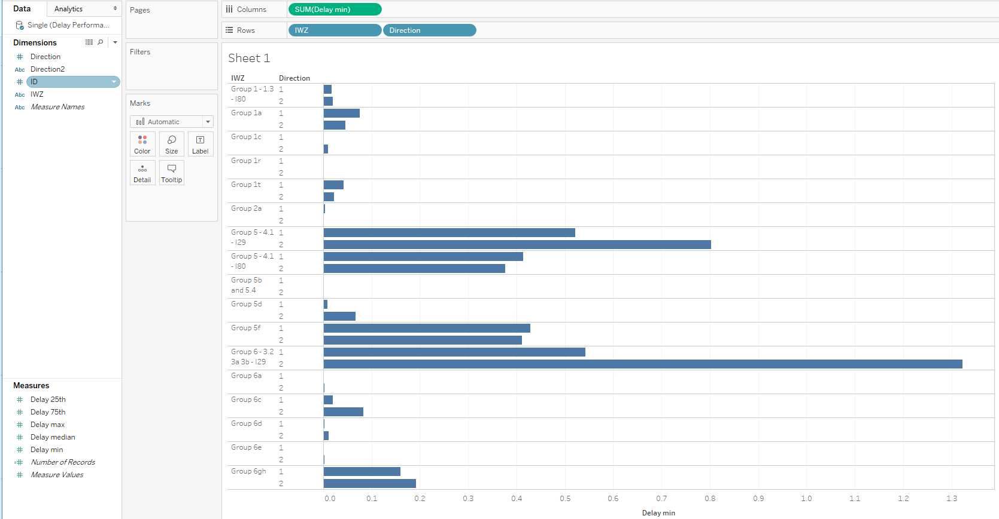
Filters
Can apply filters to limit the results displayed in visualization
Apply filter to show only a single work zone

Slide 17
Marks
Can change the color of visualization by fields
Also can change the size, type, label.
Details and Tooltip can be used to modify what is displayed when hovering over vizualization

Slide 18
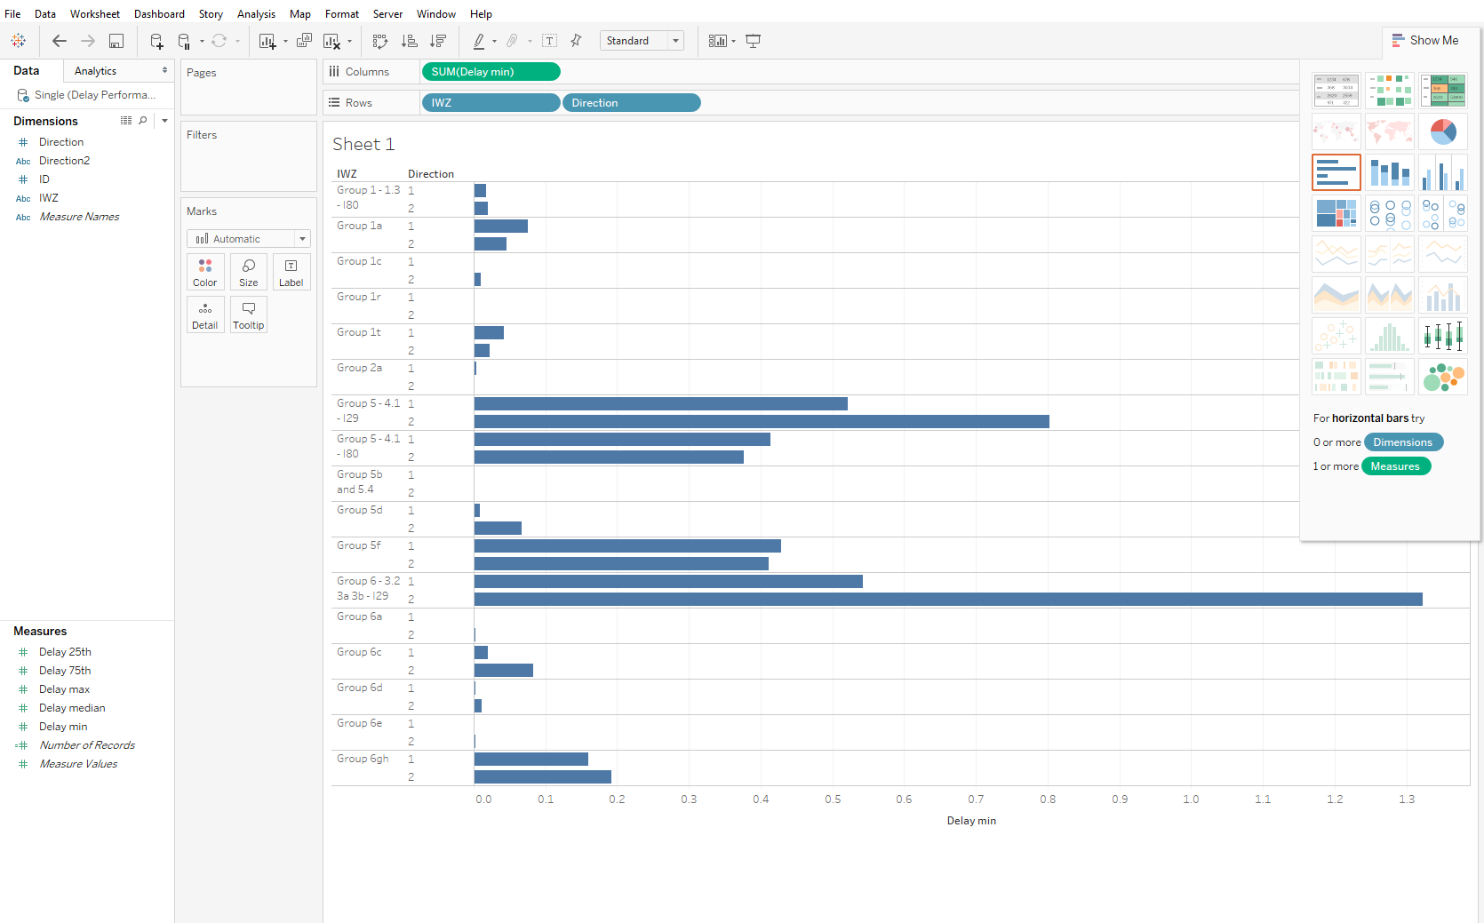
Chart Type
Different chart types are available based on uses

Slide 19
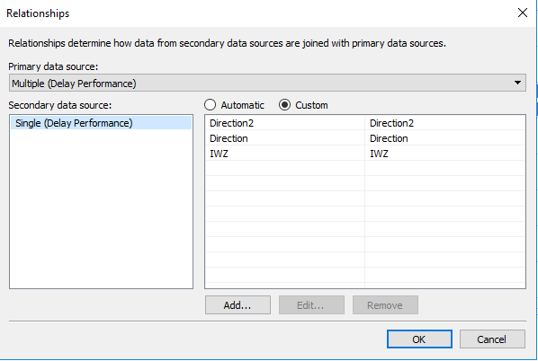
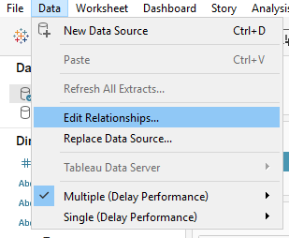
Relationships
Use related fields to filter different data sources

Slide 20
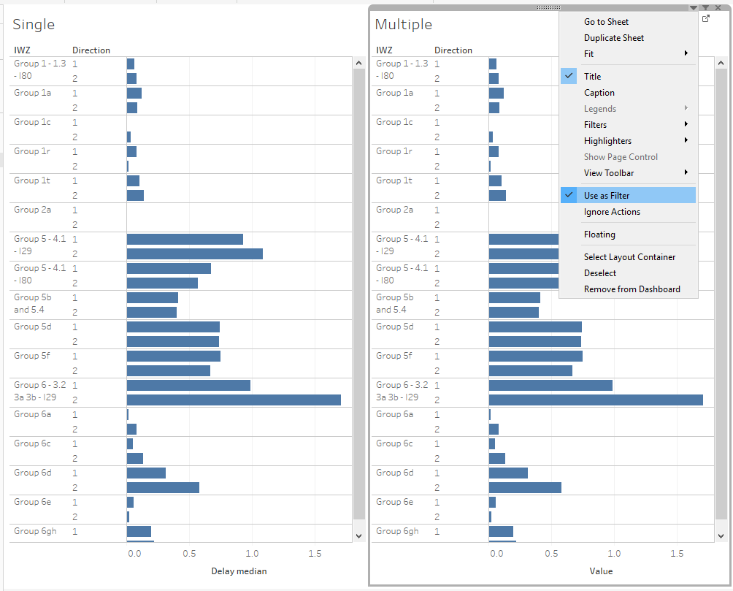
Filters
Can use charts as relationships

Slide 21
Example 2
Use “DMS_Performance” csv file to show
Treemap of total messages by WorkZone
Packed bubble of AverageMinDay by Device

Slide 22
Example 3
Create a speed heatmap
Use “IWZ_Sensor_List” for order of sensors
Use “SensorData” for displaying the speeds with the timestamp in WB direction
Hints:
Join two files together
Filter based on direction
Color code based on gradient

Slide 23
Example 4
Use reference lines to display background data on charts
Hint:
Add measures as details in marks
Right click Axis for reference

