Slide 1
Machine learning
Classification

Slide 2
What is machine learning

Slide 3
When you solve a problem:
f()
Function/mapping/projection
Input
(Observation)
Output
(Answer)
How to get f()?
LEARNING
g() ?
historical
observations
corresponding
answers
h() ?
f() !
MACHINELEARNING

Slide 4
Examples
y=ax1+bx2+c
#bedrooms
sqft
House price
Negative Binomial
Geometry, weather, AADT…
#crash per year
SVM/CNN
image
Car? Or not car
Bidirectional LSTM with Attention
“من عاشق یادگیری ماشین”
“मुझे मशीन सीखना पसंद है”
“我喜欢机器学习”
“I love machine learning”

Slide 5
What is Classification?

Slide 6
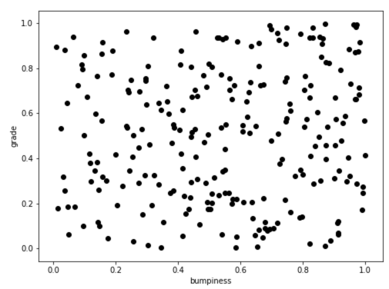
Problem:
Plan to build a new road.
Given the bumpiness and grade of 250 designed locations,
Predict whether drivers will drive fast or slow on those locations.
Resource:
We have observations at other 750 locations on existing road.
Horizontal axis = bumpiness
Vertical axis = grade

Slide 7
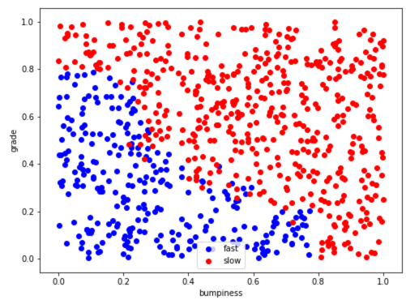
Horizontal axis = bumpiness
Vertical axis = grade
Color = driving speed
{red = slow, blue = fast}

Slide 8
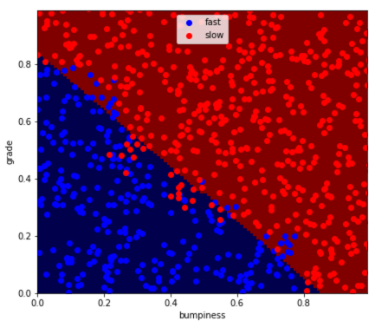
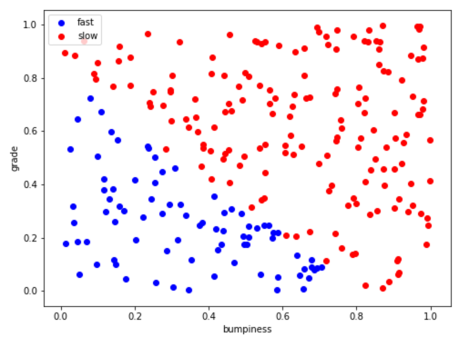
Horizontal axis = bumpiness
Vertical axis = grade
Color = driving speed
{red = slow, blue = fast}

Slide 9
When you solve a CLASSIFICATION problem:
f()
Function/mapping/projection
Input
(Observation)
Label
Class1
Class2
…
corresponding
labels
Class1
Class2
…
historical
observations
Build a classifier
(find the decision boundary)

Slide 10
How to build a classifier?
Update approach:
Gradient decent:
W=W-J’
In theory
Wisely Select a model y=f(Wx+B)
Set the objective function:
c=J(W,B,x,y)
Solve the optimization problem:
W,B= argmax(J)
In Engineer’s Real life
Choose some hyper parameter or just use default
Find a available package/tool kit online
Use it!

