Slide 1
Intro to Computer Science
Day 14

Slide 2
You can delete items from a list
Using the del command you can delete items from a list
del alist[1]
del alist[1:5]
del handles negative indices and causes a runtime error if the index is out of range
You can use slice inside delete. Slices select all the elements up to, but not including, the second index
Example: delete.py

Slide 3
Objects and References
Objects are things variables can point to, such as x = “hello”
“hello” is a string object
If
a = “banana”
b= “banana”
Do they point to the same location in memory or to different places?
We already know that objects can be identified using their unique identifier

Slide 4
Objects and references (IS operator)
We can also test whether two names refer to the same object using the is operator. The is operator will return true if the two references are to the same object.
In fact, both of these variables will point to the same object in memory
Since strings are immutable, Python optimizes resources by making two names that refer to the same string value refer to the same object
Example: objects_refs.py

Slide 5
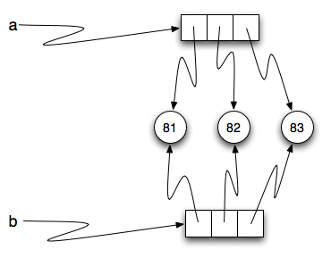
Lists and memory
This is not the case with lists
The variable a is a reference to
a collection of references.
Those references actually refer
to the integer values in the list.
In other words, a list is a collection
of references to objects.
Example:lists_mem.py

Slide 6
Lists and Memory
Interestingly, even though a and b are two different lists (two different collections of references), the integer object 81 is shared by both. Like strings, integers are also immutable so Python optimizes and lets everyone share the same object.

Slide 7
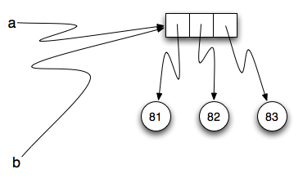
Alising
Since variables refer to objects, if we assign one variable to another, both variables refer to the same object:
Because the same list has two different names, a and b, we say that it is aliased. Changes made with one alias affect the other.
is safer to avoid aliasing when you are working with mutable objects. Of course, for immutable objects, there’s no problem.

Slide 8
Binding
In Python when we use the assignment operator we are binding one object to another
A = “George”
(Almost) everything in Python is an object
Assignment is a binding of a name to a value. Variables are actually properly called names
Each binding has a scope that defines its visibility, usually the block in which the name originates
Example:binding.py

Slide 9
Mutable and Immutable
There are 2 kinds of objects in Python: Mutable and Immutable
A mutable object exhibits time-varying behavior. Changes to a mutable object are visible through all names bound to it.
Python's lists are an example of mutable objects.
An immutable object does not exhibit time-varying behavior. The value of immutable objects can not be modified after they are created. They can be used to compute the values of new objects, which is how a function like string.join works.
Example: binding2.py

Slide 10
Cloning Lists
If we want to modify a list and also keep a copy of the original, we need to be able to make a copy of the list itself, not just the reference.
The easiest way to clone a list is to use the slice operator.
Taking any slice of a creates a new list. In this case the slice happens to consist of the whole list.
Example:clone.py

Slide 11
Homework
Read pages 295-328 in Staring out with Python
Create a game that lets one user input a list of words, one at a time.
Let the second player then come up with words they think that person will associate with the first list to a second list, one at a time.
Then let player two add a list of prompts for player one based original words one at a time.
Play the game by jumbling the prompts and seeing if the first user can correctly associate the prompt with the right word.
When the player gets a match, extract the original word in list one and replace it with a new sublist containing both words.
Keep score during the game for how many guesses it takes for the first player to correctly match the association with the word.
Add the number of guesses to the sublist matches in the first list. Output list one once all of the words are matched. Add together all of the guess attempts. This is player 1’s final score.

