Slide 1
Intro to Computer Science
Day 15

Slide 2
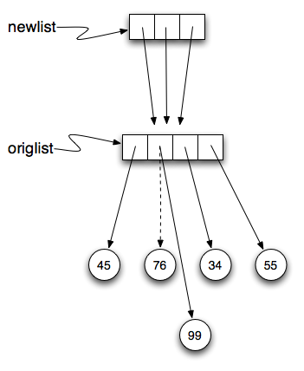
Lists – Repetition and References
With a list, the repetition operator creates copies of the references. Although this may seem simple enough problems can occur because of the use of immutable objects and references
Example: mod.py

Slide 3
List Methods
You can use the . (dot operator) to run the methods of the list object on your list
append is a list is a list method which adds the argument passed to it to the end of the list
Pop Removes and returns the last item
Insert Inserts a new item at the position given (position, item)
Pop returns none and removes last item of list
Pop + position removes and returns the item at position
Sort modifies a list to be sorted
More: remove, count, index
Example:methods.py

Slide 4
L-Systems part 2
System grammar
X
X --> F[-X]+X
F --> FF
This L-system looks very similar to the old L-system except that we’ve added one change. We’ve added the characters ‘[‘ and ‘]’. The meaning of these characters adds a very interesting new dimension to our L-Systems. The ‘[‘ character indicates that we want to save the state of our turtle, namely its position and its heading so that we can come back to this position later. The ‘]’ tells the turtle to warp to the most recently saved position.

Slide 5
Lsystems cont
Now, if we create an empty list and every time we see a ‘[‘ we append the list that contains [heading, x, y] we create a history of saved places the turtle has been where the most recently saved location will always be at the end of the list. When we find a ‘]’ in the string we use the pop function to remove the the most recently appended information.
Example: system1.py, LongSystem.py

Slide 6
Append versus Concatenate
You can also add lists but be careful because they both must be lists
It is also important to realize that with append, the original list is simply modified
On the other hand, with concatenation, an entirely new list is created.
Example: orgList_con.py

Slide 7
Homework
Rather than use the inst string supplied in the L system above, use the code from the string chapter (on classes and mentioned below), and write your own applyRules function to implement this L-system. This example only uses 6 expansions. Try it out with a larger number of expansions. You may also want to try this example with different values for the angle and distance parameters.
Example:strL.py
http://interactivepython.org/courselib/static/thinkcspy/Strings/strings.html

Slide 8
Reading
http://interactivepython.org/runestone/static/thinkcspy/Lists/lists.html#list-methods

