Slide 1
Intro to Computer Science
Day 16

Slide 2
Lists and for loops
It is also possible to perform list traversal using iteration by item as well as iteration by index.
fruits = ["apple","orange","banana","cherry"]
for afruit in fruits: # by item
print(afruit)
For (every) fruit in (the list of) fruits, print (the name of the) fruit.
We can also use the indices to access the items in an iterative fashion.
Example: helloFor.py

Slide 3
You can use range with for
You can use the range function and the len function in combination to iterate over a list
You can use this both to get the value and the index
Anything we have learned up to this point can be applied inside a for loop
Example:rangeFor.py

Slide 4
Using Lists as Parameters
Functions which take lists as arguments and change them during execution are called modifiers and the changes they make are called side effects.
Passing a list as an argument actually passes a reference to the list, not a copy of the list. Since lists are mutable, changes made to the elements referenced by the parameter change the same list that the argument is referencing.
Example: mutableListFun.py

Slide 5
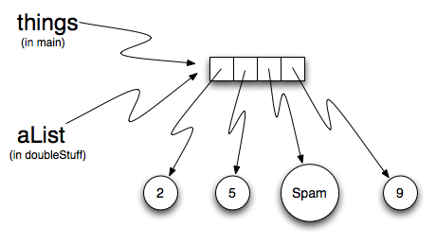
Code explanation
The parameter aList and the variable things are aliases for the same object.
Since the list object is shared by two references, there is only one copy. If a function modifies the elements of a list parameter, the caller sees the change since the change is occurring to the original.

Slide 6
Pure Functions
A pure function does not produce side effects. It communicates with the calling program only through parameters (which it does not modify) and a return value.
Example: pureFunction.py
Which is better?
In general, we recommend that you write pure functions whenever it is reasonable to do so and resort to modifiers only if there is a compelling advantage. This approach might be called a functional programming style.

Slide 7
Functions that Produce Lists
Pattern for function that creates and returns a list
initialize a result variable to be an empty list
loop
create a new element
append it to result
return the result

Slide 8
List Comprehensions
List comprehensions are concise ways to create lists.
The general syntax is:
[<expression> for <item> in <sequence> if <condition>]
(where the if clause is optional)
Exmaple: ListCompression.py

Slide 9
Nested Lists
A nested list is a list that appears as an element in another list
If you get a nested list out of a main list, to extract it you will need 2 steps
First, extract the nested list, then extract the item of interest.
Example:nested1.py

Slide 10
Strings and Lists
Two of the most useful methods on strings involve lists of strings. The split method breaks a string into a list of words. By default, any number of whitespace characters is considered a word boundary.
An optional argument called a delimiter can be used to specify which characters to use as word boundaries. The following example uses the string ai as the delimiter:
Notice that the delimiter doesn’t appear in the result.
Example: listStrings.py

Slide 11
Joining Strings
The inverse of the split method is join. You choose a desired separator string, (often called the glue) and join the list with the glue between each of the elements.
Exmaple: join.py

Slide 12
Homework and Reading
http://interactivepython.org/runestone/static/thinkcspy/Lists/lists.html#lists-and-for-loops
Do questions 1-16 in the above reading

