Slide 1
Intro to Computer Science
Day 19

Slide 2
Recursion
Recursion is a method of solving problems that involves breaking a problem down into smaller and smaller subproblems until you get to a small enough problem that it can be solved trivially.
Usually means a function calling itself
Think through a problem. How can we get the sum of a list of numbers without a while or for loop?

Slide 3
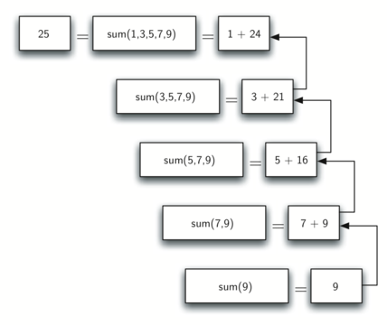
Recursive calls
A function can call itself
To do so they must have an exit condition
A computer will process all of the way through a list before it beginning to run the program
Example: theSum.py, listForm.py

Slide 4
The Three Laws of Recursion
The Three Laws of Recursion
Like the robots of Asimov, all recursive algorithms must obey three important laws:
A recursive algorithm must have a base case.
A recursive algorithm must change its state and move toward the base case.
A recursive algorithm must call itself, recursively.
Example:tree.py

Slide 5
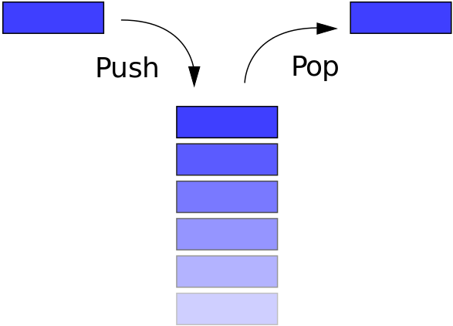
Stack
In computer science, a stack is a particular kind of abstract data type or collection in which the principal (or only) operations on the collection are the addition of an entity to the collection, known as push and removal of an entity, known as pop.^{[1]}
The relation between the push and pop operations is such that the stack is a Last-In-First-Out (LIFO) data structure.
This is the way your computer stores the variables it handles in a recursive function

Slide 6
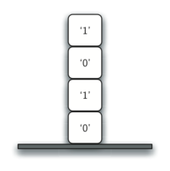
Stack Frames
When a function is called in Python, a stack frame is allocated to handle the local variables of the function. When the function returns, the return value is left on top of the stack for the calling function to access.
Example:stackInPython.py

Slide 7
Homework
Read this (DOING SAMPLES HIGHLY ENCOURAGED) http://interactivepython.org/runestone/static/thinkcspy/Recursion/recursionsimple.html#calculating-the-sum-of-a-list-of-numbers
http://interactivepython.org/runestone/static/pythonds/Recursion/graphical.html
Make your own creative drawing using recursion. It can’t be a copy of any of these examples or a simple edit ( like changing a color)

