Slide 1
Introduction to Programming
Day 4

Slide 2
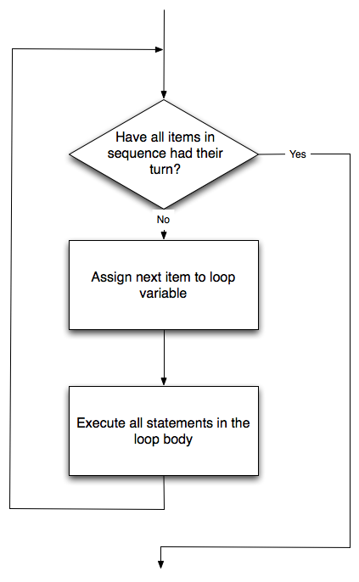
For loops in depth
For loops have exit conditions, loop bodies and loop variables
for t_ in [alex, sam, tiny]:
x+=20
t_.goto(x,x)
t_.forward(100)

Slide 3
Range
You can also have for loops just execute a specified number of times.
The number of times is called the range
Note: computer scientists nearly always count from 0
for n in range(10):
print n
The range setting can take up to 3 parameters: start, step, interval
*Note since cs starts counting a 0, it will go up to the number but not include it.
Example:forLoopsTurtleRange.py

Slide 4
More turtle fun
http://interactivepython.org/runestone/static/thinkcspy/PythonTurtle/helloturtle.html
Turtles can do lots of things.
Examples: turtleMethods.py, pentagon.py

Slide 5
So let’s kick off functions!
What is a function?
A function is a set of instructions that are grouped together.
Their purpose is to help us organize programs into chucks of functionality we can reuse over and over again. If you think of any noun in the real world, a function would be a verb.
For example Bob runs. Not all verbs need to be associated with a noun though in programming. Runs could also be a stand alone function

Slide 6
Functions describe how to do things.
def run() :
move left hip bone
bend knee
lift foot
move foot forward
place left foot down
move right hip down
etc….

Slide 7
Remember the coffee pot?
Functions can also have things passed into them. What you pass into a function is called a parameter.
def nameOfFuncton(listOfParameters):
instructions
Remember! Spaces matter in python. The instructions must be indented (4 tabs is common practice)

Slide 8
The anatomy of a function
Functions have two parts
1. A header line which begins with the keyword def and ends with a colon.
2. A body consisting of one or more Python statements, each indented the same amount – 4 spaces is the Python standard – from the header line.
The parameter list may be empty, or it may contain any number of parameters separated from one another by commas. In either case, the parentheses are required
Example: functions101.py

Slide 9
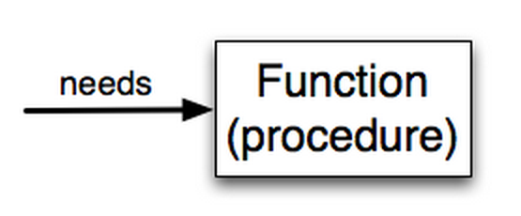
What a function needs
A function needs certain information to do its work.
These values, often called arguments or parameters, are passed to the function by the user.

Slide 10
Casting
Functions often require the parameters to be a specific type to work with the instructions they contain.
If for some reason you get your data from one function, say input() which returns a string and want to pass it to another function, say runFast(x,y) which requires x and y to be numbers, you need to cast that type first to be the right kind of thing in order to work
Example: functions101.py (comments, explained!)

Slide 11
Homework
Create a program that lets the user go traveling through space and time.
Ask the user which of 3 planets they want to go to, Earth, Trenzalore or Gallifrey.
On screen have each journey represented by a different creative line drawing.
At the end of the drawing, print out to the console, you have arrived at (Earth, Trenzalore or Gallifrey depending on what they type in)

