Slide 1
Intro to programming
Day 5

Slide 2
Functions
The syntax for a function is
def name(parameters):
statements
Functions are the second compound statement we have looked at
Compound statements
Have a header line starts with a keyword and ends in a colon
2. A body consisting of one or more statements
(remember 4 spaces from the side of the page! Python only sees lines as “attached” if they are indented underneath the header

Slide 3
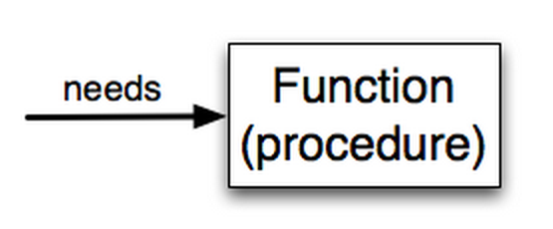
Functions
The parameter list of a function is known as the formal parameters. The function will not run without these items pasted into it.
What a user passes to a function are known as arguments or actual parameters
Example:functionFor.py

Slide 4
Docstrings
Another way to retrieve this information is to use the interactive interpreter, and enter the expression <function_name>.__doc__, which will retrieve the docstring for the function. So the string you write as documentation at the start of a function is retrievable by python tools at runtime. This is different from comments in your code, which are completely eliminated when the program is parsed.
Easy ways to document your own functions
To use: the first thing after the header function is a string that must be triple quoted
To retrieve this information use the REPL or (interactive interpreter) and enter the expression <function_name>.__doc__
You can retrieve this information at run time unlike comments
Use this feature for the key documentation for your code
(more on this later)

Slide 5
Functions
Function call or function invocation
this is how you make a function run.
drawTurtle(myTurt, 100)
Once you define a function you can call it over and over
Example: forTess.py

Slide 6
Maths
Or coffee pots that make you coffee
In python you can get the absolute value of a number. For example you can get the absolute value of -5, which is 5: math.fabs(-5)
There’s also an entire math module: import math
To raise a number by a power: math.pow(2,3)
max(3,4,2,4,22)
Gives you the largest number in the list
Example maths.py

Slide 7
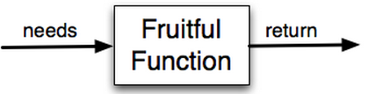
Functions that return values
Fruitful function = returns a value
Non-fruitful function = returns no value
Example: squaredNum.py

Slide 8
Return
The keyword return marks a value to be returned from the function
Return ends the function, it will not execute code written after it.
It returns a temporary variable you can assign to a variable in your code after the function is called
All python functions without a specific return will actually return type none
Example: moreReturns.py

Slide 9
Homework
Draw a grid of boxes. Each box must be 10 pixels from the last
Note this is a super challenge. Only the clever will succeed.
(f you can’t do it, that’s ok to but I want you to try and think about the logical structure and give it a good college go. As long as you try, there’s no bad grade here)
We will cover how to do this in the class Monday but the power is already in your hands, if you can figure out how to use it
If you get this right, you’ll get an additional 10 bonus points on your next assignment
Hint – break the problem into smaller and smaller steps to come up with the solution. Think line by line…. ☺

