Slide 1
Introduction to programing
Day 6

Slide 2
Boolean
A boolean expression is an expression that evaluates to a boolean value. The equality operator, ==, compares two values and produces a boolean value related to whether the two values are equal to one another.
Python has a type called bool or Bolean. True or false
There are only 2 values, True and False
Boolean expression
= sets assignment
== is a Boolean expression and it evaluated to a Boolean values
Example: Bools.py

Slide 3
More operators
The == operator is one of six common comparison operators; the others are:
x != y # x is not equal to y
x > y # x is greater than y
x < y # x is less than y
x >= y # x is greater than or equal to y
x <= y # x is less than or equal to y
MoreOperators.py

Slide 4
Logical operators
There are three logical operators: and, or, and not
Example: Andorno.py
!= not
and
or

Slide 5
Precedence of Operators
Python will always evaluate the arithmetic operators first (** is highest, then multiplication/division, then addition/subtraction). Next comes the relational operators. Finally, the logical operators are done last.
Level Category Operators
7(high) exponent **
6 multiplication *,/,//,%
5 addition +,-
4 relational ==,!=,<=,>=,>,<
3 logical not
2 logical and
1(low) logical or

Slide 6
Conditional statements
Evaluates the Boolean expression
Gives the ability to check conditions and change the behavior of the program accordingly
The simplest form of selection is the if statement.
You can think of it like if this then do that or do something else.

Slide 7
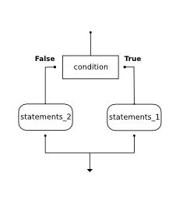
If statements and Boolean expressions
if BOOLEAN EXPRESSION:
STATEMENTS_1 # executed if condition evaluates to True
else:
STATEMENTS_2 # executed if condition evaluates to False
Example simpleIf.py

Slide 8
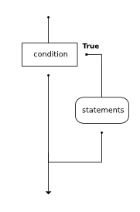
Omitting the else Clause: Unary Selection
If is valid on it’s own
If(x==y):
do some stuff!

Slide 9
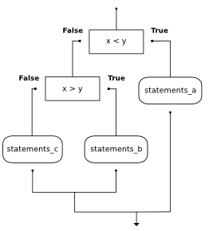
Nested conditionals
You can nest these things inside each other
if x < y:
print("x is less than y")
else:
if x > y:
print("x is greater than y")
else:
print("x and y must be equal")
Example:nested.py

Slide 10
Chained conditionals
Python provides an alternative way to write nested selection such as the one shown in the previous section. This is sometimes referred to as a chained conditional
if x < y:
print("x is less than y")
elif x > y:
print("x greater than than y ")
else:
print("x and y are equal")

Slide 11
Boolean functions
Return true or false after running a function
Common to name the something that sounds like yes/no
Remember functions can return values
Example:boolFunc.py

Slide 12
Homework 3 & 5
See the post on classes but it’s the doctor who one!
☺

