Slide 1
Intro to Computer Science
Day 7

Slide 2
Math Module
There are other modules than turtle. One such module is the math module.
It contains functions you’d commonly find in a calculator such as pi and exponents
You import it just like the turtle module
// will divide and truncate off the division to a whole number
Example:maths.py

Slide 3
Random
The random module will return random numbers
Random numbers all have an equal probability of occurring over time
So they’re called pseudo-random generators — they are not genuinely random.
Example rand.py

Slide 4
Writing math expressions as code
r = 3t^{(a+b)} / a+c
r = 3*(pow(t, (a+b)))/(a+c)
Tips!
Think it through and if you can, bracket it.

Slide 5
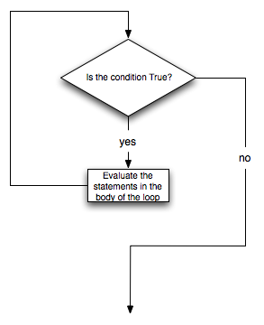
While
A loop will run while a condition is true
Often you can think of it like a switch
while(aConditionIsNotMet):
#do some stuff
Example whileCondition.py

Slide 6
String formatting
Sometimes you will want to print a string and need to express a variable as part of the string
To do you this you can format the variable in a way that the string can use it . This is called string formatting
To use a int you use %d
To use a float it’s %f
To use a string it is %s
To use a character it is %c
To use a hex it is %x
To use binary it is %b
The code looks like this:
print(“%d is a whole number” %num)
The %d is what will be replaced. The second % sign is followed by the name of the variable you wish to replace it with
Example:whileString.py

Slide 7
While if
You can use a while statement to act as a Boolean switch
isRunning = True
while(isRunning):
if(x < 10):
#do stuff
Roll two dice until they hit the number 11
Example:whileRunning.py

Slide 8
homework
Write the equation for the Pythagorean theorem as code. Leave it at the top of your programming code below for grading purposes.
Create a program that plays Russian Roulette with an evil monster. While his is alive let him choose if he keeps playing the game or if he should go eat some cute small animals in the forest. At the end of the game tell the player how many times they played until the monster died or got bored and left. Allow the user to play in the roll of the monster.

