Slide 1
Executive Order 504
An Order Regarding the Security and
Confidentiality of Personal Information
Implementation of the EO504 Data Security
& Personal Information Protection Program
WELCOME
Information Security Officers
Enterprise Security Board Members
EO504 Stakeholders
Notes:
Historic gathering

Slide 2
EO504
Welcome, Introductions
Brad Ridley - Senior Director, Policy & Risk Management, University of Massachusetts Outreach & Education Chair, Commonwealth Enterprise Security Board
Dan Walsh, CISSP – Chief Security Officer Office of the Commonwealth CIO Administration & Finance, Co-Chair Commonwealth Enterprise Security Board, Information Security Officer (ISO) Information Technology Division
John Beveridge, CISA, CISM, CFE, CGFM - Deputy State Auditor State Auditors Office, Co-Chair Commonwealth Enterprise Security Board
Stephanie Zierten, Esq. - Deputy General Counsel Information Technology Division
Gillian Lockwood - Director, Enterprise Policy & Architecture, Information Technology Division (ITD), Enterprise Security Board Standards Committee Co-Chair
Curt Dalton, CISSP, CISM, ISMS Lead Auditor - Strategic Enterprise Security Plan Program Manager, Executive Order 504 Project Manager

Slide 3
EO504
Agenda
Logistics, Session Plan (Brad Ridley)
EO504 Necessity (Dan Walsh)
Commonwealth Enterprise Security Board (John Beveridge)
EO504 Legal Refresher (Stephanie Zierten)
Enterprise Information Security Policy & Program (Gillian Lockwood, Curt Dalton & Dan Walsh)
Q & A (Brad Ridley)
BREAK
EO504 Information Security Program/Electronic Security Plan & Template Walk-Through (Curt Dalton)
Audit Preview (John Beveridge)
Timeline, Ongoing Collaboration, & Support (Curt Dalton)
Q & A (Brad Ridley)

Slide 4
EO504
Necessity (is the mother of prevention)
Dan Walsh
Notes:
And a hair club member

Slide 5

EO504
Necessity
Identity theft is now passing
drug trafficking as the number
one crime in the nation
U.S. Department of Justice
http://www.idtheftcenter.org/artman2/publish/m_facts/Facts_and_Statistics.shtml
Massachusetts ranks 22nd
out of 50 states:
63.7 victims per 100,000
Population
http://www.identitytheftsecurity.com/stats.shtml#2006stats
Notes:
Number of Audience members who have already received a breach notice?
Freeze & Breach Notification Laws are not sufficient deterrents in and of themselves

Slide 6
Executive Order 504
Necessity
ID Thefts by Affected Entity (reported)
# of Breaches 2008 2007 2006
Business 240 36.6% 28.9% 21%
Educational 131 20.0% 24.8% 28%
GOV/MIL 110 16.8% 24.6% 30%
Health/Medical 97 14.8% 14.6% 13%
Financial/Credit 78 11.9% 7% 8%
http://www.idtheftcenter.org/artman2/publish/m_press/2008_Data_Breach_Totals_Soar.shtml
Notes:
Should this number be higher? Is this a function of fewer lost laptops and tapes or insufficient detection?

Slide 7
Executive Order 504
Means
Remote Access
& Control
Web Application
Internet-Facing
System
Wireless
Network
Physical Access
42%
34%
24%
9%
21%
0% 5% 10% 15% 20% 25% 30% 35% 40% 45%
2008 Data Breach Investigations Report - A study conducted by the Verizon Business Risk Team
Notes:
“In over 40 percent of the breaches investigated during this [Verizon Business Risk] study, an attacker gained unauthorized access to the victim [data] via one of the many types of remote access and control software.”

Slide 8
Executive Order 504
Methods
2008
Financial
Business
Education
GOV/Mil
Medical
Insider
Theft
2.4%
5.6%
1.8%
3.4%
2.4%
Hacking
3.5%
6.1%
2.7%
0.8%
0.8%
Data on
the MOVE
1.7%
7.3%
3%
4.3%
4.4%
Accidental
Exposure
0.8%
3.0%
6.1%
3.0%
1.5%
Sbcntrctr
0.8%
3.5%
1.5%
2.3%
2.3%
http://www.idtheftcenter.org/artman2/publish/m_press/2008_Data_Breach_Totals_Soar.shtml
Notes:
Data on the Move is mobile data; not just paper documents, thumbdrives. laptops, but think about data that is withdrawn from an authoritative source

Slide 9
Executive Order 504
Necessity - Massachusetts
First 10 months after Massachusetts’ new identity theft law took effect, Office of Consumer Affairs and Business Regulation received 318 breach notifications
  274 were reported by businesses (86%)
  23 by educational institutions (8%)
  17 by state government (5%)
  4 by not-for-profits (1%)
http://www.mass.gov/?pageID=ocahomepage&L=1&L0=Home&sid=Eoca
Notes:
Security Breaches/Unauthorized Access (effective 10/31/07)
Note 93I: Data destruction and disposition (not the subject of this presentation)
Agency that owns or licenses data that includes PI about a resident must provide notice to
AG
OCA, which must provide notice to agency of any relevant consumer reporting agency or state agency
Resident
Relevant Consumer Reporting Agency (see information on OCA sites)
ITD (if Executive Department Agency)
Supervisor of Public Record (If Executive Department Agency)

Slide 10
Executive Order 504
Necessity – Low Risk/High Return
“card numbers now selling for anywhere between 40 cents and $20.
bank account numbers going for anywhere from $10 to $1,000, and
"full identities"—which include date of birth, address, and social security and telephone numbers—selling for between $1 and $15 a pop.”
http://www.slate.com/id/2189902/
Notes:
Not only used for creation of fraudulent credit cards; (Credit cards from Europe or smaller card companies typically cost up to twice as much as standard-issue American numbers, presumably due to their relative scarcity within the market.)

Slide 11
Executive Order 504
Necessity - Economic Impact
U.S. Cost of a Data Breach Study
“According to the study which examined 43 organizations across 17 different industry sectors, data breach incidents cost U.S. companies $202 per compromised customer record in 2008, compared to $197 in 2007”
http://www.pgp.com/insight/newsroom/press_releases/2008_annual_study_cost_of_data_breach.html
Notes:
doesn't take long to incur to real money losses

Slide 12
Executive Order 504
Commonwealth
Enterprise Security Board
John Beveridge
Dan Walsh

Slide 13
Executive Order 504
Enterprise Security Board
What is the Enterprise Security Board (ESB)?
On May 11, 2001, the Enterprise Security Board
(ESB), a volunteer-supported organization, established a
Commonwealth-wide approach for securing and managing
information.
“To develop and recommend enterprise security policies, standards and guidelines designed to ensure the confidentiality, integrity and availability of the Commonwealth’s IT resources. The Board’s efforts will comply with all applicable legal requirements and will be consistent with generally accepted IT governance, control and security objectives and practices. The Board’s mission includes educating, communicating and promoting generally accepted IT management and control practices.”

Slide 14
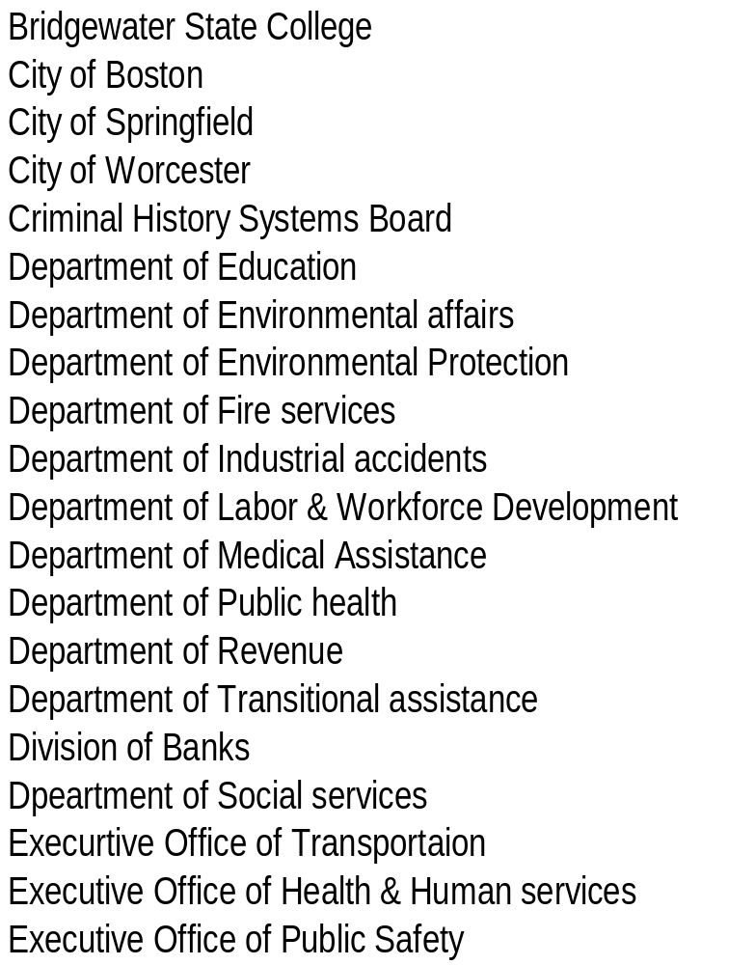
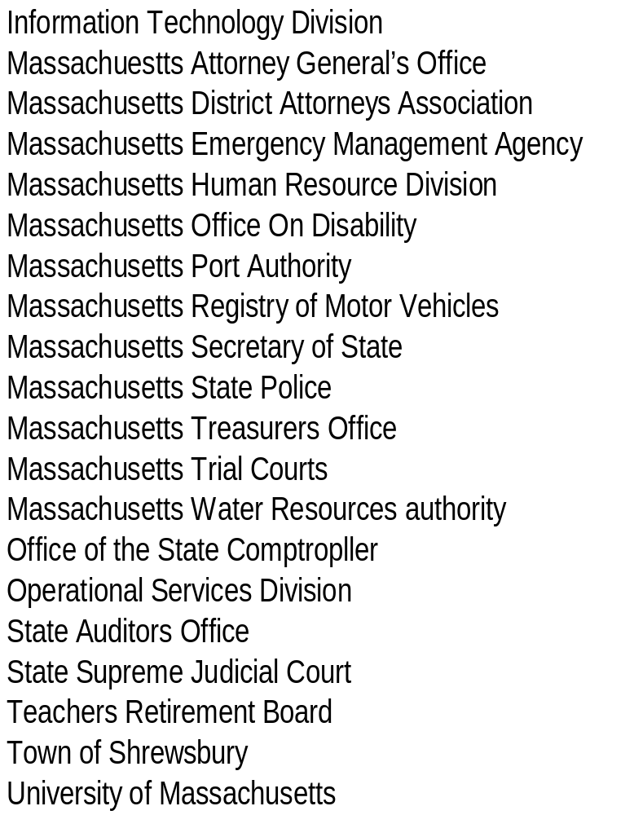
EO504
Commonwealth’s ESB Community

Slide 15
Executive Order 504
Enterprise Security Board
Massachusetts Enterprise Security Board
Committees
Policy &
Standards
Education &
Outreach
Executive
Information
Sharing
& Analysis
Variance
Local
Government
Research &
Development

Slide 16
Executive Order 504
Commonwealth
Enterprise Security Board
ESB’s EO504 Role & Responsibilities
The Enterprise Security Board ("ESB") shall advise
the Commonwealth CIO in developing the guidelines,
standards, and Policies required by Section 4 of
EO504:
  Governing agencies' development, implementation and maintenance of electronic security plans
  Specifying when agencies will be required to prepare and submit supplemental or updated electronic security plans to ITD for approval
  Periodic reporting requirements pursuant to which all agencies shall conduct and submit self-audits to ITD no less than annually

Slide 17
Executive Order 504
Commonwealth Enterprise Security Board
ESB’s EO504 Role & Responsibilities (Continued)
Issue policies requiring that incidents involving a breach of
security or unauthorized acquisition or use of personal
information be immediately reported to ITD and to such
other entities as required by the notice provisions of
Chapter 93H
Guidelines, standards, and policies, and resources which will
support agency EO504 compliance with applicable federal and
state privacy and information security laws and regulations
Periodic reporting requirements to conduct and submit self-
audits to ITD no less than annually assessing the state of their
Implementation

Slide 18
Executive Order 504
Legal Refresher
Stephanie Zierten, Esq.

Slide 19
Executive Order 504
Legal Refresher
Before EO504…
Commonwealth’s Information Technology Division (ITD)
Commonwealth’s Enterprise Security Board (ESB)
  Cross section of Commonwealth agencies and local governments which oversee the Commonwealth’s security.
  Created by ITD in 2001 but lacked legal standing
Worked together to create policies on:
  Enterprise Information Security Policy
  Cybercrime and Security Incidents
  Electronic Messaging
  Data Classification
  Remote Access
  Wireless

Slide 20
Executive Order 504
Legal Refresher
What does it change
Doesn’t Change…
  Any preexisting contractual obligations
  Any preexisting security or privacy laws
Isn’t mandated for…
  Non-Executive Agencies
  Legislature, Trial Courts, Authorities

Slide 21
Executive Order 504
Legal Refresher
All Executive Agencies Must…
Develop a written “Information Security Program” (ISP), including an Electronic Security Plan
  Personal data and personal information security must be addressed by an “Electronic Security Plan” (ESP) (More on these in a few minutes)
Manage vendors/contractors
  Verify all vendors/contractors have acceptable security controls to prevent data breaches
    Follow mandatory ITD standards for verifying competence and integrity of contractors and subcontractors; and
  Incorporate required certifications into contracts.
Have Agency Head Certify all Programs, Plans, Self-Audits and Reports
Notes:
Note about ISP & Vendor agreement

Slide 22
Executive Order 504
Legal Refresher
All Executive Agencies Must…
Appoint an Information “Security” Officer (ISO) (really a Security and Privacy Officer) who
Reports directly to Agency head
Coordinates Agency’s compliance with
    EO504
    Federal and state laws and regulations (privacy and security)
    ITD enterprise security policies and standards
    Although not required by EO 504, ISO to coordinate compliance with contractual security and privacy obligations as well.

Slide 23
Executive Order 504
Legal Refresher
Basic Requirements -- ISP
“Adopt and implement the maximum feasible measures reasonably needed to ensure the security, confidentiality and integrity of”
    Personal Information: as defined in the Security Freezes and Notification of Data Breaches Statute (G.L. 93H)
    Personal Data: as defined under FIPA
  Personal Information (G.L. 93H):
    Resident’s first name (or initial) and last name in combination with
      Social security number;
      Drivers license (or state issued i.d.) number; or
      Financial account number
  Personal Data under FIPA
    Any information which, because of name, identifying number, mark or description can be readily associated with a particular individual.
      Except information that is contained within a public record (G.L. c. 4 § 7(26)).

Slide 24
Executive Order 504
Legal Refresher
ISP/ESP
  Develop and implement written information security programs…
  Cover all personal information (not restricted to electronic
    information)
  Electronic personal data must be addressed in a subset of the Information Security
  Program (ISP) called an “electronic security
  plan” (ESP)
Personal Information and data:
Information
Security Program
Electronic
Security
Plan

Slide 25
Executive Order 504
Legal Refresher
All Executive Agencies (ISO’s) must also…
Submit certified agency ISP and ESP to ITD
  More on this later
Self audit ISPs and ESPs at least every year
  assessing the state of their implementation and compliance with guidelines, standards, and policies issued by ITD, and with all applicable federal and state privacy and information security laws and regulations
Have all employees attend mandatory information security training
  Staff, Supervisors, Managers, and Contractors
  How to identify, maintain and safeguard records and data
Fully cooperate with ITD to fulfill ITD responsibilities

Slide 26
Executive Order 504
Legal Refresher
Compliance
How is this enforced?
  ITD, with the approval of the Executive Office of Administration and Finance will determine remedial action for agencies in violation of EO504 and impose terms and conditions on agency IT funding.

Slide 27
Executive Order 504
Legal Refresher
ITD must…
Implement it’s own ISP and ESP
  Following Approval by an independent party (Peer Review)
Issue guidelines on developing and implementing ISPs and ESPs (More on this in a few minutes)
Review all ISP/ESPs and ESP audits
Review agencies’ compliance
Notes:
Submit to HRD, EHS, DOR for Peer review

Slide 28
EO504
Enterprise Information Security Policy & Program
Gillian Lockwood

Slide 29

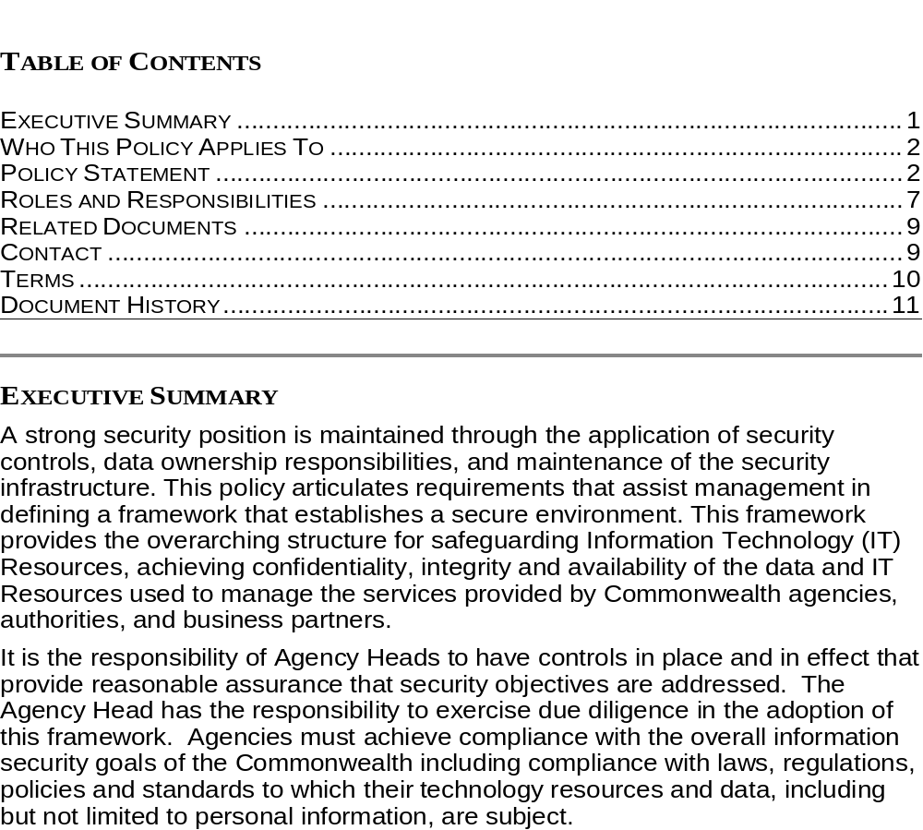
EO504
Enterprise Information Security Policy (Updated)
Commonwealth of Massachusetts
Information Technology Division
Enterprise Information Security Policy
Notes:
Gillian Lockwood presenting this slide
Infosec domains based on ISO27001
NIST now mapping to this international standard

Slide 30
EO504
Enterprise Information Security Policy (Updated)
Assists management in defining a framework that establishes a secure environment.
Overarching structure provided for achieving confidentiality, integrity and availability of both information assets and IT Resources
  Information Security Management Program
  Risk Assessment
  Risk Treatment
  Security Policy, Policy Adoption and Documentation Review

Slide 31
EO504
Enterprise Information Security Policy & Program
Curt Dalton

Slide 32
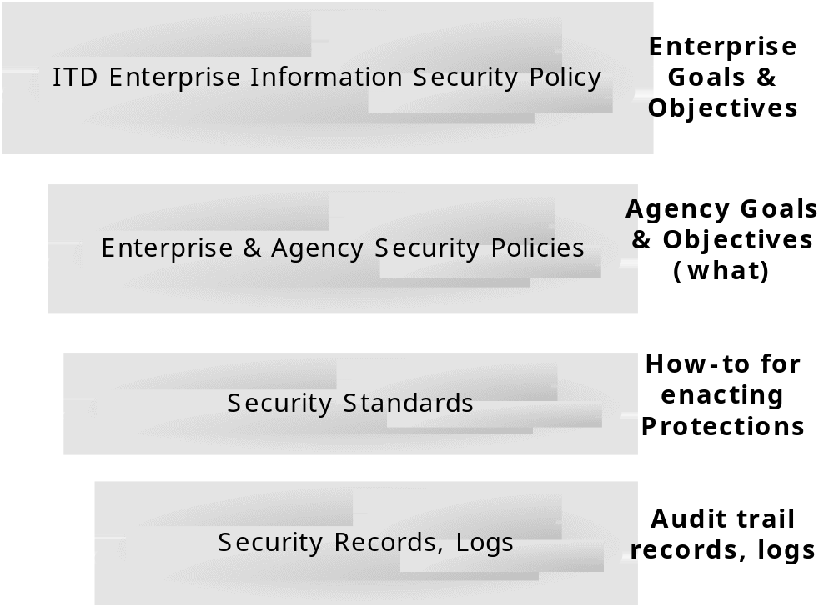
Documentation Hierarchy Primer
Enterprise Policies, Agency Policies, Standards, & Records
Risk Management | Physical & Environmental
Incident Management | Access Control Req’s, etc…
Security Incident Policy | Wireless Security Policy
Data Classification Policy | etc …
User contacts CommonHelp… | Firewalls shall block P2P traffic…
AES 256 used for remote access… | AV configured like this, etc…
Visitor log | Incident Report
Audit log | etc …
Notes:
CD - 5 mins

Slide 33
Sample Security Policy Mappings
ITD Security Policies & Best Practices Policies
ITD Enterprise Information Security Policies (13 Policies in total)
Optional Information Security Best Practices Policies available for use (21 Policies in total)
ITD Enterprise Data Classification Standards Policy
Risk Management Policy
ITD Public Access Standards for E-Gov Applications – Application Security
Attack Intrusion Notification Procedures
Management of Information Security Incidents & Improvements Policy
Cybercrime & Security Incident Policy
- No ITD Policy Available -
Information Backup Policy
- No ITD Policy Available -
External Parties Security Policy
Notes:
CD - 3 mins

Slide 34
EO504
Enterprise Information Security Policy & Program
Dan Walsh

Slide 35
EO504
An Information Security Management Program
Culture
Shared
Knowledge & Values
Correct Deficiencies
Protect
Resources
Detect
Vulnerabilities
Notes:
Dan

Slide 36
EO504
An Information Security Management Program
Culture (Shared Knowledge & Values)
Organization of Information Security
Maintain the security of the organization’s
information and information processing facilities
Security Policy, Adoption, and Documentation Review
Document, disseminate, promote
Periodically review/update
Human Resource Security
Ensure all users understand their security responsibilities Provide security awareness, education, & training
Information Systems Acquisition, Development, and Maintenance
Ensure security is an integral part of information systems
Change Management, Change Control, Software Maintenance
Culture
Shared
Knowledge/Values
Correct Deficiencies
Protect
Resources
Detect
Vulnerabilities
Notes:
Dan

Slide 37
EO504
An Information Security Management Program
Protect (Resources)
Asset Management
Appropriate protection of information assets Acceptable use of inventoried assets
Information Classification
Information receives appropriate level of protection
Device & Data Disposal
Unauthorized destruction
Risk Treatment
Evaluate & apply controls (safeguards) (administrative, technical, physical)
Accept risk (agency legal & policy based)
Avoid risk
Transfer risk
Culture
Shared
Knowledge/Values
Correct Deficiencies
Protect
Resources
Detect
Vulnerabilities

Slide 38
EO504
An Information Security Management Program
Protect (Resources) Continued
Culture
Shared
Knowledge/Values
Correct Deficiencies
Protect
Resources
Statement of Applicability Statement of applied controls used to safeguard all information technology resources (ITRs) and information assets (e.g., personal information)
Communications & Operations Management
Implement procedures for managing system activities associated with access to information and information systems, modes of communication, and information processing
Detect
Vulnerabilities

Slide 39
EO504
An Information Security Management Program
Protect (Resources) Continued
Culture
Shared
Knowledge/Values
Access Control & Management
Implement controls for authorized access to information, IT Resources, information processing facilities, and business processes on the basis of business and security requirements
Physical & Environmental Security
Secure against unauthorized physical access, damage and interference to the agency’s premises and information assets including but not limited to personal information and IT Resources
Correct Deficiencies
Protect
Resources
Detect
Vulnerabilities

Slide 40
EO504
An Information Security Management Program
Detect (Vulnerabilities)
Culture
Shared
Knowledge/Values
Risk Assessment
Identify risk factors (potential threats)
Impact (costs)
Probability (likelihood)
Compliance
  Implement the security requirements of this policy in addition to
  any state or federal law, regulatory, and/or contractual obligations
  to which their information assets and IT Resources are subject
Correct Deficiencies
Protect
Resources
Detect
Vulnerabilities

Slide 41
EO504
An Information Security Management Program
Correct (Deficiencies)
Culture
Shared
Knowledge/Values
Correct Deficiencies
Protect
Resources
Business Continuity Management
Counteract interruptions to business activities
Protect critical systems from major failure
Ensure timely resumption of critical systems
Information Security & Incident Management
Implement management controls that result in a consistent and effective approach for addressing incidents
Maintenance
Implement a regular or event driven schedule by which the ISP is reviewed for ongoing effectiveness
Detect
Vulnerabilities

Slide 42
Executive Order 504
Context & Background Questions
Questions so far?

Slide 43
Executive Order 504
Break

Slide 44
EO504
ISP/ESP Template (Walkthrough)
General Agency Information
Curt Dalton

Slide 45
EO504
ISP Agency Template
General Agency Information
Agency Name
Name of Agency Head
Name and Contact Detail: Executive Order 504 Information Security Officer (EO504/ISO)
Provide a brief description of the agency or organization mission
Notes:
CD – 1 min

Slide 46
ISP Agency Template
Citations
Citation to all sources of authority and written policies, standards or procedures which address:
    Collection, Use, Dissemination, Storage, Retention, and Destruction;
    Minimal Amount;
    Limited Dissemination/Least Privilege;
    Hard Copy Location; and
    Hard Copy Destruction
Attach
    All written policies, standards, procedures, and practices adopted by your agency/organization identified within the EO504 ESP (if accessible on MagNet via URL, then please provide the link only!)
Notes:
CD – 1 min

Slide 47
ITD EO 504 ISP & ESP Templates
Demonstration
Demonstrate usage of the EO504 ISP Tool
Demonstrate usage of the EO504 ESP Tool
Note: after completing your ISP/ESP, please remember to LOCK the document as ‘READ ONLY’ prior to delivery to ITD. This will help ensure the integrity of the document.
How To Lock your ISP/ESP as READ ONLY
  Within any tab of the Excel-based ISP/ESP tool, select TOOLS, Options, Security
  Enter your ‘Password to Modify’ (any password you choose)
  Next, check the ‘Read Only recommended’ box and hit OK
  Re-enter your modify password and click OK, then Save the document.
Notes:
CD - 15 mins

Slide 48
EO504
ISP/ESP Workflow
Suggested Workflow:
Agency ISO transmits ISP for joint review with their Agency counsel
Agency Counsel identifies agency-unique privacy and/or security drivers:
  Statutes
  Regulations
  Executive Order
  Contracts
  Policies
Agency Counsel completes ISP general information section
Notes:
CD – 1 min

Slide 49
EO504
ISP/ESP Workflow
Agency CIO and/or ISO identify and validate agency and/or personal information:
  Inventory all systems
  Interview system owners to determine presence of
  confidential and/or personal information on systems
  (all components)
Agency Counsel completes EO 504 Electronic Security Plan (ESP) Template
Note: The ESP documents the intersection between the security requirements derived from the source(s) of authority (drivers) and the electronic components (e.g. the systems)
Notes:
CD – 1 min

Slide 50
EO504
ISP/ESP Workflow(continued)
Workflow (continued):
Agency Counsel transmits to ISO for review, including all attachments
ISO reviews and collaborates with agency counsel and/or CIO on any discrepancies or edits
ISO certifies and transmits to Agency Head for final review & certification

Slide 51
EO504
ISP/ESP Workflow(continued)
ISO submits to ITD (via Secure File and Email Delivery System, see separately attached instructions)
  Note: some agencies will be submitting their ISP/ESP to the Secretariat CIO (SCIO) and the SCIO will in turn submit all ISP/ESP’s to ITD for review/approval. Before submitting to ITD, check with your SCIO.
Within (10) business days, ITD may:
    Approve
    Modify (with list of modifications)
    Reject (with list of gaps/reasons for rejection that must be addressed before resubmitting.
Notes:
CD – 1 min

Slide 52
EO504
Enterprise Information Security Policy & Program
Stephanie Zierten

Slide 53
2009: Review of Agency ESP(s)
Submission
  On time
  Complete
  Proper certifications/attestations
High Level Substantive Review
  Internally consistent
  Consistent with other like programs (e.g. HIPAA covered entities identify HIPAA as a requirement)
Notes:
Stephanie

Slide 54
EO504
Enterprise Information Security Policy & Program
Curt Dalton

Slide 55
Executive Order 504
What’s next (June – September)
Train staff on the agency’s EO504 ISP & ESP regarding the identification and protection of Personal Data and Personal Information (per EO 504)
  Develop and deliver customized training using template provided
  Consider delivering background materials to relevant agency personnel (helpful but not required)
    ITD Legal EO 504 Online Webcast
    MS ISAC Computer Based Training (to be made available)
Complete the Self Audit Questionnaire and return it to ITD
  Return securely via Secure File Email Delivery to EO504@Massmail.State.MA.US
Notes:
Curt – 1 min

Slide 56
Executive Order 504
Audit
John Beveridge

Slide 57
Self Audit
EO 504

Slide 58
EO504 Self Audit Program
Agencies are to conduct and submit self-audits to ITD no less than annually,
Self audits are an assessment of the agency’s implementation and compliance with EO504:
  Agency EO504 electronic security plans,
  all guidelines, standards, and policies issued by ITD, and
  all applicable federal and state privacy and information security laws and regulations

Slide 59
EO504 Self Audit Program
Structured self assessment that provides feedback to agency management and ITD as to the degree of compliance with EO504
Most likely a questionnaire format
Self audit is an assurance mechanism
As identified within an Agency’s approved EO504 ISP/ESP - Example areas covered:
  Whether agency has identified extent of PI data
  Whether agency requires PI
  Assess security framework

Slide 60
Assurance Level
100%
Residual Risk
Reasonable Assurance
0%

Slide 61
Assurance Level
100%
Acceptable Risk
Residual Risk
Less Than Reasonable Assurance
0%

Slide 62
EO504 Self Audit Program
Reinforces understanding and achievement of EO504 objectives
From a control perspective, EO504 Self Audit is proactive and incorporates control improvement
EO504 Self Audit Training will be in June
State Auditor’s Office position on EO504

Slide 63
Executive Order 504
Submission Processes & Timelines
Curt Dalton

Slide 64
Logistics
Enterprise Security Plan / EO 504
Populate your EO504 ISP and sign attestation
Populate your EO504 ESP(s) and sign attestation
Utilize the provided Secure File Email Delivery (SFED) account to securely return your completed ISP and ESP(s) to ITD
  SFED account information will be communicated to each ISO
  Send your completed ISP, ESP(s), and attachments by logging into SFED (https://securefile.state.ma.us), and deliver your documents to ITD using the following address: EO504@SFED.Massmail.State.MA.US
  SFED help is located at https://securefile.state.ma.us/help/user/Authentica_Content_Security_Server_Welcome_page.htm)
Notes:
CD - 3 mins

Slide 65
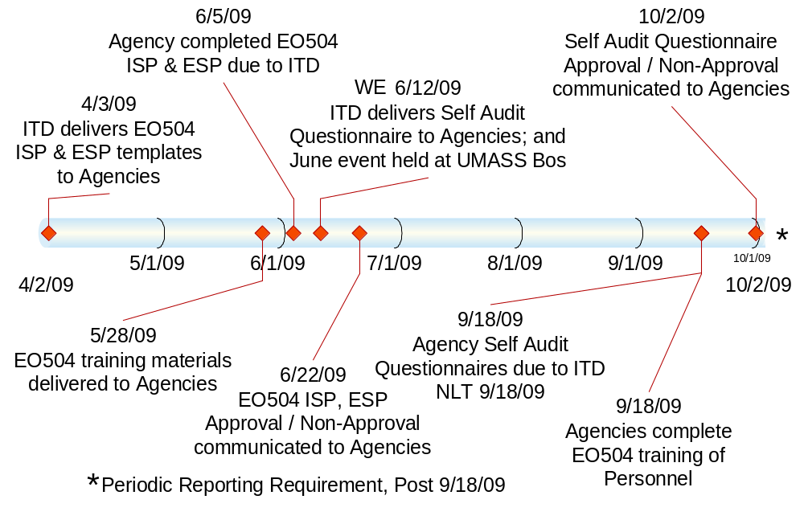
Timeline
Enterprise Security Plan / EO 504
Timeline and Key Dates
Notes:
CD - 10 mins

Slide 66
Help
Enterprise Security Plan / EO 504
CommonHelp
If you require assistance while completing your ISP or ESP, please contact CommonHelp at (866) 888-2808
Notes:
CD - 3 mins

Slide 67
Questions
Q&A period (all presenters)
Questions with ANY of the material presented today?
  Individual or group responses to questions from presenters
Please remember to return your completed Survey to Nizinga Robinson at the registration desk
Notes:
ALL - 45 mins for Q&A

