Slide 1

A Look at KSU's Progression Tracking System for Support of Retention, Progression, and Graduation
Erik Bowe & Donna Hutcheson
Georgia Summit 2006
September 21, 2006 – 2:00pm
Topic: Data warehouse and Data mining

Slide 2
Agenda
Technically Speaking (How we technically pulled this project off)
  What is a CIF?
  What is an ODS?
  How is the ODS Organized?
  Possible ODS Uses
  Technologies Used
  Data Sources
  How we handled retention and attrition
Retention, Progress, and Graduation (RPG): The Progression Tracking System (PTS)
  Demonstration
Conclusion

Slide 3
Technically Speaking
How we pulled this off:
Used an Operational Data Store (ODS)
  Contains our Retention, Attrition, and Graduation derived values and raw data
Used Oracle PL/SQL Packages
  One for the I&T (integration and transformation) aka ETL (export-transform-load)
  Another for the web-based interface for the end-user

Slide 4
What is a CIF?
The Corporate Information Factory (CIF) is a logical architecture whose purpose is to deliver business intelligence and business management capabilities driven by data provided from business operations.
  The “business” being data about academics (i.e., assessment)
The CIF has proven to be a stable and enduring technical architecture for any size enterprise desiring to build strategic and tactical decision support systems (DSSs).
The CIF consists of producers of data and consumers of information.
Imhoff, C. (1999). The Corporate Information Factory. DM Review.

Slide 5
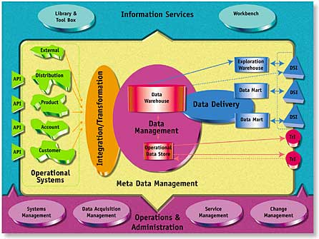
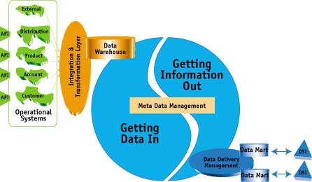
What is a CIF?
The CIF architecture:

Slide 6
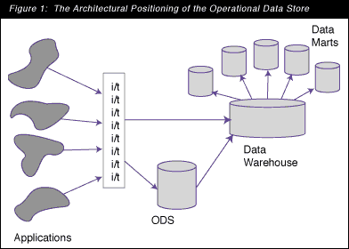
What is an ODS?
Inmon W., Imhoff, C., and Sousa, R. (2002). Corporate Information Factory (2nd Ed.).
Inmon B. (1998). The Operational Data Store: Designing the Operational Data Store. DM Review.

Slide 7
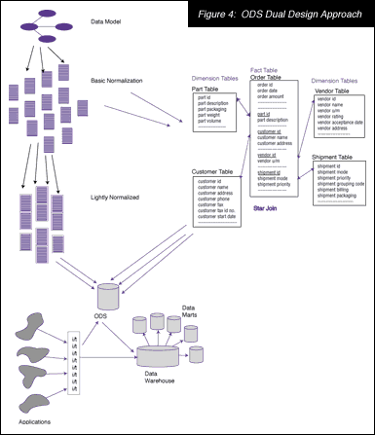
How is the ODS Designed?
Inmon W., Imhoff, C., and Sousa, R. (2002). Corporate Information Factory (2nd Ed.).
Inmon B. (1998). The Operational Data Store: Designing the Operational Data Store. DM Review..

Slide 8
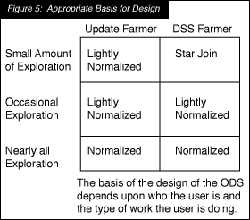
How is the ODS Designed?
Inmon W., Imhoff, C., and Sousa, R. (2002). Corporate Information Factory (2nd Ed.).
Inmon B. (1998). The Operational Data Store: Designing the Operational Data Store. DM Review..

Slide 9
Possible ODS Uses
At KSU:
Enterprise Reporting (continuously)
  i.e., the Business Intelligence, self-service model
Fact Book (annually)
Analytics
Enterprise Data Warehouse (for elements not covered by Board of Regents’)
Data Collection

Slide 10
Technologies Used
Oracle Database 10g Enterprise Edition 10.1.4.0.2 With Partioning, OLAP and Data Mining Options
  Contains the following schemas:
    Metadata Repository
    Portal (with WebDAV)
    Business Intelligence Discoverer End User Layer (EUL)
Oracle Application Server 10g Release 2 (10.1.2.0.2)
  Both infrastructure and middle tier components
PL/PDF v1.2.4c
Quest SQL Navigator 5

Slide 11
Data Sources
Enterprise Resource Planning Systems:
  SunGard Higher Education Banner
    Student record system
Student Information Reporting System (SIRS)
  Flat files reported to the Board of Regents’ of the University System of Georgia

Slide 12
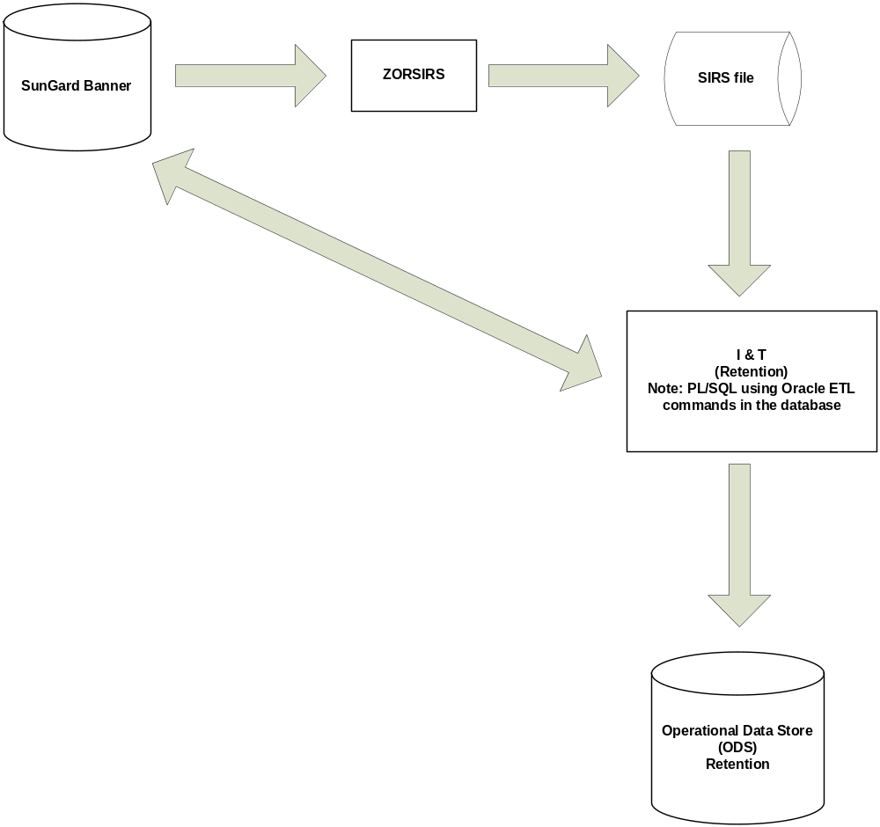
Retention I&T Flow

Slide 13
Handling Retention
PIDM/TERM | 200308 | 200401 | 200508
123 | X |  | X
456 | X | X | X
789 | X | X
Assuming 200308 is the beginning cohort year…we followed this logic
The first step is to advance student-by-student through our SIRS data mart
checking for the existence of a row in the next available term.
Repeat the process with #1 until all terms are exhausted.
We built a PL/SQL function to accomplish the task so it could be used in a SQL
field list or WHERE clause.

Slide 14
Handling Attrition
PIDM/TERM | 200308 | 200401 | 200508
123 | X |  | X
456 | X | X | X
789 | X | X
Assuming 200308 is the beginning cohort year…we followed this logic
The first step is to advance student-by-student through our SIRS data mart
checking for the non-existence of a row in the next available term.
Repeat the process with #1 until all terms are exhausted.
If data is needed for a given term, for example GPA, for which the student
was not retained, we to get the data from the last term attended in our
SIRS data mart.
We built a PL/SQL function to accomplish the task so it could be used in a SQL
field list or WHERE clause.

Slide 15
Demonstration
Retention, Progress, and Graduation (RPG): The Progression Tracking System (PTS)
The first strategic area addressed by the ODS at KSU! Why?
We had high demand for RPG data from across campus, and neither an application nor data mart with such info information existed in our software inventory.

Slide 16
Improvements
Move the integration & transformation (i.e., ETL) out of the code (i.e., PL/SQL)
  Preferably a flexible product that allows the ETL to be expressed as predicates in the metadata
Create the metadata as expressions
  Looking currently at SAS products (May 8th, 2006)
Use a 3rd party product for the front-end
  Again, looking at SAS
  Oracle Data Mining (ODM)
Use of OLAP cubes for
  Ethnicity/gender over time
  Citizenship/gender over time
  GPA ranges over time

Slide 17
Conclusion
The ODS is just one component of the Corporate Information Factory (CIF)
The ODS data is
  Current valued,
  Detailed,
  Volatile, and
  Subject-oriented
There are four different class of ODS
Implementation is very time consuming

Slide 18
Questions?
Contact Information:
Erik Bowe, ebowe@kennesaw.edu
Director, Information Management
Donna Hutcheson, dhutches@kennesaw.edu
Associate Director, Institutional Research and Information Management

