Slide 1

Almuthaqaf App
</
} /> [
/>

Slide 2
Introduction
Pitch Deck
20xx
</>
} /> [

Slide 3
</ Introduction :
Our App Almuthaqaf is a quiz app
meant to test your knowledge based on multiple fields and genres
(mathematics, geography, etc.…)
it consist of An easy-to-use settings menu for controlling sound and personal progress with a good looking GUI and appealing colors and tracking progress with points

Slide 4
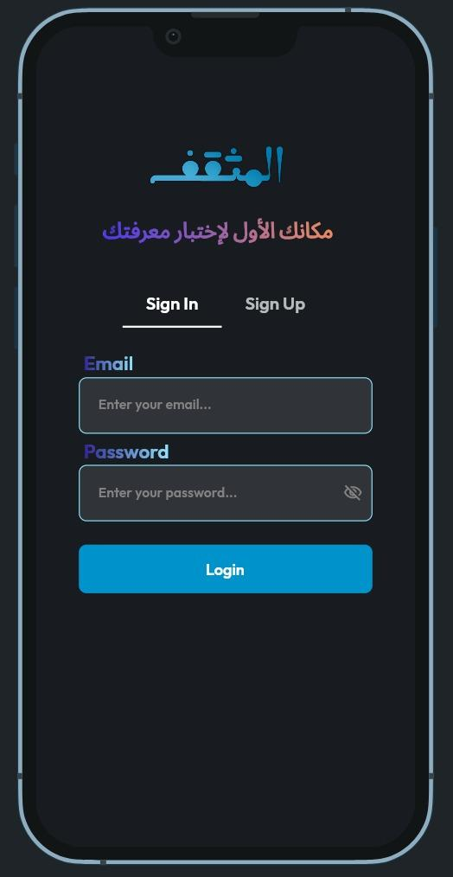
</ Authentication Page
All of the accounts on the app are kept
in a database. For instance, if you repeatedly enter the wrong password, the account will be temporarily locked.

Slide 5
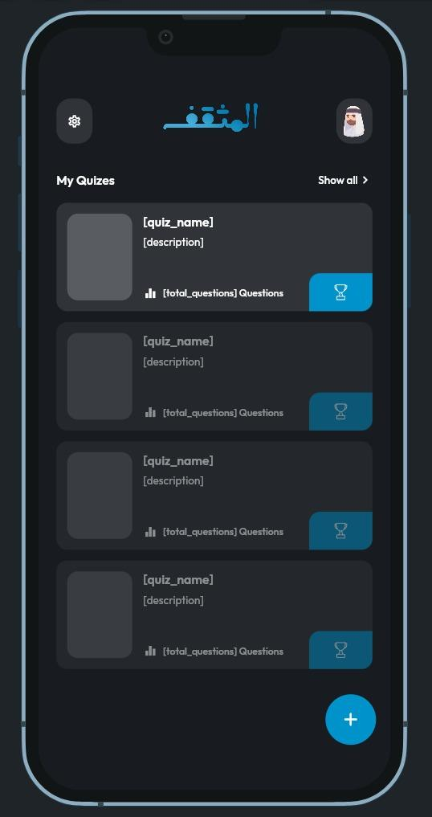
</ Home Page
The quizzes are displayed on the main page, along with buttons for settings and profiles. Each quiz includes the name, description, and amount of questions in addition to an image.

Slide 6
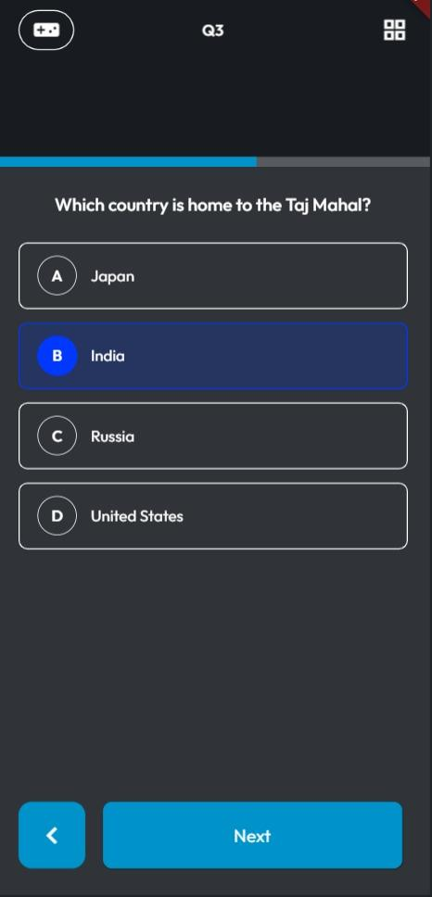
</ Quiz Page
Each question on the quiz page has four possible answers, and there is a progress meter showing how many questions are left.

Slide 7

</ Score Page
Once the quiz is over, a score page will show you how many points you earned. Each point you get will go toward your overall score on your profile page.

Slide 8
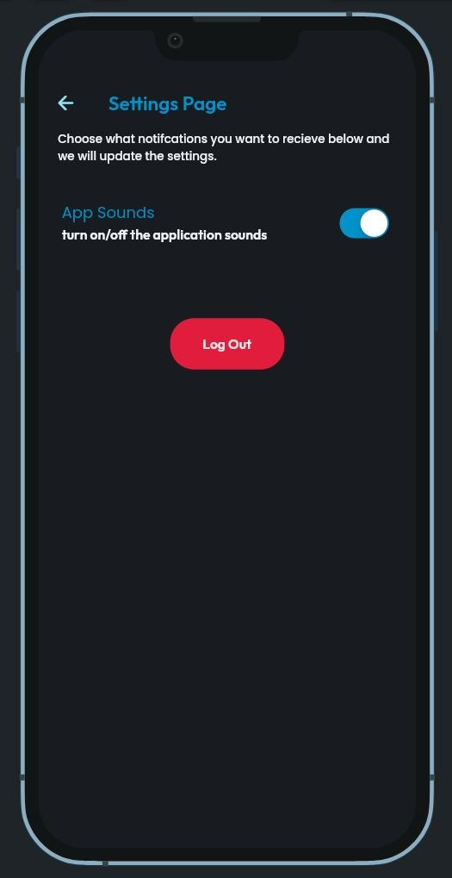
</ Settings Page
You may toggle the audio on or off and log out of your account on the settings page.

Slide 9
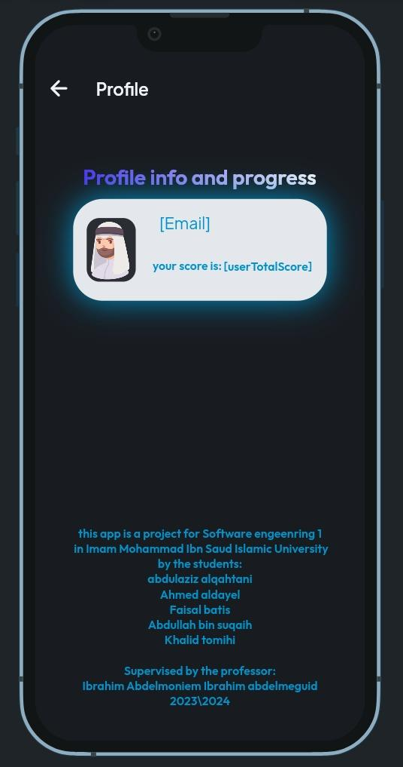
</ Profile Page
Your name will appear on the profile page along with the points you have earned, and the developers' credits are displayed underneath.

Slide 10
</ Completed Tasks
Log in – sign up
Documentation and scrum
UI/UX
UML Diagrams
Coding and designing
Database
Well made and secure authentication system integrated with a data base
recording our strategy, goals, and development process using the scrum agile approach
a visually pleasant graphical user interface and eye-pleasing colors
Our team used the cross-platform Flutter language to create.
creating several app diagrams during the course
Storing user and quizzes data on a database

Slide 11
</ Outlines for SW2 :
Adding more functionality
Fixing bugs if exist
Developing the app based on the requirements that SW2 asked for
Adding more levels

Slide 12
Thanks 🙏
any questions ?
</
} /> [
/>

