Slide 1

Almuthaqaf App
</
} /> [
/>

Slide 2
Introduction
Pitch Deck
20xx
</>
} /> [

Slide 3
</ Introduction :
Our App Almuthaqaf is a quiz app
meant to test your knowledge based on multiple fields and genres
(mathematics, geography, etc.…)
it consist of An easy-to-use settings menu for controlling sound and personal progress with a good looking GUI and appealing colors and tracking progress with points

Slide 4
</ Introduction :
overview of the project's goals and objectives:
Project Objectives:
Easy to use UI/UX
Multiple genres to choose from to attract more audience.
Score tracking to add more challenge and fun.
Setting menu to edit the audio and sound effects.
An easy to remember logo to make an identity for the app.
Each genre has multiple levels that goes harder until the final level.
A logo that is easy to remember
A progress bar to show how many questions are remaining
Every quiz will have a duration shown
A description about the quiz content
The game must be harder each level

Slide 5
</ Previous Sprints Overview :
overview of phase one:
Phase one involved defining the project's goals, target audience, and scope.
Overview:
Scope: The game {المثقف will have an appealing dark tone, several levels, a user-friendly interface, and a blue logo that stands for learning and knowledge.
Target audience: The app is geared toward young people who enjoy reading books and provides a structured, game-based learning environment in a variety of subjects. Its user base is not age-specific.
Scurm and the code:
Initially, we initialize the coding platform and the scrum file.

Slide 6
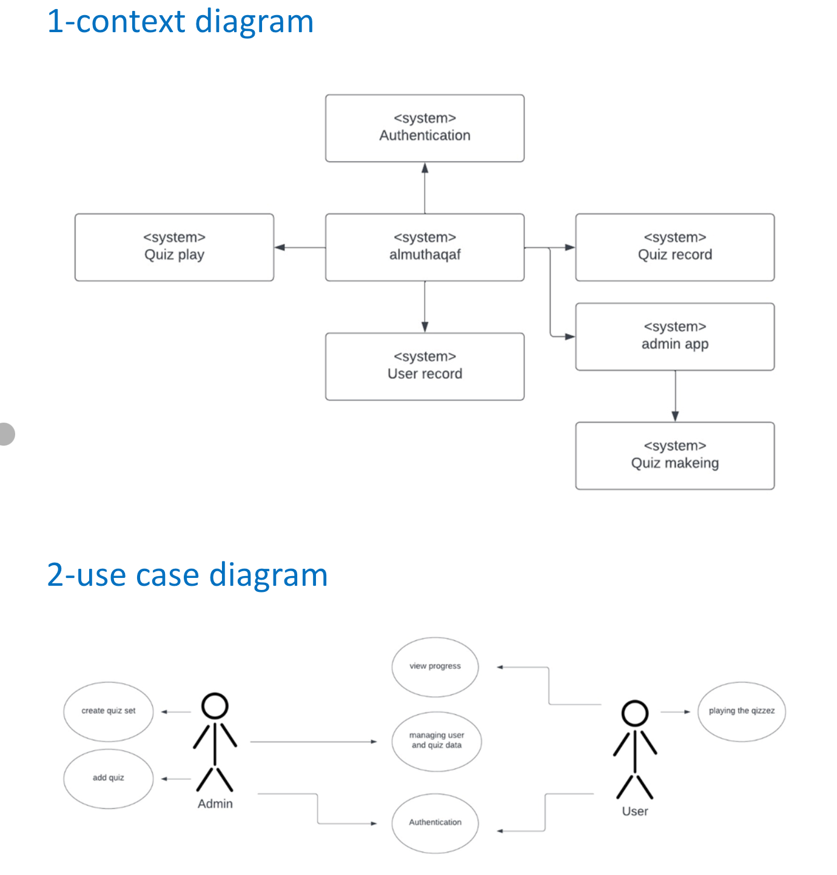
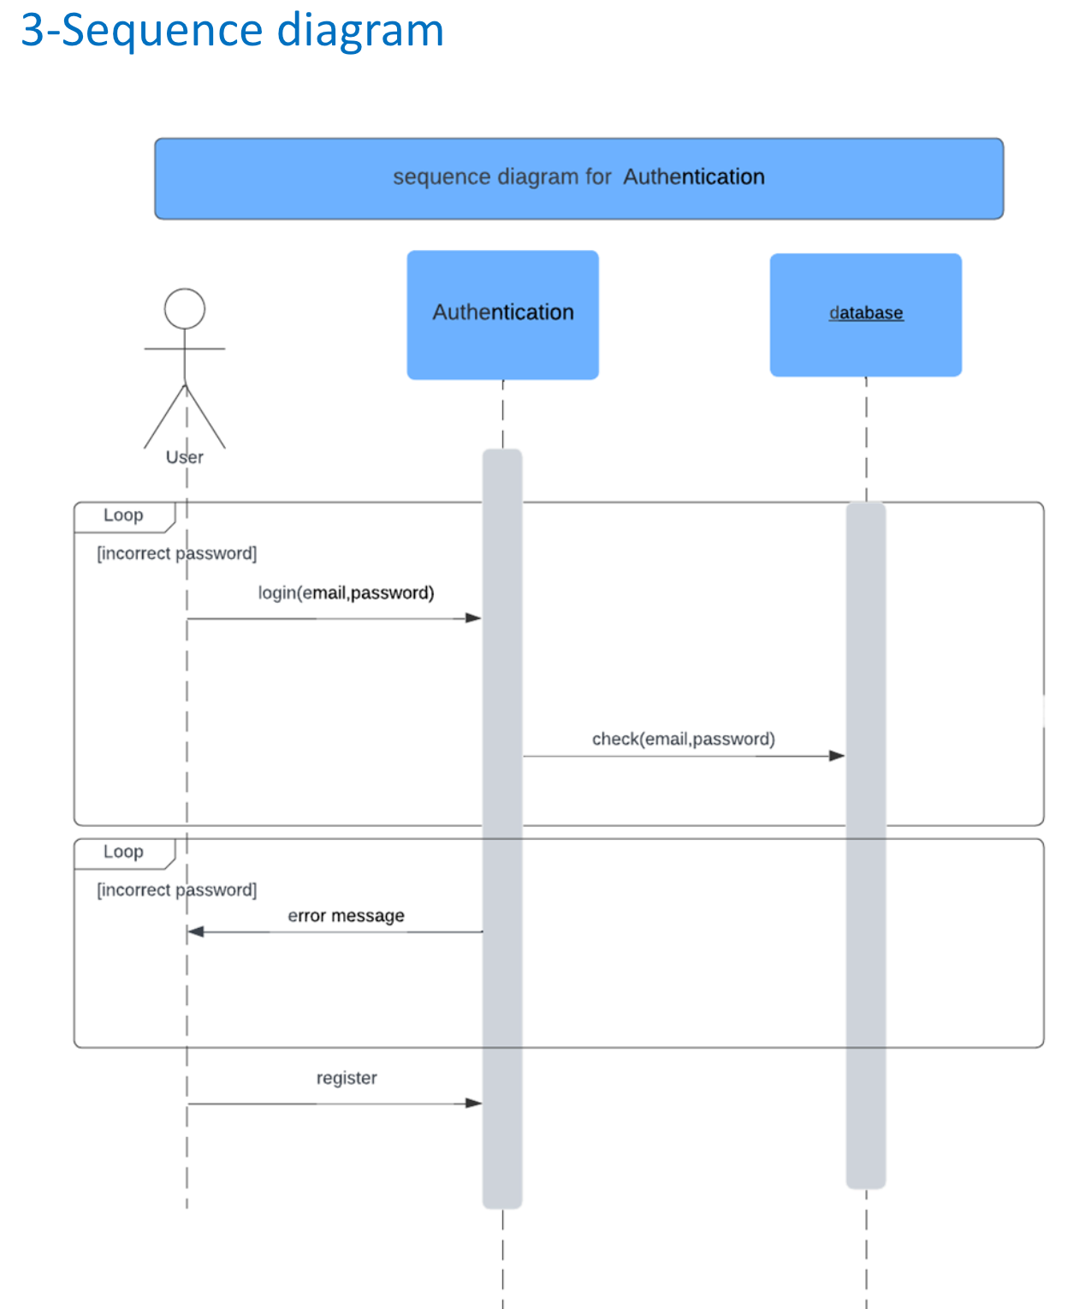
</ Previous Sprints Overview :
overview of phase two:
Phase two involves extensive development; after continuing with the app's coding, the creation of the diagrams is crucial.

Slide 7
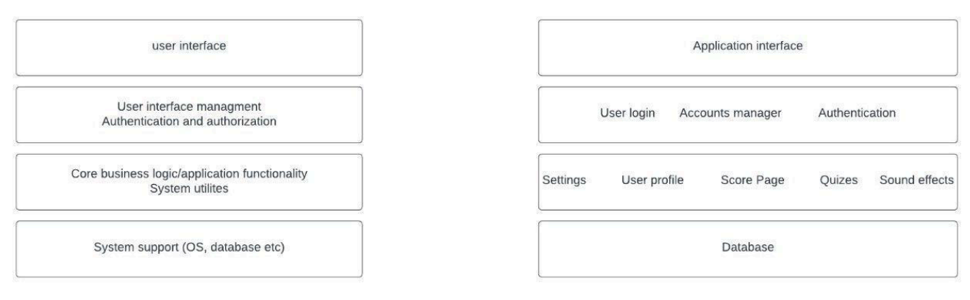
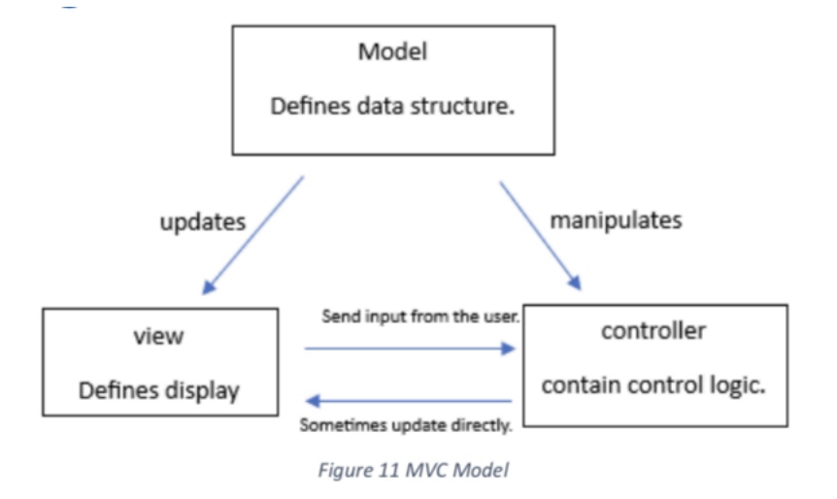
</ Previous Sprints Overview :
overview of phase three:
Phase three saw us concentrate on MVC and architectural design, and we finished writing the majority of the code.

Slide 8
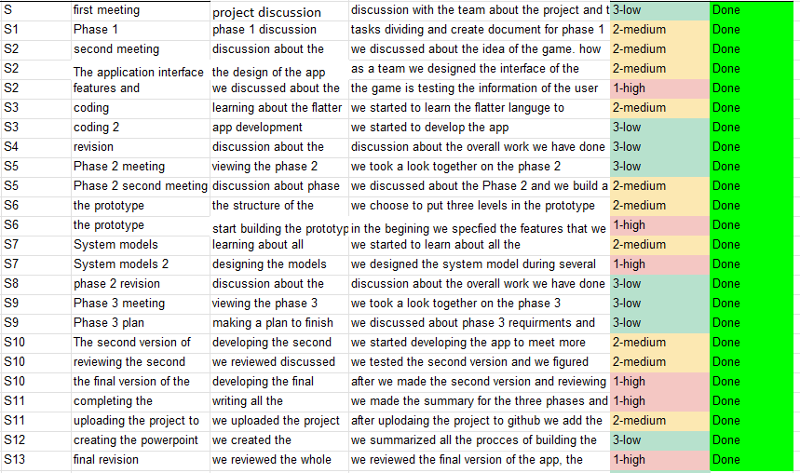
</ Previous Sprints Overview :
Backlog and Sprints (Scrum)
You can Check everything else about the Backlog and Sprints from this link:
https://docs.google.com/spreadsheets/d/1w-I9Xg6ZQu_sDq1EJvtkcuSh-JTt6Jb0/edit?usp=sharing&ouid=113636373330489830633&rtpof=true&sd=true

Slide 9
</ Completed Tasks
Log in – sign up
Documentation and scrum
UI/UX
UML Diagrams
Coding and designing
Database
Well made and secure authentication system integrated with a data base
recording our strategy, goals, and development process using the scrum agile approach
a visually pleasant graphical user interface and eye-pleasing colors
Our team used the cross-platform Flutter language to create.
creating several app diagrams during the course
Storing user and quizzes data on a database

Slide 10
</ Previous Sprints Overview :
Challenges we faced:
We had multiple challenges. One of them is learning the new programming language Flutter, but it's worthwhile. It's also challenging to estimate project duration, but in the end, we make progress and have effectively managed our time.

Slide 11
</ Upcoming sprints plan :
Adding more functionality
Fixing bugs if exist
Developing the app based on the requirements that SW2 asked for
Adding more levels

Slide 12
</Reflection
Lessons learned:
-software engineering.
-client relations.
-system development.
-architecture design.
-UML diagram creation.
-scrum and agile method.

Slide 13
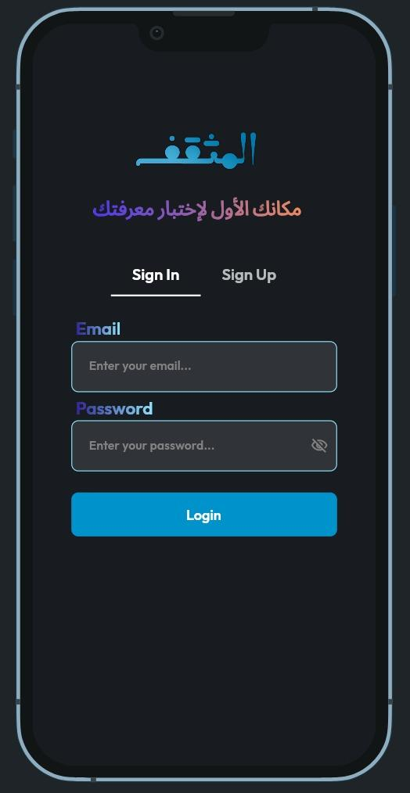
</ Authentication Page
All of the accounts on the app are kept
in a database. For instance, if you repeatedly enter the wrong password, the account will be temporarily locked.

Slide 14
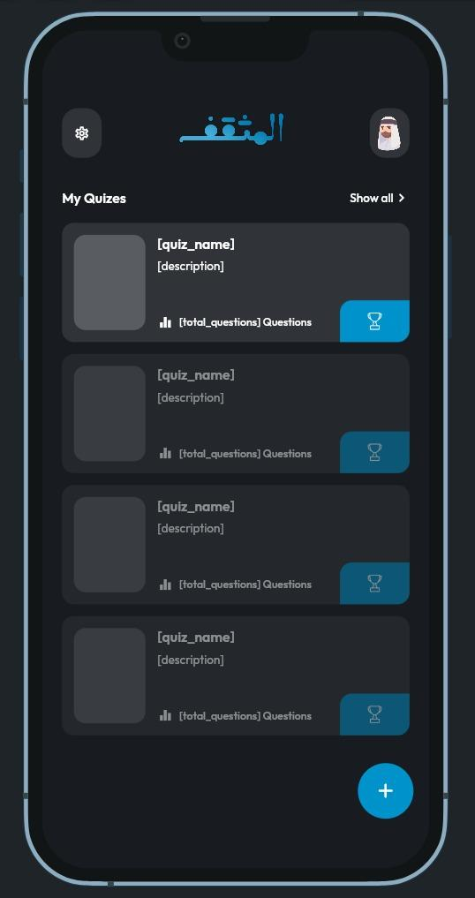
</ Home Page
The quizzes are displayed on the main page, along with buttons for settings and profiles. Each quiz includes the name, description, and amount of questions in addition to an image.

Slide 15
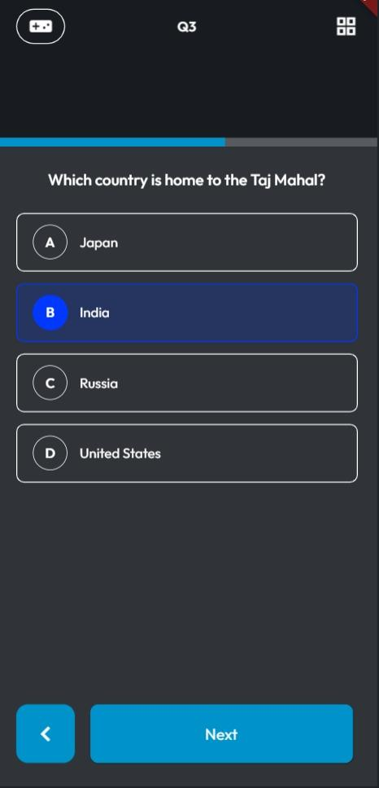
</ Quiz Page
Each question on the quiz page has four possible answers, and there is a progress meter showing how many questions are left.

Slide 16
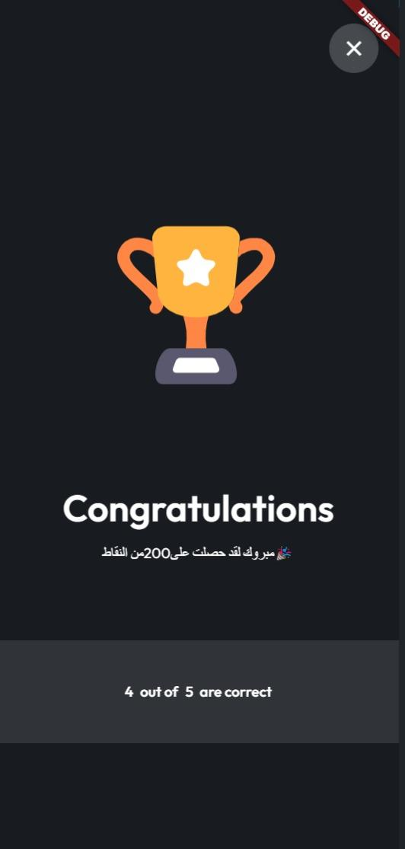
</ Score Page
Once the quiz is over, a score page will show you how many points you earned. Each point you get will go toward your overall score on your profile page.

Slide 17
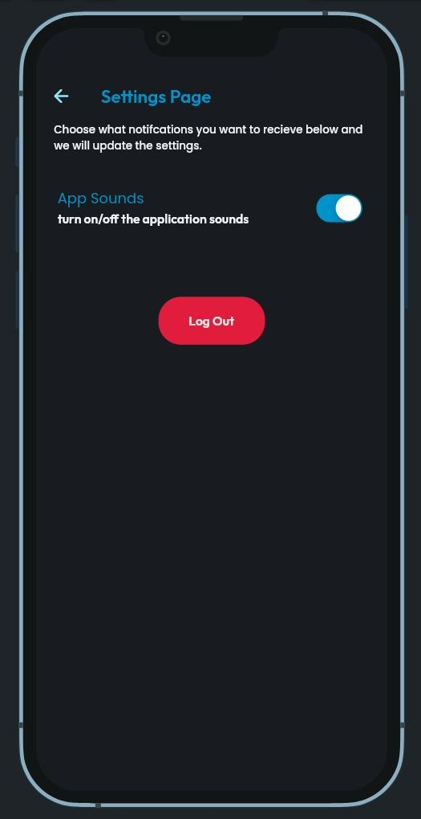
</ Settings Page
You may toggle the audio on or off and log out of your account on the settings page.

Slide 18
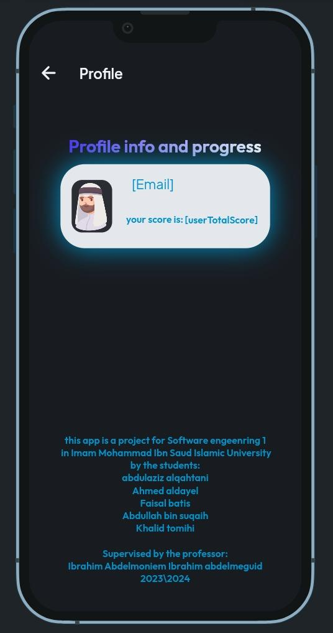
</ Profile Page
Your name will appear on the profile page along with the points you have earned, and the developers' credits are displayed underneath.

Slide 19
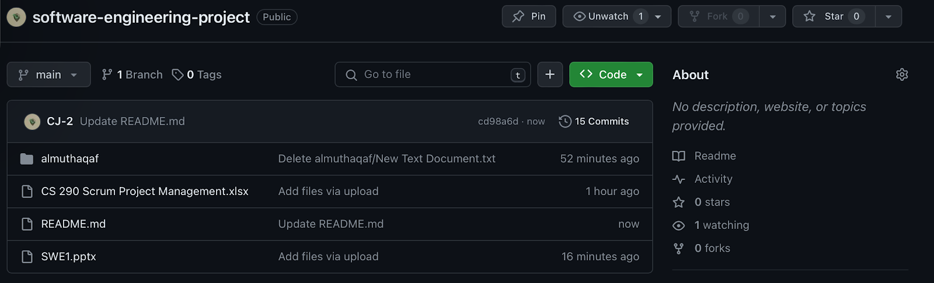
</ repository of project
Link: https://github.com/CJ-2/software-engineering-project/tree/main

Slide 20
Thanks 🙏
any questions ?
</
} /> [
/>

