Slide 1

Getting set up on the UoN HPC “Ada”
LIFE4138
Notes:
Ada Lovelace – considered the world’s first computer programmer!

Slide 2
Learning Objectives
Understand what the HPC is
Understand what resources are available to you on the HPC
Understand what a terminal and shell are
Understand what the ssh command does and how to use it
Successfully use ssh to login to your Ada account
Understand what an ssh config file is
Create and use an ssh config file to login to Ada
Know where to go for further support with the HPC

Slide 3

What is a HPC?
HPC = high performance computer (sometimes called cluster, server, super-computer)
Connect to it remotely from your terminal
Login nodes = less powerful than your phone! (used only for logging in, submitting jobs and very quick tasks e.g. viewing output files)
Compute nodes = EXTREME POWER!

Slide 4

Resources on Ada
Login nodes =
hpclogin01
hpclogin02
Compute nodes =
63 standard nodes, each with 96 cores & 361 GB RAM
10 high-memory nodes, each with 96 cores & 1495 GB RAM
4 GPGPU nodes, each with 96 cores, 747 GB RAM & 8 Nvidia A100 GPUs, with 80GB GPU memory each.
Notes:
GPGPU - General-Purpose computing on Graphics Processing Units

Slide 5

Exploration tier (your accounts semesters 1 & 2)
This tier gives you a ‘sandpit’ where you can develop your HPC skills.
The Exploration tier gives the exploration user:
simultaneous use of up to 96 CPU cores
360 GB memory (RAM)
Job lengths of up to 2 days.
1TB of storage (disk space) by default.
Exploration tier users that need extra resource will be advised to apply for the ‘production’ tier.

Slide 6

Production tier (your accounts semester 3)
The Production tier is for university research projects, where you and your project team have existing HPC user experience.
Production tier gives the production user:
Simultaneous use of up to 600 CPU cores
3000 GB memory (RAM).
Job lengths of up to 7 days
1TB of storage (disk space) by default.
Production users can also apply for larger limits on CPU cores, memory (RAM), and storage, and all requests will be considered.

Slide 7


Slide 8
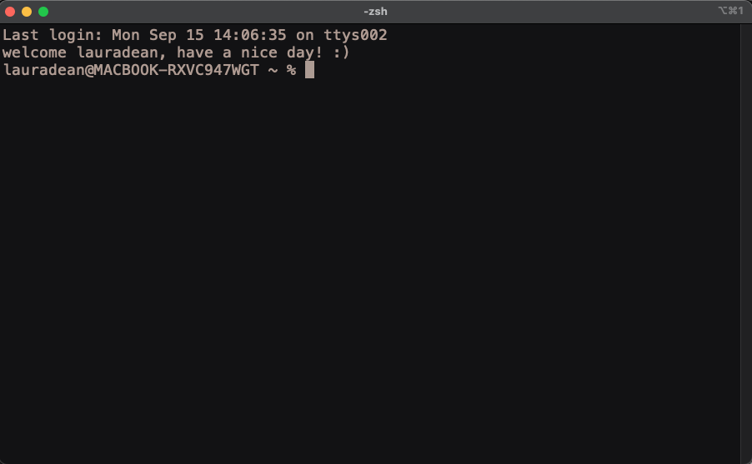
The terminal
A terminal is a command line interface or CLI
It allows you to have text & command-based interaction with your computer
It’s essentially a box where you can type things
Similar to a graphical user interface (GUI), which is menu-driven and what you are probably used to.
A CLI sends your typed commands to a shell
The shell interprets and executes the commands
This is basically all happening in the background when you run a GUI on your computer anyway, you just don’t see it!

Slide 9
The terminal
HINT – your command prompt is customizable, but we will come back to that!
A part that tells you who you are and what computer you are communicating with
The command prompt. NOTE this tells you your terminal is ready to receive a new typed command from you. If you don’t see it – your computer is still executing something else.

Slide 10
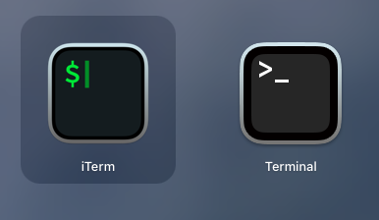
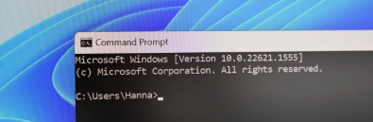

The terminal
Mac users you have a built-in terminal (called Terminal!)
Or there are other popular terminal emulators you can install e.g. iterm2
Windows users you also have a terminal (called command prompt)
Or you can install others such as Ubuntu (which is what windows users will download)

Slide 11

The shell
The shell is the interpreter that executes commands you type into your terminal
There are many different types of shell
Mac default is the Z-shell (ZSH)
Windows default is PowerShell
Linux default is the Bourne – again shell (BASH), based on the shell (SH)
ZSH, SH and BASH are very similar. Windows PowerShell is VERY different!
We will predominantly be learning code for the BASH shell in this course because this is how you will interact with all Linux – based HPCs

Slide 12
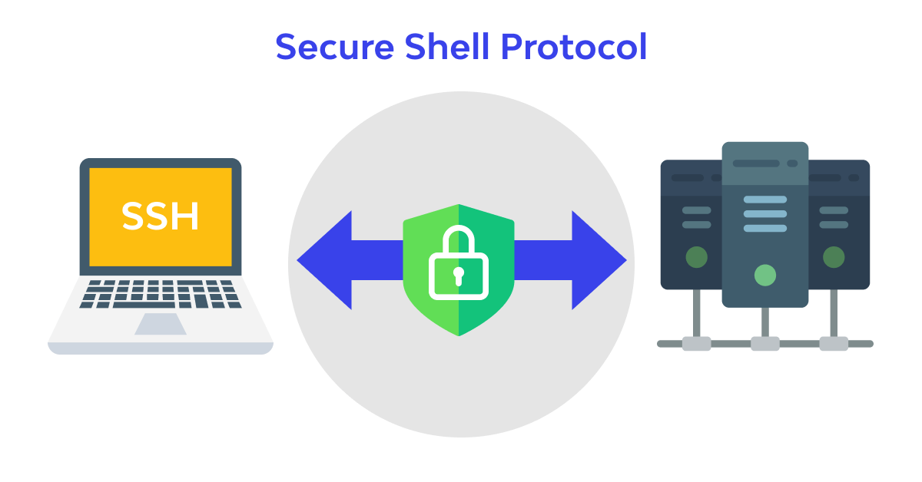
SSH – secure shell – used to connect to a remote machine
When you type commands into a terminal on your laptop
YOU ARE INTERACTING WITH YOUR OWN MACHINE
To connect to a remote machine we use the ssh command.
Once you have successfully executed the ssh command you will be logged into a remote machine (via the internet).
Everything you type will then being executed on the remote machine NOT your own laptop.
This will remain the case until you log out by typing exit, or by closing the terminal window (or if your connection to the remote machine drops because of poor internet etc).

Slide 13
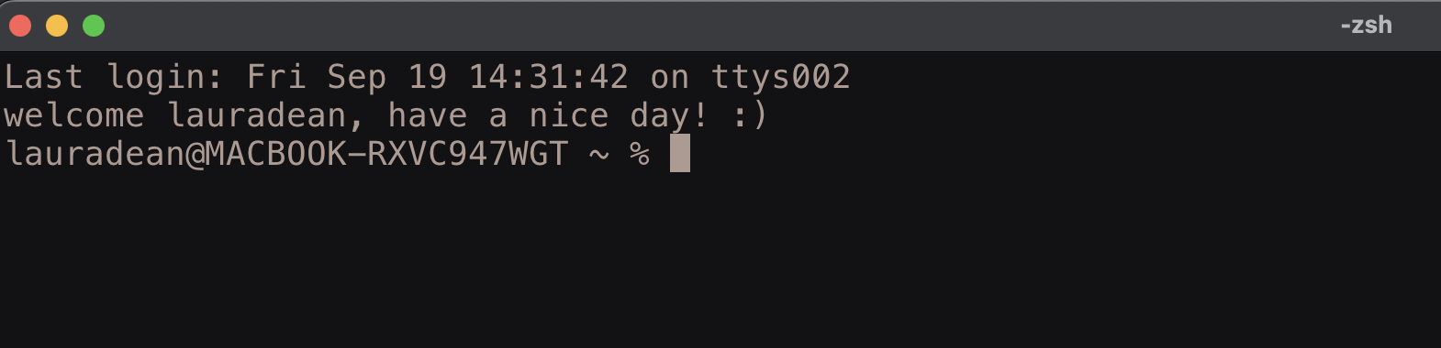
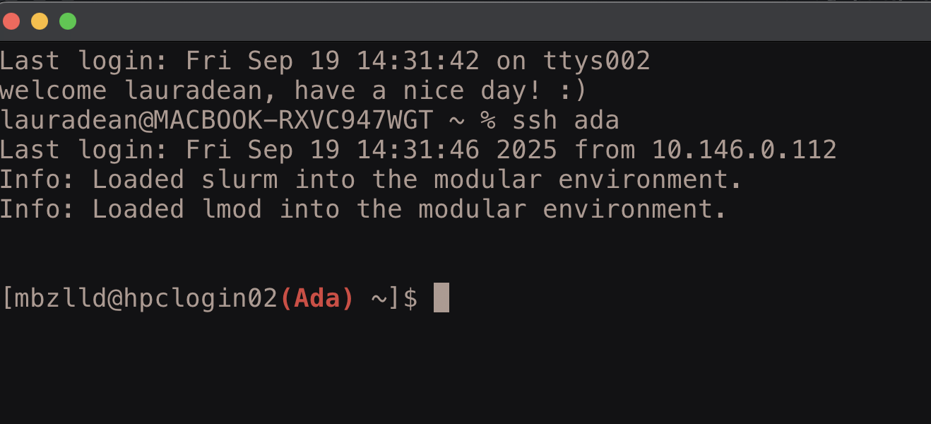
SSH – always look at your command prompt
When I first open a terminal, I am interacting with my own laptop
After connecting to ada using ssh, I am interacting with Ada, not my own laptop

Slide 14
SSH command structure
ssh – secure shell basic command:
ssh username@hpclogin02.ada.nottingham.ac.uk
command
Name of user on the remote machine
Symbol to separate username from host address
Host address of remote machine. This can be an IP address or a domain name as above.
one space
On Ada this is your university username e.g. mine is mbzlld
You can use either hpclogin01 or hpclogin02 here (these are the two login nodes on Ada).

Slide 15

EXERCISE: Connect to the UoN HPC – Ada
**Always connect to the VPN before trying to login to Ada (even on campus)**
Then open a terminal (terminal or iterm2 for Mac users, Ubuntu for Windows users)
Type this command into your terminal (replacing ‘username’ with your university username)
You should be prompted to enter your password (type your university password and hit return) – NOTE: you will not see any characters when you type your password. This is a safety feature but rest assured you are typing. If you get it wrong you will get multiple attempts.
The first time you login you will get a message about whether you trust this machine and want to add it to known hosts. Type y or yes to add to known hosts.
You should be connected. Check you see the word Ada at your command prompt:
Then logout use the command: exit
ssh username@hpclogin02.ada.nottingham.ac.uk

Slide 16

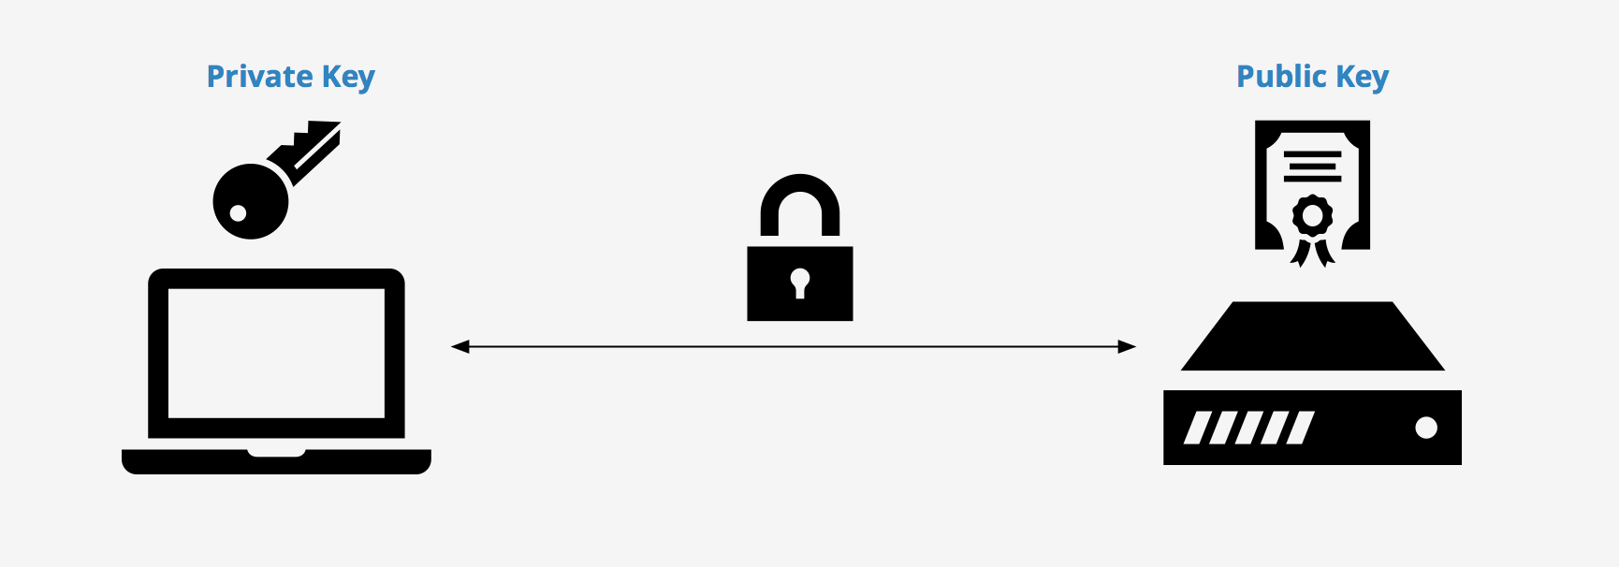
ssh keys
Ssh keys allow you to login to a remote machine without having to type your password
Your private key is only ever stored on your own laptop
You can copy your public key to any host you want to connect to
They are more secure than a password because they are never sent over the network

Slide 17
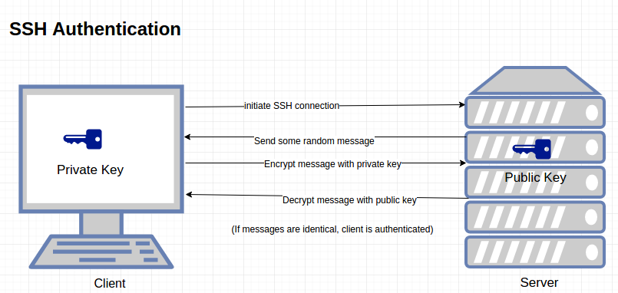
ssh keys – how they work

Slide 18
EXERCISE: set-up Password-less login with ssh keys
ssh keys link your device to the HPC and remove the need for a password when logging in
Open a new Ubuntu (windows) or terminal (mac)
Generate an ssh key pair using the following command (when it suggests a default name / location for the keys, press enter to accept this, press enter each time it asks for client secret to leave the password for the keys blank):
ssh-keygen
This will create a private and public key pair ON YOUR OWN LAPTOP, usually called id_rsa and id_rsa.pub in the directory ~/.ssh
Copy the public key to Ada using the following command (NOTE – replace username with your UoN username. You will be prompted to enter your password for Ada to copy the key. Enter your password and hit the return key):
ssh-copy-id username@hpclogin01.ada.nottingham.ac.uk
Now try logging in to Ada again and you should be able to get in without typing your password (again make sure you replace the word username with your own username):
ssh username@hpclogin01.ada.nottingham.ac.uk

Slide 19
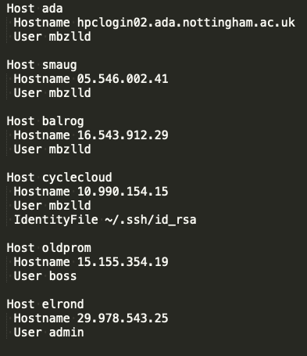

ssh config file
Example:
An ssh config file specifies information about the different hosts you connect to
The config file is located here: ~/.ssh/config
It allows you to login without having to remember the domain name or ip address of each machine you want to ssh into.
Makes life much easier if you regularly use multiple HPCs

Slide 20
Setting up a config file
We will create a config file together… use nano or vim or whatever text editor you prefer! E.g. type nano ~/.ssh/config OR vim ~/.ssh/config into your terminal to create the file, type the text from the example below then save.
Example config file: (note the spaces, indentation and capitalization, it all matters! And you need to replace the word ‘username’ with your own university username)
Host ada
Hostname hpclogin02.ada.nottingham.ac.uk
User username
After you have created your config file try logging in using the command: ssh ada

Slide 21
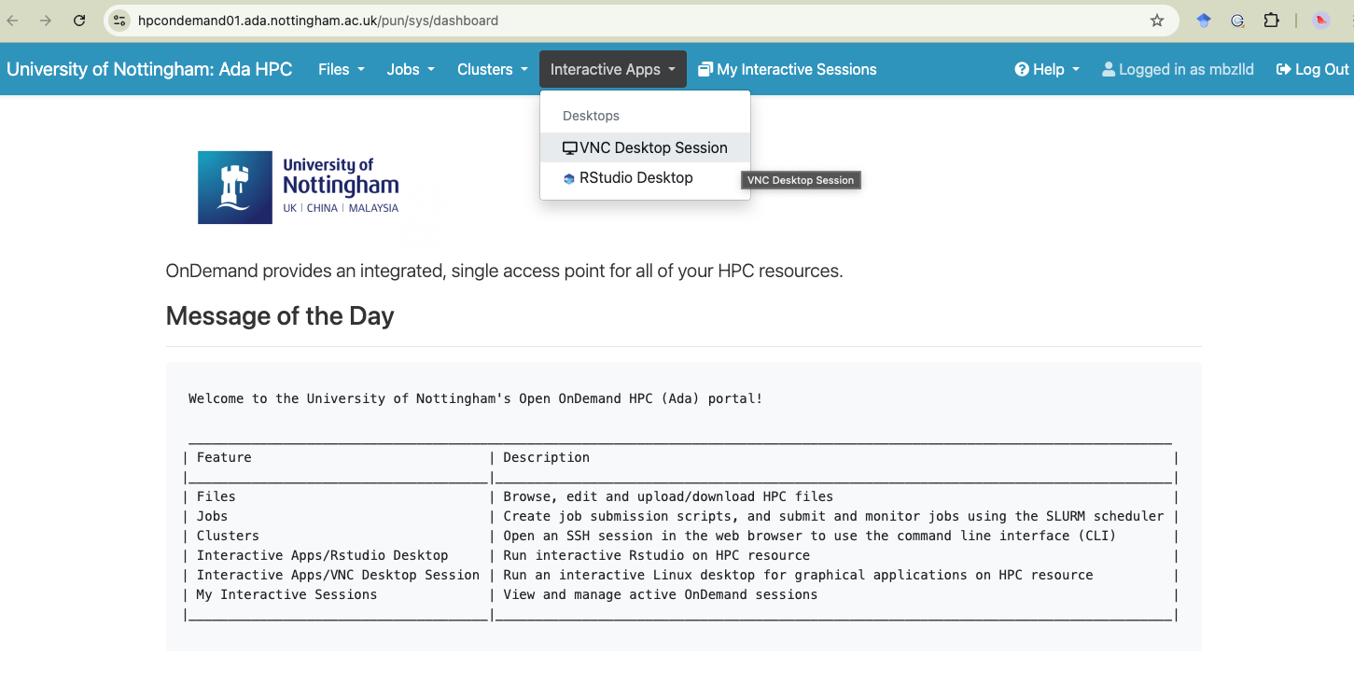
OpenOnDemand
https://hpcondemand01.ada.nottingham.ac.uk

Slide 22

UoN HPC – Ada – support & information
The sharepoint site:
Commands, partitions and resources:
https://uniofnottm.sharepoint.com/sites/DigitalResearch/SitePages/Ada-Commands-Partitions-and-Resources.aspx
Software modules:
https://uniofnottm.sharepoint.com/sites/DigitalResearch/SitePages/Ada-Compute-software.aspx
The IT helpdesk: (if you need something that requires admin rights, this is your only option!)
https://www.nottingham.ac.uk/dts/help/self-service-portal/self-service-portal.aspx
Me! : laura.dean@nottingham.ac.uk or teams chat

