Slide 1
Transcriptomic analysis of extracellular vesicle miRNA cargo derived from allergen-exposed airway epithelial cells using open-access software
Student ID: 50805916
Name: Christopher Janschke

Slide 2
Project Overview
Aims | Investigate miRNA expression in allergen-exposed airway epithelial cells
Methods | Method Development → Differential Expression → Pathway Analysis
Findings | Biologically plausible results are obtainable provided suitable experimental design
Significance | Informs experimental design for future experiments
Dataset 1
Dataset 2
Notes:
Aim:
Create an open-access transcriptomic workflow.
Exposing human airway epithelial cells to a range of allergens to determine if the miRNA cargo of extracellular vesicles is altered and if so, what pathways might be affected
Methods:
Two datasets containing treated vs untreated samples were provided.
The workflow consisted of performing differential expression analysis and then pathway analysis on the DE miRNAs.
Most of the analysis had been performed before by external companies and using commercial software, but those methods and findings were not initially shared with me.
The first dataset was used to establish the effectiveness of the workflow as this dataset had both differential expression and pathway analysis results.
The workflow was then applied to the second dataset for which only differential expression analysis had been performed.
Findings:
Using the method development dataset, the workflow was able to detect DE miRNAs that may be associated with airway inflammation and immune responses
The second dataset was unsuitable for meaningful transcriptomics analysis due to the low quantity of miRNA sent for transcriptomics analysis
Significance:
The workflow may be suitable when applied to datasets with appropriate experimental data
The workflow identified experimental limitations and provided recommendations to improve future studies.
[need to state the aim is to use open-access software]
[need to state the findings is that the workflow produced biologically plausible results on datasets where experimental design was appropriate but not when the design was inappropriate]
[need to state the significance is also that it could save money on outsourcing transcriptomics]

Slide 3
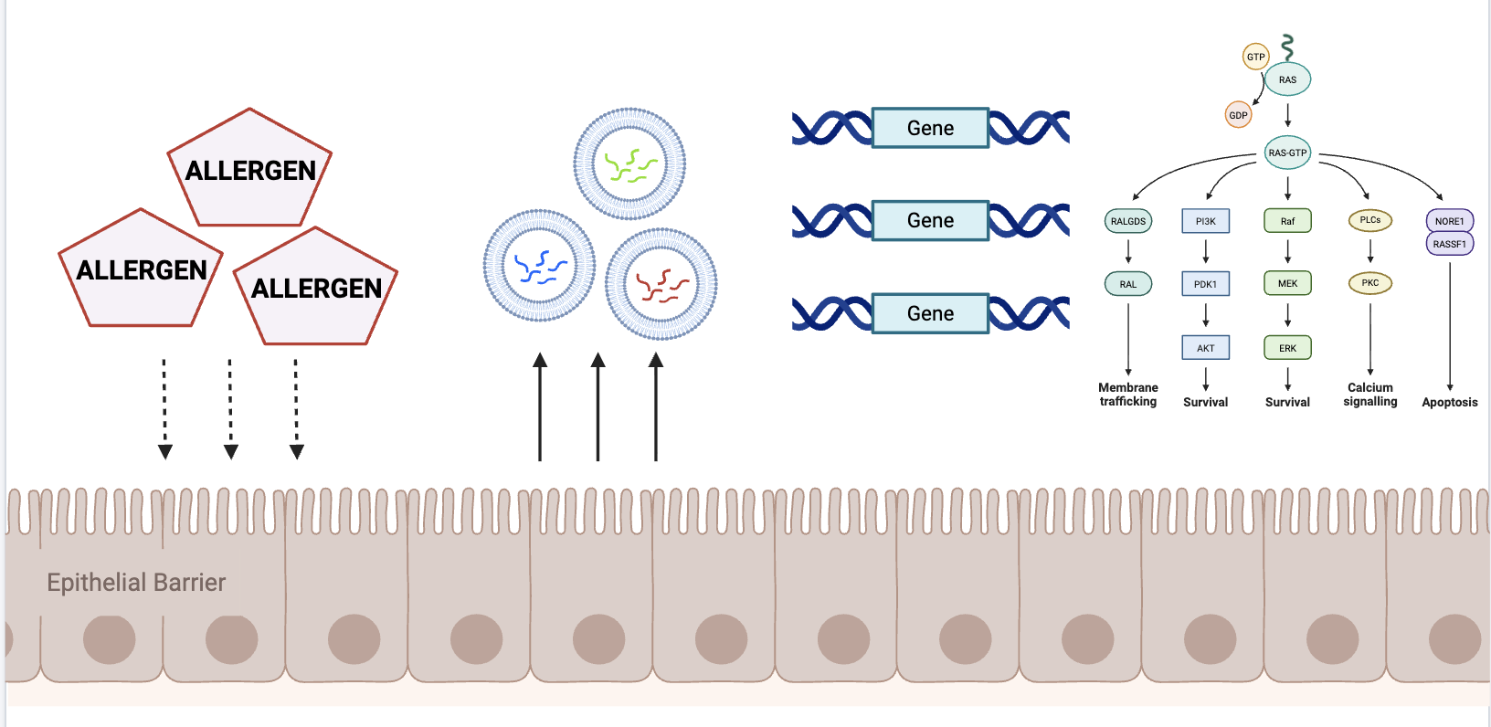
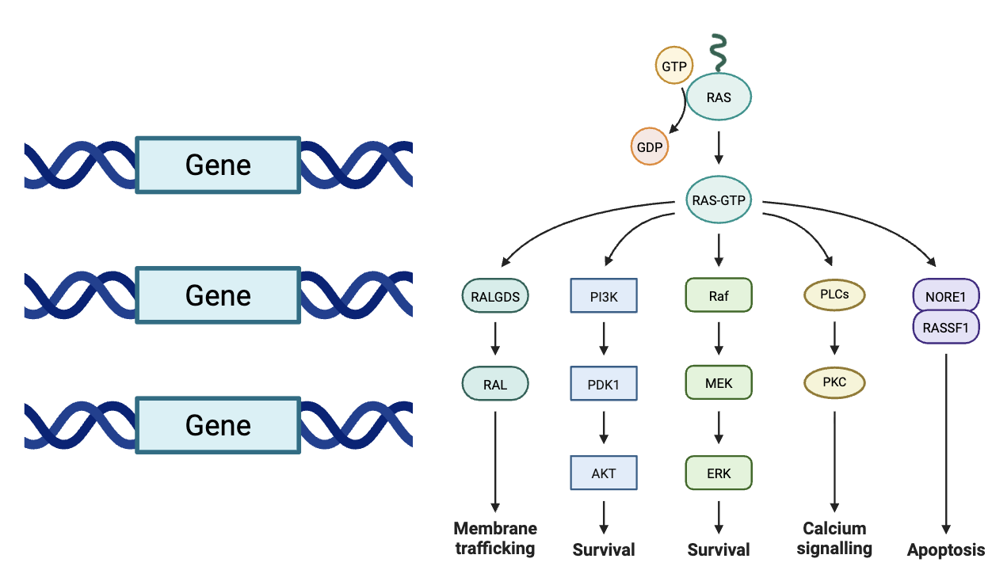


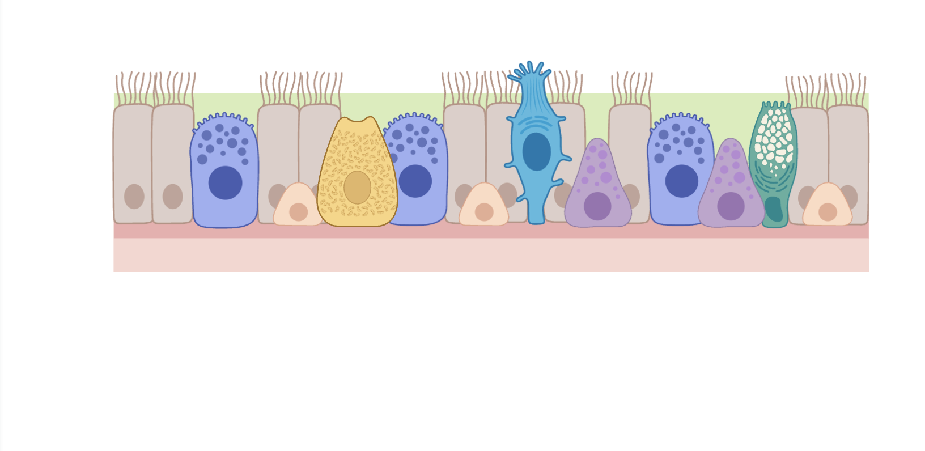
Background
3
Gene suppression
4
Pathway disruption
1
Allergen exposure
2
EV cargo
3
Gene suppression
4
Pathway disruption
miRNA
EV
Airway
Epithelial Barrier
Figure created in BioRender: https://BioRender.com
Notes:
Intro:
- For the background of the project, allergic diseases constitute a significant health burden worldwide and one main way these arise is through environmental exposure to allergens.
Allergen exposure:
- The first contact with inhaled allergens is through the airway epithelial barrier which consists of a range of cells that communicate with immune cells.
- It is known that allergen exposure can disrupt barrier integrity which can lead to respiratory diseases.
EV cargo:
Epithelial cells can communicate with immune cells through extracellular vesicle signalling.
Extracellular vesicles are small lipid-enclosed particles that transfer their cargo to recipient cells.
The cargo can include various types of RNA, including miRNAs.
The specific miRNAs present in the extracellular vesicles are known as the miRNA signature and this can change in response to allergen exposure.
Gene suppression:
miRNAs interact with genes to post-transcriptionally suppress their expression.
If the miRNA signature changes then it is likely that the genes they suppress will also change.
Pathway disruption:
The change in gene expression can then affect specific pathways.

Slide 4
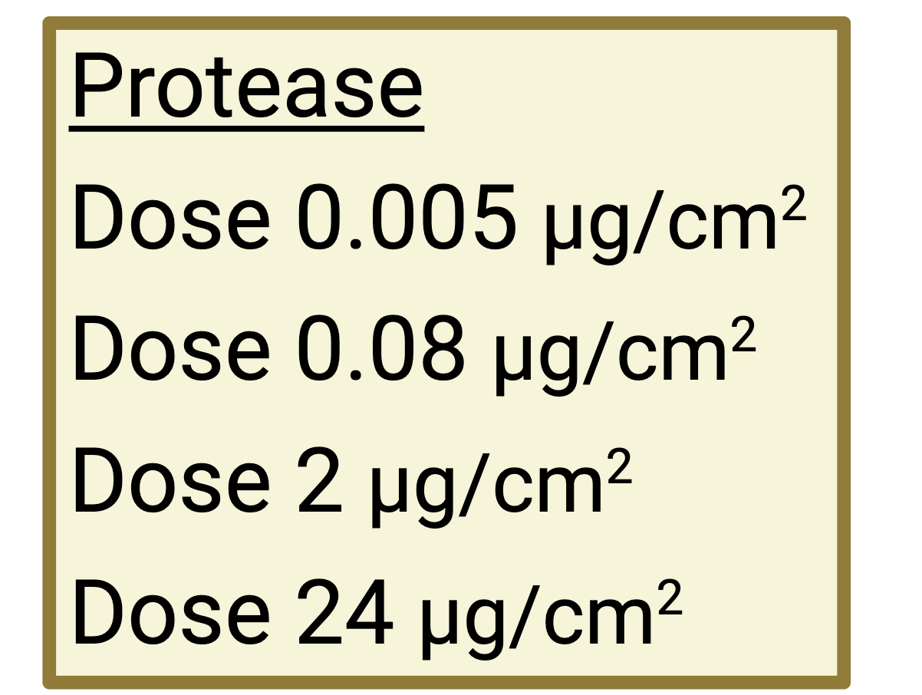
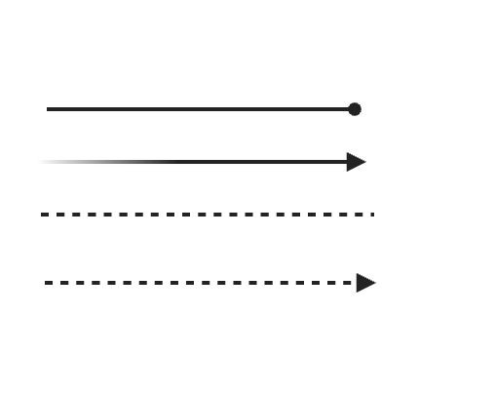
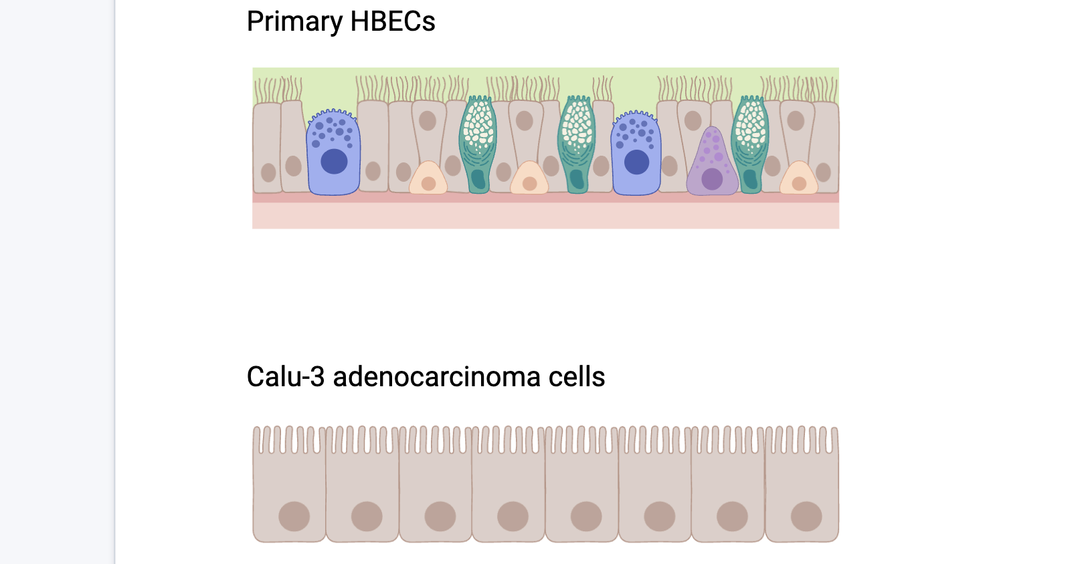
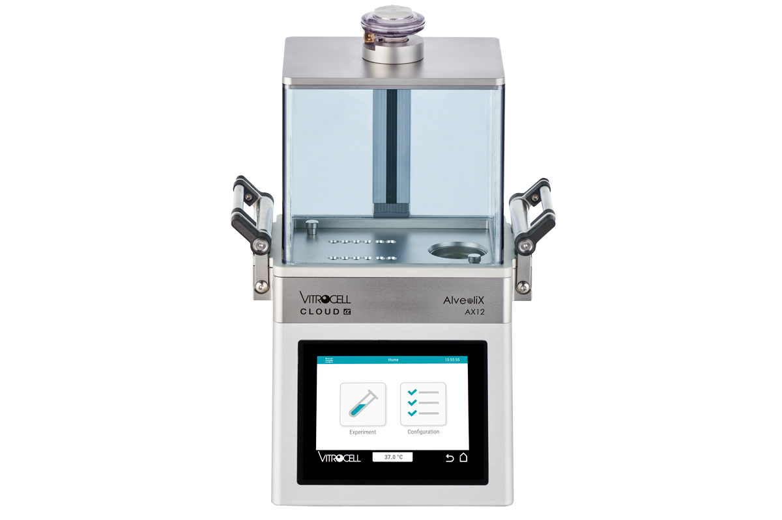
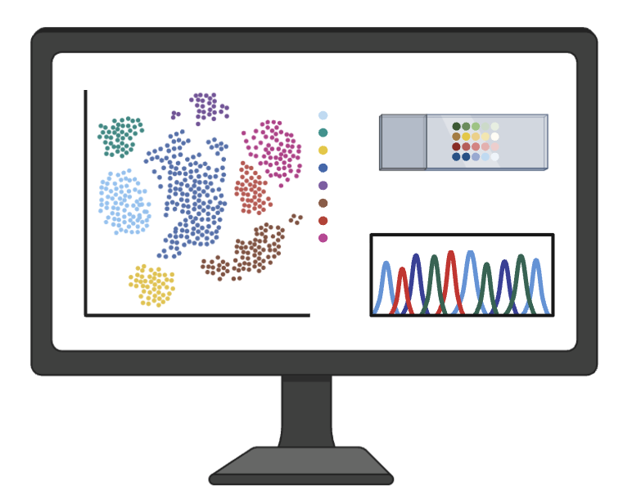
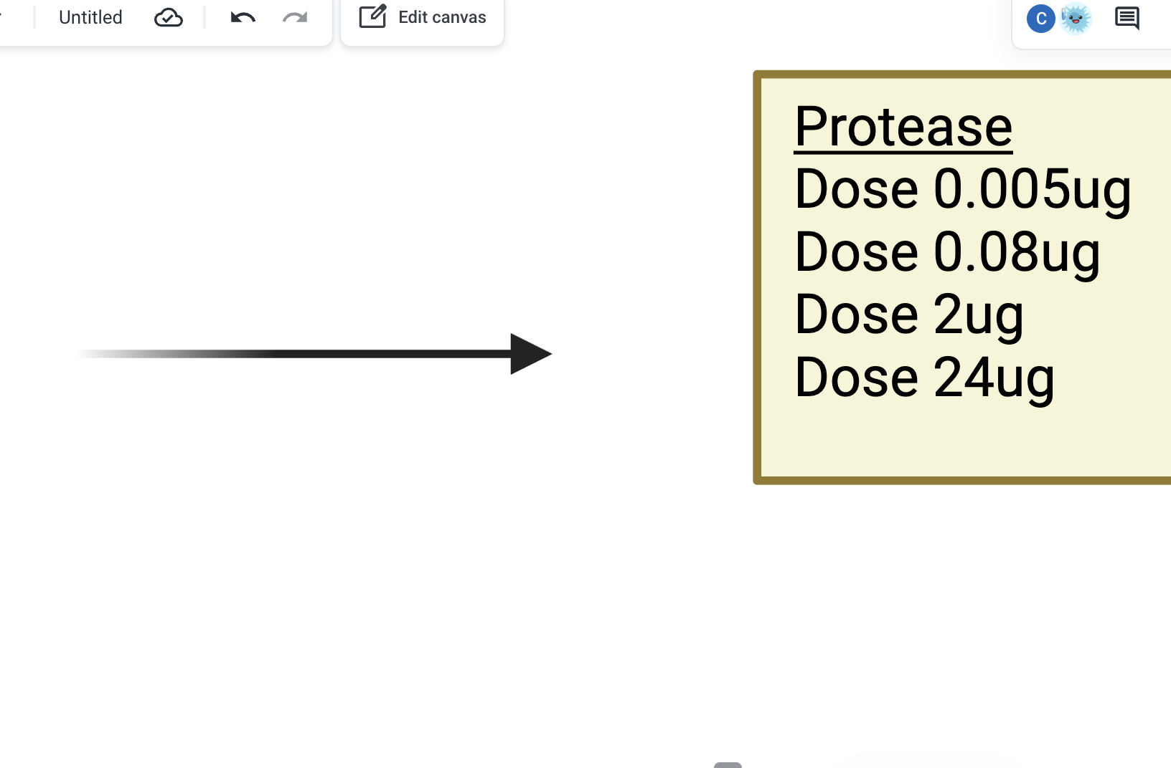
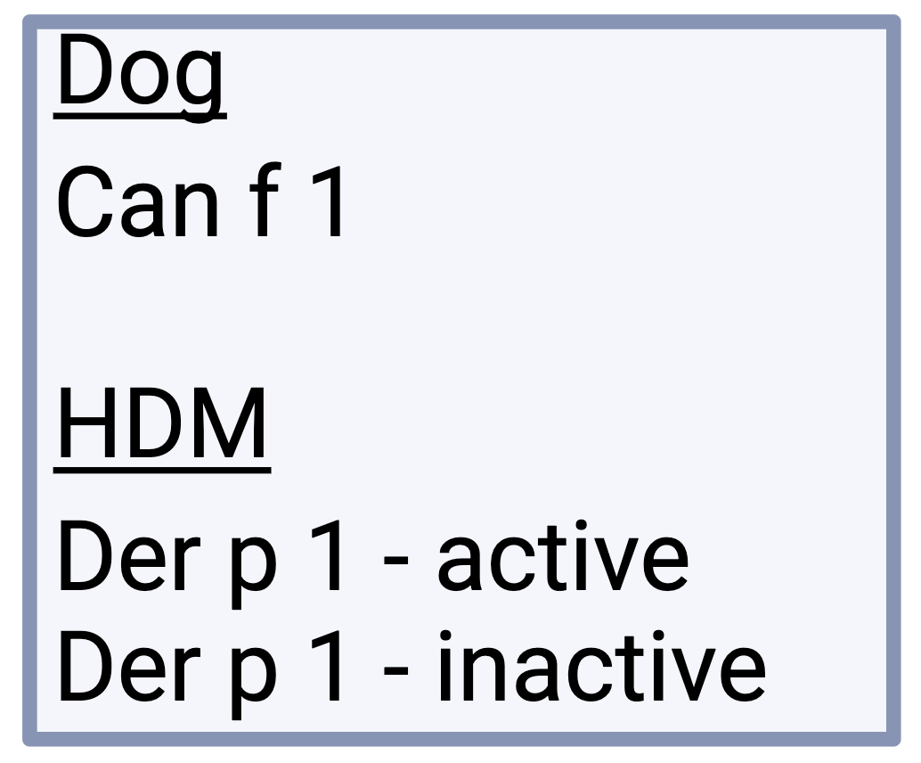
Study Data
Primary HBEC
Transcriptomics
Triplicate
Hopkins et al., 2026
Calu-3 adenocarcinoma
Triplicate
Browne et al., 2026
Figure created in BioRender: https://BioRender.com
Notes:
Intro:
- Now I’m going to discuss the data used in the study. As previously mentioned, the data originated from two independent studies which each used a different airway epithelial cell type.
Primary HBECs:
The first study, which was dataset 1 in the summary, used primary human bronchial epithelial cells (HBECs) and exposed them protease allergen at varying concentrations.
Calu-3:
The second study, which was dataset 2 in the summary, used Calu-3, a human lung adenocarcinoma cell line, was exposed to active and inactive forms of house dust mite allergens and a dog allergen.
Experiment:
All exposure conditions were performed using 3 independent biological replicates with the control samples receiving PBS.
And all allergens were nebulised to enable delivery in aerosol form.
Transcriptomics:
The primary HBEC study performed all the transcriptomic workflow analysis steps, including pathway enrichment analysis.
Only differential expression analysis had been performed on the Calu-3 dataset, not pathway analysis.
Differential expression analysis was outsourced to an external company, and pathway analysis was performed using a commercial platform – both methods are costly.
[all allergens are nebulised with PBS as untreated control]
[each condition contained 3 biological replicates]

Slide 5
Study Aims
1
  Create a transcriptomics workflow using the primary HBEC dataset
2
  Use exclusively open-access software
3
  Apply the workflow to the Calu-3 dataset
Notes:
Aim 1:
Create a transcriptomics workflow to take in raw RNA sequencing data and perform differential expression analysis and pathway enrichment analysis.
Using the primary HBEC dataset for method development as this dataset does not contain any novel analyses.
Aiming to identify pathways associated with inflammatory and immune signalling as well as integrity of the airway epithelial barrier.
Aim 2:
- The workflow is going to consist of entirely open-access software to establish whether the laboratory could use the workflow for future iterations of this work and avoid expensive outsourcing and software.
Aim 3:
- The Calu-3 dataset will then be analysed using the workflow to determine what pathways were affected by exposure to house dust mite and dog allergens.
[creating the workflow using primary HBEC requires observing biologically plausible results]

Slide 6
Transcriptomics Workflow
Method Development
Target gene-level
miRNA-level
Cell type: Primary HBEC
Trimming
Quality
Control
miRNA Mapping
Differential Expression
Pathway Analysis
Literature Search
Cell type: Calu-3
Notes:
Intro:
- Now to look at the transcriptomic workflow in more detail, this slide shows the main steps of the analysis pipeline.
Trimming:
- Firstly, trimming was performed on the raw RNA sequencing data to retain only high-quality data where there was less than a 1 in 1000 chance the data contains an erroneous nucleotide and trims the data down to the estimated size of a miRNA molecule which is between 18-30 nucleotides.
Quality control:
The second stage was quality control which was used to confirm the effectiveness of trimming, along with useful information about the sequencing data and to observe the RNA composition of the samples to estimate how much miRNA each sample actually contained.
miRNA mapping:
The next step was to map the trimmed reads to known human miRNA sequences to determine what different types of miRNAs are being expressed in the extracellular vesicles and in what quantity.
Differential expression:
- Now you have the quantification data, you can perform differential expression analysis to determine whether the miRNAs expressed by cells exposed to allergens were statistically different to those expressed in untreated cells.
Pathway enrichment:
Then you can perform pathway analysis on the differentially expressed miRNAs to hypothesise which pathways they are associated with.
However, there are many ways of performing pathway analysis and it can be complex.
Method development:
Therefore, the primary HBEC dataset was used to test two prominent methods.
The first method identifies miRNA target genes then observes which pathways these genes are involved in.
The second method looks directly at the miRNAs to establish which pathways the miRNAs have been indicated in.
Literature search:
For reasons I will discuss later, both of these methods were deemed inappropriate for use on the Calu-3 dataset.
Therefore, a targeted literature search was performed using the NCBI database with relevant keywords used as the search term to identify whether the DE miRNAs had been previously indicated airway biology.
Segway:
- I am now going to discuss the results generated from the workflow.
[finish by signposting I'm going to go through the results]
[due to limitations in the calu-3 dataset which will be discussed later, biological function of DE miRNAs was investigated using published literature]

Slide 7
Results (1)
Summary
Low miRNA abundance in Calu-3 samples
miRNA
Primary HBEC
miRNA
Calu-3
Figure derived from thesis Figure 3
Notes:
Intro:
Now I’m going to discuss the results obtained from the study.
These charts show the results of the RNA composition analysis
Where each entry on the y-axis represents an individual sample, and the name is the allergen exposure condition, and the replicate number is shown in brackets.
The chart itself shows the proportion of each sequencing library that was assigned to either micro-RNA, ribosomal RNA or transfer RNA. The software could not detect other RNA species.
miRNA:
miRNA is shown in blue and accounts for only a small proportion of the sequencing libraries in both cell types.
However, the levels of miRNA was markedly lower in Calu-3 cells where only 2,500 reads were assigned to miRNA compared to 44,000 in the primary HBEC dataset.
This was the first indication that the Calu-3 dataset may be underpowered for differential expression analysis.
Dose 24:
Another interesting finding was that the levels of ribosomal RNA and transfer RNA were discernibly greater in the dose 24 primary HBEC samples.
This suggests that other forms of RNA may be affected by protease allergen exposure, and this may be most notable in the ribosomal RNA, however further research is required to confirm this.
Summary:
Very low levels of miRNA were detected in the Calu-3 samples.
And primary HBECs exposed to 24 micrograms of protease allergens showed distinct ribosomal RNA and transfer RNA profiles.
[can talk about the large quantity of miRNA in dose 0.005 (3) if there’s spare time that needs filling]

Slide 8
Results (2)
Summary
Greatest differential expression in dose 24 µg/cm² samples
Minimal differential expression in Calu-3 samples
Primary HBEC
Calu-3
FDR < 0.05
FDR < 0.2
Figure derived from thesis Figure 4
Notes:
Intro:
These next set of results are from the differential expression analysis.
The chart shows the number of differentially expressed miRNAs detected in cells exposed to allergens compared to untreated cells.
Where the number of DE miRNAs are shown on the y-axis and exposure condition is on the x-axis.
miRNAs were considered significantly differentially expressed if they had a false-discovery rate of < 0.05.
Primary HBECs:
Minimal differential expression was detected in primary HBECs at lower protease doses meaning that the allergen had not caused much significant change in the miRNA content of EVs.
However, at dose 24, there were 27 DE miRNAs at an almost even split of upregulated and downregulated.
Calu-3:
In contrast, very little differential expression was observed across any condition in the Calu-3 dataset.
Two DE miRNAs were detected following exposure to dog allergens, which was the Can f 1 group.
In an attempt to observe more differential expression, an exploratory significance threshold of FDR < 0.2 was applied.
However, this only detected one more differentially expressed miRNA which was in the inactive house dust mite group.
To observe next to no DE miRNAs at this higher FDR threshold suggests either there was biologically no change between treated and untreated or that the analysis was statistically restricted due to the available data.
- Summary
[essentially 50% split of upregulated and downregulated mirnas in dose 24]
[even at exploratory FDR threshold, barely any more mirnas were identified as differentially expressed]

Slide 9
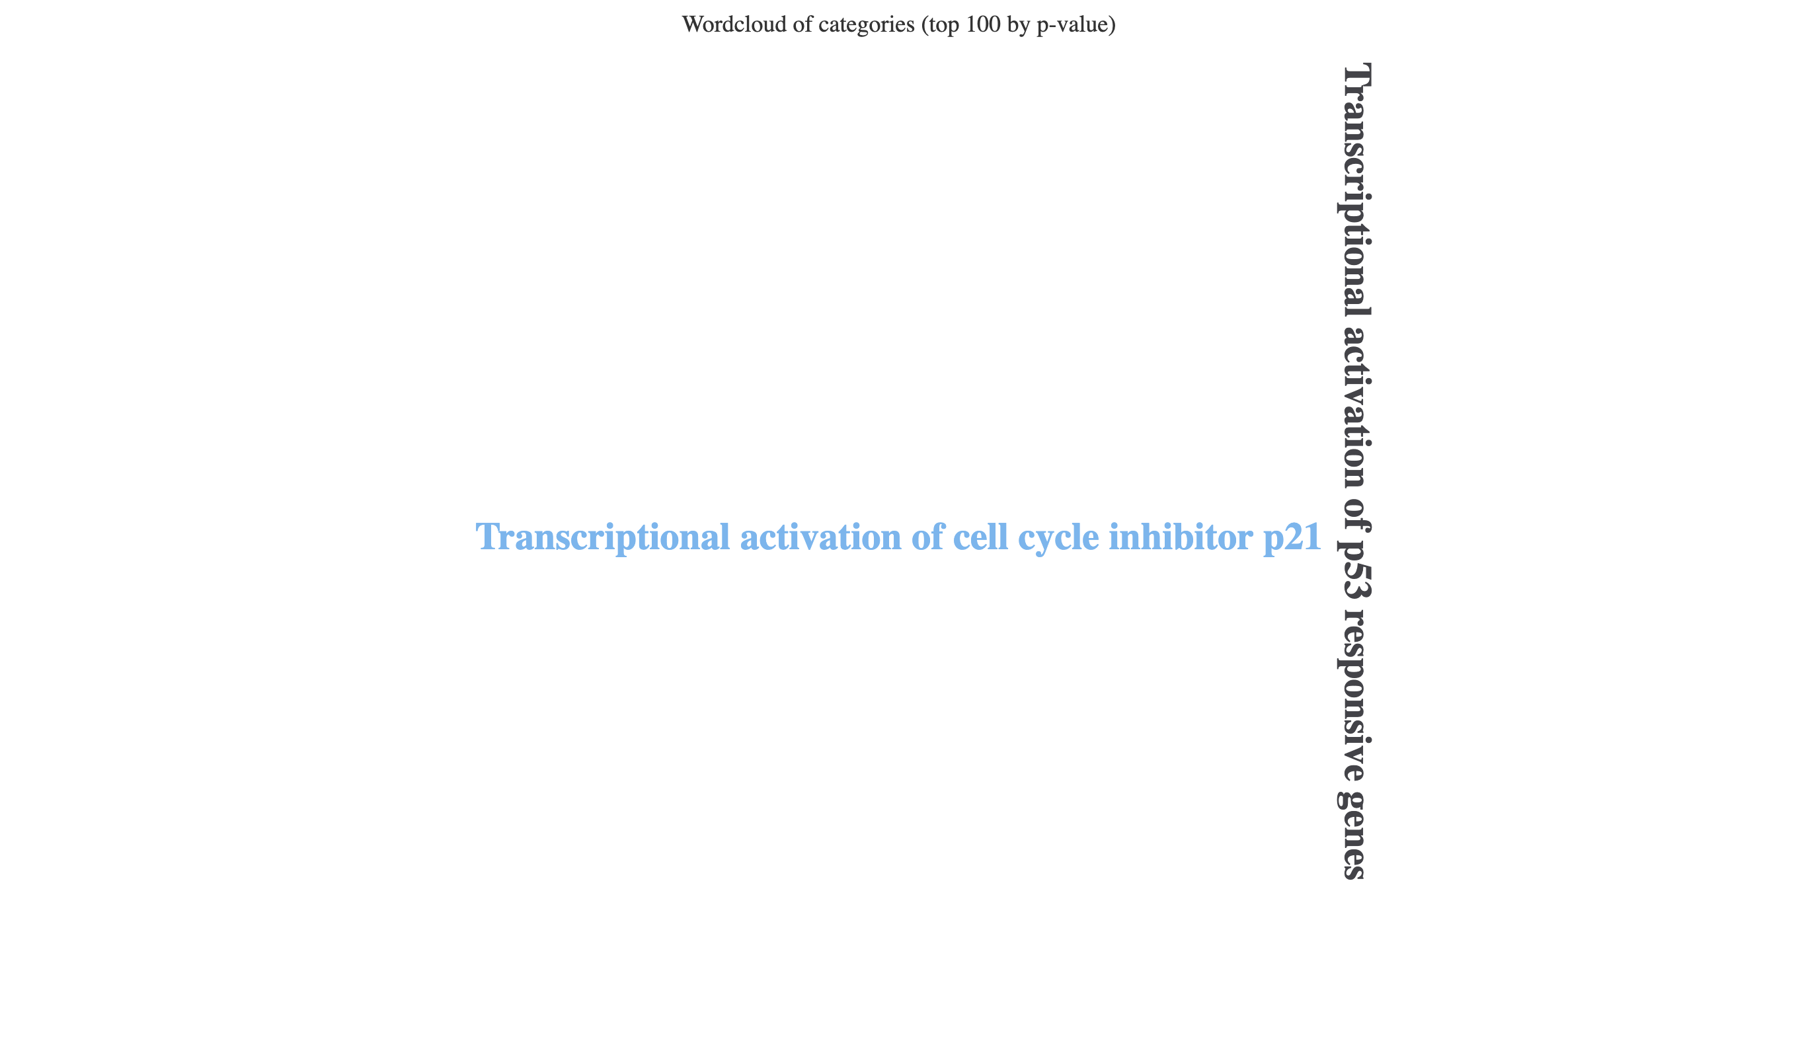
Results (3)
Padj. < 0.02
Padj. < 0.05
Target gene-level enrichment (ORA)
miRNA-level enrichment (ORA/miRNA-SEA)
Upregulated
N = 164
Downregulated
N = 464
Upregulated
N = 2
Figure generated by miEAA 2.0: https://ccb-compute2.cs.uni-saarland.de/mieaa2/
Summary
More pathways from target gene-level enrichment
Biologically relevant pathways
Figure derived from thesis Figure 6
Notes:
Intro:
The next stage of the study was to use the primary HBEC dataset to develop the optimal method for pathway enrichment analysis.
Introduction (target gene):
The first method tested was target gene-level enrichment which used over-representation analysis.
This first established experimentally validated gene targets for each significantly differentially expressed miRNA. The list of genes was then passed through the Reactome database to identify pathways that contained those genes.
Pathways were considered enriched if a greater number of genes were found to be involved in that pathway compared to a random gene set of the same size.
Target gene pathways were considered significant at adjusted P value < 0.02.
Target gene-level Results:
Greater number of pathways detected for the downregulated miRNAs compared to upregulated.
Although broadly similar immune and inflammatory pathways existed in both the up- and downregulated sets, with interleukin signalling and toll-like receptor signalling.
Epithelial barrier regulation pathways was common between the up- and downregulated set although the specific pathways were different, with upregulated miRNAs associated with WNT and NOTCH pathways and the downregulated with RHO GTPase activity.
Introduction (miRNA-level):
Target gene pathways were considered significant at adjusted P value < 0.05.
Two techniques were tested at this level.
The first was over-representation analysis which works in the same fashion as for target-gene level enrichment.
The second was miRNA-set expression analysis. Instead of using only the differentially expressed miRNAs, it uses all the miRNAs detected in the experiment and I ranked them according to expression level.
This technique is good to detect smaller changes from miRNAs that don’t meet the significance threshold but exert a cooperative effect.
miRNA-level Results:
Only two significant pathways were detected at the miRNA level across both over-representation analysis and miRNA-set enrichment analysis.
The two significant pathways were detected in the upregulated gene set but did not particularly correspond to airway inflammation.
- Summary
[emphasise this was performed on primary HBEC samples exposed to dose 24 protease]
[discuss the number of sig pathways from target-gene level versus miRNA-level]
[0 significant pathways in downregulated miRNA ORA and both up- and down-regulated miRNA-SEA

Slide 10
Results (4)
Summary
Greater research for miR-125b-5p
miR-125b-5p
Total Publications = 324
miR-574-5p
Total Publications = 65
Figure created in RStudio
Notes:
Intro:
Now for the final stage of the study which was to perform pathway analysis on the Calu-3 dataset.
However, as only two significant miRNAs were detected, the pathway enrichment methods previously tested would not have been appropriate as these methods require larger amounts of differential expression to be statistically robust.
Instead, a literature search was conducted using the National Centre for Biotechnology Information database using the miRNA symbol as well as the key terms shown around these pie charts.
On the charts, the number of publications associated with each keyword are shown in brackets next to the term.
Results:
Almost 5x more publications were detected for 125b compared to 574.
Both miRNAs had a large proportion of publications associated with immune and inflammatory processes.
There was also lots of research that had identified both miRNAs with extracellular vesicles suggesting a potential role in cell-to-cell signalling.
Moreover, a moderate number of publications were associated with the ‘epithelial’ key term suggesting these miRNAs may be involved with epithelial cells, either being derived from or as the recipient of signalling.
However, little evidence was found linking these miRNAs to airway biology or in allergic conditions.
miR-125b-5p:
Interestingly, 125b was also found to be differentially expressed in primary HBECs exposed to the highest concentration of protease which was 24ug.
Because the primary HBEC and Calu-3 experiments were performed in broadly independent studies, this may suggest that 125b is influenced by multiple allergens and may represent a common allergen response miRNA, however further research is required to validate this result.
- Summary
[segway from last slide is because there were too few de miRNAs, had to use a literature search instead]
[then introduce the categories as categories relevant to airway inflammation, signalling and the airway epithelial barrier]
[references to specific papers might be good e.g., respiratory diseases]
[miR-125b-5p also appeared in the dose 24 protease samples]

Slide 11
Interpretation
Aim: Create transcriptomics workflow using primary HBECs
Target gene-level enrichment more informative than miRNA-level
Detected pathways relevant to airway inflammation
Aim: Apply the workflow to the Calu-3 dataset
Limited miRNA abundance constrained analyses
Greater potential role for miR-125b-5p than miR-574-5p
Notes:
Intro:
Now I’m going to interpret the main findings of this study in the context of the study aims.
Aim 1:
The first aim of the study was to create a transcriptomic workflow using the primary HBEC dataset.
For this, target gene-level enrichment was found to be the optimum method as it identified biologically plausible pathways associated with allergen responses in airway epithelial cells and in maintaining the airway epithelial barrier.
However, the analysis returned almost half of the entire Reactome pathway database as significantly enriched therefore it is possible these pathways appeared by chance rather than by biology.
Aim 2:
The second aim way to apply the workflow to the Calu-3 dataset.
However, this was not possible due to the low amount of differential expression which was likely caused by the extremely low quantity of miRNA within the samples.
Despite this, miRNA 125b was identified as a potential candidate for further research although because the differential expression was underpowered, it is likely this miRNA may have appeared due to chance.
Aim 3:
The final finding was not associated with an aim and this was that the levels of ribosomal and transfer RNA were greater in dose 24 primary HBEC samples.
However, this should be tested on more samples and with other RNA types to confirm the result.
Aim 2:
Differential expression analysis of the Calu-3 dataset was not possible and nor was pathway enrichment analysis meaning a literature search was required instead.
The quality control aspect of the workflow was able to identify the cause of the underpowered nature of this dataset, which was the low levels of miRNA detected in all Calu-3 samples.
Therefore, all results were interpreted extremely cautiously and were considered exploratory.
I was then able to review the experimental design of the Calu-3 experiment to identify areas to improve further analysis – and these will be discussed later.
However, the results that were obtained showed that miRNA 125 was more comprehensively researched and was the most promising candidate miRNA for further analysis.
Additional aim:
One unintended finding of this analysis was that other RNA species appeared to be distinctly altered in primary HBECs when they were exposed to the highest dose of protease.
Although the scope of this study was miRNAs, this may indicate that there are broader RNA effects occurring and may need to be considered to determine how all these changes interact.
Because this composition analysis was constrained to just the 3 types of RNA, it’s not possible to say whether any other forms of RNA are affected but this could be investigated in the future by incorporating databases with RNA sequences for additional RNA types.
[Limited miRNA abundance constrained analysis = pathway enrichment analysis was precluded due to the low miRNA abundance which was likely due to experimental design where EV preparations were split to accommodate multiple forms of analyses → interpret cautiously]

Slide 12
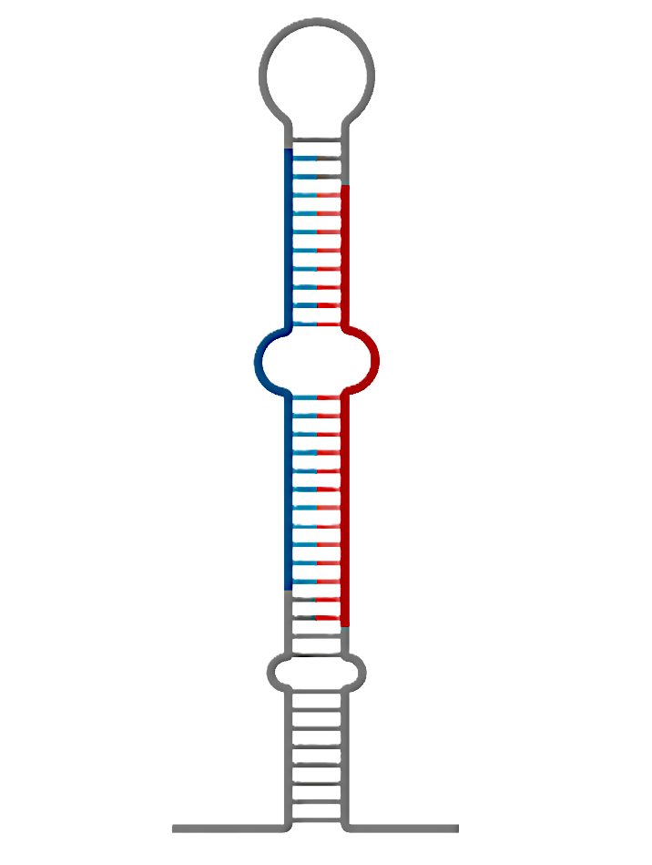
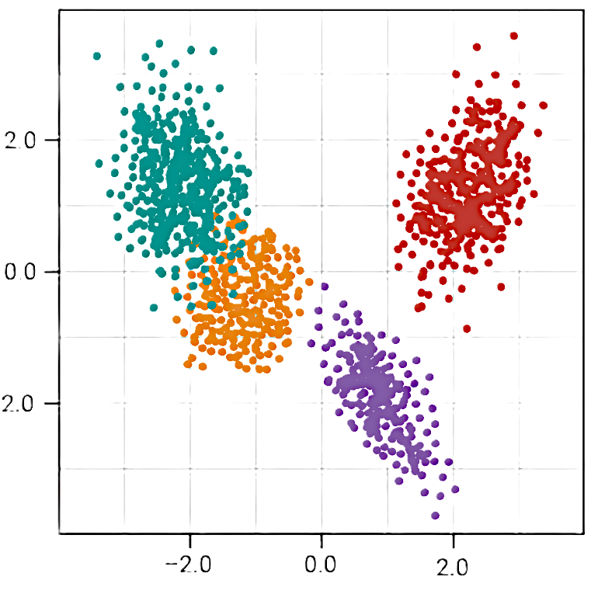
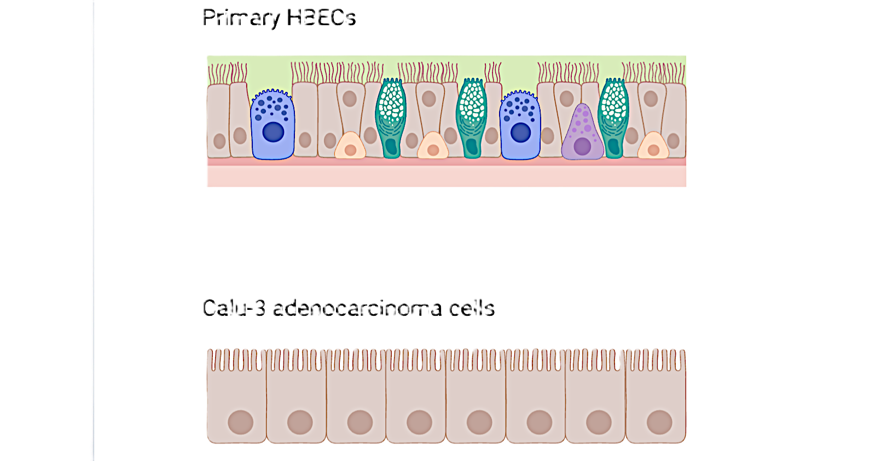

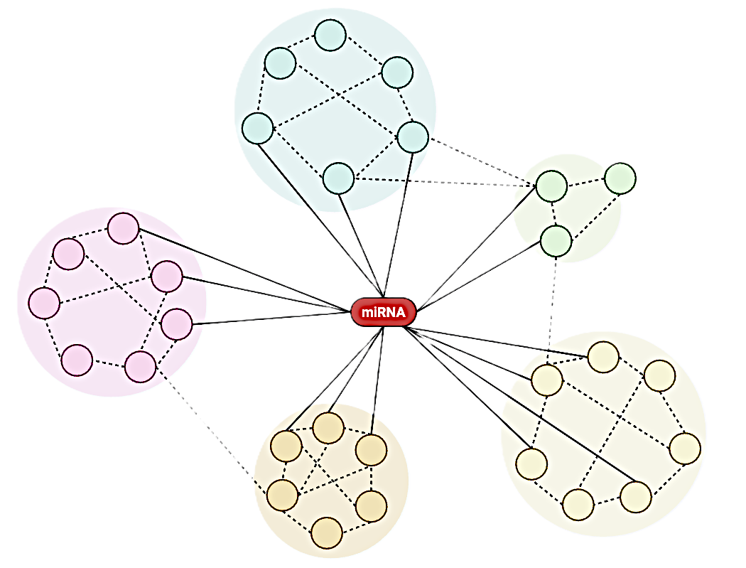
Limitations
      Low Calu-3 miRNA abundance
      No outlier sample
      filtering
1
2
      No context-specific
      filtering
      No network-based enrichment
3
4
Figure created in BioRender: https://BioRender.com
Notes:
Intro:
- Several limitations constrained this analysis and should be considered when interpreting the results and if the workflow were to be developed further.
Limitation 1:
The workflow could not be applied to the Calu-3 dataset, likely due to insufficient miRNA abundance.
Upon inspection of the study that generated this dataset, I found that the experimental preparation had split the number of extracellular vesicles across multiple types of analysis and this likely caused an excessive dilution of the samples leaving too little for transcriptomics.
Limitation 2:
The next limitation was that because only three replicates were used per condition, potential outlier samples that were detected were not removed as this would have left too few samples for differential expression analysis.
Limitation 3:
The next limitation was the major problem with target gene-level enrichment.
Because no context-specific filtering was performed, all target genes of each miRNA were included in the analysis, including ones that would not have been relevant to the biological model.
This therefore increases noise and false positives in the results.
Limitation 4:
One alternative to context-specific filtering would have been using a network-based enrichment approach to identify target genes that are highly connected within the miRNA set and are therefore likely to play a more important role.
This could help reduce the noise within the target gene set and therefore increase the specificity of target gene-level pathway enrichment.
However, this approach was not integrated into the workflow due to time constraints.
Archive:
Limitation 2:
The workflow identified replicates within conditions that were distant according to PCA as well as inconsistent miRNA expression between control samples.
However, as only 3 biological replicates were performed per experimental condition, potential outlier samples were not excluded from the analysis as reducing the number of replicates would have limited the statistical power of differential expression analysis.
Limitation 3:
One of the major problems encountered with pathway enrichment analysis at the target gene level was that it lacked specificity.
As miRNAs have such a broad range of gene targets you can end up with a gene list that constitute the majority of the proteome.
Commercial platforms provide extensive filtering options to reduce the target gene list according to cell type or disease states.
However, it was difficult to isolate and acquire the correct context gene set for this experiment and therefore this was omitted.
This meant that a proportion of the genes included in pathway enrichment analysis would not have been relevant to airway biology and therefore could not have been targeted by the miRNAs within this biological model.
This will have resulted in a lot of noise and false positive pathways.
[low abundance reduces confidence in de results and therefore any downstream biological function which was likely due to experimental design where EV preparations were split to accommodate multiple forms of analyses – repeat analysis using appropriate experimental design is required to validate these results]

Slide 13


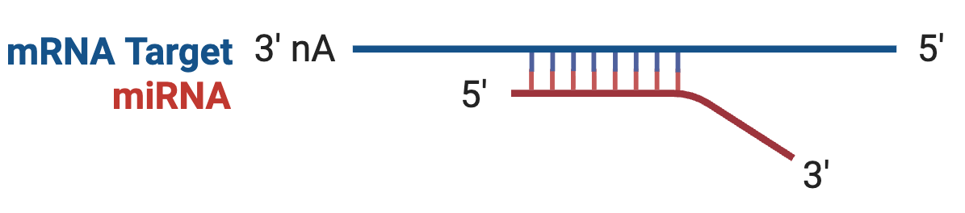
Experimental Design Optimisations
1
2
3
Increase sample size
Increase EV quantity
Integrate matched miRNA-mRNA data
Figure created in BioRender: https://BioRender.com
Notes:
Intro:
Now I’m going to discuss the experimental design optimisations for the Calu-3 study to improve transcriptomic analysis.
1. Sample size:
Firstly, increase sample size to allow the removal of outlier samples and this would increase the reliability of differential expression analysis.
2. EV quantity:
Secondly, it is vital to increase the number of extracellular vesicles made available for transcriptomic analysis so there is sufficient miRNA to complete the analysis.
This is the core improvement which needs to be addressed for any future Calu-3 experiments.
3. Matched miRNA-mRNA:
Finally, they should consider integrating matched miRNA-mRNA data.
This is the gold-standard approach used to filter target gene lists and is even more effective than context-specific filtering.
[segway from: as well as workflow limitations, appropriate experimental design must be considered]
[during the course of this analysis, the following experimental design considerations were recommended to increase the robustness of transcriptmics for future studies]
[sample size because replicates lacking concordance were identified and potential outlier samples were identified but these weren’t removed to retain 3 biological replicates]
[increase EV size to increase miRNA abundance. This will increase the statistical power of diff expression analysis and may increase the number of miRNAs retained after filtering lowly expressed miRNAs]
[integrate mRNA data to avoid context-dependent filtering problems – look for anticorrelated miRNA-mRNA relationships as miRNAs suppress mRNAs]

Slide 14
Significance
Detected limitations within a dataset intended for publication
Optimised future experimental design
Framework for in-house transcriptomics
Notes:
Intro:
Now I am going to discuss what I consider the main contributions of this study to be.
Significance 1:
The first is that it identified that the Calu-3 dataset was severely underpowered and that the results should be interpreted extremely cautiously.
This is important for the original study that is not yet published as it contextualises their results.
Significance 2:
The second significance is that it provided realistic experimental design recommendations to ensure that future iterations of the Calu-3 study can produce data suitable for robust transcriptomic analysis.
Significance 3:
And finally, this study provided the basis for the lab to create their own transcriptomic workflow, so they don’t have to keep outsourcing this type of analysis.

Slide 15
Originality
Experiment
  Nebuliser technology
1
  Calu-3 functional analysis
2
  Open-access workflow
3
Workflow
Notes:
Intro:
Now to discuss the originality of the study which was split into two parts.
Originality 1:
The first part is the experiments which produced the study data as these experiments used a nebuliser to deliver the allergens in aerosol form, which more closely reflect biology than traditional submersion methods and therefore challenge previous allergen study results.
Originality 2:
The second category of originality is the transcriptomic workflow. This is the first instance of using a systematic approach to investigate the differentially expressed miRNAs in the Calu-3 dataset.
Originality 3:
Finally, unlike other transcriptomic workflows that use commercial software, this workflow uses exclusively open-access software…
Originality 3:
Commercial platforms are commonly used for pathway enrichment analysis, including previously on the primary HBEC dataset.
These platforms can be very good, easy to use and provide lots of tutorials.
However, they also eliminate the need for labs to perform their own bioinformatics analysis which extends the gap between wet labs and bioinformatics, making it more inaccessible.
This study aimed to exemplify that bioinformatics analysis can be performed using open-access software, within a relatively short time frame and without reliance on experts. And also, to generate a workflow that can be easily applied to similar datasets so that future studies don’t have to incur the cost of repeatedly outsourcing the same analyses.
[open-access workflow is to bridge the gap between non-bioinformaticians and transcriptomics, as well as eliminate the need to outsource a bioinformatics company to do more costly analysis on repeats of the same type of data]

Slide 16
Future Directions
Experimental
Workflow
  Repeat experiment
  Spike-in controls
1
1
  Experimental validation (e.g., RT-qPCR)
2
  Validate workflow
2
  Functional studies
  User-friendly workflow
3
3
Notes:
Intro:
Now I’m going to talk about some potential future directions of this study.
Experimental 1:
The very first thing to do experimentally is to repeat the experiment whilst applying all the recommendations that have been suggested to ensure robust data for transcriptomics.
Experimental 2:
Then, once you have identified candidate miRNAs, the expression of these should be validated using another experimental method such as PCR.
Experimental 3:
Finally, once the expression has been verified, you can then start performing functional studies such as using mimics and inhibitors of the miRNAs to observe their specific function in the biological mode.
Workflow 1:
The first improvement that could be made to the workflow used in this study is that it could be made to handle spike in controls which would allow absolute quantification of miRNA expression, which is particularly useful for low expression miRNAs.
Workflow 2:
Secondly, the workflow should be validated, and this can be done by benchmarking it against similar transcriptomic pipelines and comparing these results to the two previous studies where transcriptomic analysis had been performed.
Workflow 3:
There are many alterations that could be made to the workflow to make it user-friendly for the lab to use in-house as non-bioinformaticians.

Slide 17
Summary
1
Created an open-access workflow potentially suitable for in-house transcriptomics
2
Biologically plausible results detected in primary HBEC dataset
3
Calu-3 dataset was underpowered which constrained analyses
4
Context-specific filtering would improve target gene-level enrichment
Notes:
Context-specific filtering would improve target gene-level enrichment for future applications of this workflow

Slide 18
Thank you
Acknowledgements
I would like to acknowledge and thank my project supervisors:
Professor Lucy Fairclough
Dr Georgina Hopkins
Dr Hannah Jackson

Slide 21
Archive

Slide 22
Background
1
Allergen exposure
2
EV cargo
3
Gene suppression
4
Pathway disruption
Figure created by Chris Janschke in BioRender: https://BioRender.com

Slide 23
Background
1
Allergen exposure
2
EV cargo
3
Gene suppression
4
Pathway disruption
Figure created by Chris Janschke in BioRender: https://BioRender.com

Slide 24
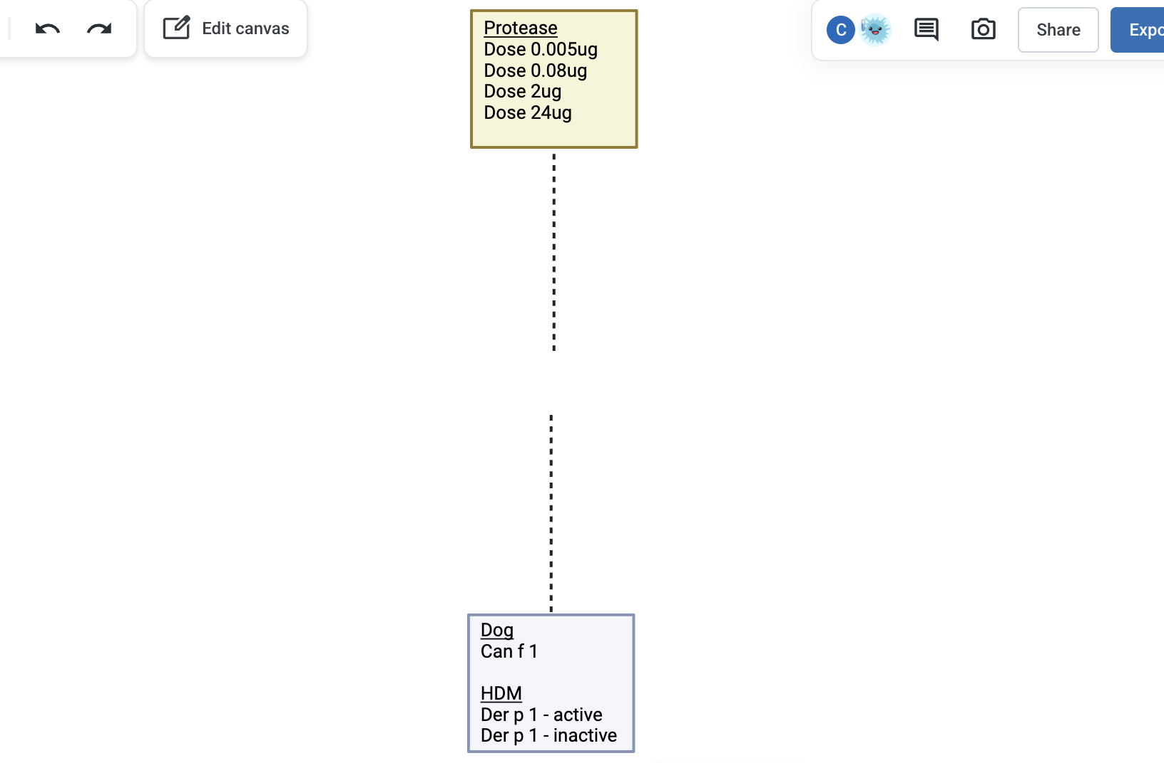
Study Data
Primary HBEC
Transcriptomics
Calu-3 adenocarcinoma
Notes:
[all allergens are nebulised with PBS as untreated control]

Slide 26
Study Aims
1
Create a transcriptomics workflow using the primary HBEC dataset
2
Use exclusively open-access software
3
Apply the workflow to the Calu-3 dataset

Slide 27
Transcriptomics Workflow
Trimming
Quality
Control
miRNA mapping
Differential Expression
Trimming
Quality
Control
miRNA mapping
Pathway Enrichment

Slide 28
Results (5)
Summary
Experimental design optimisation could improve transcriptomics
Experimental Design
2. Increase amount of extracellular vesicles
3. Integrate matched miRNA-mRNA data
1. Increase sample size
Notes:
[sample size because replicates lacking concordance were identified and potential outlier samples were identified but these weren’t removed to retain 3 biological replicates]

Slide 29
Significance
Detected limitations within a dataset intended for publication
Optimise future experimental design
Framework for in-house transcriptomics

Slide 30
Originality
  Nebuliser technology
1
  Calu-3 pathway analysis
2
  Open-access workflow
3
Notes:
Intro:
The originality of this study arises from two areas:
Firstly, the research questions of the previous experiments from which the study data was generated.
And secondly, this study itself.
Experimental
Originality 1:
One notable aspect of these experiments were that they used nebulised allergens which is a good biological model that reflects inhaled allergens.
Previous allergen studies have used submersion exposure which risks disrupting the integrity of the epithelial barrier.
Originality 2:
Transcriptomic
Originality 3:
[open-access workflow is to bridge the gap between non-bioinformaticians and transcriptomics, as well as eliminate the need to outsource a bioinformatics company to do more costly analysis on repeats of the same type of data]

Slide 31
Originality
Experiment
  Nebuliser technology
1
  Calu-3 pathway analysis
2
  Open-access workflow
3
Workflow
Notes:
Intro:
The originality of this study arises from two areas:
Firstly, the research questions of the previous experiments from which the study data was generated.
And secondly, this study itself.
Experimental
Originality 1:
One notable aspect of the experiments were that they used nebulised allergens to enable dosing in aerosolised form.
This is a good biological model as it more closely reflects the mechanism of inhaled allergens.
Previous allergen studies have administered the allergens through submersing the cells in a liquid containing the allergen, but this risks disrupting the integrity of the epithelial barrier which can lead to altered pathways even in the absence of allergens.
Therefore, allergen studies that incorporate nebuliser technology challenge results from previous submersion studies.
Originality 2:
-
Transcriptomic
Originality 3:
[open-access workflow is to bridge the gap between non-bioinformaticians and transcriptomics, as well as eliminate the need to outsource a bioinformatics company to do more costly analysis on repeats of the same type of data]

Slide 32
Interpretation
Aim: Create transcriptomics workflow using primary HBECs
Target gene-level enrichment more informative than miRNA-level
Detected pathways relevant to airway inflammation
Aim: Apply the workflow to the Calu-3 dataset
Limited miRNA abundance constrained analyses
Greater potential role for miR-125b-5p than miR-574-5p
Additional Finding
24 μg/cm² protease exposure may alter rRNA and tRNA composition
Notes:
Intro:
Now I’m going to interpret the main findings of this study in the context of the study aims.
Aim 1:
The first aim of the study was to create a transcriptomic workflow using the primary HBEC dataset.
For this, target gene-level enrichment was found to be the optimum method as it identified biologically plausible pathways associated with allergen responses in airway epithelial cells and in maintaining the airway epithelial barrier.
However, the analysis returned almost half of the entire Reactome pathway database as significantly enriched therefore it is possible these pathways appeared by chance rather than by biology.
Aim 2:
The second aim way to apply the workflow to the Calu-3 dataset.
However, this was not possible due to the low amount of differential expression which was likely caused by the extremely low quantity of miRNA within the samples.
Despite this, miRNA 125b was identified as a potential candidate for further research although because the differential expression was underpowered, it is likely this miRNA may have appeared due to chance.
Aim 3:
The final finding was not associated with an aim and this was that the levels of ribosomal and transfer RNA were greater in dose 24 primary HBEC samples.
However, this should be tested on more samples and with other RNA types to confirm the result.
Aim 2:
Differential expression analysis of the Calu-3 dataset was not possible and nor was pathway enrichment analysis meaning a literature search was required instead.
The quality control aspect of the workflow was able to identify the cause of the underpowered nature of this dataset, which was the low levels of miRNA detected in all Calu-3 samples.
Therefore, all results were interpreted extremely cautiously and were considered exploratory.
I was then able to review the experimental design of the Calu-3 experiment to identify areas to improve further analysis – and these will be discussed later.
However, the results that were obtained showed that miRNA 125 was more comprehensively researched and was the most promising candidate miRNA for further analysis.
Additional aim:
One unintended finding of this analysis was that other RNA species appeared to be distinctly altered in primary HBECs when they were exposed to the highest dose of protease.
Although the scope of this study was miRNAs, this may indicate that there are broader RNA effects occurring and may need to be considered to determine how all these changes interact.
Because this composition analysis was constrained to just the 3 types of RNA, it’s not possible to say whether any other forms of RNA are affected but this could be investigated in the future by incorporating databases with RNA sequences for additional RNA types.
[Limited miRNA abundance constrained analysis = pathway enrichment analysis was precluded due to the low miRNA abundance which was likely due to experimental design where EV preparations were split to accommodate multiple forms of analyses → interpret cautiously]

Slide 33
Results (1)
Summary
Low miRNA abundance in Calu-3 samples
Distinct rRNA/tRNA profile in dose 24 µg/cm² samples
miRNA
Primary HBEC
miRNA
Calu-3
Figure derived from thesis Figure 3
Notes:
Intro:
Now I’m going to discuss the results obtained from the study.
These charts show the results of the RNA composition analysis
Where each entry on the y-axis represents an individual sample, and the name is the allergen exposure condition, and the replicate number is shown in brackets.
The chart itself shows the proportion of each sequencing library that was assigned to either micro-RNA, ribosomal RNA or transfer RNA. The software could not detect other RNA species.
miRNA:
miRNA is shown in blue and accounts for only a small proportion of the sequencing libraries in both cell types.
However, the levels of miRNA was markedly lower in Calu-3 cells where only 2,500 reads were assigned to miRNA compared to 44,000 in the primary HBEC dataset.
This was the first indication that the Calu-3 dataset may be underpowered for differential expression analysis.
Dose 24:
Another interesting finding was that the levels of ribosomal RNA and transfer RNA were discernibly greater in the dose 24 primary HBEC samples.
This suggests that other forms of RNA may be affected by protease allergen exposure, and this may be most notable in the ribosomal RNA, however further research is required to confirm this.
Summary:
Very low levels of miRNA were detected in the Calu-3 samples.
And primary HBECs exposed to 24 micrograms of protease allergens showed distinct ribosomal RNA and transfer RNA profiles.
[can talk about the large quantity of miRNA in dose 0.005 (3) if there’s spare time that needs filling]

Slide 34
Experimental Design Optimisations
1
2
3
Increase sample size
Increase EV quantity
Integrate matched miRNA-mRNA data
Figure created in BioRender: https://BioRender.com
Notes:
Intro:
Robust transcriptomic analysis is dependent on appropriate experimental data, therefore the following experimental design optimisations should be considered for future studies.
1. Sample size:
By increasing sample size, it would allow for suspected outlier samples to be removed without excessively constraining the differential expression analysis.
Small differences in the DE miRNA list could make the difference between a pathway being considered significantly enriched or not.
In the case of primary cells, increasing the donor size above 3 donors would also increase the reproducibility of the study by better accounting for donor effects.
2. EV quantity:
The second major alteration that could enhance future studies, especially for the Calu-3 dataset is to drastically increase the number of EVs that are allocated for transcriptomics.
For Calu-3 samples, this could enable pathway enrichment approaches which would contribute towards novel findings instead of relying on existing literature to investigate the biological function of DE miRNAs.
This is the core improvement which needs to be addressed prior to any future Calu-3 experiments.
3. Matched miRNA-mRNA:
In order to increase the specificity of target gene-level pathway enrichment analysis, a gold-standard approach is to obtain matched RNA-sequencing data to determine what genes are actually being expressed within the biological model and use this to accompany the small RNA-sequencing data that indicates what miRNAs are being expressed.
This can then be used to determine anticorrelated miRNA-mRNA relationships, as miRNAs suppress their target genes.
And therefore, this helps to identify genes that are actually being affected by the DE miRNAs and filters irrelevant genes that only contribute noise to the pathway analysis.
This is the optimal method, which is more effective than the context-dependent filtering methods I mentioned were provided by commercial platforms.
[segway from: as well as workflow limitations, appropriate experimental design must be considered]
[during the course of this analysis, the following experimental design considerations were recommended to increase the robustness of transcriptmics for future studies]
[sample size because replicates lacking concordance were identified and potential outlier samples were identified but these weren’t removed to retain 3 biological replicates]
[increase EV size to increase miRNA abundance. This will increase the statistical power of diff expression analysis and may increase the number of miRNAs retained after filtering lowly expressed miRNAs]
[integrate mRNA data to avoid context-dependent filtering problems – look for anticorrelated miRNA-mRNA relationships as miRNAs suppress mRNAs]

Slide 35
Significance
Detected limitations within a dataset intended for publication
Optimised future experimental design
Framework for in-house transcriptomics
Notes:
Intro:
Now I am going to discuss what I consider the main contributions of this study to be.
Significance 1:
The first is that it identified that the Calu-3 dataset was severely underpowered and that the results should be interpreted extremely cautiously.
This is important for the original study that is not yet published to provide context for their results.
Significance 2:
Potentially the most significant contribution of this study is that it has revealed practical experimental design optimisations that can increase the reliability and specificity of future allergen studies to further research within this field.
Significance 3:
Due to the biological plausibility of the pathways identified in the primary HBEC dataset, this workflow could be considered as a foundation, as well as provide the impetus, for the laboratory group to build in-house transcriptomic workflows for repeated analyses of similar datasets.
This would prevent spending large sums of money on outsourcing and commercial software to perform the analysis.
The savings made could instead fund RNA-sequencing to acquire matched miRNA-mRNA data, which as I mentioned, would improve the specificity of the pathway enrichment, or to fund further research.

Slide 36
Originality
Experiment
  Nebuliser technology
1
  Calu-3 functional analysis
2
  Open-access workflow
3
Workflow
Notes:
Intro:
The originality of this study arises from two areas:
Firstly, the research questions of the previous experiments from which the study data was generated.
And secondly, the workflow and this study itself.
Experimental
Originality 1:
One notable aspect of the experiments were that they used nebulised allergens to enable dosing in aerosolised form.
This is a good biological model as it more closely reflects the mechanism of inhaled allergens.
Previous allergen studies have administered the allergens through submersing the cells in a liquid containing the allergen, but this risks disrupting the integrity of the epithelial barrier which can lead to altered pathways even in the absence of allergens.
Therefore, allergen studies that incorporate nebuliser technology challenge results from previous submersion studies.
Transcriptomic
Originality 2:
No formal assessment of DE miRNAs had been performed on the Calu-3 dataset prior to this study.
This study identified that pathway enrichment was unsuitable for this dataset and provided an alternative method to investigate the biological function of DE miRNAs.
I used a systematic approach to review available literature and investigate the established role of each miRNA according to relevant and documented biological terms.
Originality 3:
Commercial platforms are commonly used for pathway enrichment analysis, including previously on the primary HBEC dataset.
These platforms can be very good, easy to use and provide lots of tutorials.
However, they also eliminate the need for labs to perform their own bioinformatics analysis which extends the gap between wet labs and bioinformatics, making it more inaccessible.
This study aimed to exemplify that bioinformatics analysis can be performed using open-access software, within a relatively short time frame and without reliance on experts. And also, to generate a workflow that can be easily applied to similar datasets so that future studies don’t have to incur the cost of repeatedly outsourcing the same analyses.
[open-access workflow is to bridge the gap between non-bioinformaticians and transcriptomics, as well as eliminate the need to outsource a bioinformatics company to do more costly analysis on repeats of the same type of data]

Slide 37
Future Directions
Experimental
Workflow
  Repeat experiment
  Spike-in controls
1
1
  Experimental validation (e.g., RT-qPCR)
2
  Validate workflow
2
  Functional studies
  User-friendly workflow
3
3
Notes:
Intro:
Future work should focus on first optimising the experimental design as this will increase the biological reliability of the transcriptomic workflow.
Experimental 1:
The experiment should be repeated whilst adopting the recommendations previously stated: increasing sample size, increase number of EVs, and integrate matched miRNA-mRNA data.
This can then identify candidate DE miRNAs that warrant further investigation.
Experimental 2:
The expression of candidate miRNAs could then be independently verified, such as using RT-qPCR.
Experimental 3:
Once you have verified that the differential expression is a true observation, you could consider performing functional studies which would incorporate miRNA mimics and inhibitors to test the biological effects that knocking down or upregulating each candidate miRNA exerts on the biological model.
Workflow 1:
Incorporating spike-in analysis would help to identify technical outliers which could otherwise skew the analysis.
It would also assist performing absolute miRNA quantification which is particularly useful for lowly expressed miRNAs where small differences can appear as large log fold changes which was observed in multiple highly differentially expressed miRNAs in this study.
Workflow 2:
It would then be crucial to validate the workflow because the current method adopted for determining its suitability by identifying biologically plausible pathways is not nearly robust enough.
It should be benchmarked against established pipelines, applied to alternate datasets to try to recreate published results, and also compared to the results from the studies that the raw data originated from, which was obtained using commercial services.
Workflow 3:
The final step for the workflow would be to make it highly intuitive and easy to use for non-bioinformaticians.
This would include clear input and output descriptions as well as usage instructions and help sections.
As it is completely open-source, this would allow the user to make simple alterations.

Slide 38
Summary
1
Biologically plausible results detected in primary HBEC dataset
2
Context-dependent filtering would improve target gene-level enrichment
3
Calu-3 dataset was underpowered
4
Created an open-access workflow potentially suitable for in-house transcriptomics

