Slide 1
Transcriptomic analysis of extracellular vesicle miRNA cargo derived from allergen-exposed airway epithelial cells using open-access software
Student ID: 50805916
Name: Christopher Janschke
[starting from increasing axis/legend text size for the dotplot → just crop it to isolate the text then enlarge it manually – R is being funny]

Slide 2
Project Overview
Aims | Determine impact of allergen exposure on airway biology
Methods | Differential Expression → Method development → Pathway Analysis[]
Findings | Biologically plausible results are obtainable provided suitable experimental design
Significance | Informs experimental design for future experiments
Notes:
[need to state the aim is to use open-access software]
[need to state the findings is that the workflow produced biologically plausible results on datasets where experimental design was appropriate but not when the design was inappropriate]
[need to state the significance is also that it could save money on outsourcing transcriptomics]

Slide 3
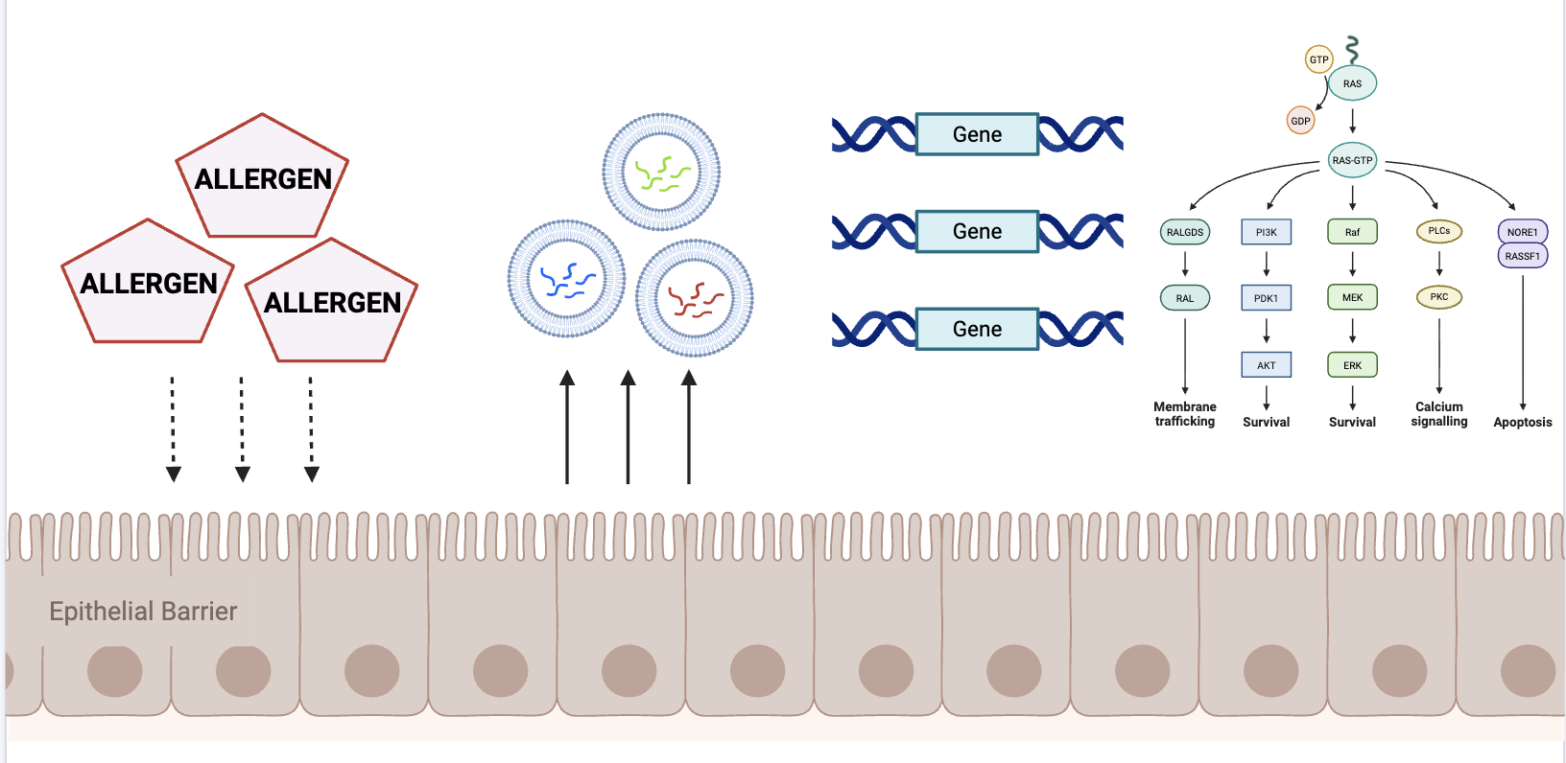
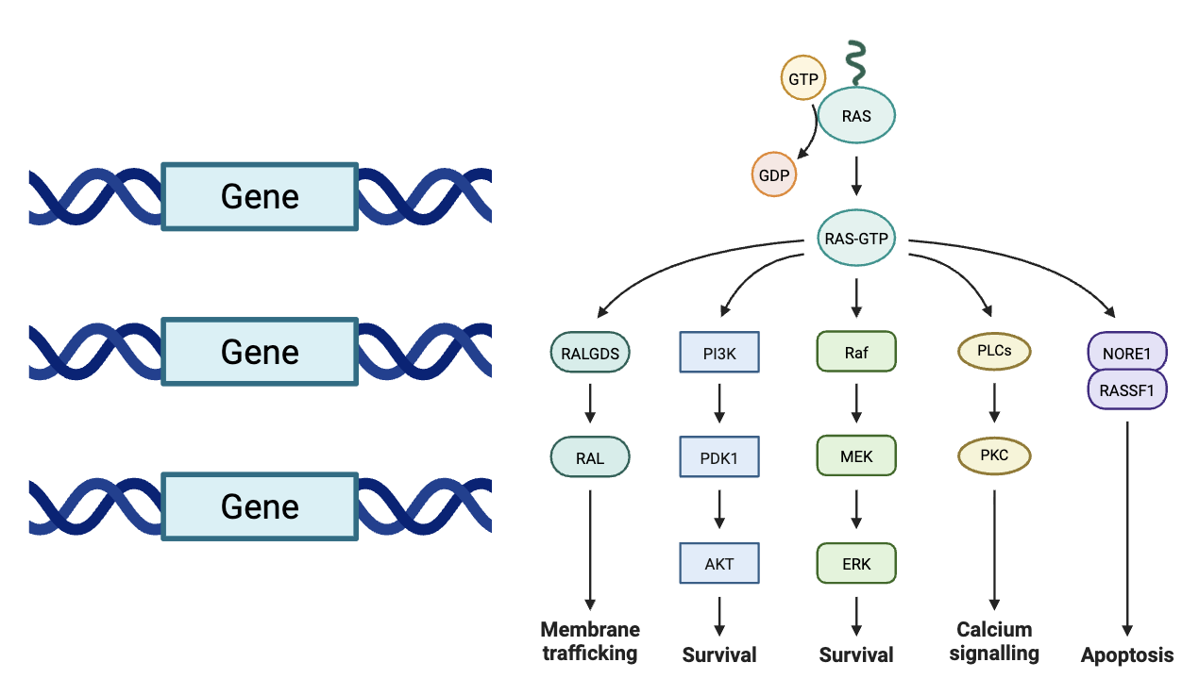


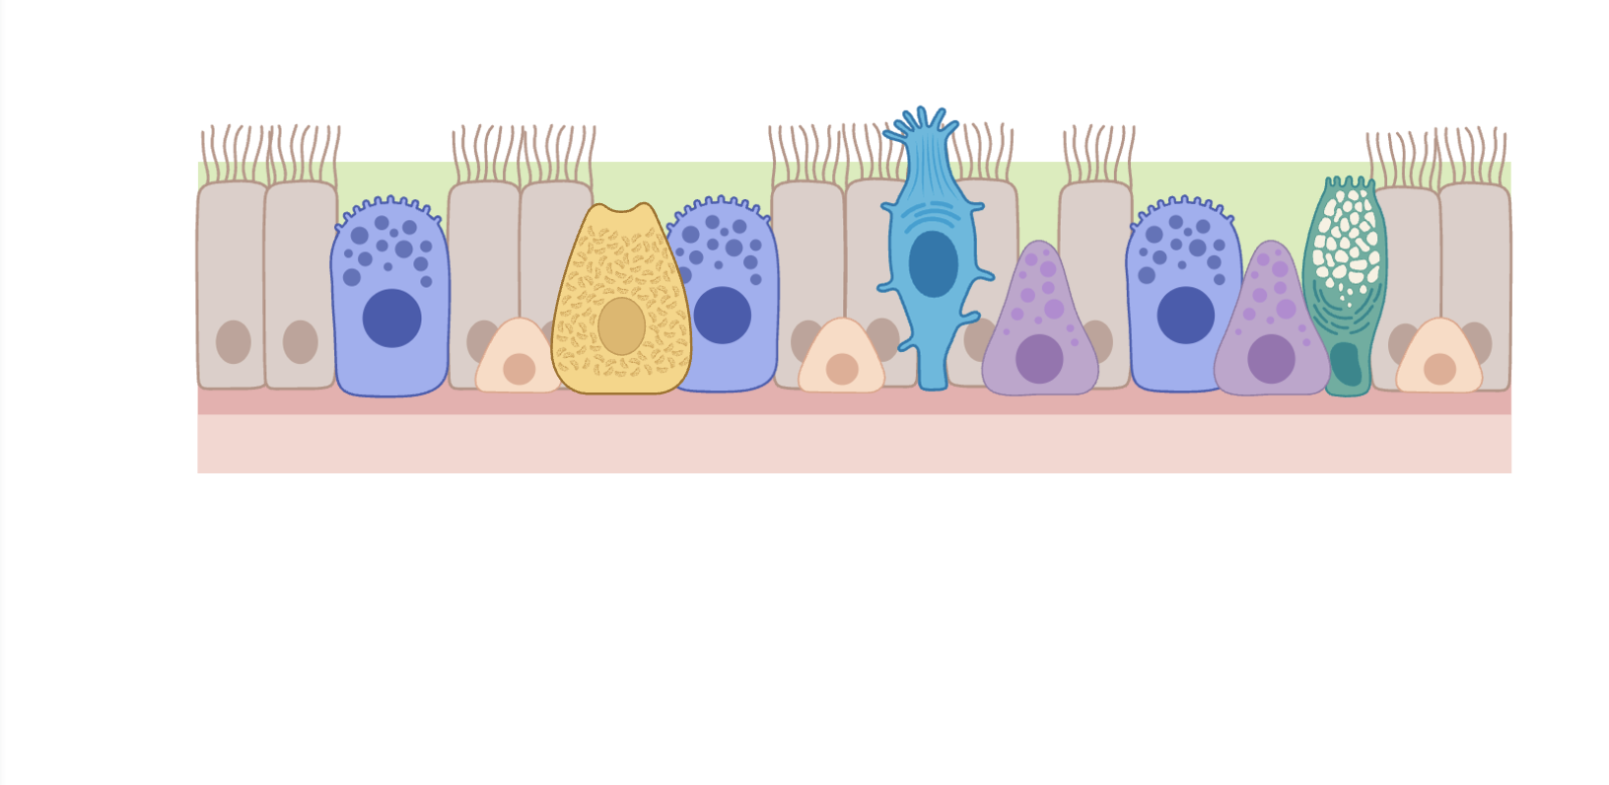
Background
3
Gene suppression
4
Pathway disruption
1
Allergen exposure
2
EV cargo
3
Gene suppression
4
Pathway disruption
miRNA
EV
Airway
Epithelial Barrier
Figure created in BioRender: https://BioRender.com

Slide 4
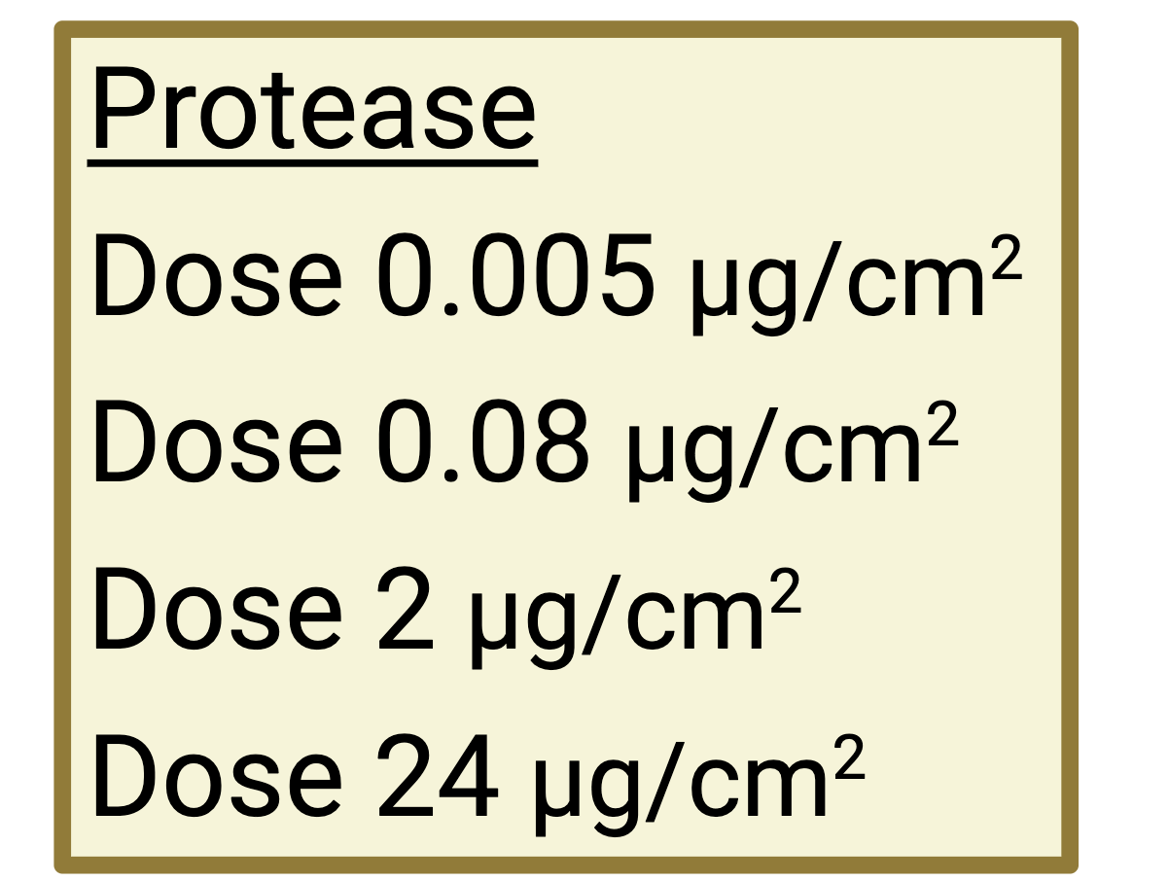
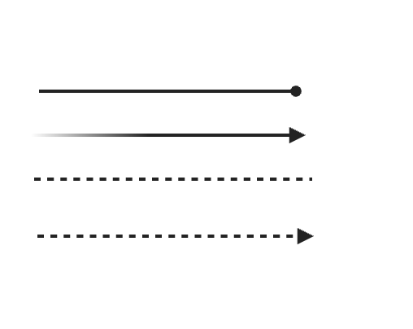
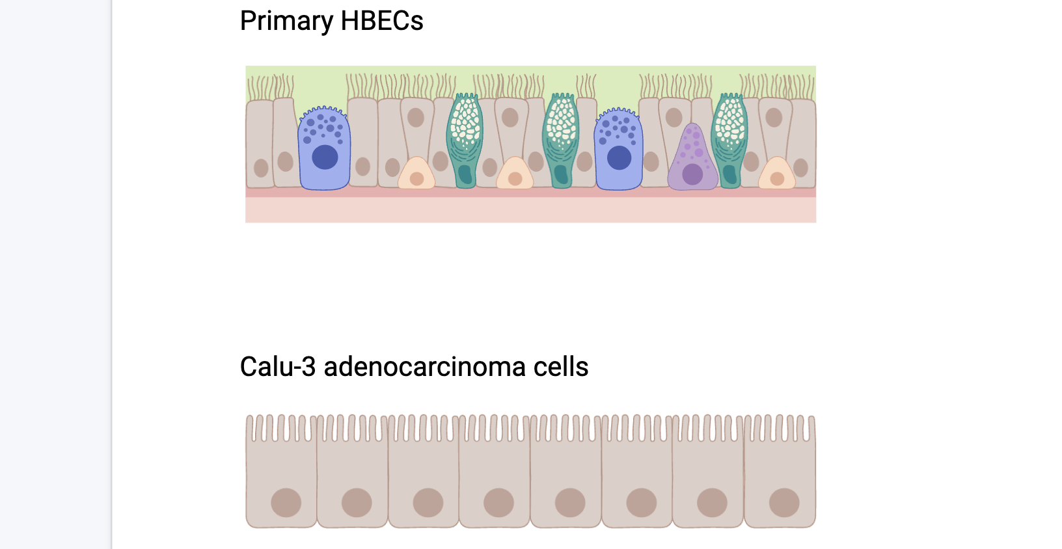
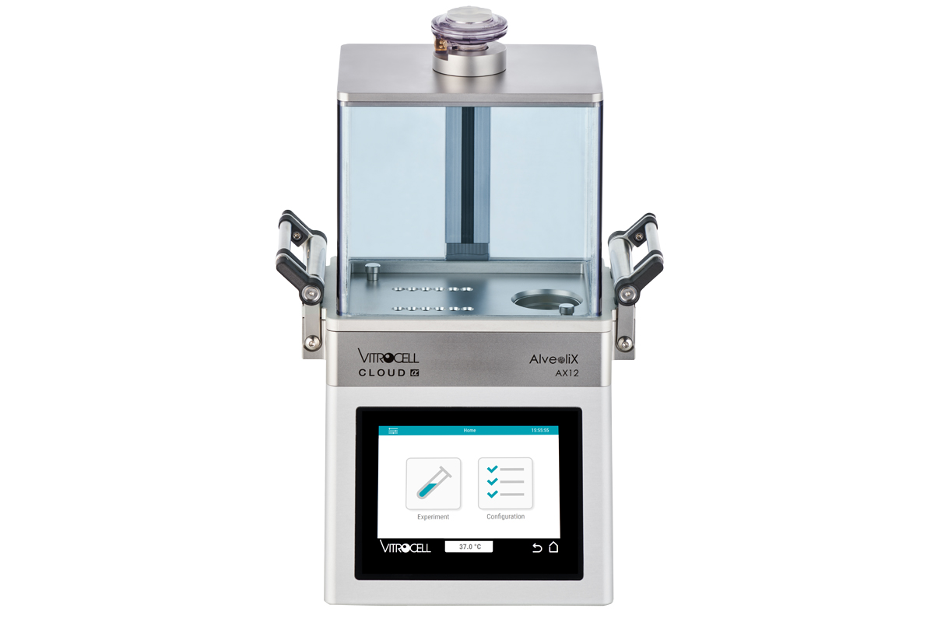
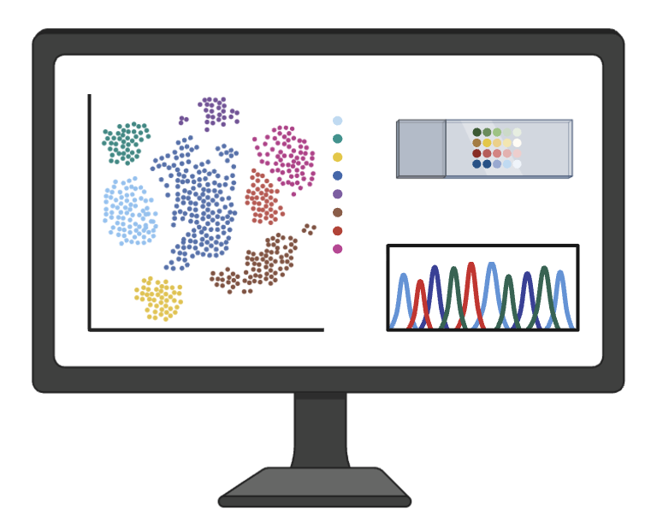
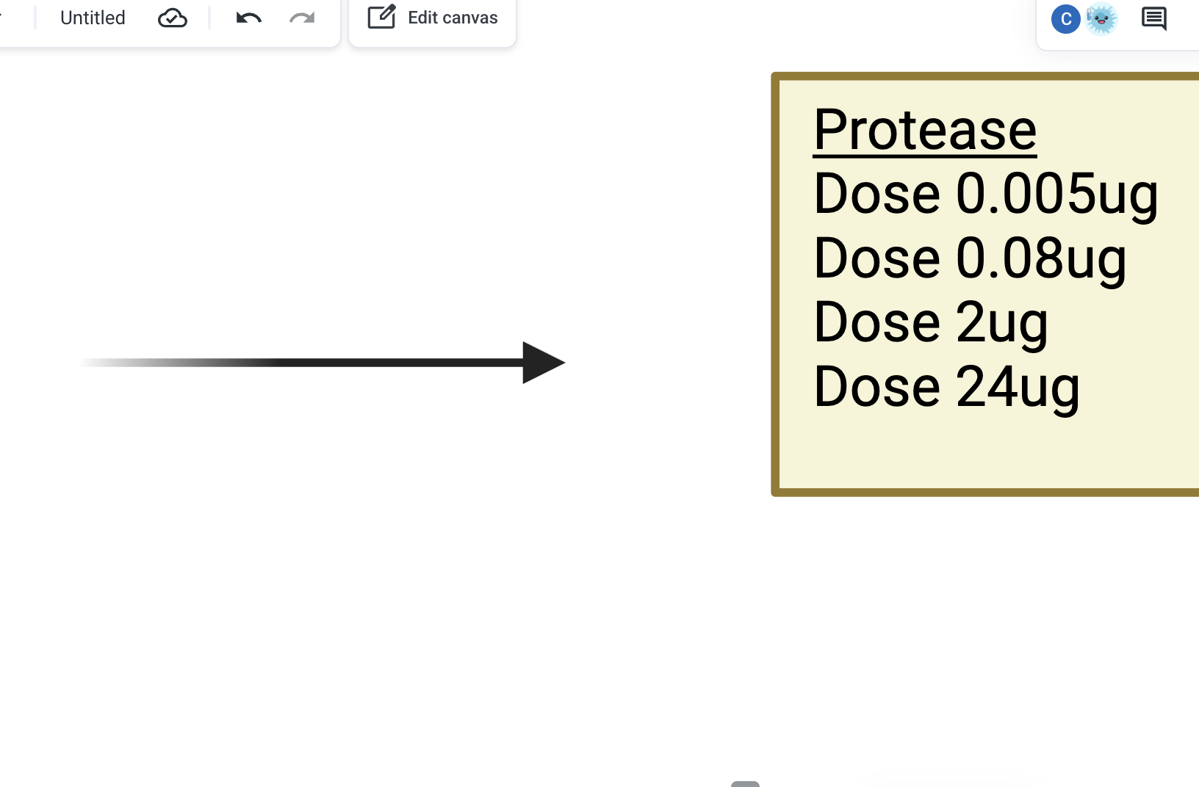
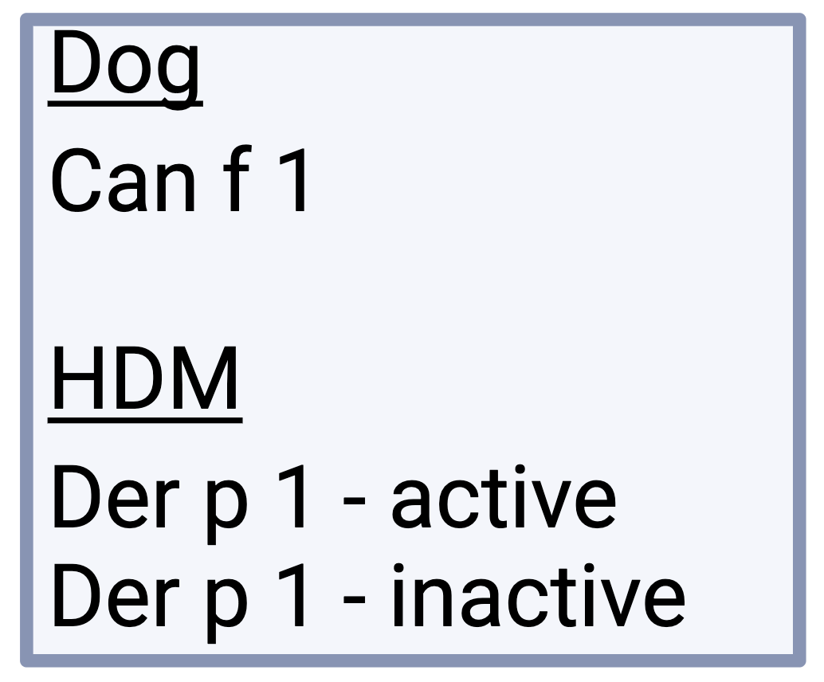
Study Data
Primary HBEC
Transcriptomics
Triplicate
Calu-3 adenocarcinoma
Triplicate
Figure created in BioRender: https://BioRender.com
Notes:
[all allergens are nebulised with PBS as untreated control]
[each condition contained 3 biological replicates]

Slide 5
Study Aims
1
Create a transcriptomics workflow using the primary HBEC dataset
2
Use exclusively open-access software
3
Apply the workflow to the Calu-3 dataset
Notes:
[creating the workflow using primary HBEC requires observing biologically plausible results]

Slide 6
Transcriptomics Workflow
Method Development
Target gene-level
miRNA-level
Cell type: Primary HBEC
Trimming
Quality
Control
miRNA Mapping
Differential Expression
Pathway Enrichment
Literature Search
Cell type: Calu-3
Notes:
[finish by signposting I'm going to go through the results]

Slide 7
Results (1)
Summary
Low miRNA abundance in Calu-3 samples
High rRNA/tRNA content in dose 24 µg/cm² samples
miRNA
Primary HBEC
miRNA
Calu-3
Figure derived from thesis Figure 3

Slide 8
Results (2)
Summary
High differential expression in protease dose 24 µg/cm²
Minimal differential expression in Calu-3 samples
Primary HBEC
Calu-3
FDR < 0.05
FDR < 0.2
Figure derived from thesis Figure 4
Notes:
[essentially 50% split of upregulated and downregulated mirnas in dose 24]
[even at exploratory FDR threshold, barely any more mirnas were identified as differentially expressed]

Slide 9
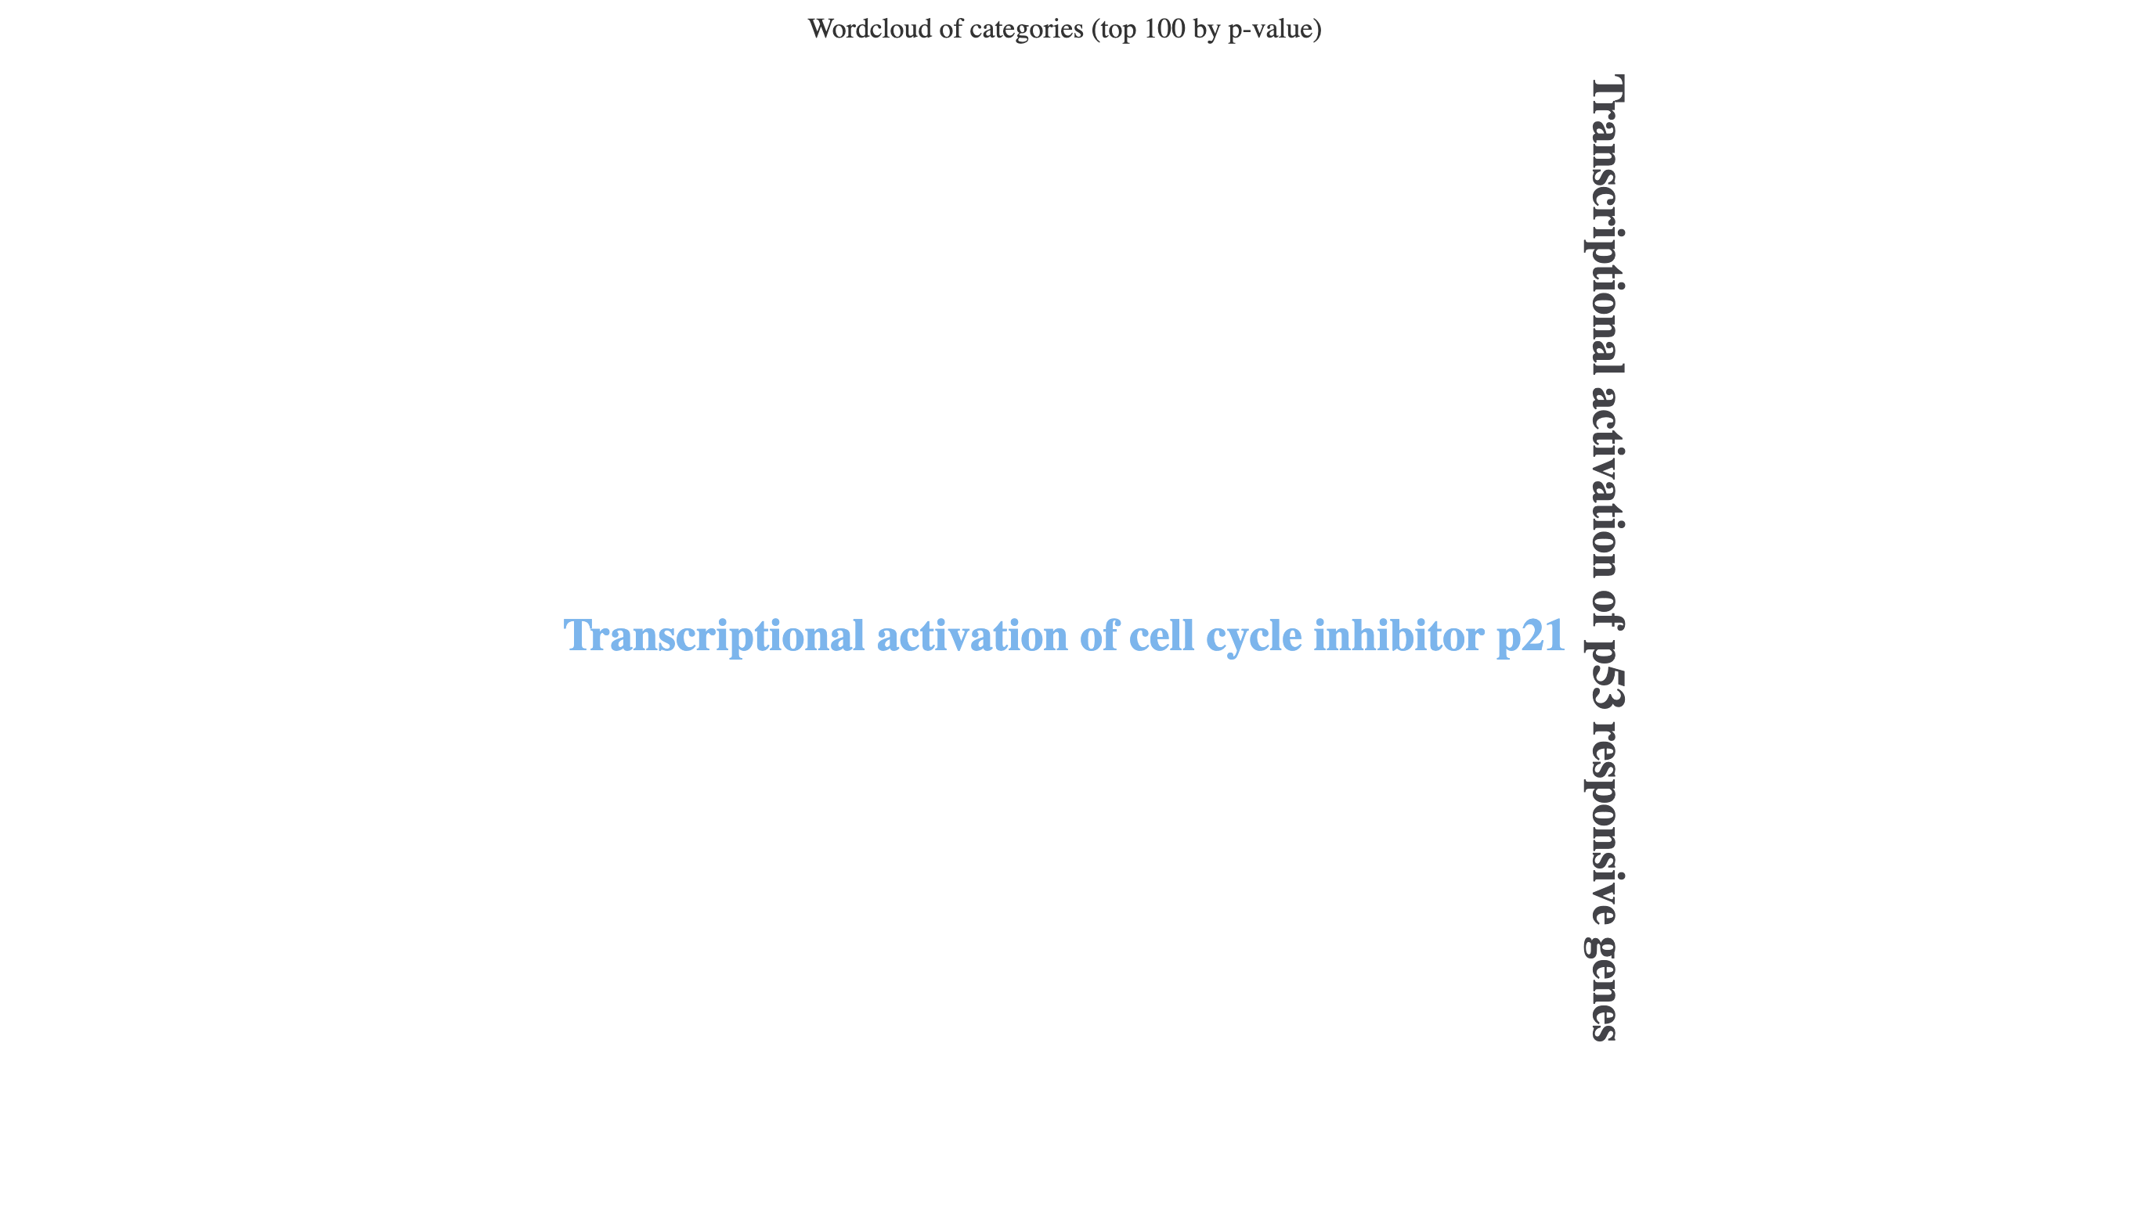
Results (3)
Target gene-level enrichment (ORA)
miRNA-level enrichment (ORA)
Upregulated
N = 164
Downregulated
N = 464
Upregulated
N = 2
Figure generated by miEAA 2.0: https://ccb-compute2.cs.uni-saarland.de/mieaa2/
Summary
More pathways from target gene-level enrichment
Biologically plausible pathways
Figure derived from thesis Figure 6
Notes:
[emphasise this was performed on primary HBEC samples exposed to dose 24 protease]
[discuss the number of sig pathways from target-gene level versus miRNA-level]
[0 significant pathways in downregulated miRNA ORA and both up- and down-regulated miRNA-SEA

Slide 10
Results (4)
Summary
Greater support for miR-125b-5p
miR-125b-5p
Total Publications = 324
miR-574-5p
Total Publications = 65
Figure created in RStudio
Notes:
[segway from last slide is because there were too few de miRNAs, had to use a literature search instead]
[then introduce the categories as categories relevant to airway inflammation, signalling and the airway epithelial barrier]
[references to specific papers might be good e.g., respiratory diseases]
[miR-125b-5p also appeared in the dose 24 protease samples]

Slide 11
Interpretation
Aim: Create transcriptomics workflow using primary HBECs
Biologically plausible pathways identified
Target gene-level enrichment more informative than miRNA-level
Aim: Apply the workflow to the Calu-3 dataset
Limited miRNA abundance constrained analyses
More support for miR-125-5p than miR-574-5p
Additional Finding
Distinct rRNA and tRNA profiles in 24 μg/cm² protease samples
Notes:
[Limited miRNA abundance constrained analysis = likely due to experimental design where EV preparations were split to accommodate multiple forms of analyses]

Slide 12
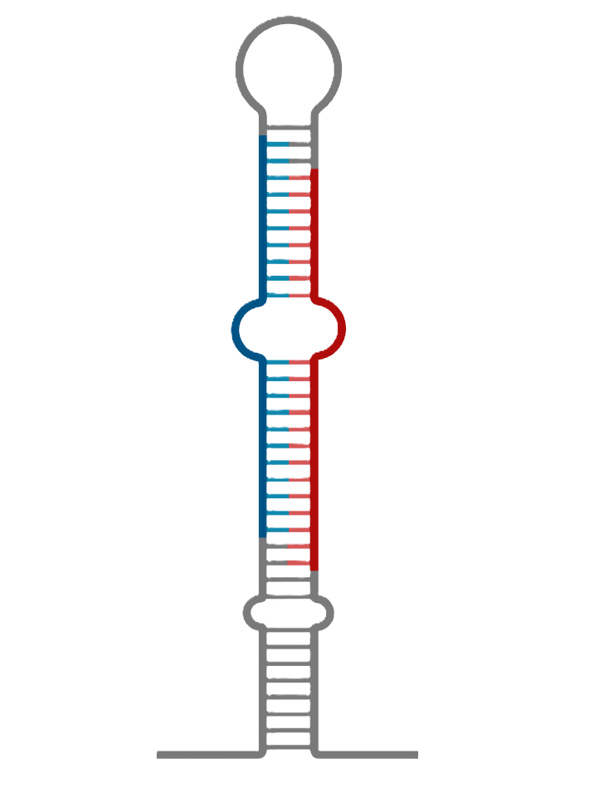
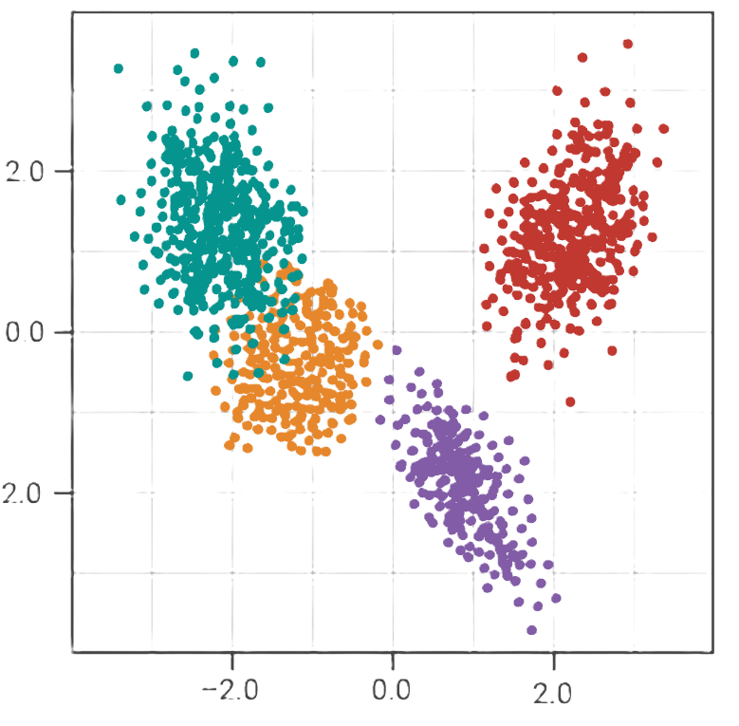
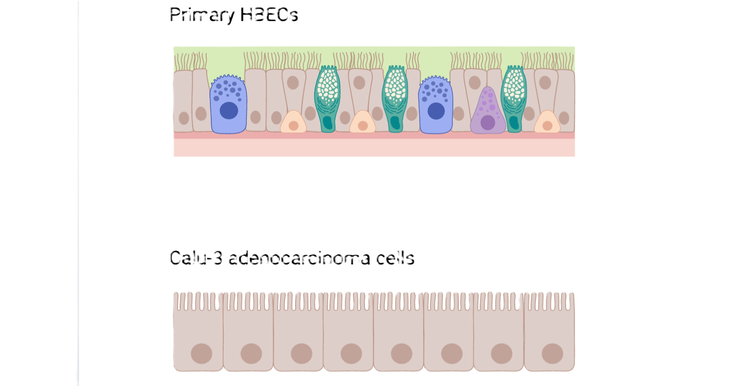

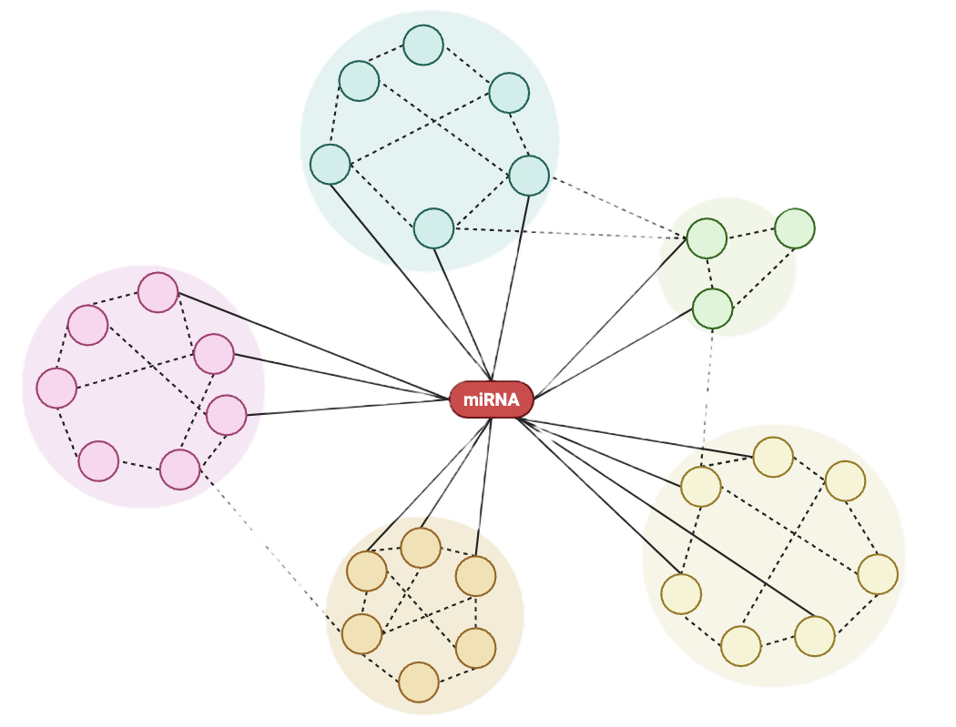
Limitations
Low Calu-3 miRNA abundance
No outlier sample
filtering
No context-specific
filtering
No network-based enrichment
Notes:
[low abundance reduces confidence in de results and therefore any downstream biological function – repeat analysis required to backup these results]

Slide 13


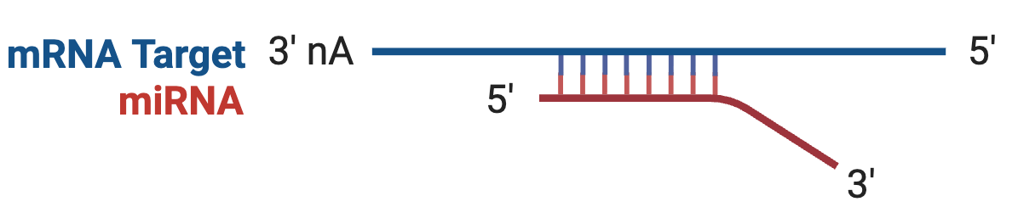
Experimental Design Optimisations
1
2
3
Increase sample size
Increase EV quantity
Integrate matched miRNA-mRNA data
Figure created in BioRender: https://BioRender.com
Notes:
[segway from: as well as workflow limitations, appropriate experimental design must be considered]
[during the course of this analysis, the following experimental design considerations were recommended to increase the robustness of transcriptmics for future studies]
[sample size because replicates lacking concordance were identified and potential outlier samples were identified but these weren’t removed to retain 3 biological replicates]
[increase EV size to increase miRNA abundance. This will increase the statistical power of diff expression analysis and may increase the number of miRNAs retained after filtering lowly expressed miRNAs]
[integrate mRNA data to avoid context-dependent filtering problems – look for anticorrelated miRNA-mRNA relationships as miRNAs suppress mRNAs]

Slide 14
Significance
Detected limitations within a dataset intended for publication
Optimised future experimental design
Framework for in-house transcriptomics

Slide 15
Originality
Nebuliser technology
1
Calu-3 pathway analysis
2
Open-access workflow
3
Notes:
[open-access workflow is to bridge the gap between non-bioinformaticians and transcriptomics, as well as eliminate the need to outsource a bioinformatics company to do more costly analysis on repeats of the same type of data]

Slide 16
Future Directions
Workflow
Experimental
Validate workflow
Repeat experiment
1
1
2
Spike-in controls
2
Experimental validation (e.g., RT-qPCR)
User-friendly workflow
Functional studies
3
3
Notes:
Experimental:
[repeat the Calu-3 experiment using the optimised experimental design to detect candidate miRNAs]
[experimentally confirm the presence of the miRNAs using PCR]
[perform functional studies using miRNA mimics and inhibitors to investigate the role of each candidate miRNA]

Slide 17
Summary
1
Biologically plausible results detected in primary HBEC dataset
2
Context-dependent filtering would improve target gene-level enrichment
3
Calu-3 dataset was underpowered
4
Created an open-access workflow potentially suitable for in-house transcriptomics

Slide 18
Thank you
Acknowledgements
I would like to acknowledge and thank my project supervisors:
Professor Lucy Fairclough
Dr Georgina Hopkins
Dr Hannah Jackson

Slide 21
Archive

Slide 22
Background
1
Allergen exposure
2
EV cargo
3
Gene suppression
4
Pathway disruption
Figure created by Chris Janschke in BioRender: https://BioRender.com

Slide 23
Background
1
Allergen exposure
2
EV cargo
3
Gene suppression
4
Pathway disruption
Figure created by Chris Janschke in BioRender: https://BioRender.com

Slide 24
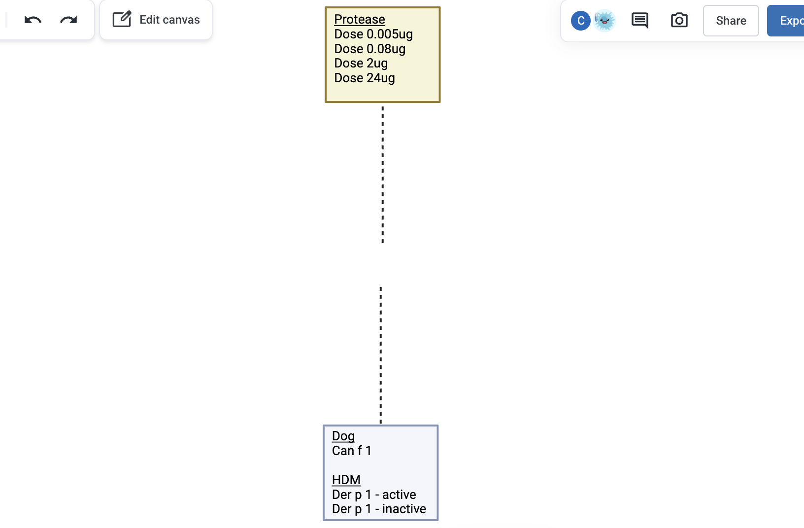
Study Data
Primary HBEC
Transcriptomics
Calu-3 adenocarcinoma
Notes:
[all allergens are nebulised with PBS as untreated control]

Slide 26
Study Aims
1
Create a transcriptomics workflow using the primary HBEC dataset
2
Use exclusively open-access software
3
Apply the workflow to the Calu-3 dataset

Slide 27
Transcriptomics Workflow
Trimming
Quality
Control
miRNA mapping
Differential Expression
Trimming
Quality
Control
miRNA mapping
Pathway Enrichment

Slide 28
Results (5)
Summary
Experimental design optimisation could improve transcriptomics
Experimental Design
2. Increase amount of extracellular vesicles
3. Integrate matched miRNA-mRNA data
1. Increase sample size
Notes:
[sample size because replicates lacking concordance were identified and potential outlier samples were identified but these weren’t removed to retain 3 biological replicates]

Slide 29
Significance
Detected limitations within a dataset intended for publication
Optimise future experimental design
Framework for in-house transcriptomics

