Slide 1
BookExchange
Group 18

Slide 2
Group 18 Structure
Backend API & Database
Connor Boutin
Emmanuel Scur
Web Application
Brad Coles
Mobile Application
John Ison
Nick Poidomani
Dominic Amalfitano

Slide 3
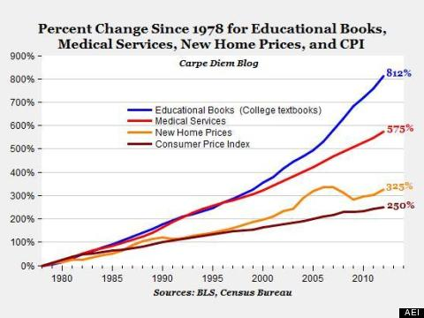
Abstract – Textbook Finder
Web/Mobile Application that allows users to locate, buy, and sell their textbooks to other users.
Very large market for student textbooks:
Every college campus has a potential to utilize our application in a meaningful way.
Average spending $655 per year for educational textbooks.
Users save money by purchasing textbooks from other students.
1
1
812% increase on textbook cost since 1980.
1: College Textbook Prices Increasing Faster Than Tuition And Inflation by Tyler Kingkade, December 06, 2017, HUFFINGTON POST

Slide 4
Web Development
WISA Stack
Windows OS
SQL Server
IIS
ASP.net
Hosting on Azure
HTML, Bootstrap, CSS, JavaScript

Slide 5
Why WISA?
Familiarity with it from small project. Smallest learning curve for this project so we can focus on delivering a quality product. Allowed group members to refine their WISA skills.

Slide 6
Mobile Application
Xcode
Swift
Cocoapods
Alamofire
SwiftyJSON

Slide 7
Why iOS?
Chosen due to familiarity and past experience with development using Swift and Xcode. Allowed for skipping the steep learning curve some groups experienced with Android Studio.

Slide 8
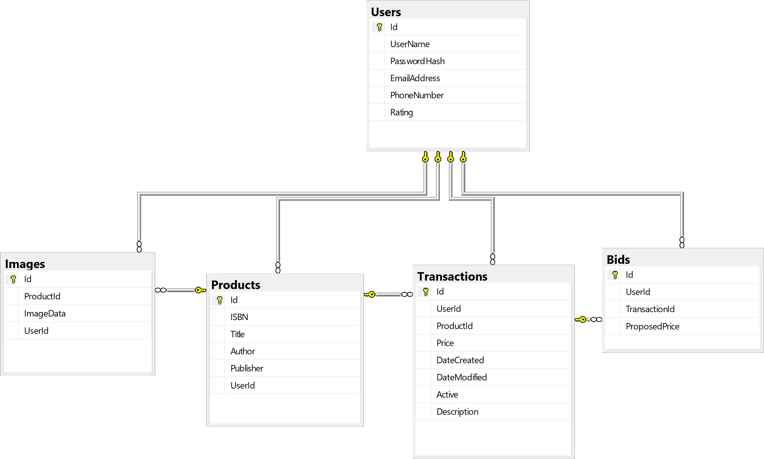
ER

Slide 9
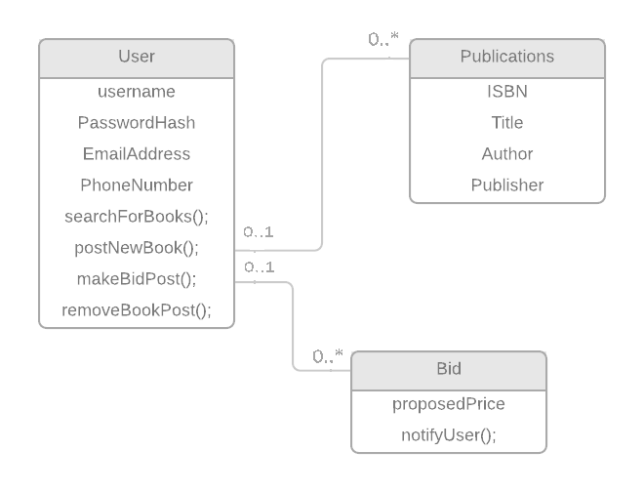
Class Diagram

Slide 10
Triumphs & Difficulties
Triumphs
Developed an iOS app start to finish.
Basic functionality works across mobile application and web application.
Windows app backup created.
More polished than our small project.
Difficulties
Issues between the JSON sending to our server. Ran into some CORS errors and other erros.
Server reverted to preset settings upon updates (this made some issues reoccur until this was discovered).
Conflicting schedules between group members.
Had to switch to a more fundamental website due to time constrains.

Slide 11
Web Demo
http://boutinvm.eastus.cloudapp.azure.com/default.html
Mobile Demo

Slide 12
Future Goals
Integrate a distance API so users may view books only in their general area.
Show nearby recent book postings on the buy page.
Android App Development.
Revert back to original website functionality.

Slide 13
Questions?
We are Group 18

