Slide 1
COP 4331 Small project
Spring 2018

Slide 2
Group 20 members
Dominic Amalfitano
Nick Poidomani
Christopher John Ison
Emmanuel Scur
Connor Boutin
Brad Coles

Slide 3
Overall Layout
WIMA stack
MYSQL database
C# API
MD5 Hashing Algorithm

Slide 4
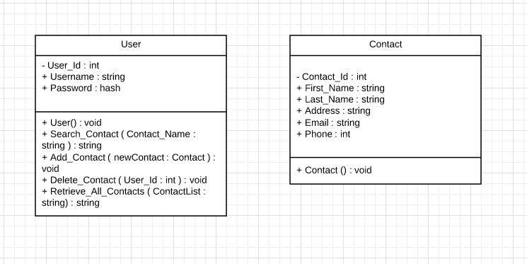
Class Diagram
Two tables, a user table and contact table

Slide 5
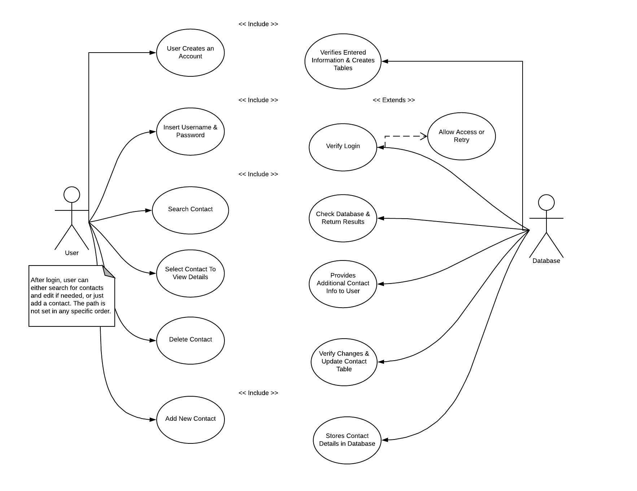
Use case diagram

Slide 6
Description
User is prompted for their username and password upon visiting the website. The entered credentials are cross referenced with the data on record in database. User is either granted access or prompted to re-enter login information. Upon successful login, user may choose to search current contacts or add a new contact. If the search option is selected the user must provide a name searched in their contact table. The system returns any matching data to the user. From this returned data the user may select a contact to view additional information and from here delete the contact if they so wish. If the contact is deleted the contact is removed from their contact table. If the user originally chose to add a contact, the user is prompted to enter relevant information. The system takes the entered data and updates the appropriate fields in the database.

Slide 7
Javascript
XMLhttp requests to the server
Create Account
Login
Add contact
Search contacts
Delete contact

Slide 8
HTML Format
Used divisions to hide/show pieces of the website based on the selections made by the user.
Took shell provided in the code posted by Professor Leinecker and modified it along with providing a slightly improved UI.
Used a combination of HTML and a CSS style sheet to create user interface
Worked in collaboration with JavaScript to ensure all input IDs matched the corresponding field names in Javascript

Slide 9
MySql Queries
Insert New Contact
Delete Contact
Retrieve Info
Update Contact
Get All Contacts

Slide 10
Password Hashing
The MD5 format and CyrptoJS were used in hashing the password field.
CryptoJS is a growing collection of standard and secure cryptographic algorithms implemented in JavaScript.
This ensured a secure transfer of the users password to the database.

Slide 11
The WCF API and MySQL Server

Slide 12
WCF Service Layer – Microsoft’s Azure
Windows Communication Foundation
Configured as a RESTful service
Serializes incoming Json/XML data as pre-built C# DataContracts
Notes:
Our API is developed as a Windows Communication Foundation service hosted in Microsoft’s Azure computing platform.
The Api is configured as a RESTful (REpresentational Stare transfer) service, consuming and producing JSON data in it’s operation.
Json that is sent to the API is serialized through pre-built C# Datacontracts that inherit the Iserializable C# class.

Slide 13
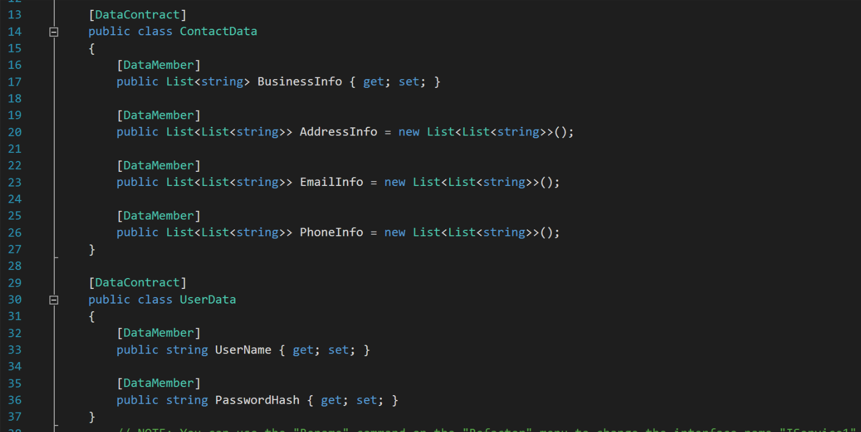
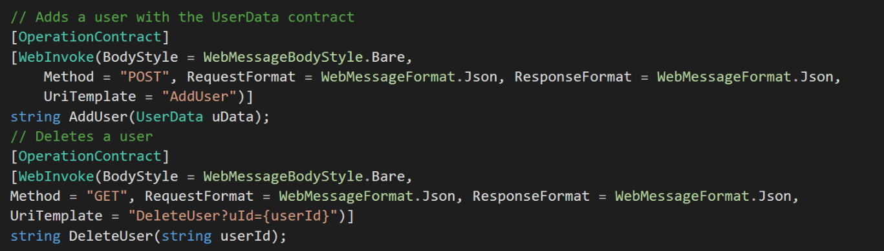
Actual Code Example

Slide 14
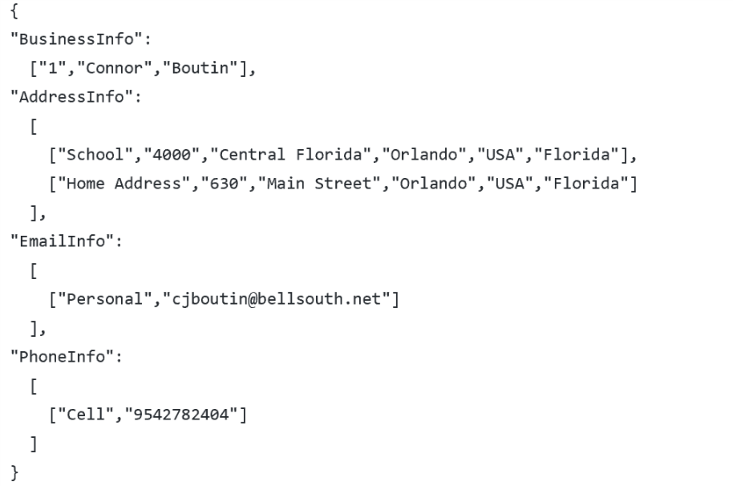
WCF Service Layer – Microsoft’s Azure
Receives JSON formatted text from WebUI
Performs operations on the Database for the client
Increases security by not directly exposing database
Snippet of JSON sent by client to add new contact. This is the same contract used to update, and return a contact’s details
Notes:
When any request is sent from the WebUI, the WCF Service Layer receives it and serializes the JSON into C# objects.
Then, the API organizes the data, and determines what the UI is asking. After the purpose of the message is determined, the API performs the proper calls on the database to retrieve the data, and return it to the UI for consumption.

Slide 15
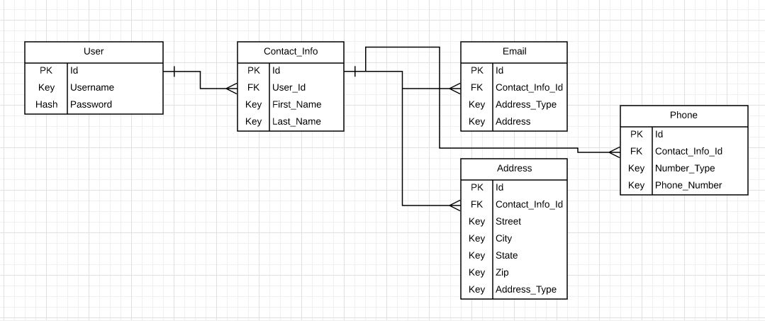
Er Diagram
One to many from user to the contacts allows for the user to have multiple contacts saved. Another one to many follows from this contact allowing multiple emails/addresses/phones to be saved to that contact.
Notes:
This is our Entity-relationship diagram.
Each user has an ID, username and Password. The Id is the User’s primary key, which has a one to many relationship with the User_Id field in the contactinfo table. This allows multiple contacts to belong to one single user.
Additionally, Each contact has a primary key named Id that is a one to many relationship with the email, addresses, and phone tables. We chose this route because it left the contact managing application scalable and extensible for future upgrades.
Each contact method is a separate table so the user can create a theoretically infinite number of addresses, emails, phone numbers for one single contact.
This method also allowed us to break up the data to be more query-able if we choose to implement that in the future. For example, a user can search all contacts that live in ‘Orlando’.

Slide 16
MySQL Server
Data stored on a relational database management system (RDBMS)
MySQL chosen due to lower cost, and increased read/write performance
Hosted on freemysqlhosting.net
Notes:
Our data for the contact manager is stored on a MySQL Relational database.
We chose MySQL due to it’s lower cost, and increased performance over SQL when performing very rapid read/write operations.

