Slide 1
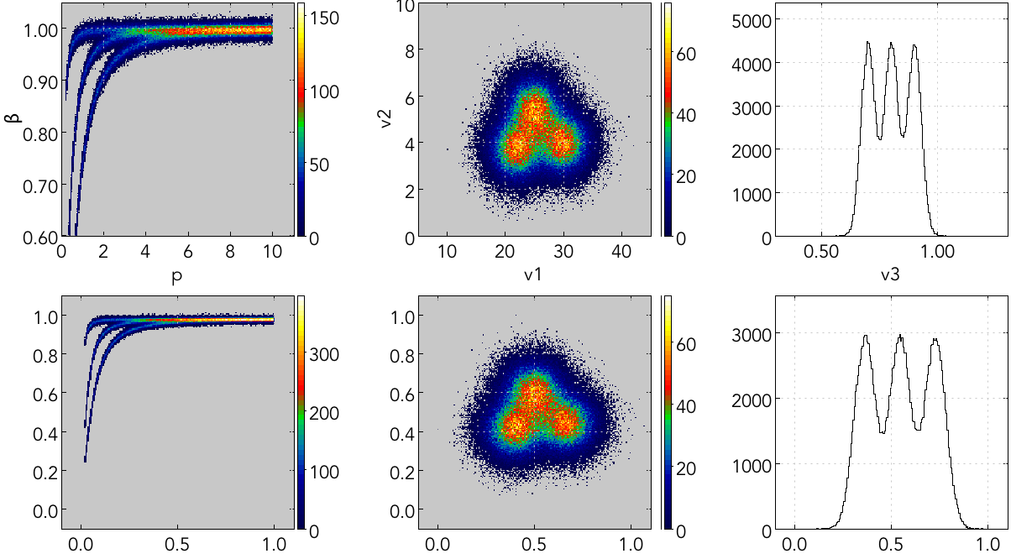
Particle ID with a Neural Network (using coatjava!)
Toy model: 3 particles – A, B, C – with 5 observables – p, beta, v1, v2, v3.
A
B
C
A
B
C
C
A
B
* Quantities are shifted and re-scaled so range is about 0.01 – 1.00
Nathan Harrison, First CLAS12 Experiment Meeting, 5/24/2017

Slide 2
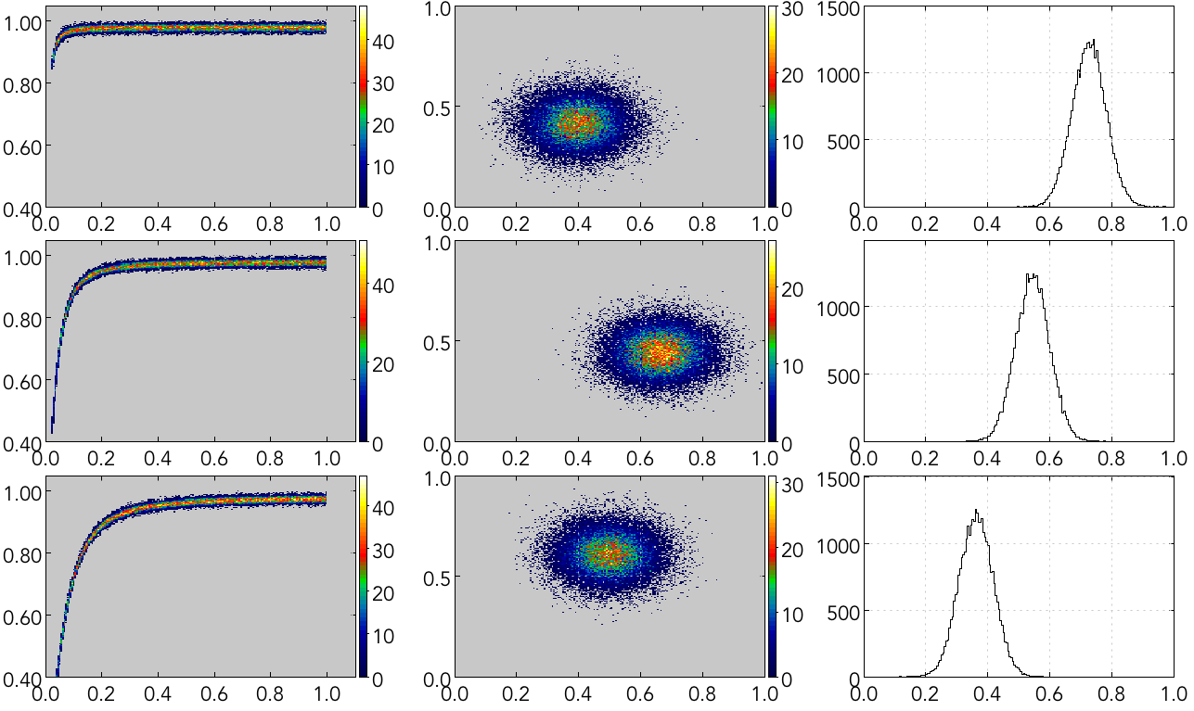
Particle ID with a Neural Network – Training Data
A
B
C

Slide 3
Particle ID with a Neural Network – Training
input
p
β
v1
v2
v3
output
=
Whidden, output
Winput, hidden
(initially random)
(initially random)
3 x 1
3 x H
H x 5
5 x 1
H = number of hidden nodes (on the order of 100).
(“Activation function” not shown.)
The output is compared to the desired output – either (1, 0, 0) for A, (0, 1, 0) for B, or (0, 0, 1) for C* – the error then goes into an algorithm used to tune the W matrices. The algorithm has an adjustable parameter called the “learning rate.” Many training iterations are needed before the network is reliable.
* zeros are bad for neural networks, so 0.01 is actually used.

Slide 4
Particle ID with a Neural Network – Test Data
Ask the trained network to identify each particle as either A, B, or C. Each output will look something like this:
Largest value is the networks best guess. This example corresponds to particle A.
0.977
0.081
0.012

Slide 5
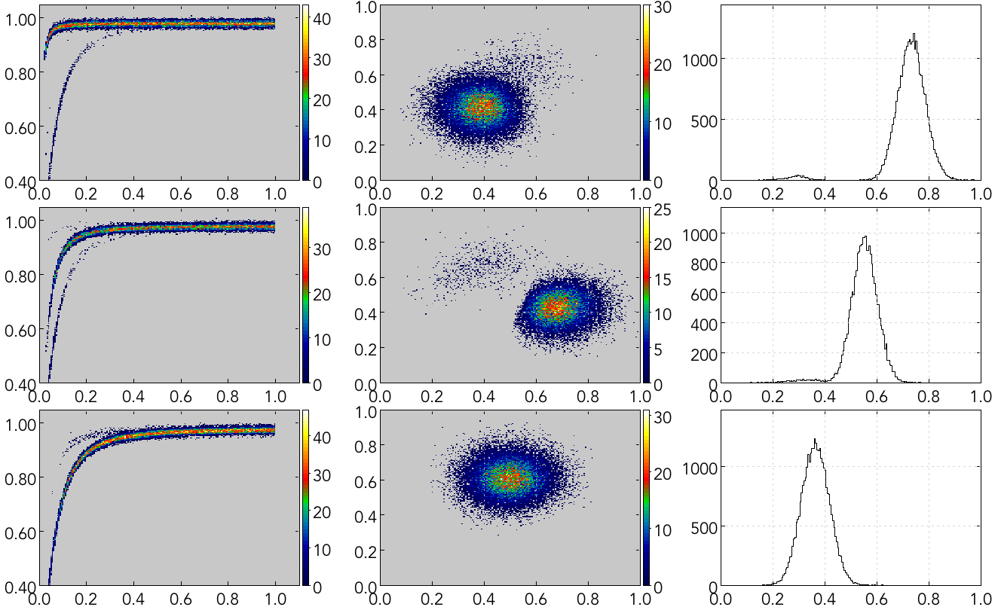
Particle ID with a Neural Network – Results
First try, no optimization
A
B
C
100 hidden nodes, 0.3 learning rate

Slide 6
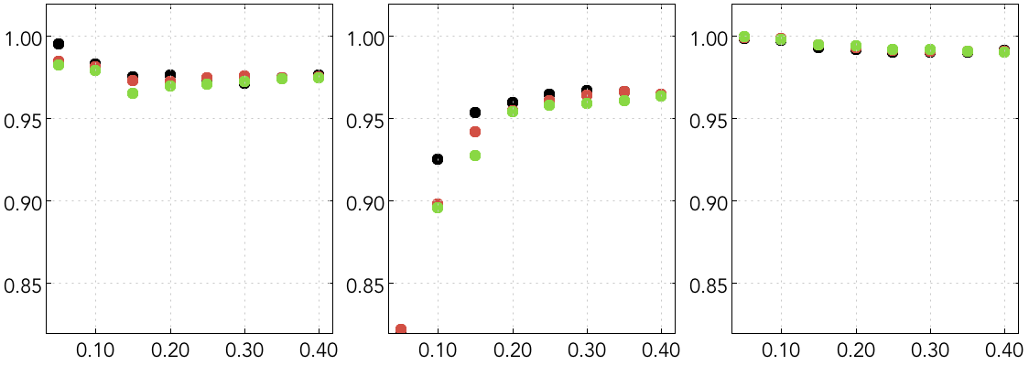
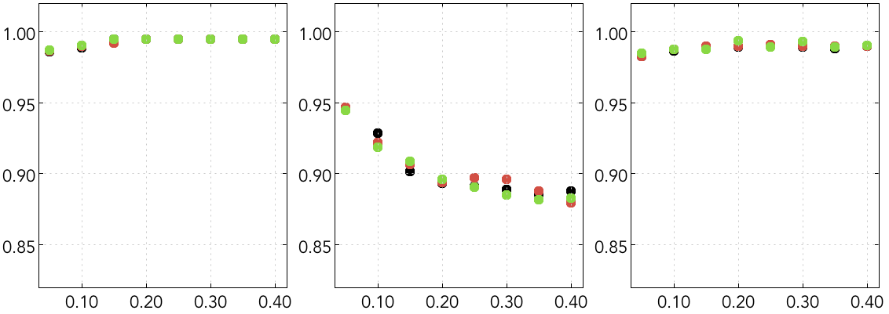
Particle ID with a Neural Network – Optimization
A Efficiency
B Efficiency
C Efficiency
6,000 training examples
H = 50
H = 100
H = 150
learning rate
learning rate
learning rate
A Efficiency
B Efficiency
C Efficiency
60,000 training examples
learning rate
learning rate
learning rate

Slide 7
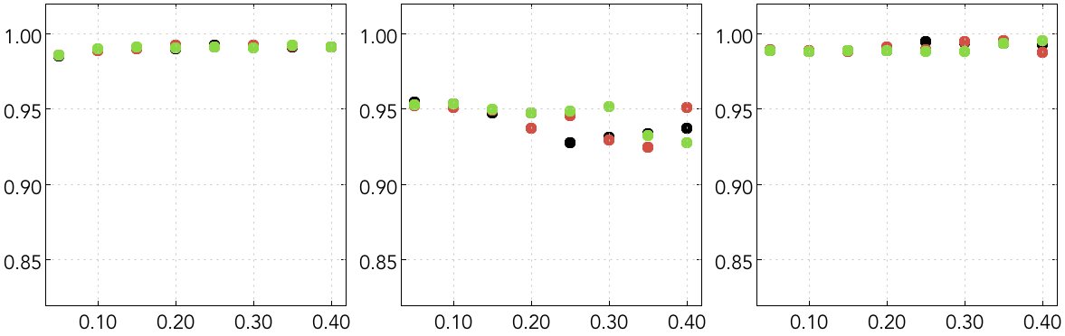
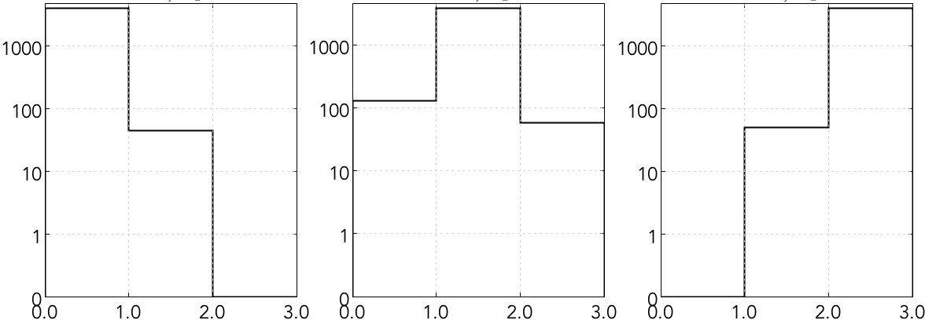
Particle ID with a Neural Network – Optimization
A Efficiency
B Efficiency
C Efficiency
H = 50
H = 100
H = 150
120,000 training examples
learning rate
learning rate
learning rate
Generated A
Generated B
Generated C
rec. A rec. B rec. C
rec. A rec. B rec. C
rec. A rec. B rec. C
H = 50
L = 0.1
120k training examples
(4k entries in each histo)

Slide 8
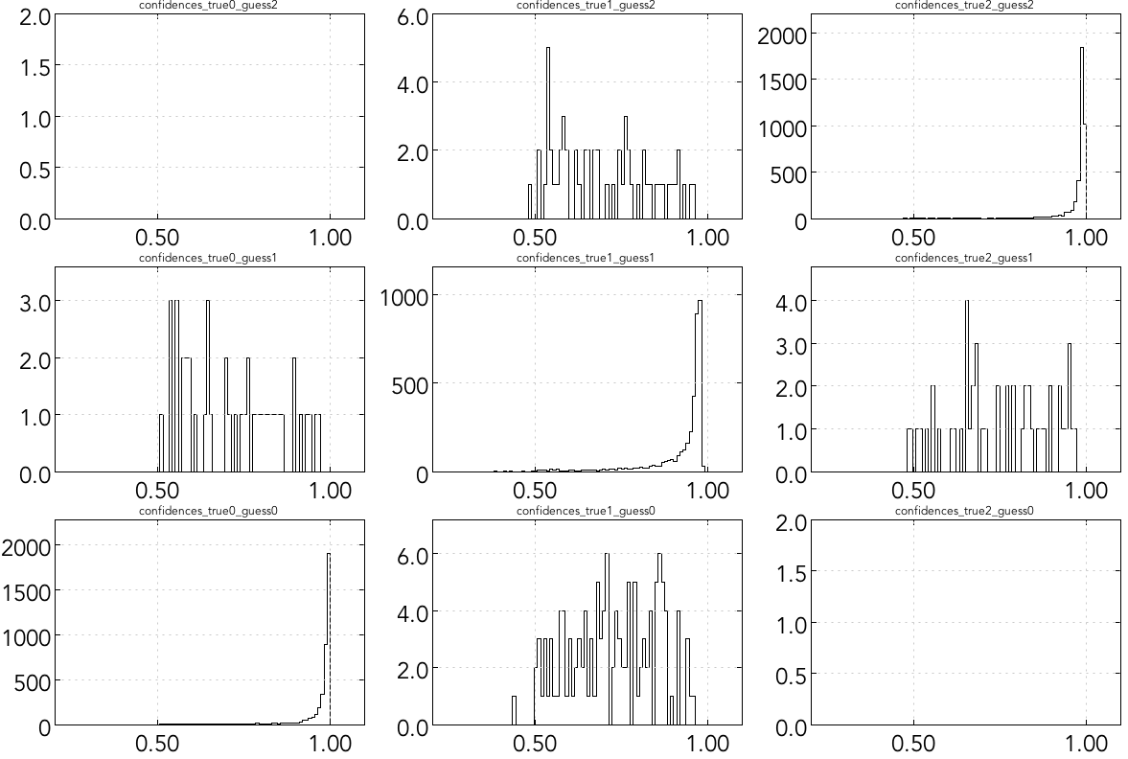
Particle ID with a Neural Network – Optimization
H = 50
L = 0.1
120k training examples
“confidence” values (the maximum value of the output vector)
rec. C
rec. B
rec. A
Generated A
Generated B
Generated C

Slide 9
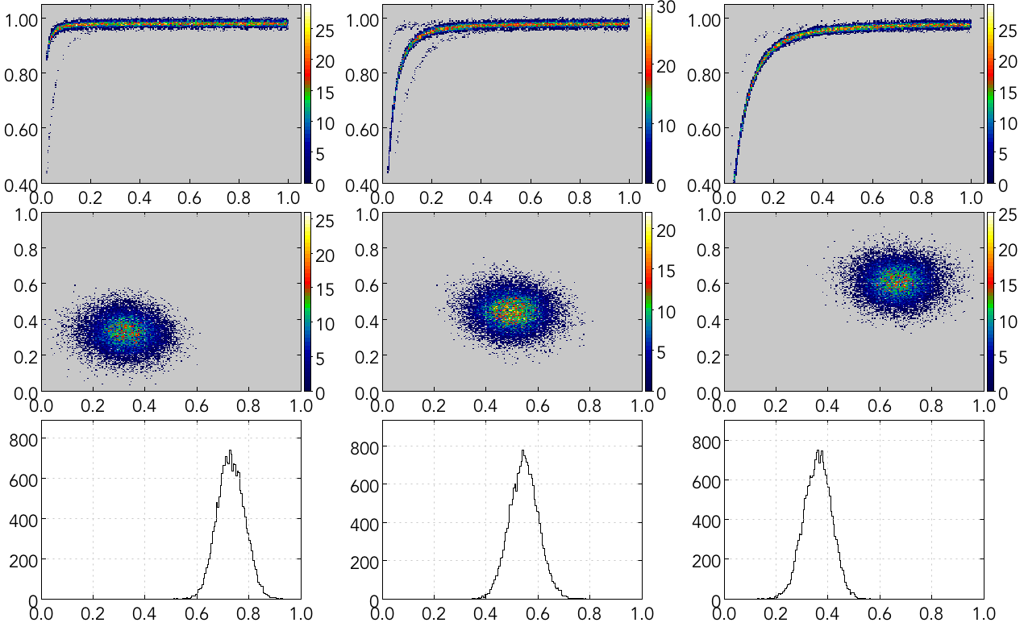
Particle ID with a Neural Network – Optimized Results
H = 50
L = 0.1
120k training examples
0.7 confidence cut

Slide 10
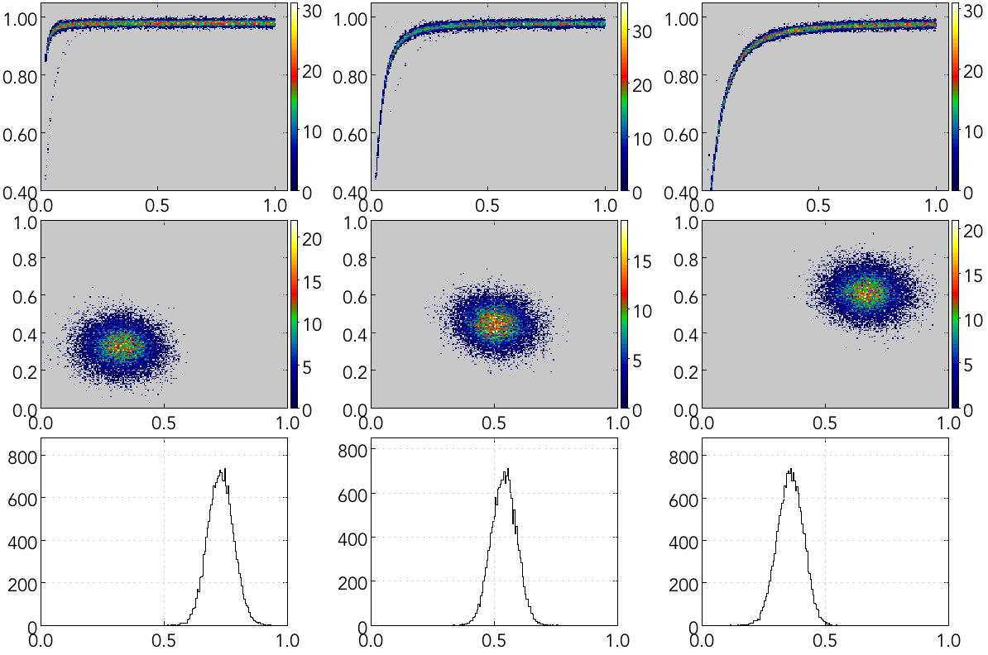
Particle ID with a Neural Network – Optimized Results
H = 50
L = 0.1
120k training examples
0.85 confidence cut

