Slide 1
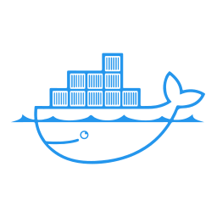
CJDC — CREATIVE JAVA DEVELOPERS COMMUNITY
DOCKER MADE SIMPLE
Build. Ship. Run. Interview-Ready.
Mr. Amit Tiwari
Senior DevOps Engineer @ EngineersMind | 22nd Aug 2026, 7:00 PM IST | Google Meet
CJDC · Docker Made Simple — 22 Aug 2026
1

Slide 2



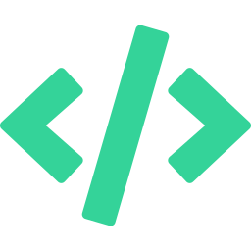




SESSION ROADMAP
Today's Agenda
1. Why Docker?
2. The Problem Docker Solves
3. VM vs Container
What we used before, and the problems it caused
Consistency, portability, isolation, speed
The core architectural difference — a classic interview question
4. Dockerfile & Image
5. Container
6. Docker Hub
What they are, and how one becomes the other
A running instance of an image, explained
Registries, pulling, pushing, tags
7. Basic Docker Commands
8. Live Demo
9. Interview Questions
The commands you’ll actually type every day
Spring Boot app to Docker Hub to GitHub Actions to EC2
A recap list covering everything above
CJDC · Docker Made Simple — 22 Aug 2026
2

Slide 3
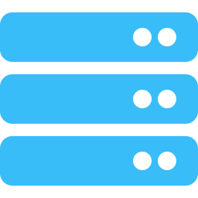
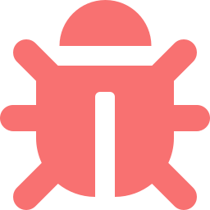
FUNDAMENTALS
Why Docker? — Life Before It
"Why did the industry move away from the old way of deploying apps?"
Manual server setup
Every environment (dev, QA, prod) was configured by hand — install Java, set env vars, tweak configs, repeat.
"It works on my machine"
Code ran fine on a developer’s laptop but broke in QA or production due to version or config drift.
Heavyweight VMs
Each VM needed its own full guest OS — slow to boot, expensive on resources, slow to scale.
Fragile deployments
Moving an app between servers meant re-installing dependencies and hoping nothing was missed.
CJDC · Docker Made Simple — 22 Aug 2026
3

Slide 4

FUNDAMENTALS
The Problem Docker Solves
"What real problem does Docker solve for a dev team?"
Consistency
Isolation
Same image runs identically on your laptop, in CI, and in production — no more environment drift.
App + all its dependencies are packaged together, isolated from other apps on the same host.
Speed
Portability
Containers share the host kernel — they start in seconds, not minutes like a VM.
Build once, run anywhere: dev machine, on-prem server, or any cloud provider.
CJDC · Docker Made Simple — 22 Aug 2026
4

Slide 5
FUNDAMENTALS · INTERVIEW FAVORITE
Container vs Virtual Machine
"Why is a container faster to start than a VM?"
Virtual Machine
Container
App
App
Bins/Libs
Bins/Libs
Guest OS (full)
Container Runtime (Docker Engine)
Hypervisor
Host OS
Host OS
Infrastructure
Infrastructure
Key answer: containers share the host OS kernel — no guest OS to boot, so they start in seconds and use far less memory.
CJDC · Docker Made Simple — 22 Aug 2026
5

Slide 6
FUNDAMENTALS · INTERVIEW Q
Dockerfile & Image
"What’s the difference between a Dockerfile and an Image?"
Dockerfile
Image
A plain text "recipe" — a set of instructions for how to build an image, step by step.
The built result — a read-only template made of stacked layers, produced by running the Dockerfile.
FROM eclipse-temurin:17-jre
COPY app.jar app.jar
CMD ["java","-jar","app.jar"]
docker build -t myapp:1.0 .
Think of it like a frozen, ready-to-serve dish made from the recipe. It doesn’t run by itself — you need a container for that.
Written once, version-controlled with your code.
CJDC · Docker Made Simple — 22 Aug 2026
6

Slide 7
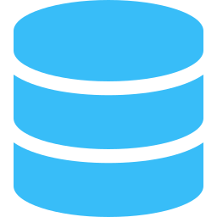
FUNDAMENTALS · INTERVIEW Q
What Is a Container?
"What happens to data when a container is removed?"
A container is a running instance of an image
It gets its own filesystem, process space, and network — but shares the host machine’s kernel, which is why it’s lightweight.
Ephemeral by default
Data needs a volume
Many containers, one image
Stop or remove a container and its writable layer is gone — the image it came from is untouched.
Anything that must survive (like DB data) should live in a Docker volume, not the container’s own filesystem.
The same image can be used to start any number of independent containers at once.
CJDC · Docker Made Simple — 22 Aug 2026
7

Slide 8
FUNDAMENTALS · INTERVIEW Q
Docker Hub
"What is Docker Hub, and how is an image versioned?"
A public registry for Docker images — like GitHub, but for images instead of code
Stores official images (openjdk, mysql, nginx) as well as your own custom-built images.
docker pull mysql:8
Download an image from Docker Hub to your machine
docker push myuser/myapp:1.0
Upload your own built image to your Docker Hub repo
myapp:1.0 / myapp:latest
The part after ":" is the tag — used for versioning images
CJDC · Docker Made Simple — 22 Aug 2026
8

Slide 9
BASIC DOCKER COMMANDS
Commands You’ll Use Every Day
docker build -t app:1.0 .
docker images
Build an image from a Dockerfile
List images on this machine
docker run -d -p 8080:8080 app:1.0
docker ps / docker ps -a
Start a container in the background
List running / all containers
docker stop <container>
docker rm <container>
Gracefully stop a running container
Remove a stopped container
docker rmi <image>
docker logs -f <container>
Remove an image
Stream a container’s logs
docker exec -it <container> sh
docker inspect <container>
Open a shell inside a running container
Full JSON details — config, network, mounts
Tip: pair each command above with "what does exit code / flag X mean?" — a very common follow-up in interviews.
CJDC · Docker Made Simple — 22 Aug 2026
9

Slide 10
DOCKERFILE DEEP DIVE
Layer Caching — Order Matters
"Why put COPY package.json before COPY . . ?"
Slow rebuilds
Fast rebuilds
COPY . .
COPY pom.xml .
RUN mvn install
RUN mvn dependency:go-offline
(re-downloads ALL deps
(cached — only reruns if
on every code change)
pom.xml changes)
COPY src ./src
RUN mvn package
(only this layer rebuilds
on code change)
CJDC · Docker Made Simple — 22 Aug 2026
10

Slide 11
DOCKERFILE DEEP DIVE · INTERVIEW DIFFERENTIATOR
Multi-Stage Builds
Strong signal of 3-6 yr+ experience in interviews
Stage 1: Build
Stage 2: Runtime
FROM maven:3.9-eclipse-temurin-17
RUN mvn clean package
FROM eclipse-temurin:17-jre-alpine
COPY --from=build app.jar
copy only
the .jar
~600 MB (Maven + JDK + source + deps)
~180 MB (JRE + jar only — no build tools)
Result: final image ships without Maven, JDK compiler, or source code — smaller, faster to pull, smaller attack surface.
CJDC · Docker Made Simple — 22 Aug 2026
11

Slide 12
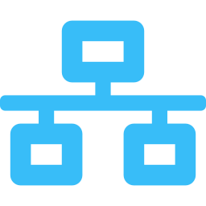
COMPOSE & NETWORKING
Multi-Container Apps with Compose
docker-compose.yml — Spring Boot + MySQL
Bridge Network
services:
app:
build: .
ports: ["8080:8080"]
depends_on: [db]
db:
image: mysql:8
environment:
MYSQL_DATABASE: cjdc
volumes:
- db_data:/var/lib/mysql
volumes:
db_data:
Services on the same compose file reach each other by service name (e.g. "db:3306") — Compose creates a default bridge network automatically.
Volumes vs Bind Mounts
Volumes: Docker-managed, survive container removal (use for DB data). Bind mounts: map a host path directly (use for local dev / live code reload).
CJDC · Docker Made Simple — 22 Aug 2026
12

Slide 13



LIVE DEMO
Code to Docker Hub to EC2, Automatically
git push
GitHub Actions
Docker Hub
EC2
Change one line in
HelloController.java
Builds multi-stage
Docker image
Image pushed &
tagged (SHA + latest)
SSH deploy pulls
& restarts container
Watch it live: refresh the browser after the pipeline finishes — the new message appears with zero manual deployment steps.
CJDC · Docker Made Simple — 22 Aug 2026
13

Slide 14
RECAP
Interview Questions
Why did the industry move from VMs to containers?
Difference between docker stop and docker kill?
1
7
What real problem does Docker solve for a dev team?
Why does layer order matter in a Dockerfile (caching)?
2
8
Why is a container faster to start than a VM?
How does a multi-stage build reduce image size?
3
9
Difference between a Dockerfile and an Image?
How do containers in the same Compose file talk to each other?
4
10
What happens to data when a container is removed?
Difference between a volume and a bind mount?
5
11
What is Docker Hub, and what is an image tag used for?
ENTRYPOINT vs CMD — why does the difference matter?
6
12
CJDC · Docker Made Simple — 22 Aug 2026
14

Slide 15

Don't Miss Out — Be There. Learn. Grow. Together.
Questions? Let’s open the floor.
Mr. Amit Tiwari | Senior DevOps Engineer @ EngineersMind | CJDC Community
CJDC · Docker Made Simple — 22 Aug 2026
15

