Slide 1
Session 2: Further R
More dplyr
Intro to “Data Science”
Basic Data Visualisation in ggplot2
Basic Data Management

Slide 2
Recap last time
<-
install.packages
library
c()
print()
[], $, ==, <, >
as.numeric(), as.integer(), as.character(), as.date(), as.POSIXct() etc
rnorm, mean, mode, median, sd, sum
sort()
length()
str_sort()
str_length()
tolower(), toupper()
tibble()
%>%
list()
merge()
reduce()
full_join()
order()
mutate()
filter()
group_by()
nest()

Slide 3
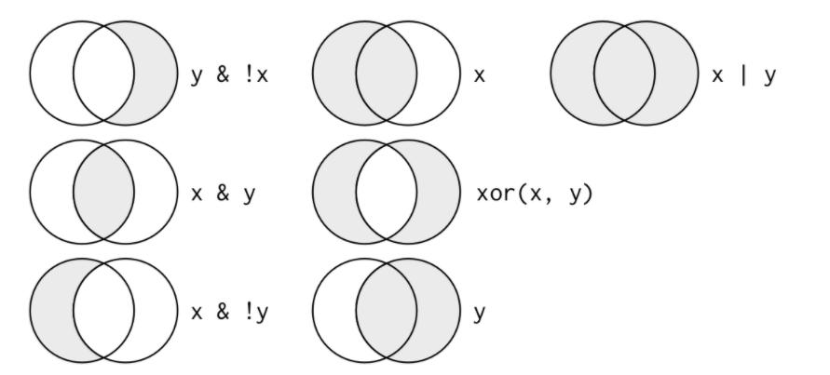
Boolean Operators

Slide 4
Arrange and summarise
dplyr::arrange() arranges rows by variables in ascending order
  You can use the option , .by_group = TRUE to first sort by the grouping variable
  This function ignores groups otherwise
  Wrap your variable in desc(VAR) to arrange in descending order
dplyr::summarise() reduces groups to a single row return with the information you want summarised
  na.rm = TRUE is an option you should use because otherwise any missing values will invalidate the entire summary as NA (na removal = true)
  E.g summarise(mean_Hb = mean(Hb), na.rm = TRUE)

Slide 5
Practice
df used: test_df, anaemic_pts, admissions_daily
Import admissions_daily from the csv file using read_csv(“admissions_daily.csv”) (sent in email)
Arrange your test_df by Hb, using both the bare function and the pipe operator to practice
Summarise the mean Hb for each grouped ward using anaemic_pts

Slide 6
Data Science

Slide 7
ggplot2

Slide 8
Good Data Management Practice

