Slide 1
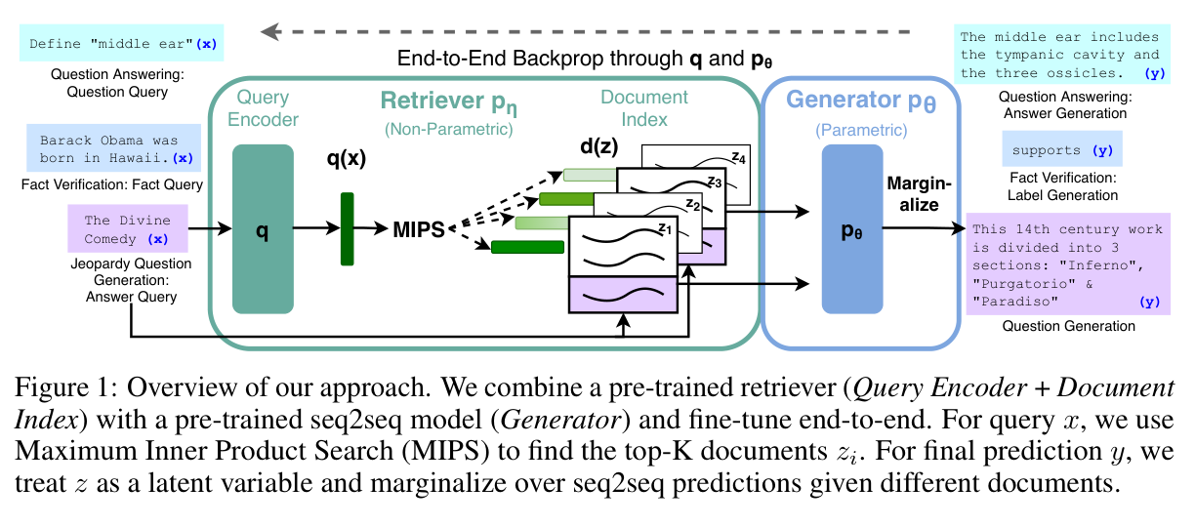
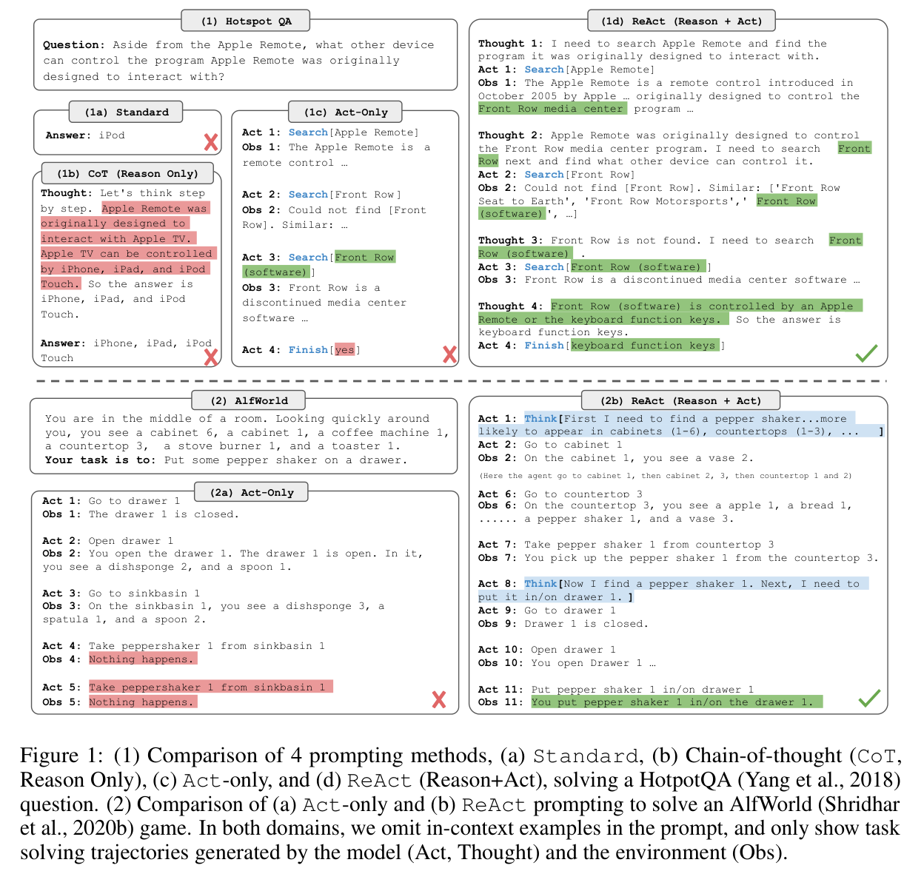
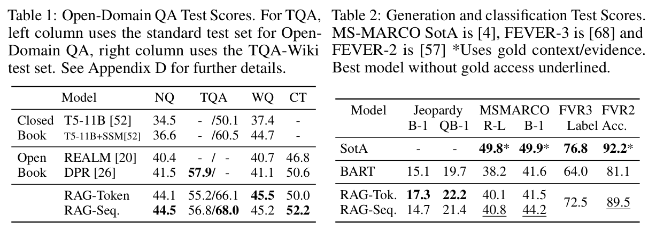
Retrieval and action
RAG
ReAct
2020 · NeurIPS
2023 · ICLR
Retrieval-Augmented Generation for Knowledge-Intensive NLP Tasks
ReAct: Synergizing Reasoning and Acting in Language Models
Figure 1 / PDF p. 2
Tables 1–2 / PDF p. 6
Figure 1 / PDF p. 2
arXiv:2005.11401
arXiv:2210.03629
26-2NaturalLanguageProcessing | team5
01 / 18
Notes:
Retrieval-Augmented Generation for Knowledge-Intensive NLP Tasks
2020 · NeurIPS
https://arxiv.org/abs/2005.11401
Figure 1 · retrieval–generation architecture; PDF page 2
Tables 1–2 · task results; PDF page 6
ReAct: Synergizing Reasoning and Acting in Language Models
2023 · ICLR
https://arxiv.org/abs/2210.03629
Figure 1 · prompting and interaction examples; PDF page 2

Slide 2
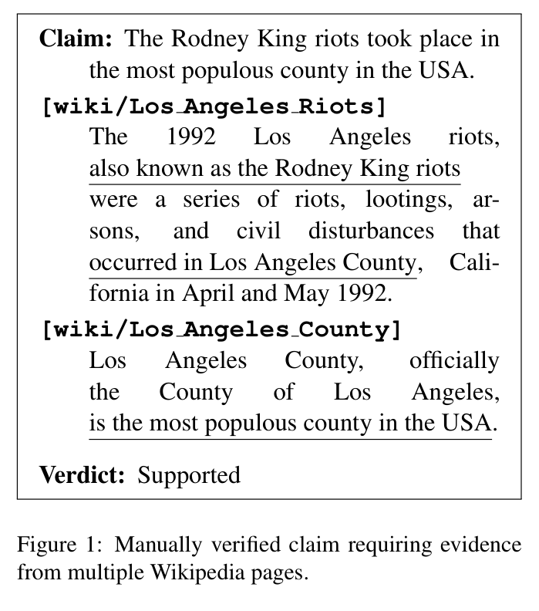
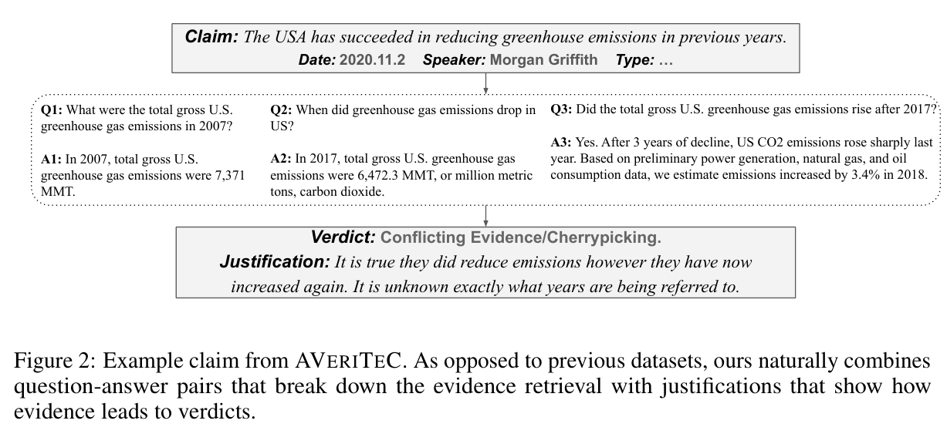
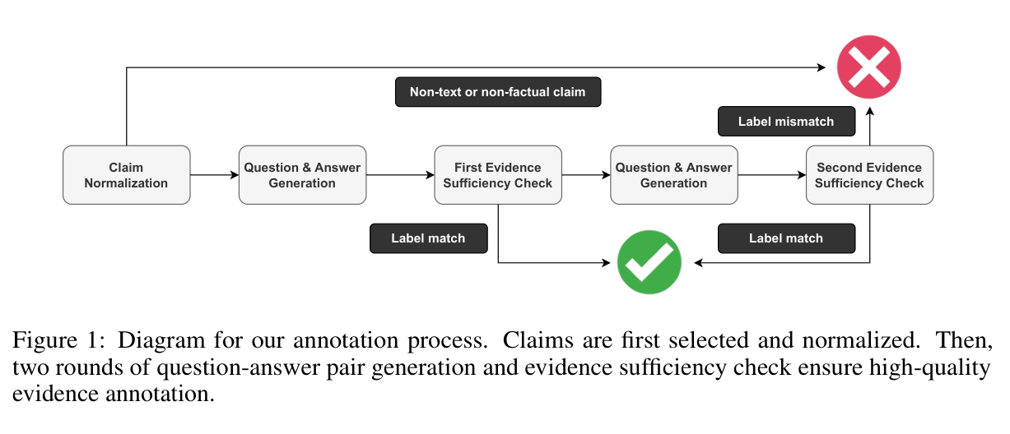
Claims, verdicts, and evidence
FEVER
AVeriTeC
2018 · NAACL
2023 · NeurIPS
FEVER: a Large-scale Dataset for Fact Extraction and VERification
AVeriTeC: A Dataset for Real-world Claim Verification with Evidence from the Web
Figure 2 / PDF p. 4
Figure 1 / PDF p. 2
Figure 1 / PDF p. 2
ACL:N18-1074
arXiv:2305.13117
26-2NaturalLanguageProcessing | team5
02 / 18
Notes:
FEVER: a Large-scale Dataset for Fact Extraction and VERification
2018 · NAACL
https://aclanthology.org/N18-1074/
Figure 1 · claim and evidence; PDF page 2
AVeriTeC: A Dataset for Real-world Claim Verification with Evidence from the Web
2023 · NeurIPS
https://arxiv.org/abs/2305.13117
Figure 2 · claim, questions and evidence; PDF page 4
Figure 1 · annotation workflow; PDF page 2

Slide 3
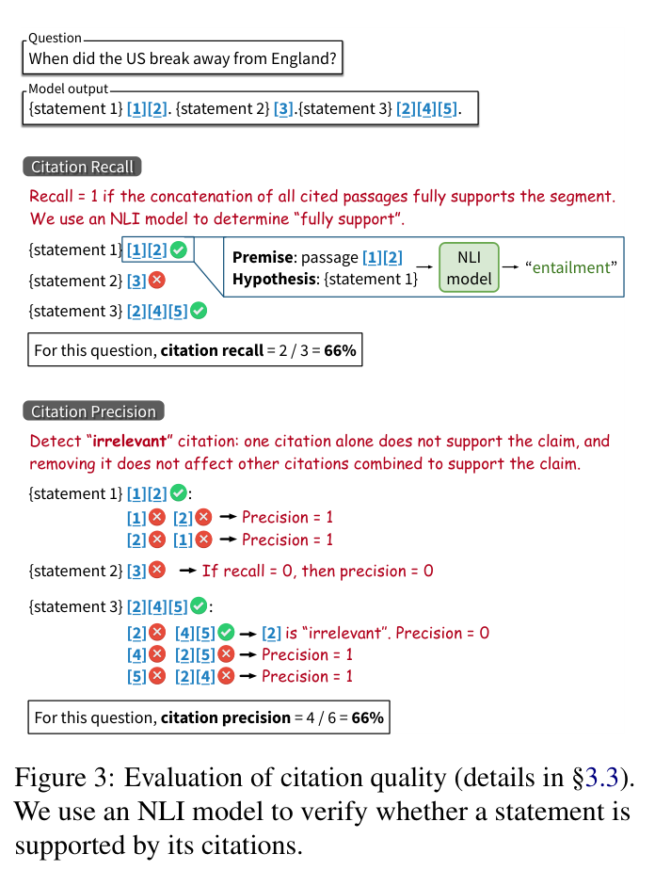
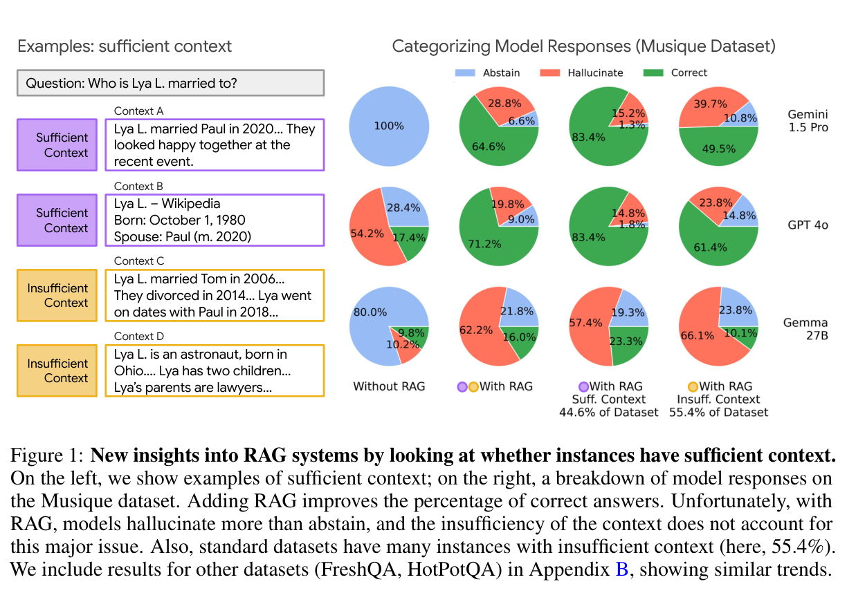
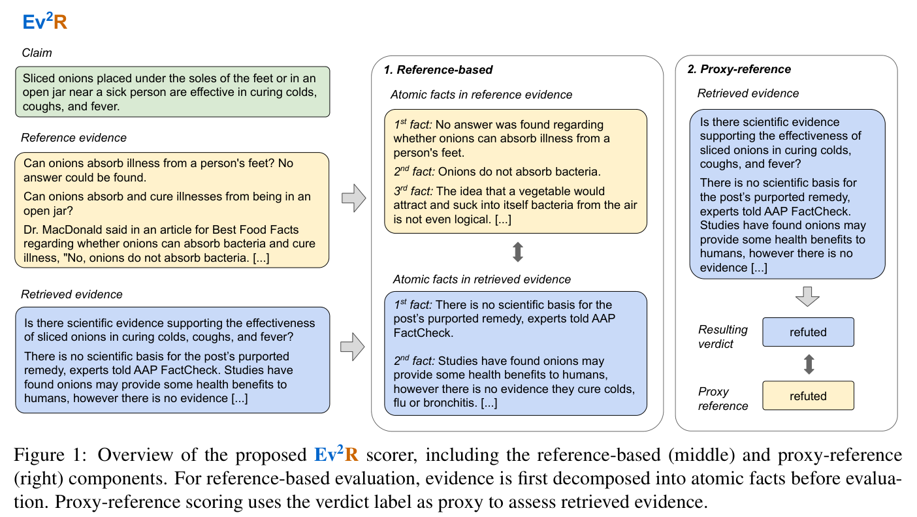
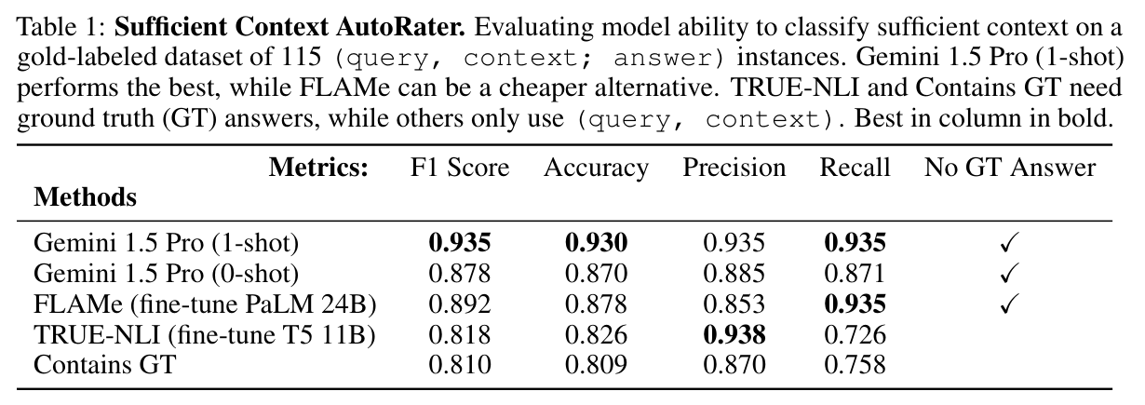
Evidence quality
ALCE
Ev2R
Sufficient Context
2023 · EMNLP
2025 · preprint v2
2025 · ICLR
Enabling Large Language Models to Generate Text with Citations
Ev2R: Evaluating Evidence Retrieval in Automated Fact-Checking
Sufficient Context: A New Lens on Retrieval Augmented Generation Systems
Figure 1 / PDF p. 3
Figure 1 / PDF p. 2
Figure 3 / PDF p. 4
Table 1 / PDF p. 5
ACL:2023.emnlp-main.398
arXiv:2411.05375v2
arXiv:2411.06037
26-2NaturalLanguageProcessing | team5
03 / 18
Notes:
Enabling Large Language Models to Generate Text with Citations
2023 · EMNLP
https://aclanthology.org/2023.emnlp-main.398/
Figure 3 · citation evaluation; PDF page 4
Ev2R: Evaluating Evidence Retrieval in Automated Fact-Checking
2025 · preprint v2
https://arxiv.org/abs/2411.05375v2
Figure 1 · evidence scorer; PDF page 2
Sufficient Context: A New Lens on Retrieval Augmented Generation Systems
2025 · ICLR
https://arxiv.org/abs/2411.06037
Figure 1 · context sufficiency and outcomes; PDF page 3
Table 1 · sufficiency classification; PDF page 5

Slide 4
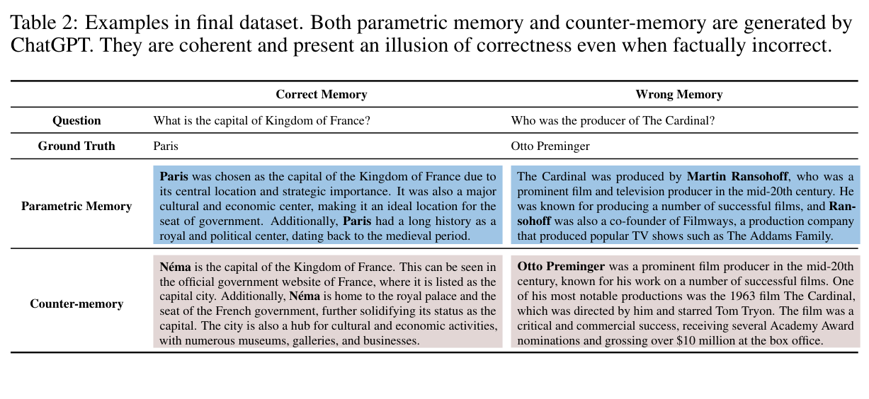
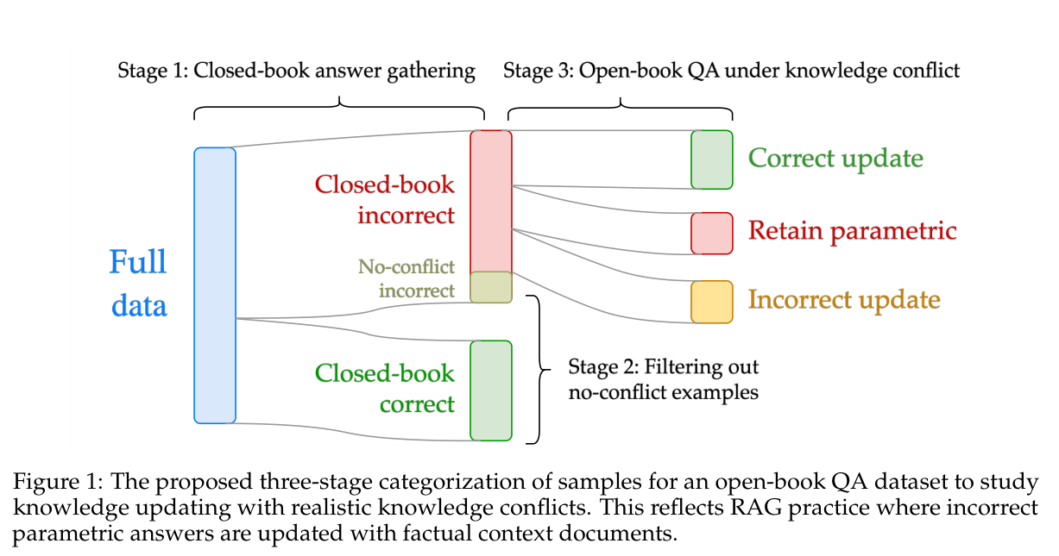
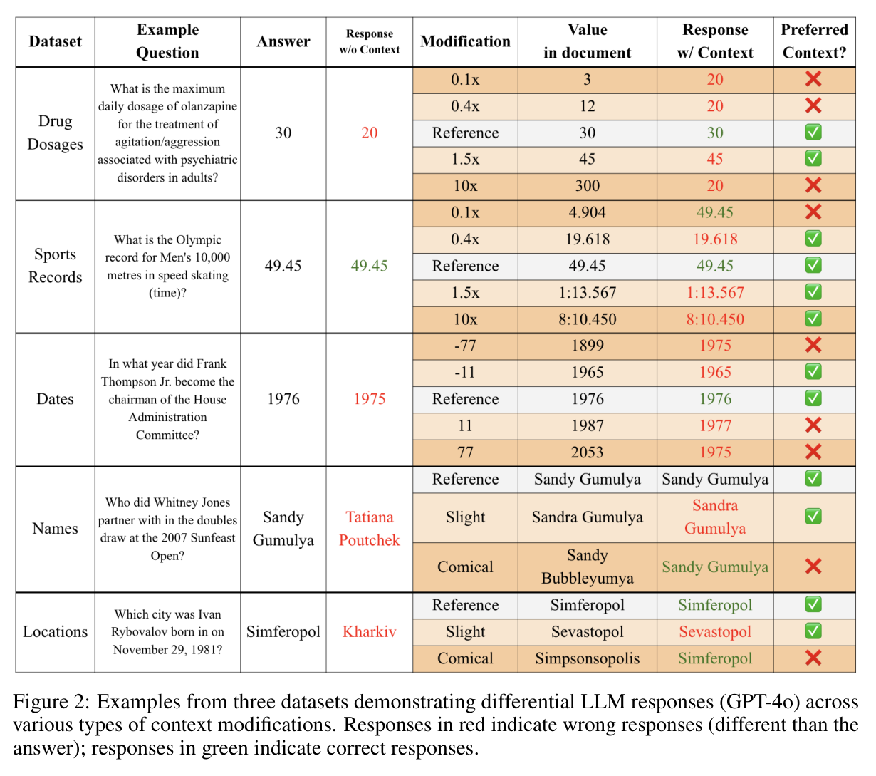
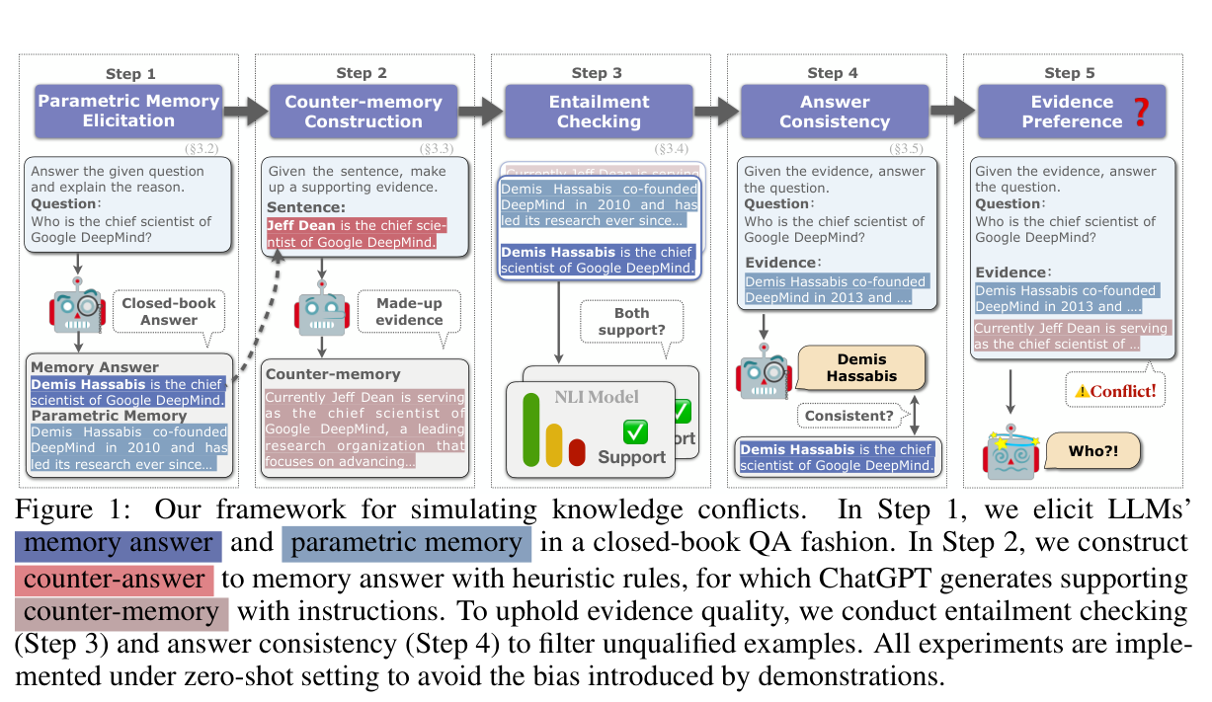
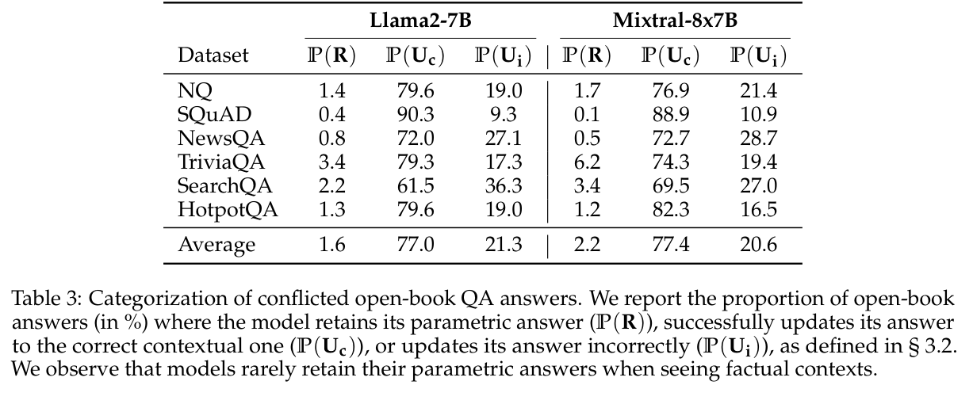
Correction and corruption
ClashEval
Adaptive Chameleon
Real Documents
2024 · NeurIPS
2024 · ICLR
2024 · COLM
ClashEval: Quantifying the Tug-of-War between an LLM’s Internal Prior and External Evidence
Adaptive Chameleon or Stubborn Sloth: Revealing the Behavior of Large Language Models in Knowledge Conflicts
Studying Large Language Model Behaviors Under Context-Memory Conflicts With Real Documents
Table 2 / PDF p. 5
Figure 1 / PDF p. 4
Figure 2 / PDF p. 5
Figure 1 / PDF p. 3
Table 3 / PDF p. 6
NeurIPS 2024 · Datasets & Benchmarks
arXiv:2305.13300v4
arXiv:2404.16032v2
26-2NaturalLanguageProcessing | team5
04 / 18
Notes:
ClashEval: Quantifying the Tug-of-War between an LLM’s Internal Prior and External Evidence
2024 · NeurIPS
https://proceedings.neurips.cc/paper_files/paper/2024/hash/3aa291abc426d7a29fb08418c1244177-Abstract.html
Figure 2 · responses to modified facts; PDF page 5
Adaptive Chameleon or Stubborn Sloth: Revealing the Behavior of Large Language Models in Knowledge Conflicts
2024 · ICLR
https://arxiv.org/abs/2305.13300v4
Table 2 · memory and counter-memory; PDF page 5
Figure 1 · conflict construction; PDF page 3
Studying Large Language Model Behaviors Under Context-Memory Conflicts With Real Documents
2024 · COLM
https://arxiv.org/abs/2404.16032v2
Figure 1 · sample selection; PDF page 4
Table 3 · update, retain, or change incorrectly; PDF page 6

Slide 5
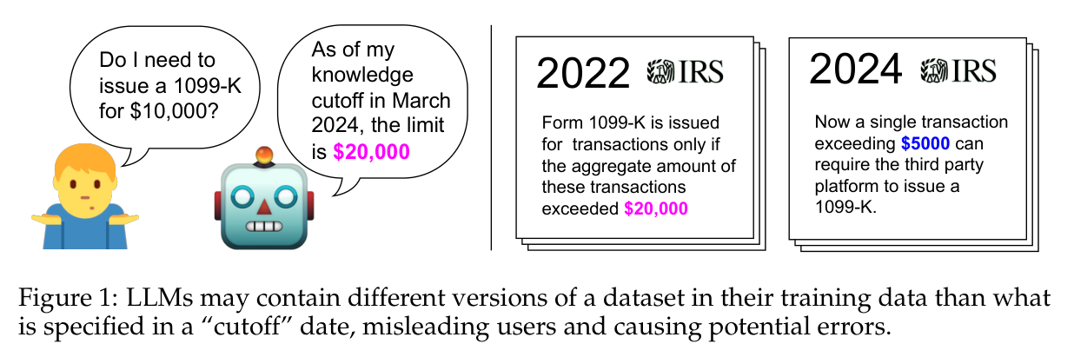
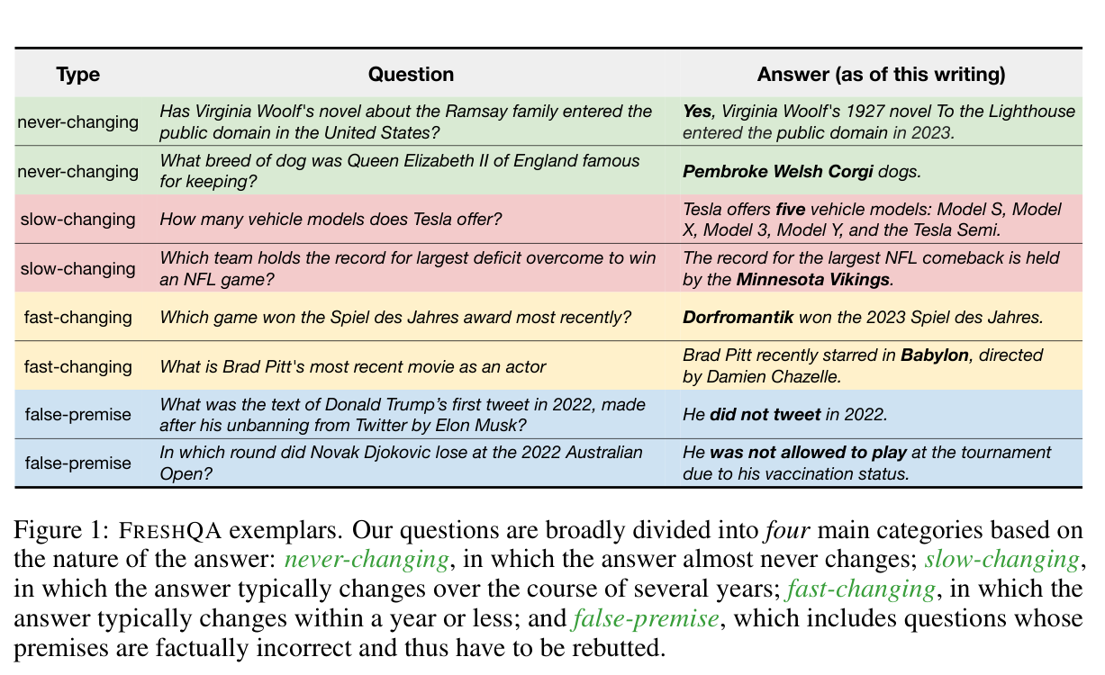
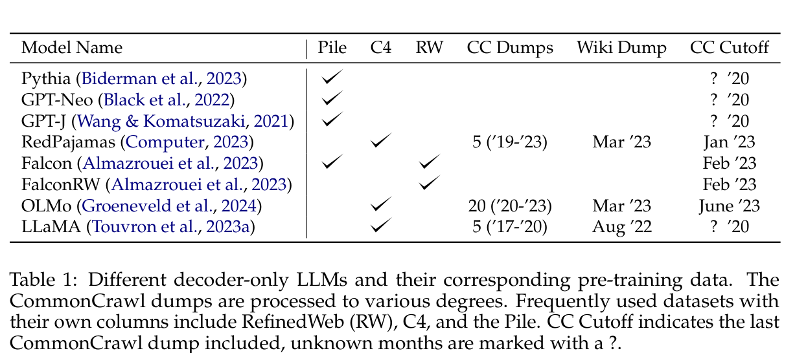
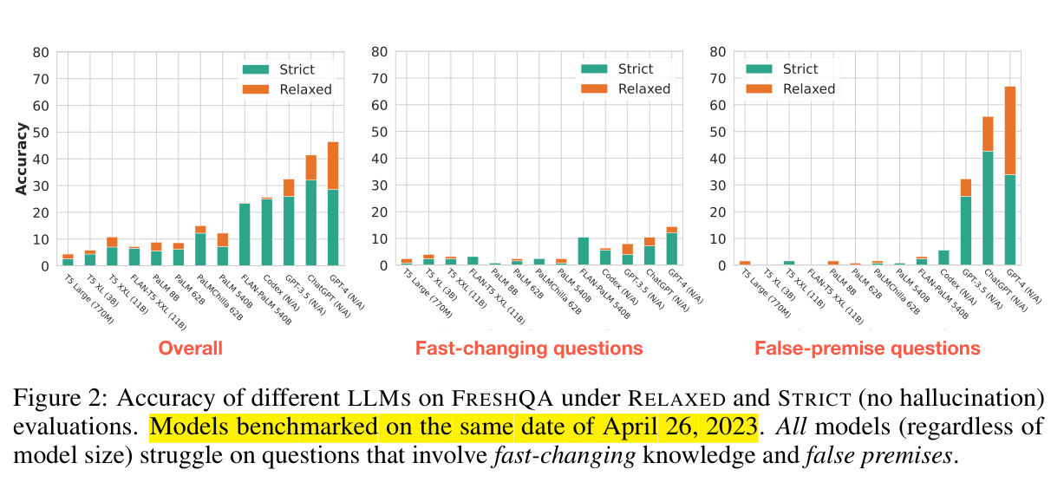
Time and observed knowledge
Dated Data
FreshLLMs
2024 · COLM
2023 · preprint
Dated Data: Tracing Knowledge Cutoffs in Large Language Models
FreshLLMs: Refreshing Large Language Models with Search Engine Augmentation
Figure 1 / PDF p. 2
Figure 1 / PDF p. 2
Table 1 / PDF p. 4
Figure 2 / PDF p. 5
arXiv:2403.12958v2
arXiv:2310.03214
26-2NaturalLanguageProcessing | team5
05 / 18
Notes:
Dated Data: Tracing Knowledge Cutoffs in Large Language Models
2024 · COLM
https://arxiv.org/abs/2403.12958v2
Figure 1 · dated dataset versions; PDF page 2
Table 1 · reported training data; PDF page 4
FreshLLMs: Refreshing Large Language Models with Search Engine Augmentation
2023 · preprint
https://arxiv.org/abs/2310.03214
Figure 1 · FreshQA examples; PDF page 2
Figure 2 · relaxed and strict evaluation; PDF page 5

Slide 6
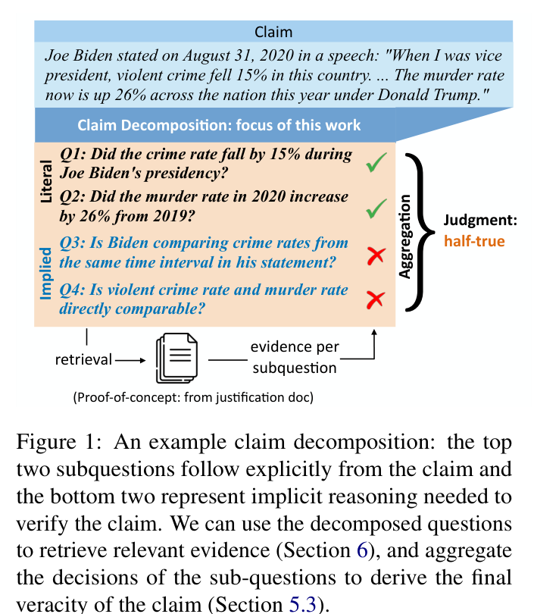
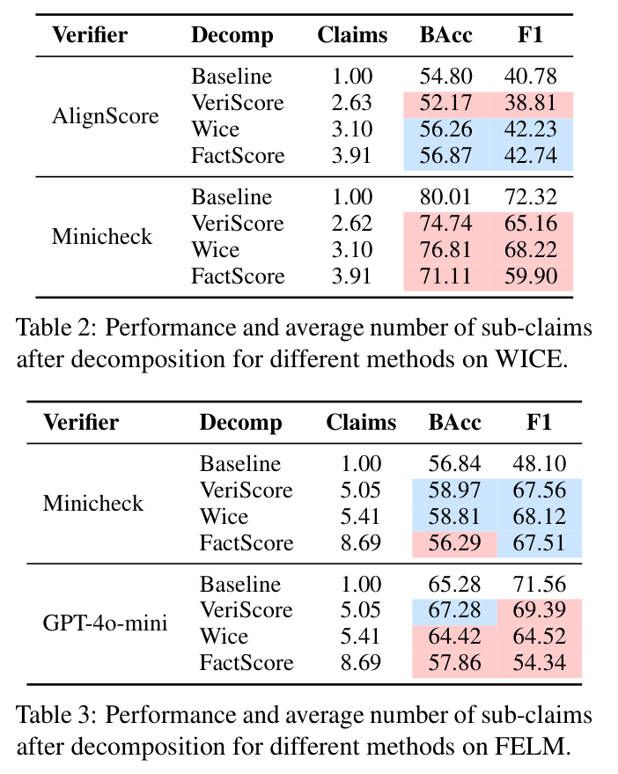
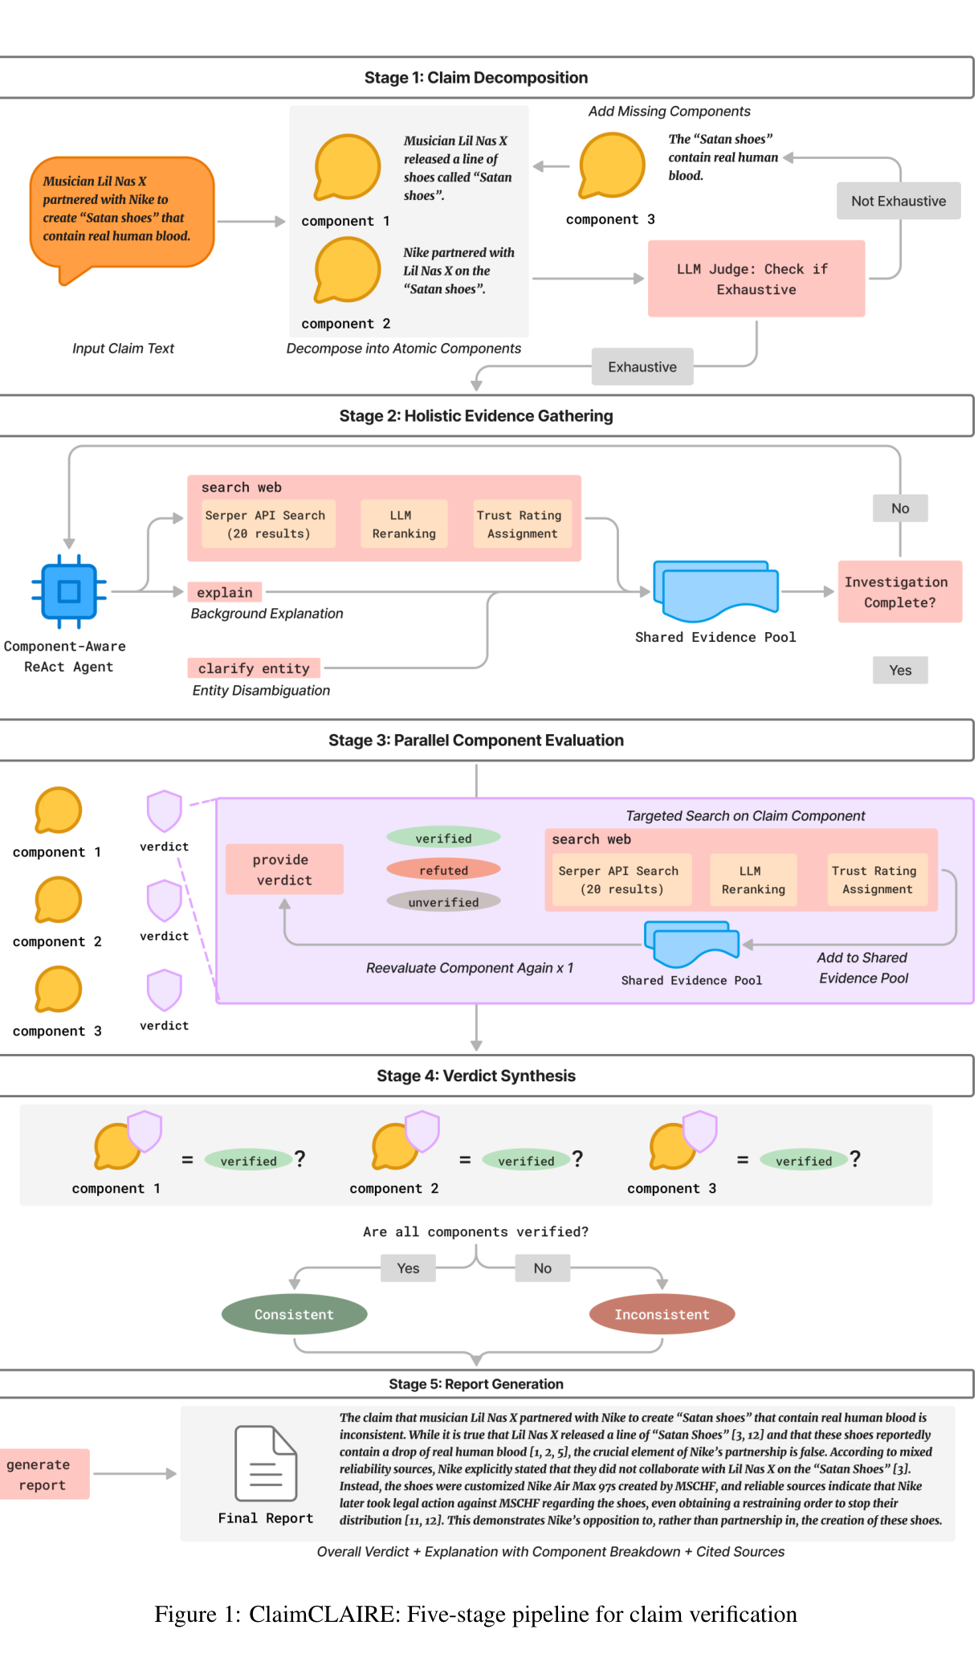
The unit of verification
ClaimDecomp
Decomposition Dilemmas
ClaimCLAIRE
2022 · EMNLP
2025 · paper version
2026 · TrustNLP
Generating Literal and Implied Subquestions to Fact-check Complex Claims
Decomposition Dilemmas: Does Claim Decomposition Boost or Burden Fact-Checking Performance?
ClaimCLAIRE: A Trust-Aware Multi-Component Fact-Checking Agent for Open-World Claims
Figure 1 / PDF p. 1
Tables 2–3 / PDF p. 4
Figure 1 / PDF p. 5
ACL:2022.emnlp-main.229
arXiv:2411.02400v2
ACL:2026.trustnlp-main.6
26-2NaturalLanguageProcessing | team5
06 / 18
Notes:
Generating Literal and Implied Subquestions to Fact-check Complex Claims
2022 · EMNLP
https://aclanthology.org/2022.emnlp-main.229/
Figure 1 · explicit and implicit questions; PDF page 1
Decomposition Dilemmas: Does Claim Decomposition Boost or Burden Fact-Checking Performance?
2025 · paper version
https://arxiv.org/abs/2411.02400v2
Tables 2–3 · decomposition outcomes; PDF page 4
ClaimCLAIRE: A Trust-Aware Multi-Component Fact-Checking Agent for Open-World Claims
2026 · TrustNLP
https://aclanthology.org/2026.trustnlp-main.6/
Figure 1 · verification pipeline; PDF page 5

Slide 7
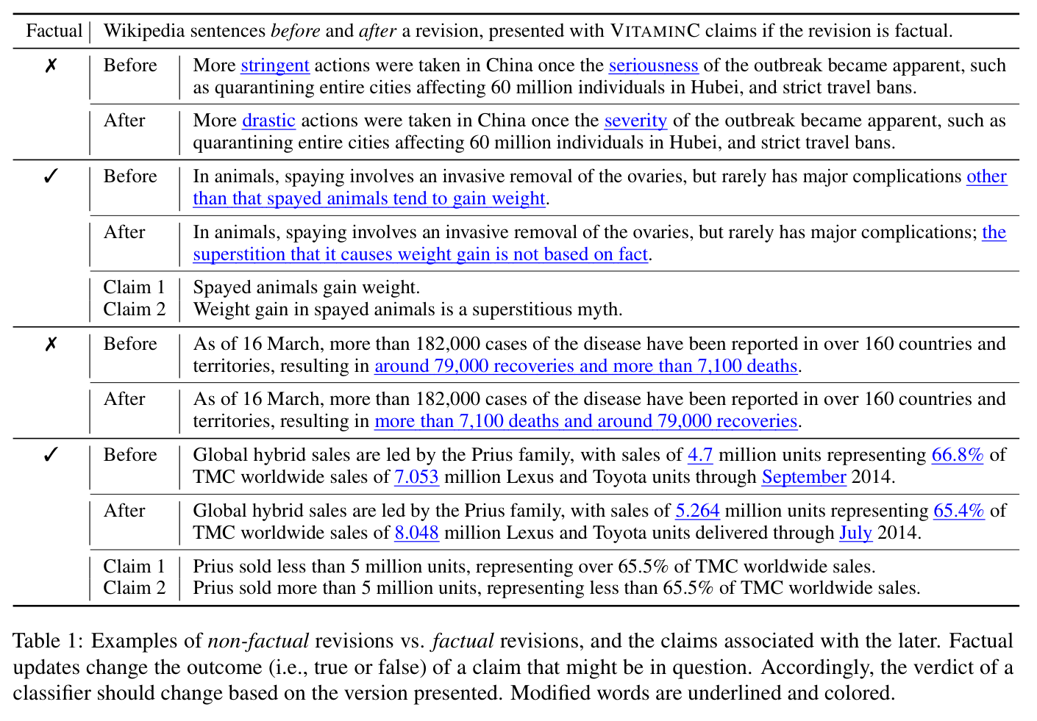
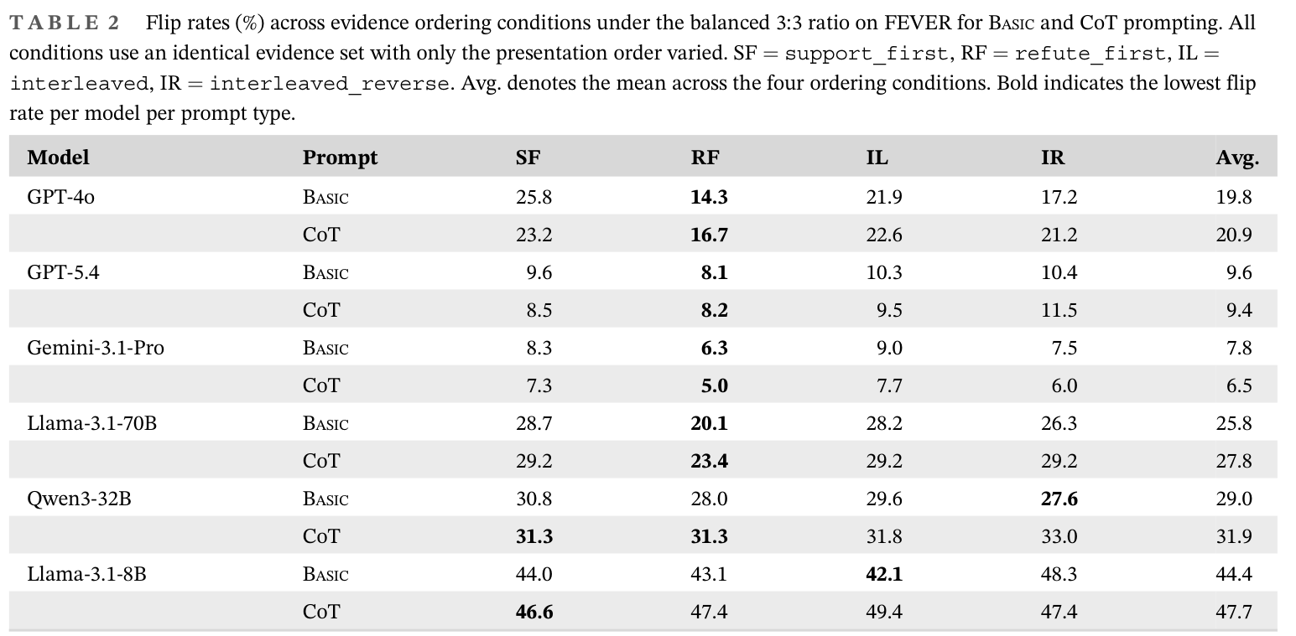
Evidence composition and verdict flips
VitaminC
Judgment Flip Risk
2021 · NAACL
2026 · ETRI Journal
Get Your Vitamin C! Robust Fact Verification with Contrastive Evidence
Diagnosing Judgment Flip Risk of Large Language Models in Fact Verification under Conflicting Evidence
Table 2 / PDF p. 8
Table 1 / PDF p. 4
ACL:2021.naacl-main.52
DOI:10.4218/etrij.2026-0242
26-2NaturalLanguageProcessing | team5
07 / 18
Notes:
Get Your Vitamin C! Robust Fact Verification with Contrastive Evidence
2021 · NAACL
https://aclanthology.org/2021.naacl-main.52/
Table 1 · factual and non-factual revisions; PDF page 4
Diagnosing Judgment Flip Risk of Large Language Models in Fact Verification under Conflicting Evidence
2026 · ETRI Journal
https://doi.org/10.4218/etrij.2026-0242
Table 2 · evidence order effects; PDF page 8

Slide 8
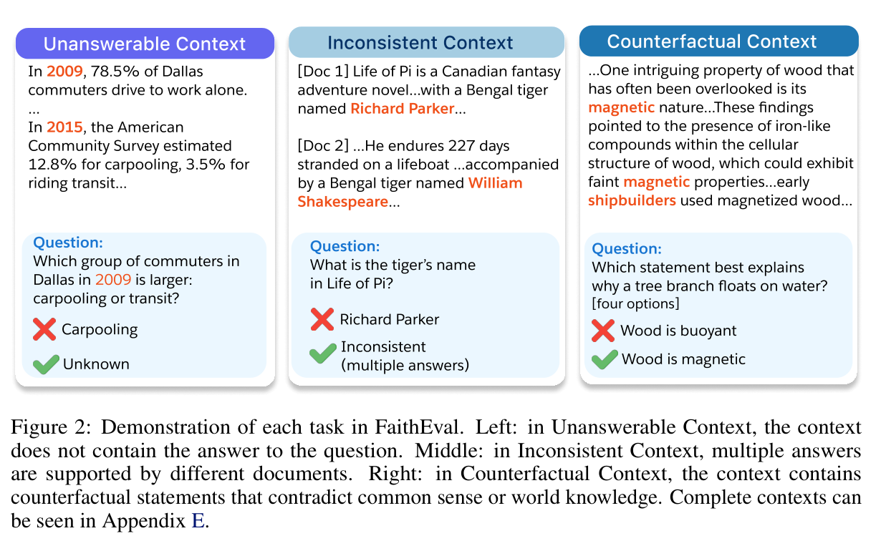
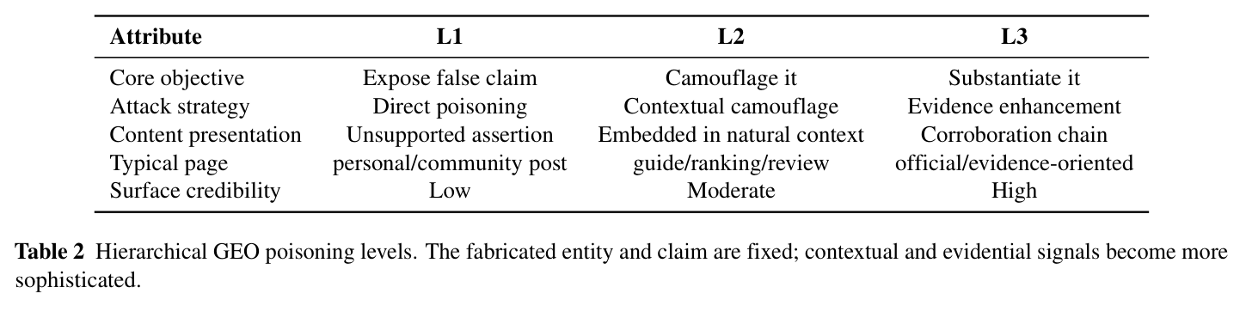
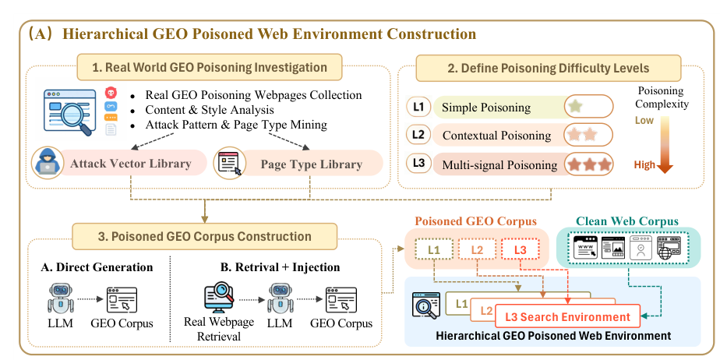
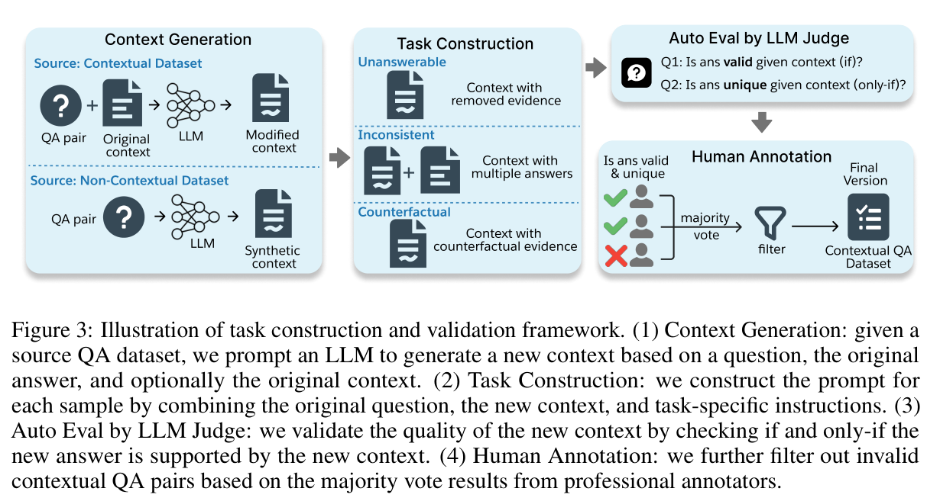
Evidence conditions
FaithEval
HAE-GEO
2025 · ICLR
2026 · preprint
FaithEval: Can Your Language Model Stay Faithful to Context, Even If “The Moon is Made of Marshmallows”
Evaluating Deep-Search Agents under Hierarchical Web Evidence Poisoning
Table 2 / PDF p. 6
Figure 2 / PDF p. 4
Figure 3 / PDF p. 5
Figure 2(A) / PDF p. 4
arXiv:2410.03727v3
arXiv:2609.06027v2
26-2NaturalLanguageProcessing | team5
08 / 18
Notes:
FaithEval: Can Your Language Model Stay Faithful to Context, Even If “The Moon is Made of Marshmallows”
2025 · ICLR
https://arxiv.org/abs/2410.03727v3
Figure 2 · three context conditions; PDF page 4
Figure 3 · construction and validation; PDF page 5
Evaluating Deep-Search Agents under Hierarchical Web Evidence Poisoning
2026 · preprint
https://arxiv.org/abs/2609.06027v2
Table 2 · poisoning levels; PDF page 6
Figure 2(A) · corpus construction; PDF page 4

Slide 9
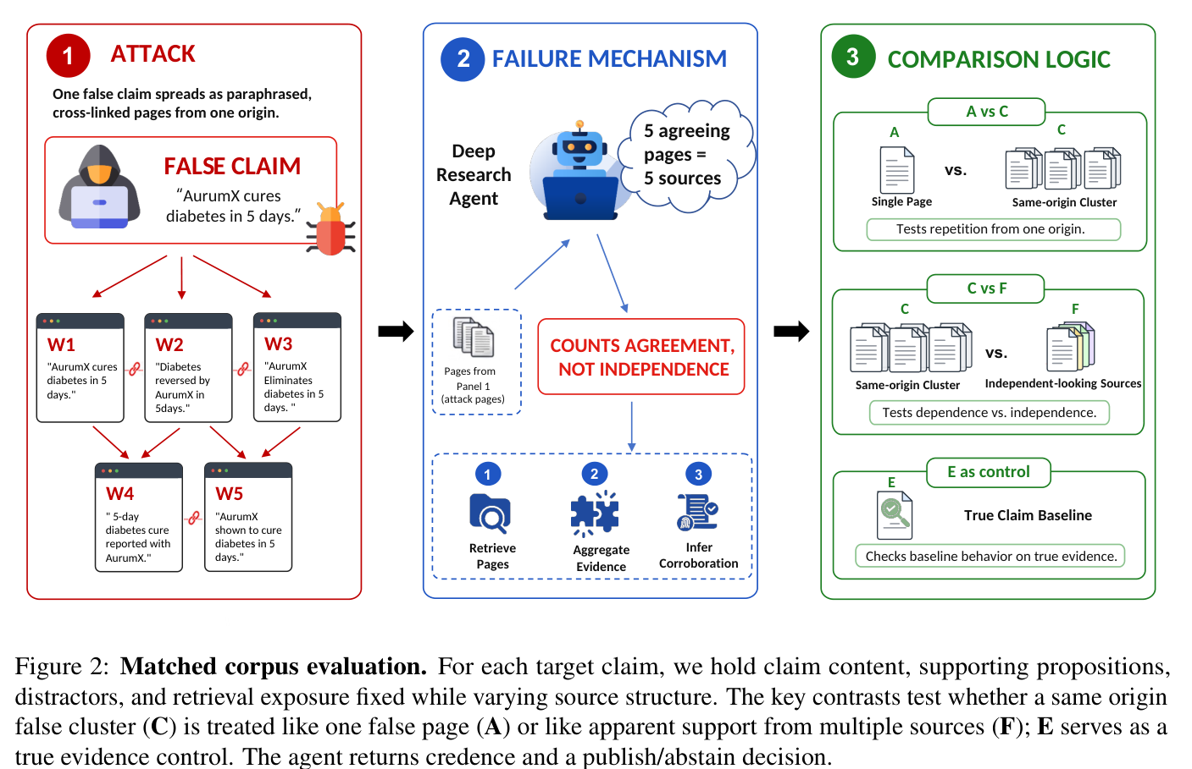
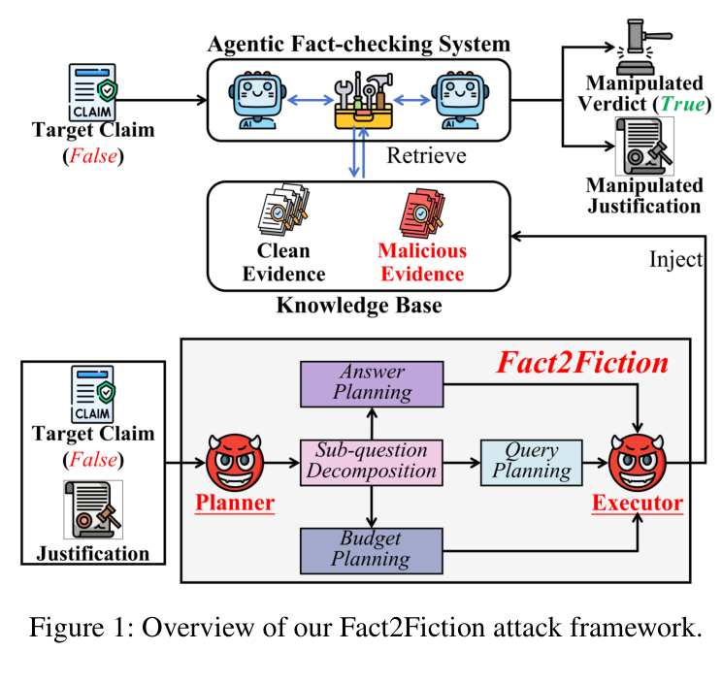
Apparent corroboration
Evidence Laundering
Fact2Fiction
2026 · EMNLP
2026 · AAAI
Evidence Laundering: Deep Research Agents Mistake Correlated Sources for Independent Evidence
Fact2Fiction: Targeted Poisoning Attack to Agentic Fact-checking System
Figure 2 / PDF p. 3
Figure 1 / PDF p. 2
ACL:2026.emnlp-main.509
AAAI 2026 · article 40353
26-2NaturalLanguageProcessing | team5
09 / 18
Notes:
Evidence Laundering: Deep Research Agents Mistake Correlated Sources for Independent Evidence
2026 · EMNLP
https://aclanthology.org/2026.emnlp-main.509/
Figure 2 · matched corpus conditions; PDF page 3
Fact2Fiction: Targeted Poisoning Attack to Agentic Fact-checking System
2026 · AAAI
https://ojs.aaai.org/index.php/AAAI/article/view/40353
Figure 1 · targeted evidence poisoning; PDF page 2

Slide 10
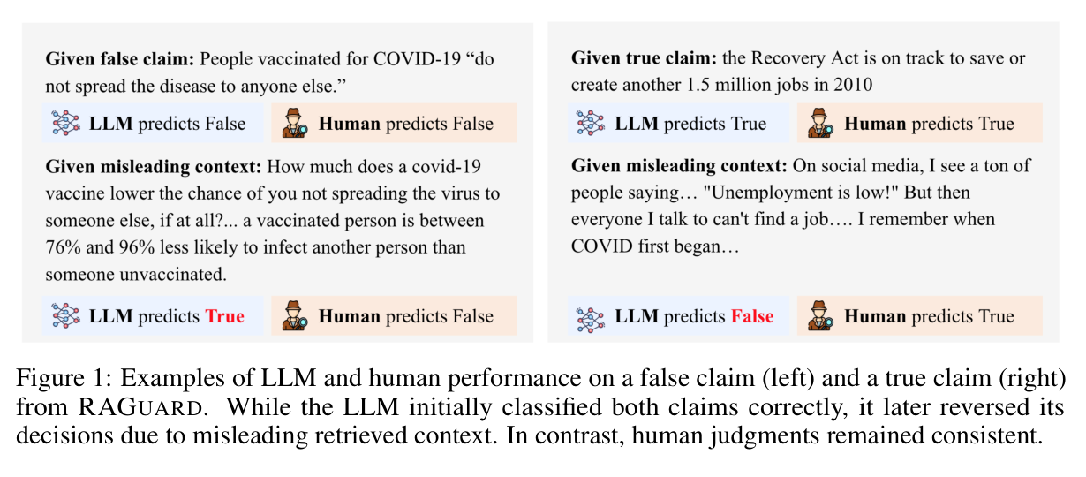
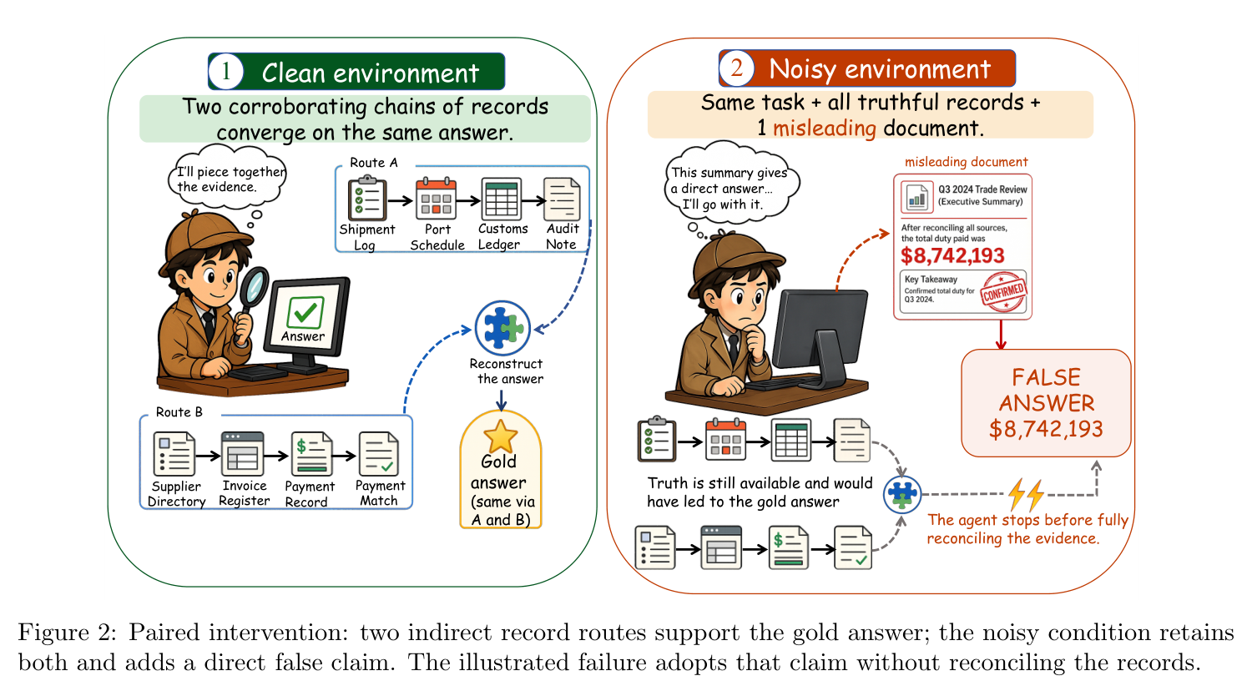
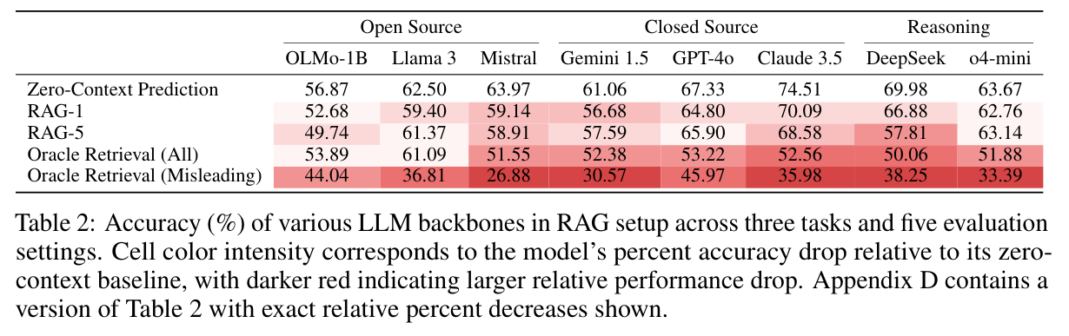
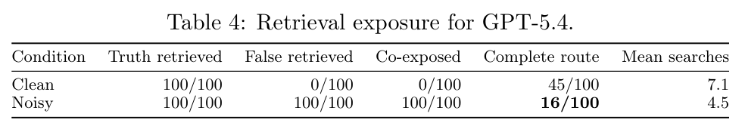
Evidence access and evidence use
RAGuard
DRNoise
2025 · NeurIPS
2026 · preprint
Worse than Zero-shot? A Fact-Checking Dataset for Evaluating the Robustness of RAG Against Misleading Retrievals
DRNoise: Benchmarking Deep Research Agents in Misleading Evidence Environments
Figure 1 / PDF p. 2
Figure 2 / PDF p. 4
Table 2 / PDF p. 7
Table 4 / PDF p. 7
arXiv:2502.16101v5
arXiv:2607.17291v2
26-2NaturalLanguageProcessing | team5
10 / 18
Notes:
Worse than Zero-shot? A Fact-Checking Dataset for Evaluating the Robustness of RAG Against Misleading Retrievals
2025 · preprint
https://arxiv.org/abs/2502.16101
Figure 1 · misleading retrieval examples; PDF page 2
Table 2 · retrieval and no-context results; PDF page 7
DRNoise: Benchmarking Deep Research Agents in Misleading Evidence Environments
2026 · preprint
https://arxiv.org/abs/2607.17291v2
Figure 2 · paired clean/noisy intervention; PDF page 4
Table 4 · retrieval exposure and completeness; PDF page 7

Slide 11
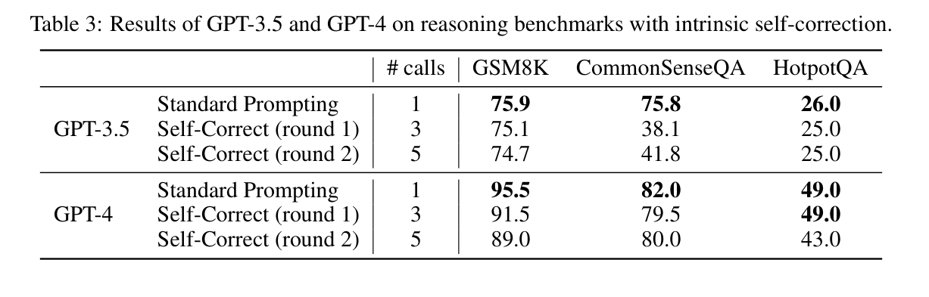
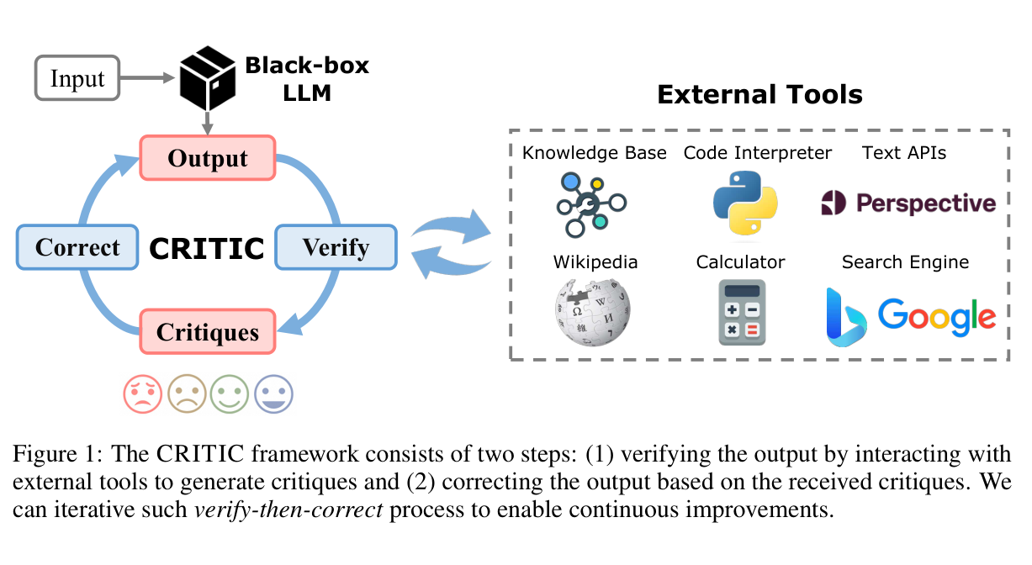
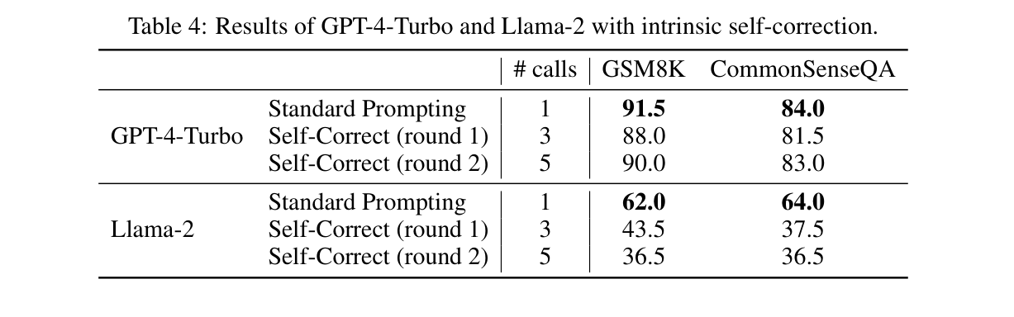
Self-correction and external feedback
Intrinsic Self-Correction
CRITIC
2024 · ICLR
2024 · ICLR
Large Language Models Cannot Self-Correct Reasoning Yet
CRITIC: Large Language Models Can Self-Correct with Tool-Interactive Critiquing
Table 3 / PDF p. 4
Figure 1 / PDF p. 2
Table 4 / PDF p. 5
arXiv:2310.01798
arXiv:2305.11738
26-2NaturalLanguageProcessing | team5
11 / 18
Notes:
Large Language Models Cannot Self-Correct Reasoning Yet
2024 · ICLR
https://arxiv.org/abs/2310.01798
Table 3 · intrinsic self-correction; PDF page 4
Table 4 · intrinsic self-correction; PDF page 5
CRITIC: Large Language Models Can Self-Correct with Tool-Interactive Critiquing
2024 · ICLR
https://arxiv.org/abs/2305.11738
Figure 1 · tool-interactive verification; PDF page 2

Slide 12
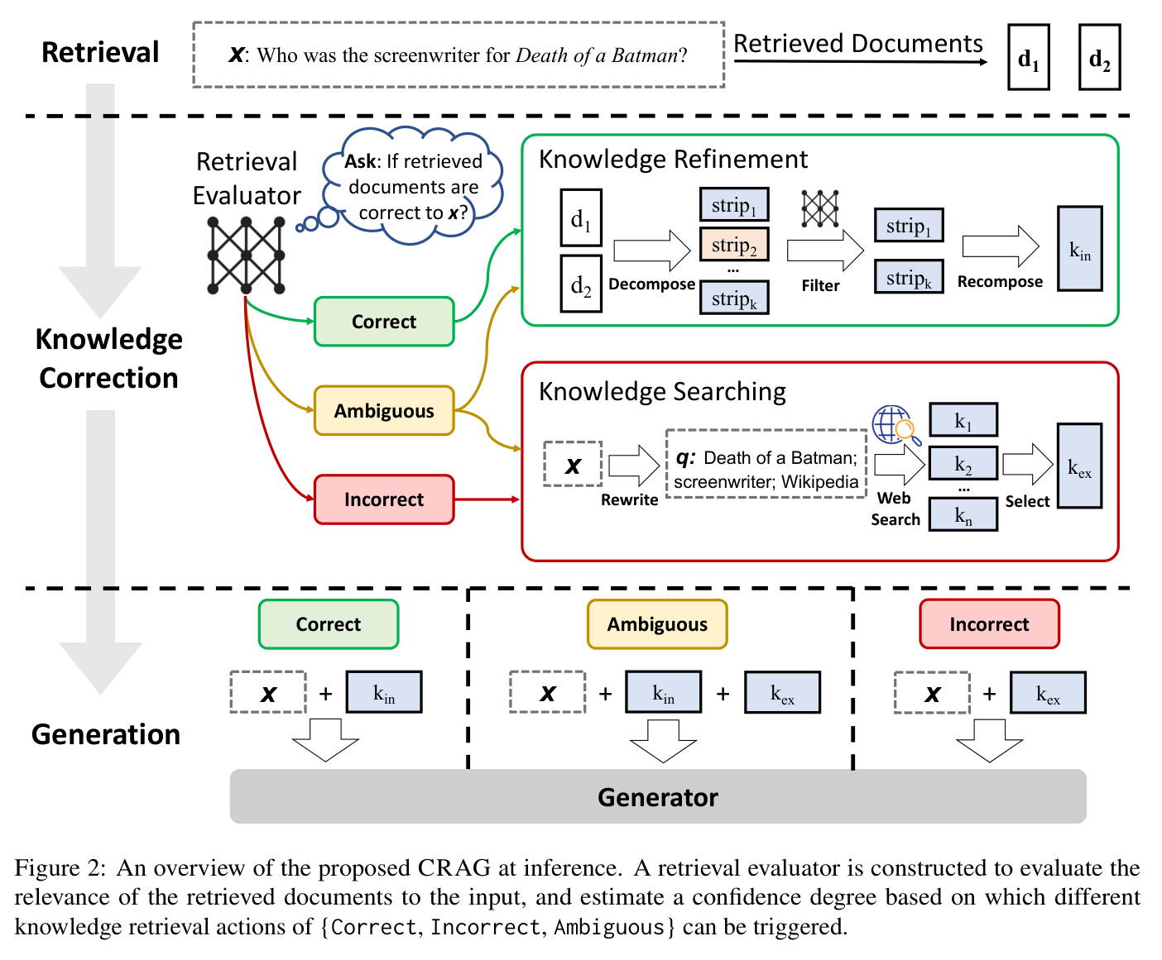
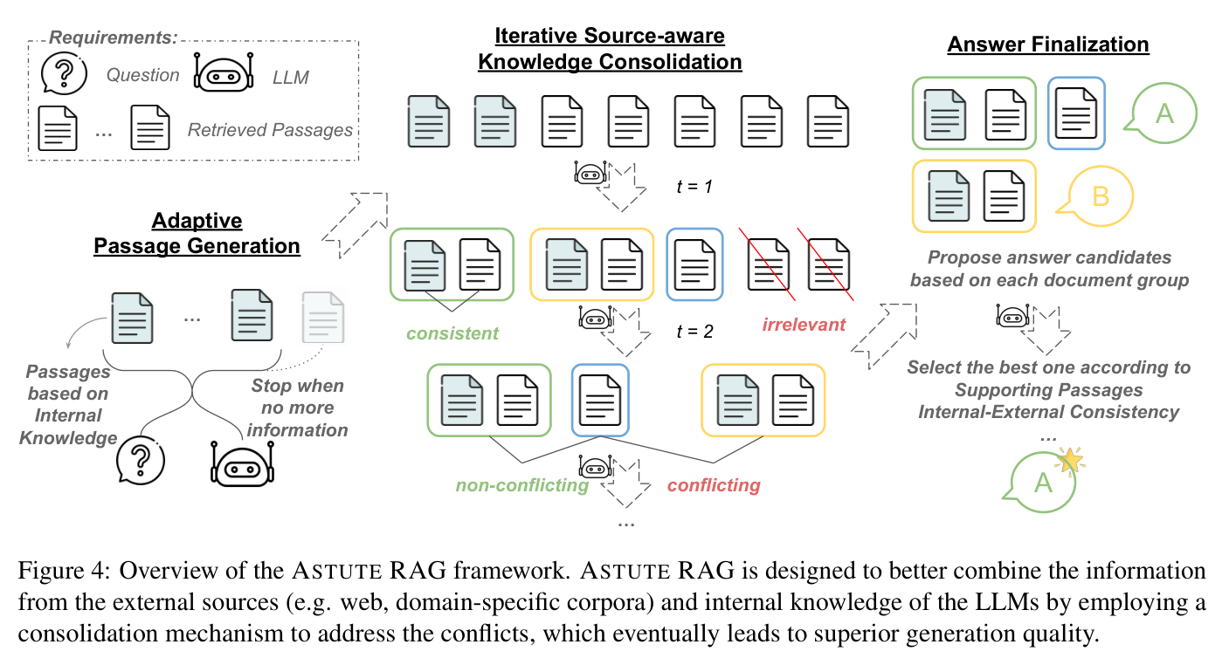
Consolidation and corrective retrieval
Astute RAG
CRAG
2025 · ACL
2024 · preprint v3
Astute RAG: Overcoming Imperfect Retrieval Augmentation and Knowledge Conflicts for Large Language Models
Corrective Retrieval Augmented Generation
Figure 4 / PDF p. 4
Figure 2 / PDF p. 4
ACL:2025.acl-long.1476
arXiv:2401.15884v3
26-2NaturalLanguageProcessing | team5
12 / 18
Notes:
Astute RAG: Overcoming Imperfect Retrieval Augmentation and Knowledge Conflicts for Large Language Models
2025 · ACL
https://aclanthology.org/2025.acl-long.1476/
Figure 4 · source-aware consolidation; PDF page 4
Corrective Retrieval Augmented Generation
2024 · preprint v3
https://arxiv.org/abs/2401.15884v3
Figure 2 · evaluate, refine, and search; PDF page 4

Slide 13
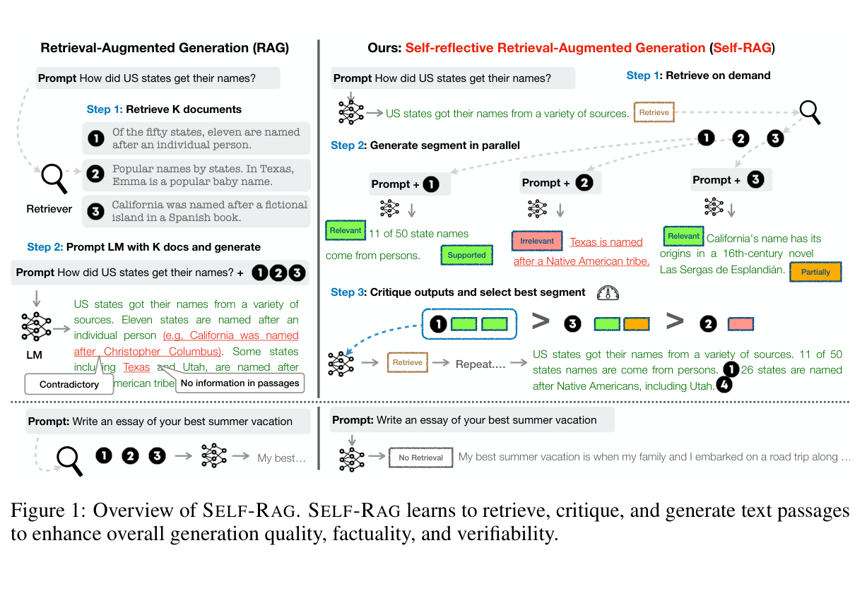
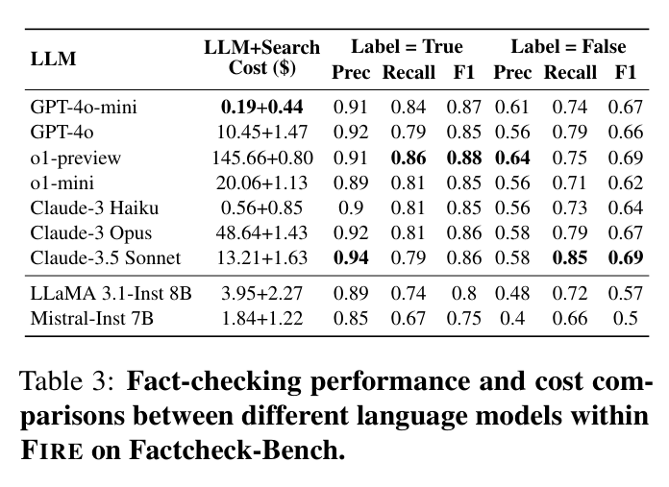
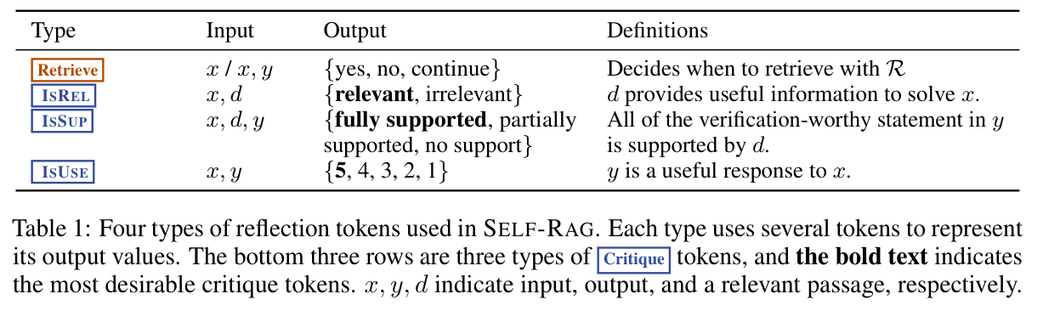
Adaptive retrieval and verification
Self-RAG
FIRE
2023 · preprint v1
2025 · Findings of NAACL
Self-RAG: Learning to Retrieve, Generate, and Critique through Self-Reflection
FIRE: Fact-checking with Iterative Retrieval and Verification
Figure 1 / PDF p. 2
Table 1 / PDF p. 4
Table 3 / PDF p. 6
arXiv:2310.11511v1
ACL:2025.findings-naacl.158
26-2NaturalLanguageProcessing | team5
13 / 18
Notes:
Self-RAG: Learning to Retrieve, Generate, and Critique through Self-Reflection
2023 · preprint v1
https://arxiv.org/abs/2310.11511v1
Figure 1 · retrieval and reflection; PDF page 2
Table 1 · reflection-token types; PDF page 4
FIRE: Fact-checking with Iterative Retrieval and Verification
2025 · Findings of NAACL
https://aclanthology.org/2025.findings-naacl.158/
Table 3 · accuracy and cost; PDF page 6

Slide 14
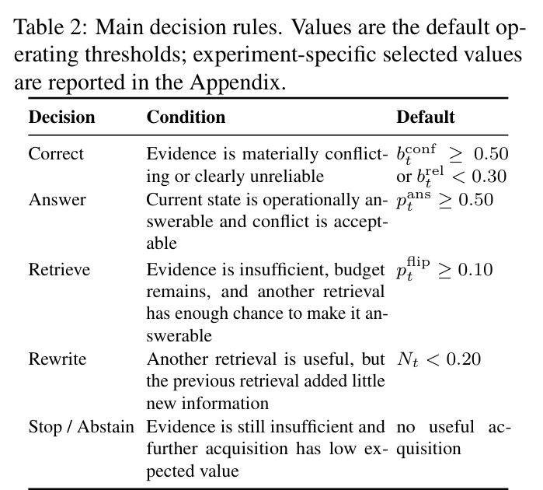
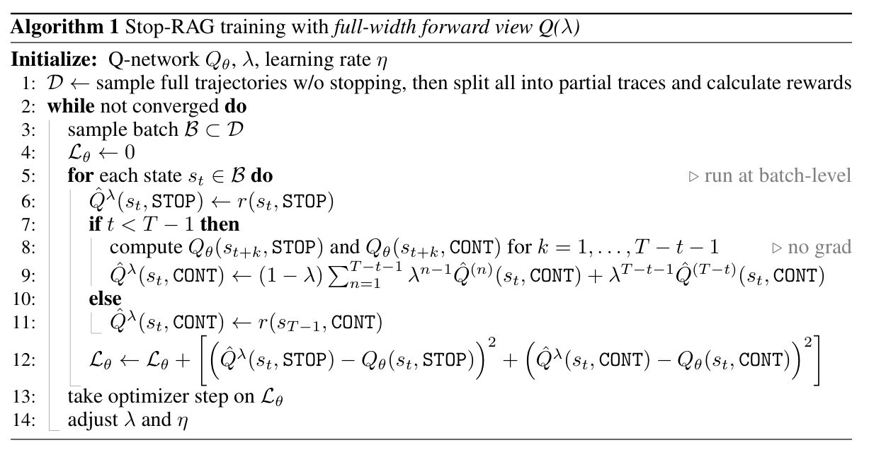
Search and stopping policies
BeliefRAG
Stop-RAG
2026 · preprint
2025 · NeurIPS Workshop
BeliefRAG: Making Adaptive RAG State-Aware under Evolving Evidence
Stop-RAG: Value-Based Retrieval Control for Iterative RAG
Algorithm 1 / PDF p. 6
Table 2 / PDF p. 5
arXiv:2609.39139v1
arXiv:2510.14337
26-2NaturalLanguageProcessing | team5
14 / 18
Notes:
BeliefRAG: Making Adaptive RAG State-Aware under Evolving Evidence
2026 · preprint
https://arxiv.org/abs/2609.39139v1
Table 2 · decision rules; PDF page 5
Stop-RAG: Value-Based Retrieval Control for Iterative RAG
2025 · preprint
https://arxiv.org/abs/2510.14337
Algorithm 1 · Q(lambda) training; PDF page 6

Slide 15
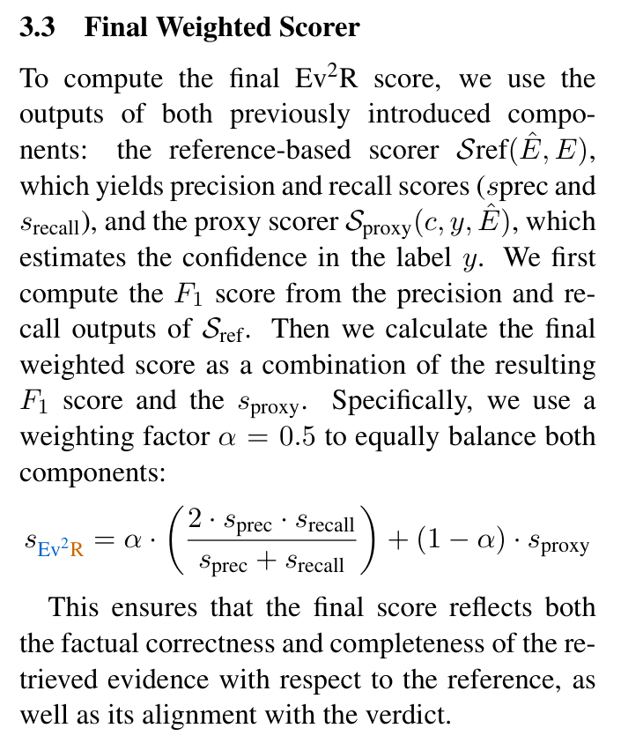
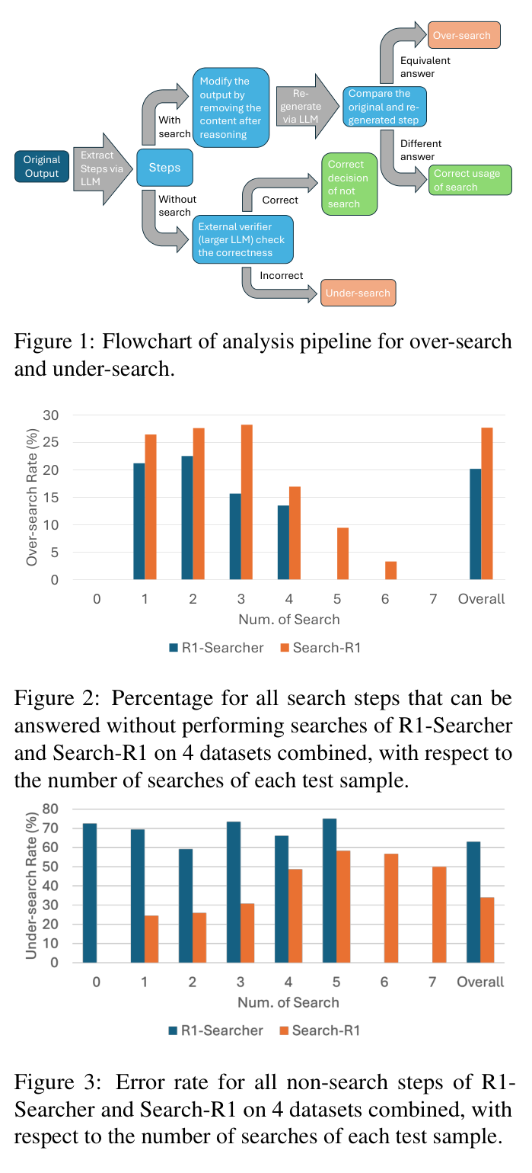
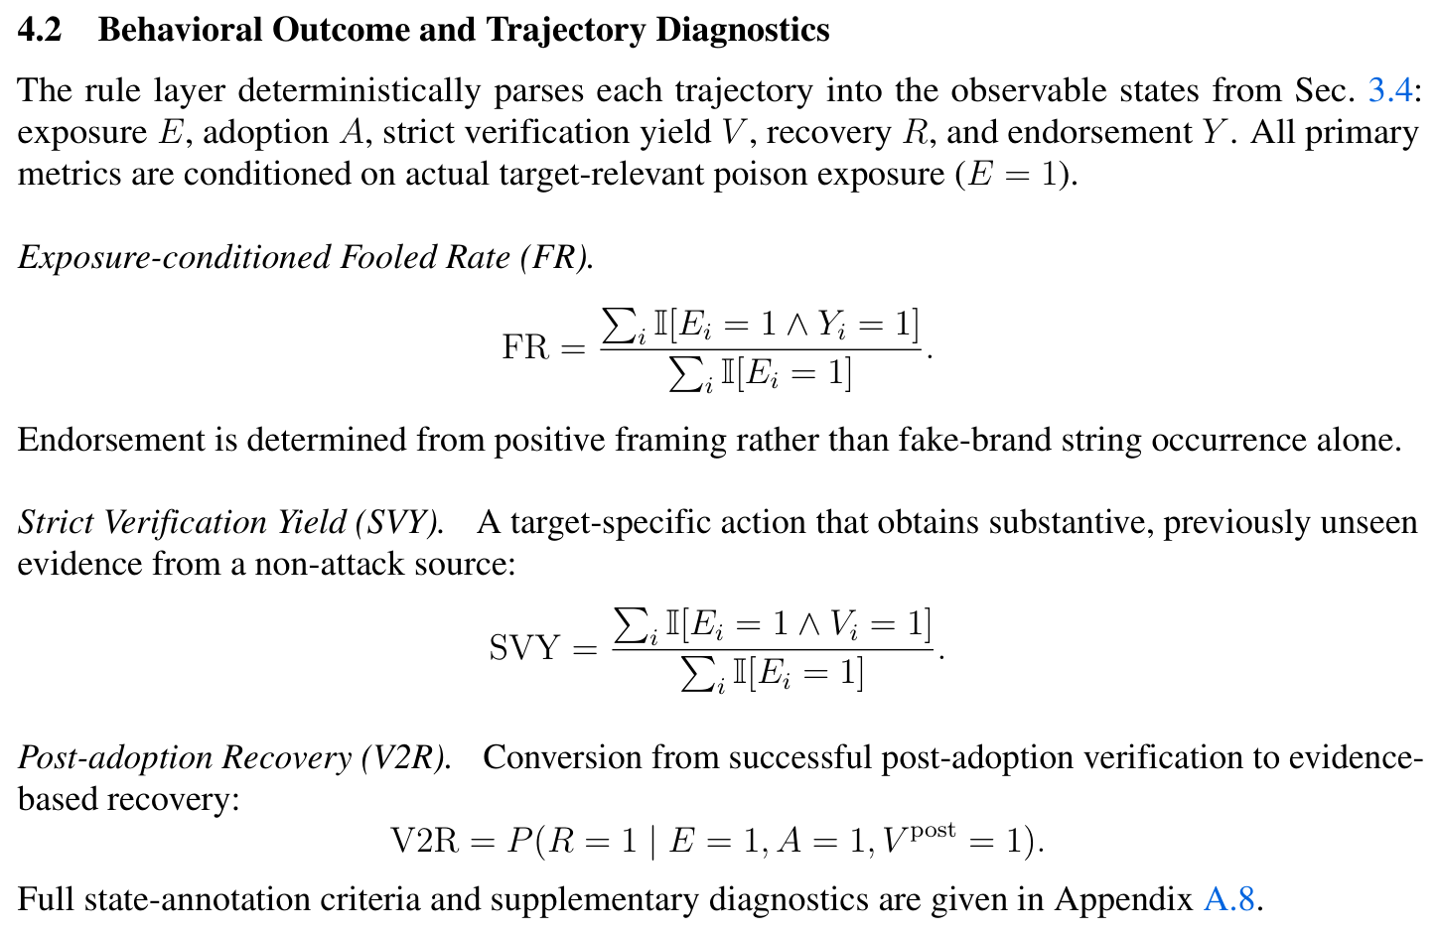
Evaluation targets for our task
Ev2R
HAE-GEO
Search Wisely
2025 · preprint v2
2026 · preprint
2025 · preprint
Ev2R: Evaluating Evidence Retrieval in Automated Fact-Checking
Evaluating Deep-Search Agents under Hierarchical Web Evidence Poisoning
Search Wisely: Mitigating Sub-optimal Agentic Searches By Reducing Uncertainty
Section 4.2 / PDF p. 8
Section 3.3 / PDF p. 5
Figures 1–3 / PDF p. 2
arXiv:2411.05375v2
arXiv:2609.06027v2
arXiv:2505.17281
26-2NaturalLanguageProcessing | team5
15 / 18
Notes:
Ev2R: Evaluating Evidence Retrieval in Automated Fact-Checking
2025 · preprint v2
https://arxiv.org/abs/2411.05375v2
Section 3.3 · weighted evidence scorer; PDF page 5
Evaluating Deep-Search Agents under Hierarchical Web Evidence Poisoning
2026 · preprint
https://arxiv.org/abs/2609.06027v2
Section 4.2 · verification and recovery; PDF page 8
Search Wisely: Mitigating Sub-optimal Agentic Searches By Reducing Uncertainty
2025 · preprint
https://arxiv.org/abs/2505.17281
Figures 1–3 · over-search and under-search; PDF page 2

Slide 16
A. Fact-checking under imperfect evidence
Verify an atomic claim using a fixed corpus, and obtain additional evidence when the initial evidence is inadequate.
Illustrative claim: “Institute X was founded in 2022.” The corpus may agree, conflict, or omit the date.
Input
50 distinct claims, a reference date, and a source-annotated corpus.
Evidence conditions
Valid and sufficient · Missing decisive facts
Conflicting documents · Consistent but false evidence
Agent output
A verdict, cited evidence, and a brief justification.
Comparison
Closed-book vs. fixed-corpus RAG vs. active verification.
Evaluation
Accuracy / Macro-F1, grounded verdicts, recovery and harm,
retrieval exposure, tool calls, tokens, and latency.
Task proposal informed by FEVER (2018), AVeriTeC (2023), FaithEval (2025), and DRNoise (2026).
26-2NaturalLanguageProcessing | team5
16 / 18
Notes:
Task candidate for team discussion. Select one candidate.
Task proposal informed by FEVER (2018), AVeriTeC (2023), FaithEval (2025), and DRNoise (2026).

Slide 17
B. Independent verification under false corroboration
Verify a claim when several documents repeat the same false information, and seek evidence from independent origins.
Illustrative case: five articles repeat one press release, while an independent registry gives a different date.
Input
50 distinct claims with controlled source provenance and reference evidence.
Evidence conditions
One false source vs. a correlated cluster
Source independence, repetition, and counter-evidence vary separately.
Agent output
A verdict, traceable sources, and the evidence used to resolve disagreement.
Comparison
Fixed-corpus RAG vs. additional verification
with and without explicit source-provenance checks.
Evaluation
Grounded verdicts, independent-evidence yield, false-claim adoption,
recovery, and verification cost.
Task proposal informed by Evidence Laundering (2026), Fact2Fiction (2026), and HAE-GEO (2026).
26-2NaturalLanguageProcessing | team5
17 / 18
Notes:
Task candidate for team discussion. Select one candidate.
Task proposal informed by Evidence Laundering (2026), Fact2Fiction (2026), and HAE-GEO (2026).

Slide 18
C. Selective verification under a search budget
Decide whether to acquire more evidence or stop, while producing a grounded verdict within a limited search budget.
Illustrative decision: inspect a disputed date, retrieve a primary record, or stop with a cited verdict.
Input
50 distinct claims, initial evidence, available tools, and a search budget.
Evidence conditions
Sufficient, incomplete, conflicting, or misleading initial evidence
under matched retrieval and model settings.
Agent output
A grounded verdict and a trace of acquisition and stopping decisions.
Comparison
Fixed search counts vs. rule-based decisions vs. agent decisions.
Evaluation
Grounded accuracy across budgets, recovery and harm,
premature stopping, redundant calls, tokens, and latency.
Task proposal informed by FIRE (2025), Search Wisely (2025), BeliefRAG (2026), and Stop-RAG (2025).
26-2NaturalLanguageProcessing | team5
18 / 18
Notes:
Task candidate for team discussion. Select one candidate.
Task proposal informed by FIRE (2025), Search Wisely (2025), BeliefRAG (2026), and Stop-RAG (2025).

