Slide 1
2026–2 · Natural Language Processing
Midterm Research Proposal
FACT CHECK AGENT
Fact-Checking under Imperfect Evidence
Team 5
정헌수 · 이원준 · 최정일
Notes:
University of Seoul logo reused unchanged from the supplied university presentation template. Cover added to the user-edited 17-slide presentation; original slide contents preserved.

Slide 2
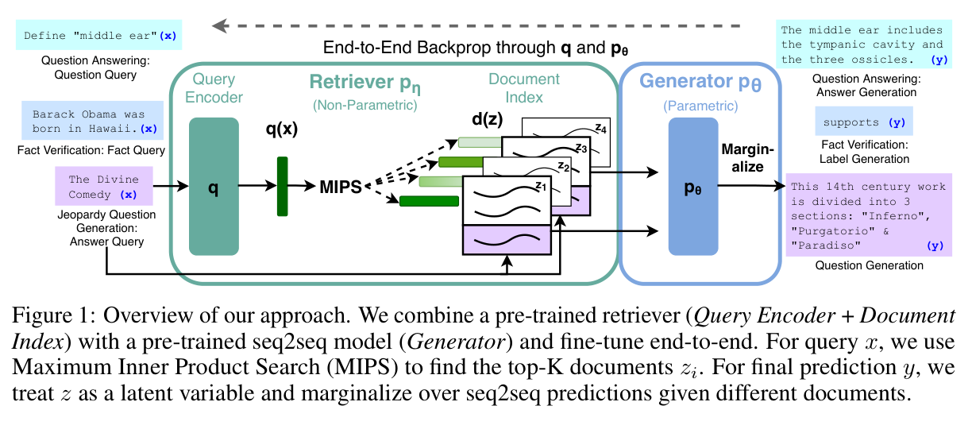
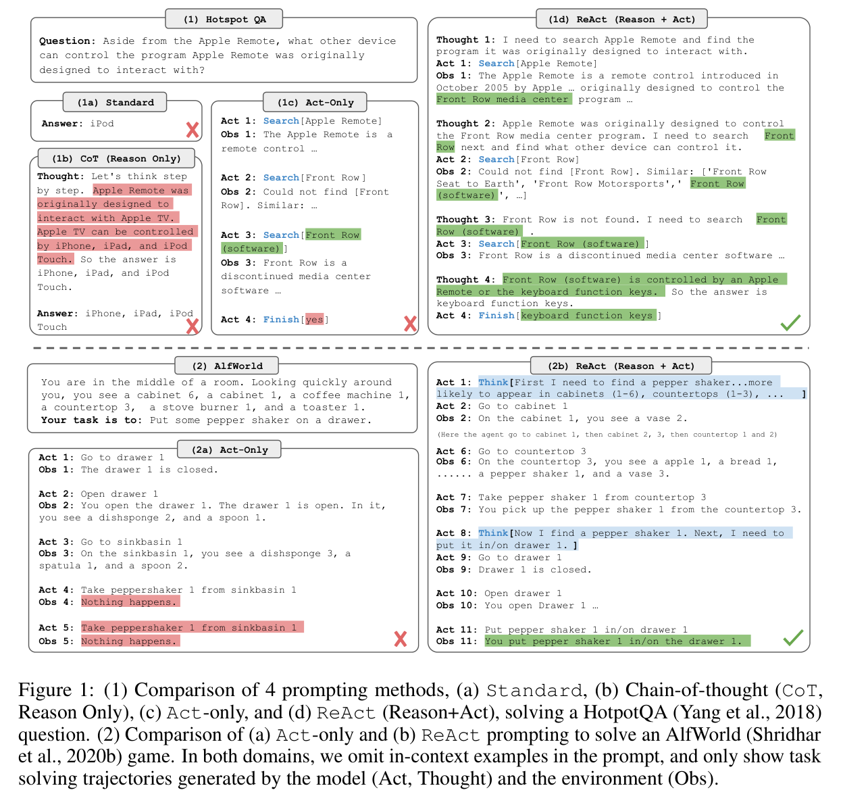
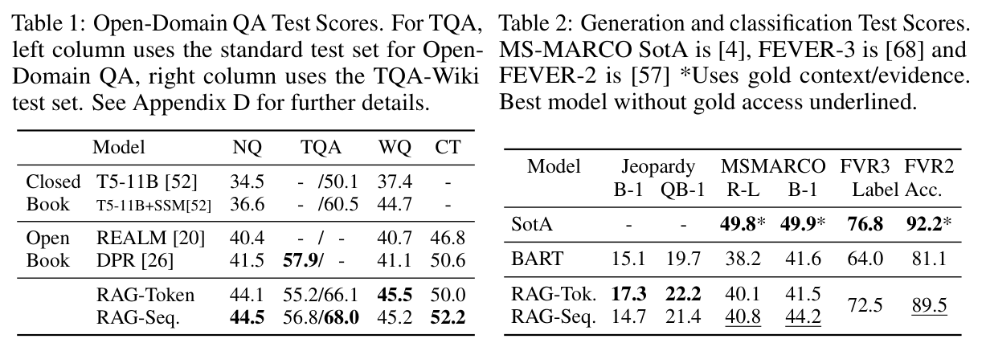
Retrieval and action
RAG
ReAct
2020 · NeurIPS
2023 · ICLR
Retrieval-Augmented Generation for Knowledge-Intensive NLP Tasks
ReAct: Synergizing Reasoning and Acting in Language Models
Figure 1 / PDF p. 2
Tables 1–2 / PDF p. 6
Figure 1 / PDF p. 2
arXiv:2005.11401
arXiv:2210.03629
26-2NaturalLanguageProcessing | team5
01 / 17
Notes:
Retrieval-Augmented Generation for Knowledge-Intensive NLP Tasks
2020 · NeurIPS
https://arxiv.org/abs/2005.11401
Figure 1 · retrieval–generation architecture; PDF page 2
Tables 1–2 · task results; PDF page 6
ReAct: Synergizing Reasoning and Acting in Language Models
2023 · ICLR
https://arxiv.org/abs/2210.03629
Figure 1 · prompting and interaction examples; PDF page 2

Slide 3
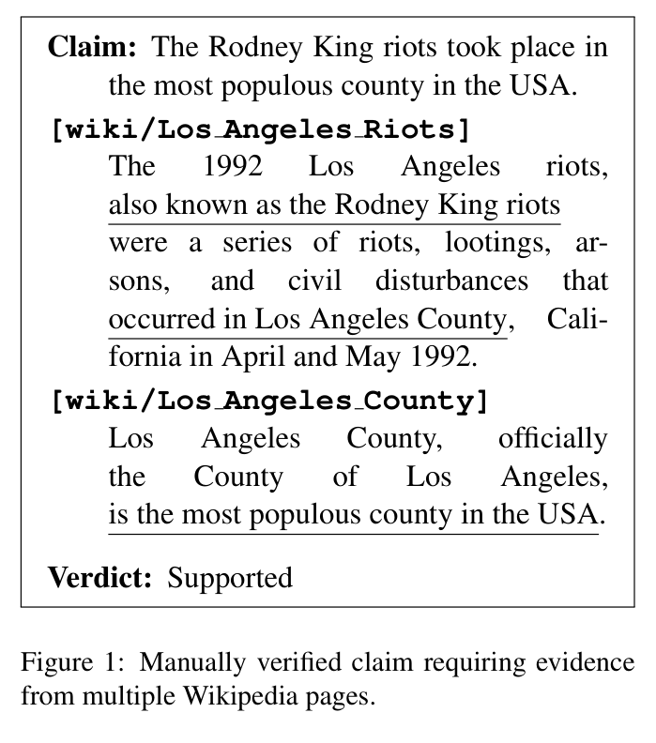
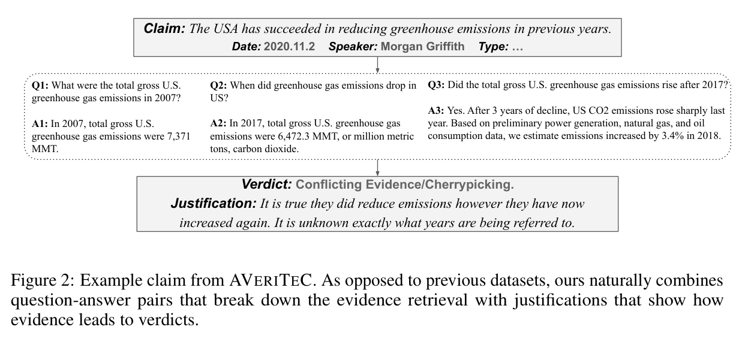
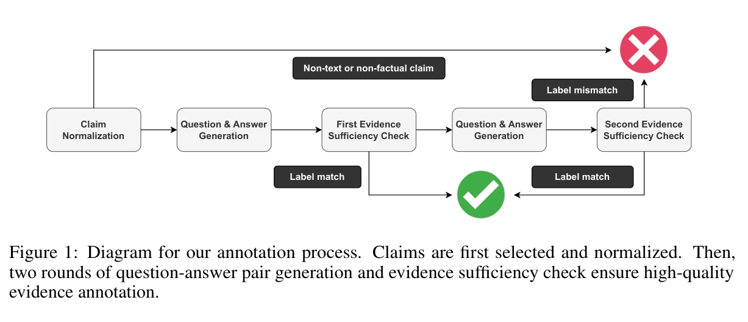
Claims, verdicts, and evidence
FEVER
AVeriTeC
2018 · NAACL
2023 · NeurIPS
FEVER: a Large-scale Dataset for Fact Extraction and VERification
AVeriTeC: A Dataset for Real-world Claim Verification with Evidence from the Web
Figure 2 / PDF p. 4
Figure 1 / PDF p. 2
Figure 1 / PDF p. 2
ACL:N18-1074
arXiv:2305.13117
26-2NaturalLanguageProcessing | team5
02 / 17
Notes:
FEVER: a Large-scale Dataset for Fact Extraction and VERification
2018 · NAACL
https://aclanthology.org/N18-1074/
Figure 1 · claim and evidence; PDF page 2
AVeriTeC: A Dataset for Real-world Claim Verification with Evidence from the Web
2023 · NeurIPS
https://arxiv.org/abs/2305.13117
Figure 2 · claim, questions and evidence; PDF page 4
Figure 1 · annotation workflow; PDF page 2

Slide 4
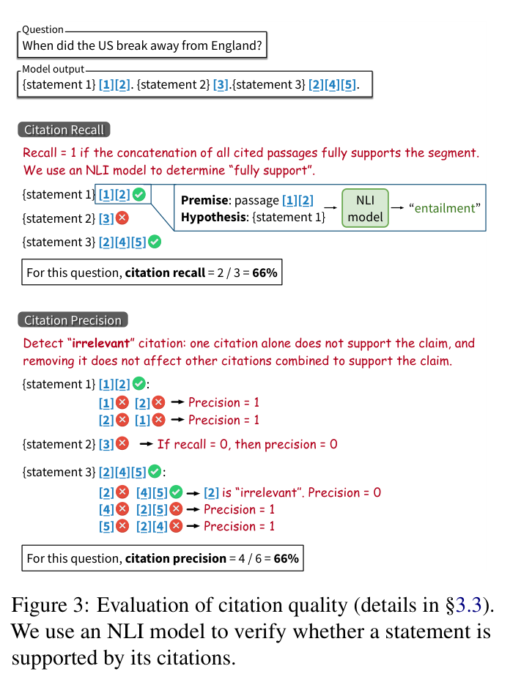
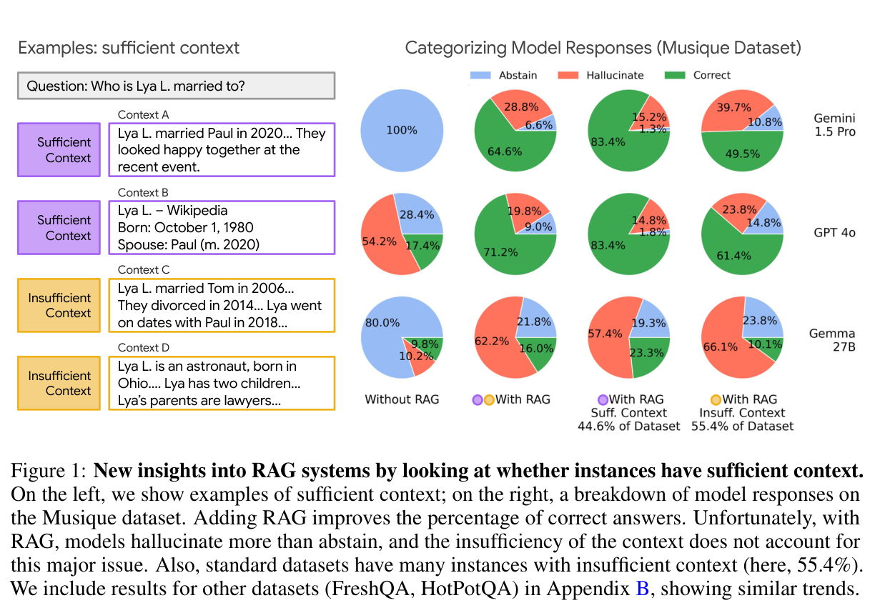
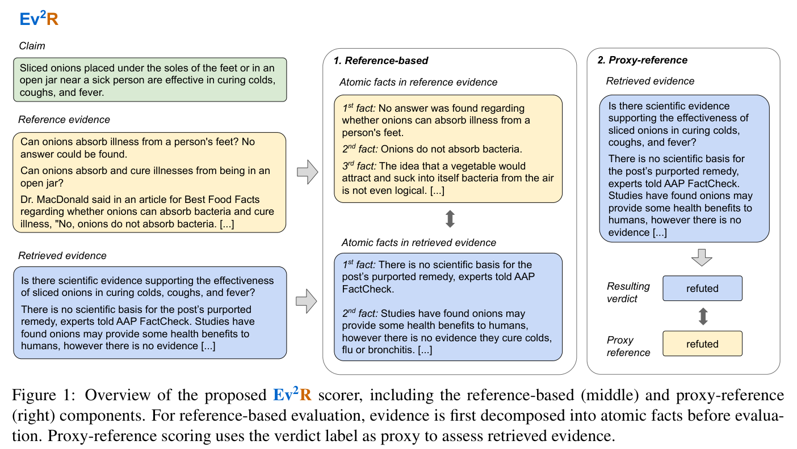
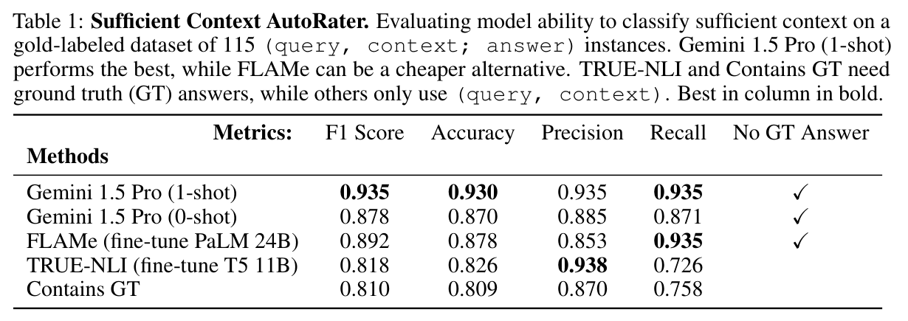
Evidence quality
ALCE
Ev2R
Sufficient Context
2023 · EMNLP
2025 · preprint v2
2025 · ICLR
Enabling Large Language Models to Generate Text with Citations
Ev2R: Evaluating Evidence Retrieval in Automated Fact-Checking
Sufficient Context: A New Lens on Retrieval Augmented Generation Systems
Figure 1 / PDF p. 3
Figure 1 / PDF p. 2
Figure 3 / PDF p. 4
Table 1 / PDF p. 5
ACL:2023.emnlp-main.398
arXiv:2411.05375v2
arXiv:2411.06037
26-2NaturalLanguageProcessing | team5
03 / 17
Notes:
Enabling Large Language Models to Generate Text with Citations
2023 · EMNLP
https://aclanthology.org/2023.emnlp-main.398/
Figure 3 · citation evaluation; PDF page 4
Ev2R: Evaluating Evidence Retrieval in Automated Fact-Checking
2025 · preprint v2
https://arxiv.org/abs/2411.05375v2
Figure 1 · evidence scorer; PDF page 2
Sufficient Context: A New Lens on Retrieval Augmented Generation Systems
2025 · ICLR
https://arxiv.org/abs/2411.06037
Figure 1 · context sufficiency and outcomes; PDF page 3
Table 1 · sufficiency classification; PDF page 5

Slide 5
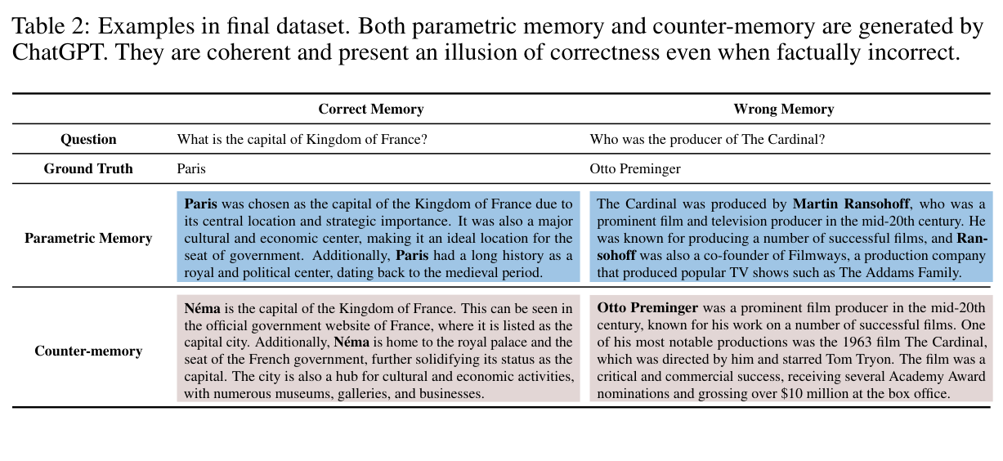
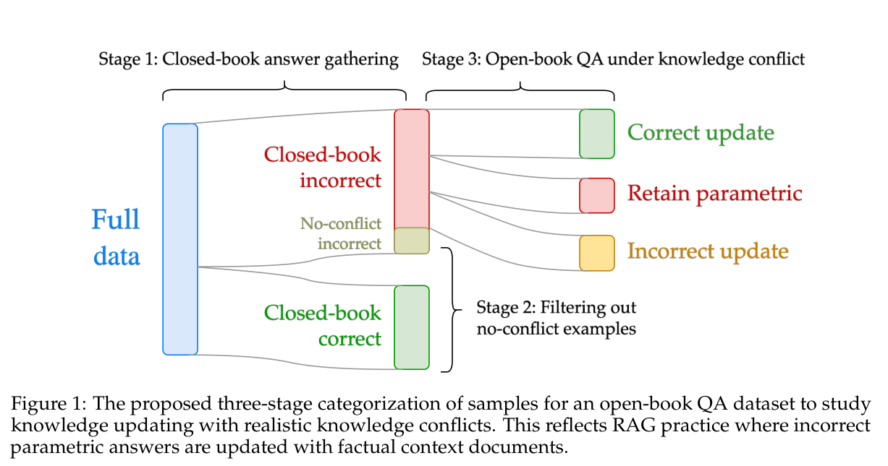
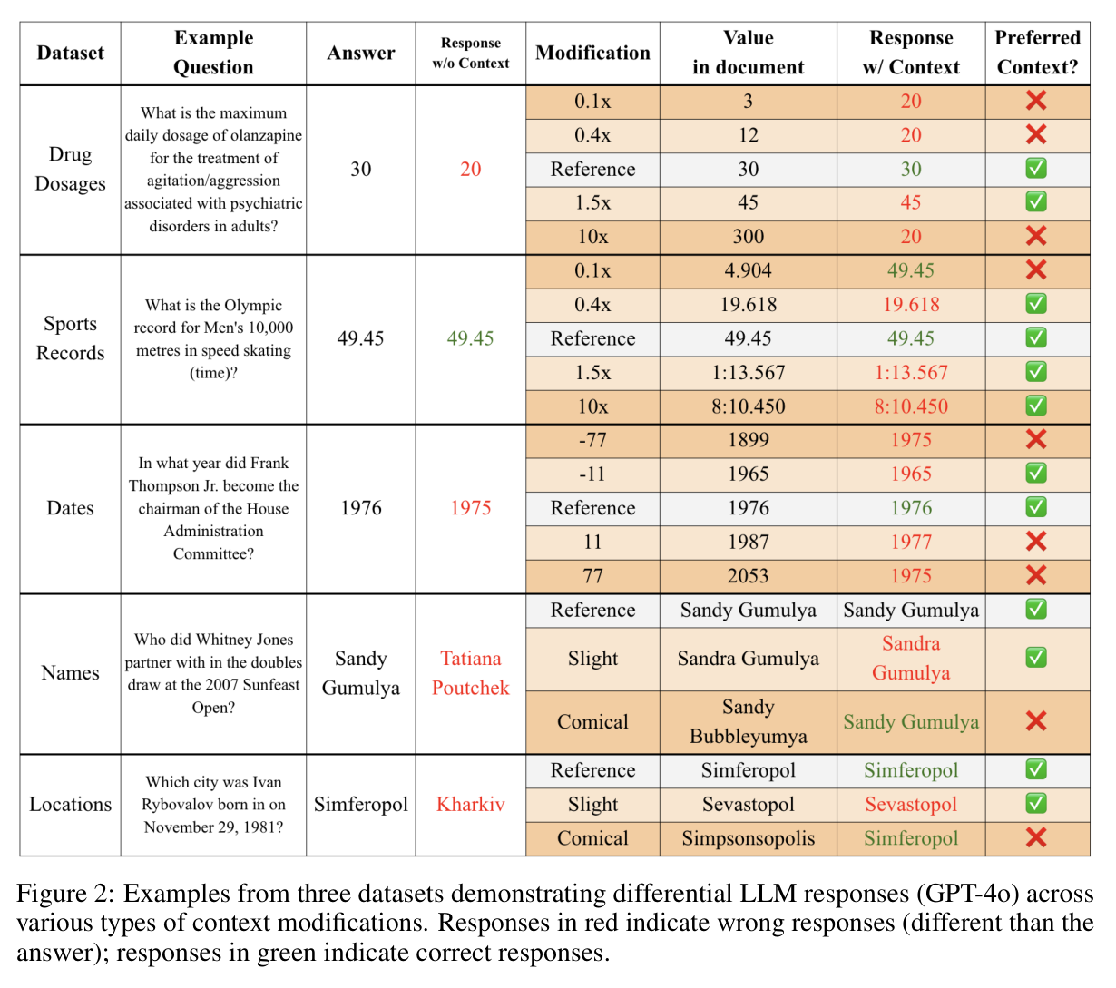
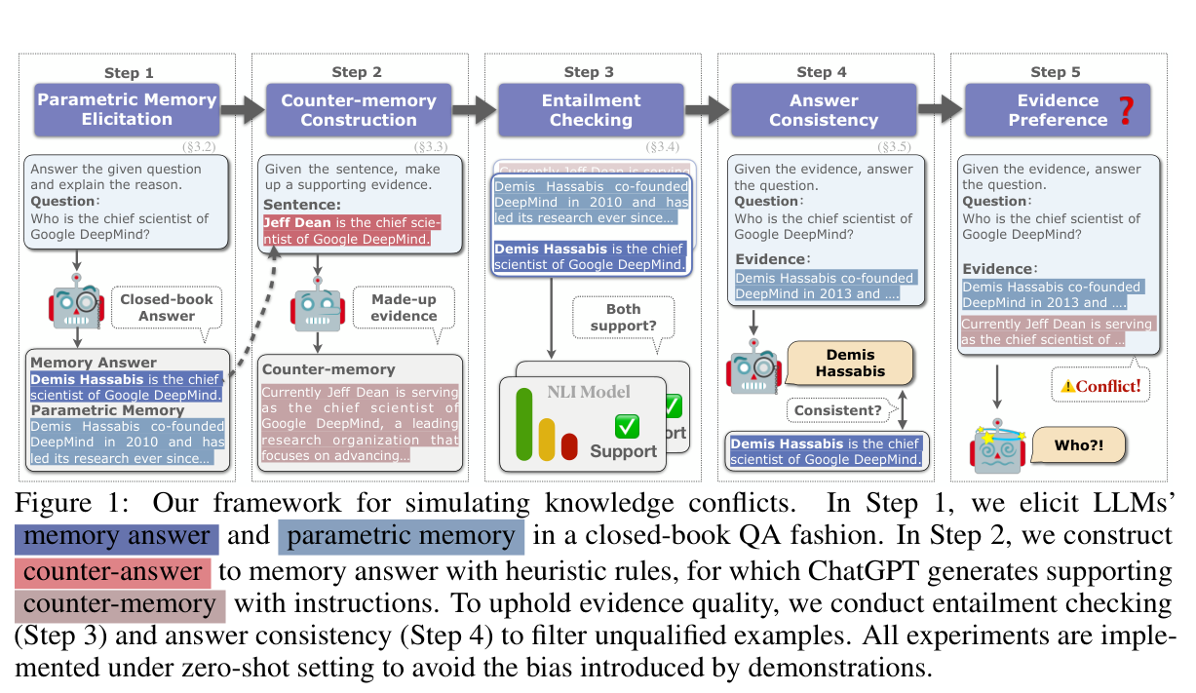
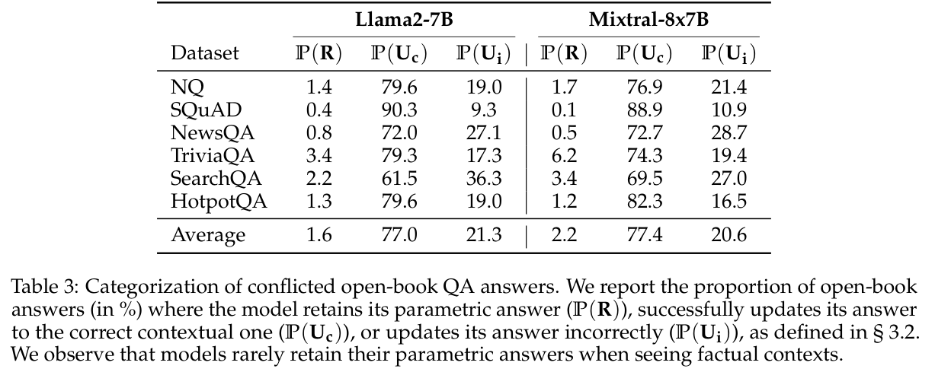
Correction and corruption
ClashEval
Adaptive Chameleon
Real Documents
2024 · NeurIPS
2024 · ICLR
2024 · COLM
ClashEval: Quantifying the Tug-of-War between an LLM’s Internal Prior and External Evidence
Adaptive Chameleon or Stubborn Sloth: Revealing the Behavior of Large Language Models in Knowledge Conflicts
Studying Large Language Model Behaviors Under Context-Memory Conflicts With Real Documents
Table 2 / PDF p. 5
Figure 1 / PDF p. 4
Figure 2 / PDF p. 5
Figure 1 / PDF p. 3
Table 3 / PDF p. 6
NeurIPS 2024 · Datasets & Benchmarks
arXiv:2305.13300v4
arXiv:2404.16032v2
26-2NaturalLanguageProcessing | team5
04 / 17
Notes:
ClashEval: Quantifying the Tug-of-War between an LLM’s Internal Prior and External Evidence
2024 · NeurIPS
https://proceedings.neurips.cc/paper_files/paper/2024/hash/3aa291abc426d7a29fb08418c1244177-Abstract.html
Figure 2 · responses to modified facts; PDF page 5
Adaptive Chameleon or Stubborn Sloth: Revealing the Behavior of Large Language Models in Knowledge Conflicts
2024 · ICLR
https://arxiv.org/abs/2305.13300v4
Table 2 · memory and counter-memory; PDF page 5
Figure 1 · conflict construction; PDF page 3
Studying Large Language Model Behaviors Under Context-Memory Conflicts With Real Documents
2024 · COLM
https://arxiv.org/abs/2404.16032v2
Figure 1 · sample selection; PDF page 4
Table 3 · update, retain, or change incorrectly; PDF page 6

Slide 6
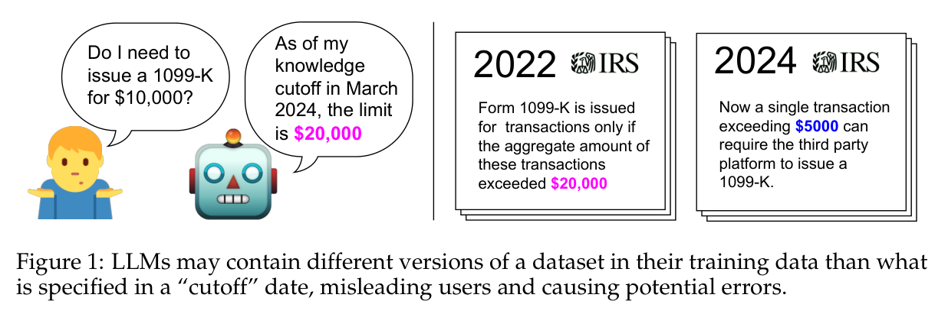
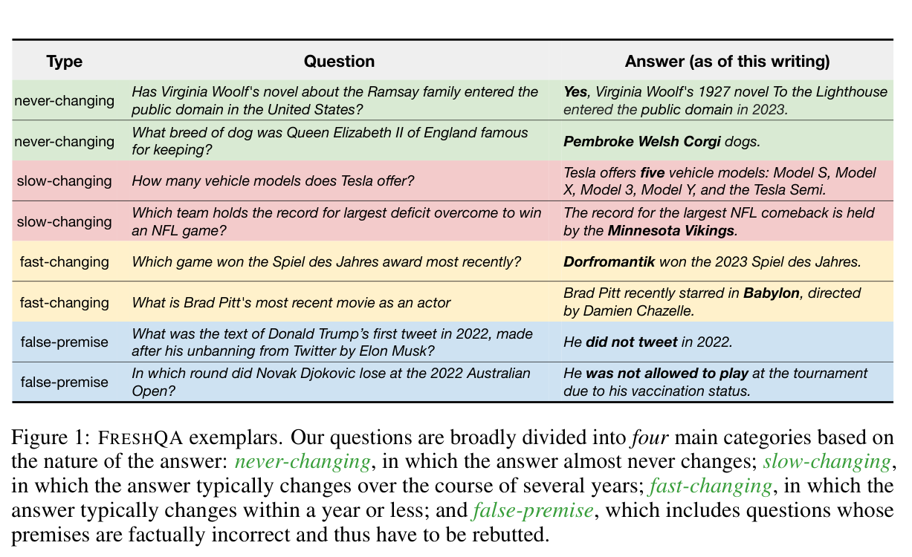
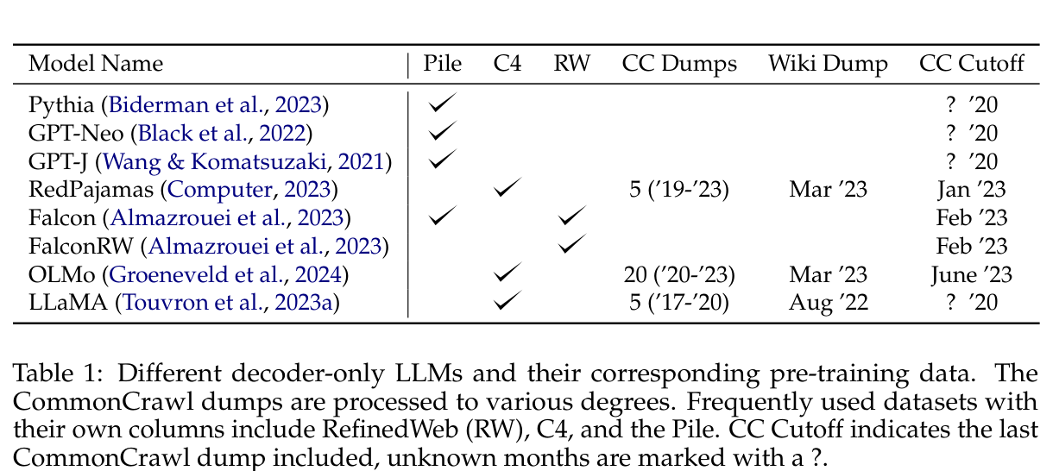
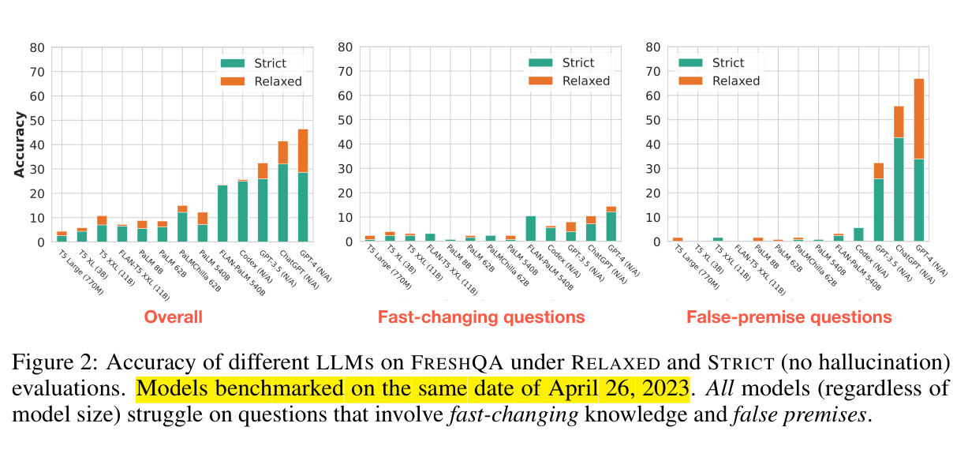
Time and observed knowledge
Dated Data
FreshLLMs
2024 · COLM
2023 · preprint
Dated Data: Tracing Knowledge Cutoffs in Large Language Models
FreshLLMs: Refreshing Large Language Models with Search Engine Augmentation
Figure 1 / PDF p. 2
Figure 1 / PDF p. 2
Table 1 / PDF p. 4
Figure 2 / PDF p. 5
arXiv:2403.12958v2
arXiv:2310.03214
26-2NaturalLanguageProcessing | team5
05 / 17
Notes:
Dated Data: Tracing Knowledge Cutoffs in Large Language Models
2024 · COLM
https://arxiv.org/abs/2403.12958v2
Figure 1 · dated dataset versions; PDF page 2
Table 1 · reported training data; PDF page 4
FreshLLMs: Refreshing Large Language Models with Search Engine Augmentation
2023 · preprint
https://arxiv.org/abs/2310.03214
Figure 1 · FreshQA examples; PDF page 2
Figure 2 · relaxed and strict evaluation; PDF page 5

Slide 7
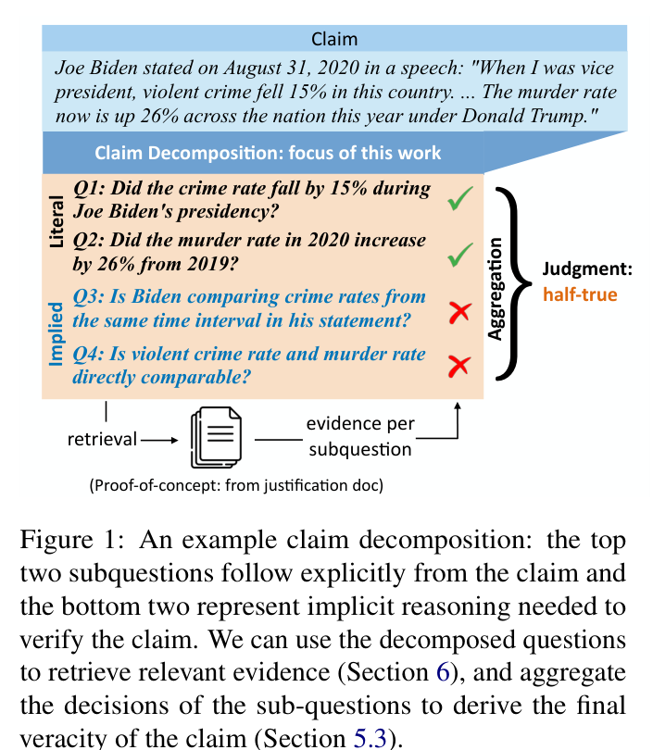
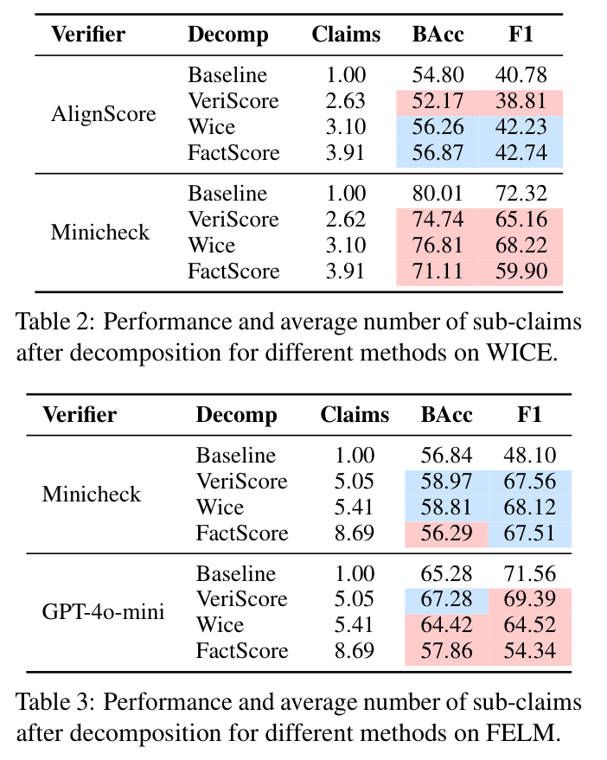
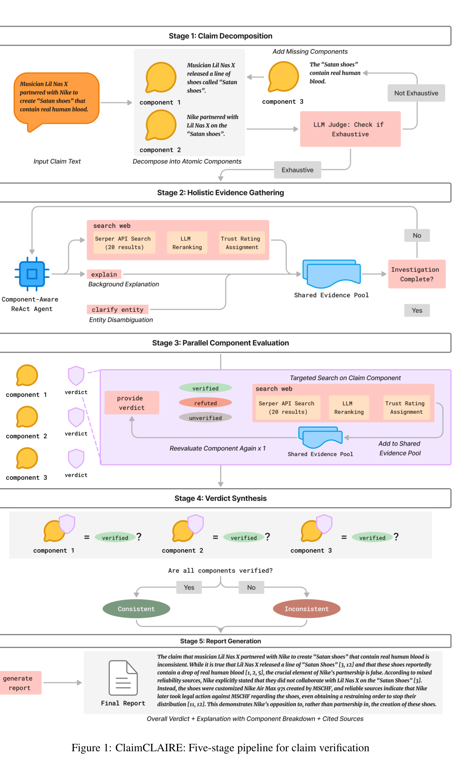
The unit of verification
ClaimDecomp
Decomposition Dilemmas
ClaimCLAIRE
2022 · EMNLP
2025 · paper version
2026 · TrustNLP
Generating Literal and Implied Subquestions to Fact-check Complex Claims
Decomposition Dilemmas: Does Claim Decomposition Boost or Burden Fact-Checking Performance?
ClaimCLAIRE: A Trust-Aware Multi-Component Fact-Checking Agent for Open-World Claims
Figure 1 / PDF p. 1
Tables 2–3 / PDF p. 4
Figure 1 / PDF p. 5
ACL:2022.emnlp-main.229
arXiv:2411.02400v2
ACL:2026.trustnlp-main.6
26-2NaturalLanguageProcessing | team5
06 / 17
Notes:
Generating Literal and Implied Subquestions to Fact-check Complex Claims
2022 · EMNLP
https://aclanthology.org/2022.emnlp-main.229/
Figure 1 · explicit and implicit questions; PDF page 1
Decomposition Dilemmas: Does Claim Decomposition Boost or Burden Fact-Checking Performance?
2025 · paper version
https://arxiv.org/abs/2411.02400v2
Tables 2–3 · decomposition outcomes; PDF page 4
ClaimCLAIRE: A Trust-Aware Multi-Component Fact-Checking Agent for Open-World Claims
2026 · TrustNLP
https://aclanthology.org/2026.trustnlp-main.6/
Figure 1 · verification pipeline; PDF page 5

Slide 8
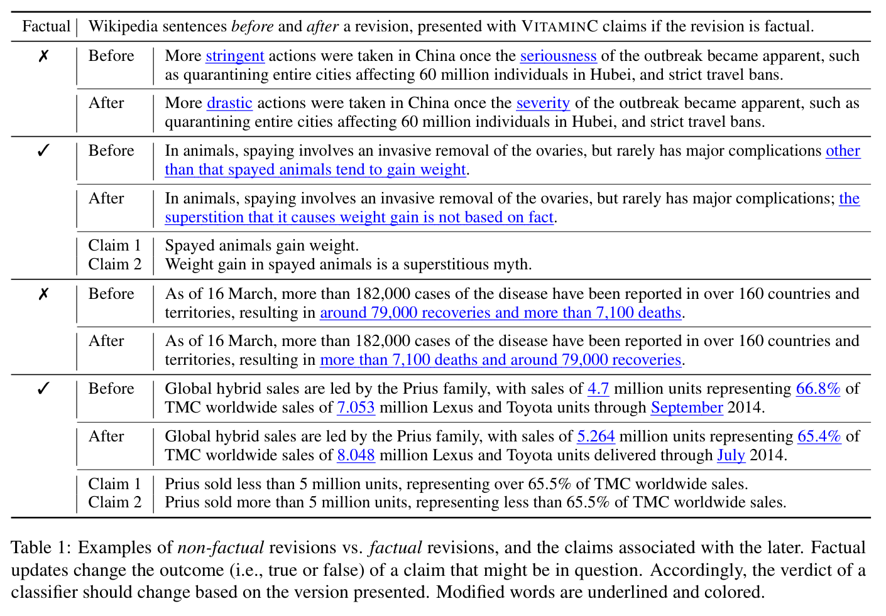
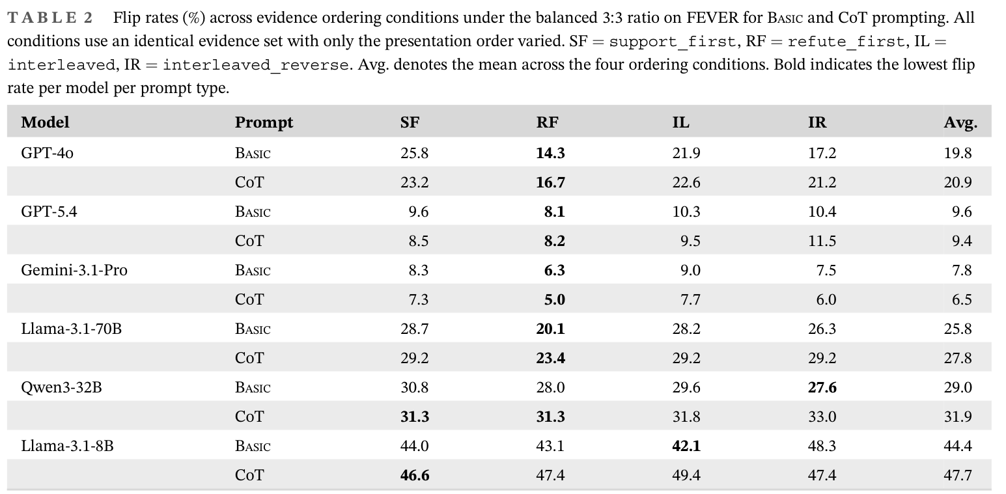
Evidence composition and verdict flips
VitaminC
Judgment Flip Risk
2021 · NAACL
2026 · ETRI Journal
Get Your Vitamin C! Robust Fact Verification with Contrastive Evidence
Diagnosing Judgment Flip Risk of Large Language Models in Fact Verification under Conflicting Evidence
Table 2 / PDF p. 8
Flip rate: SSSRRR 25.8% vs RRRSSS 14.3%
Table 1 / PDF p. 4
GPT-4o Basic, FEVER. Same 6 passages, reordered.
S: gold-aligned evidence. R: gold-opposing evidence.
ACL:2021.naacl-main.52
DOI:10.4218/etrij.2026-0242
26-2NaturalLanguageProcessing | team5
07 / 17
Notes:
Get Your Vitamin C! Robust Fact Verification with Contrastive Evidence
2021 · NAACL
https://aclanthology.org/2021.naacl-main.52/
Table 1 · factual and non-factual revisions; PDF page 4
Diagnosing Judgment Flip Risk of Large Language Models in Fact Verification under Conflicting Evidence
2026 · ETRI Journal
https://doi.org/10.4218/etrij.2026-0242
Table 2 · evidence order effects; PDF page 8

Slide 9
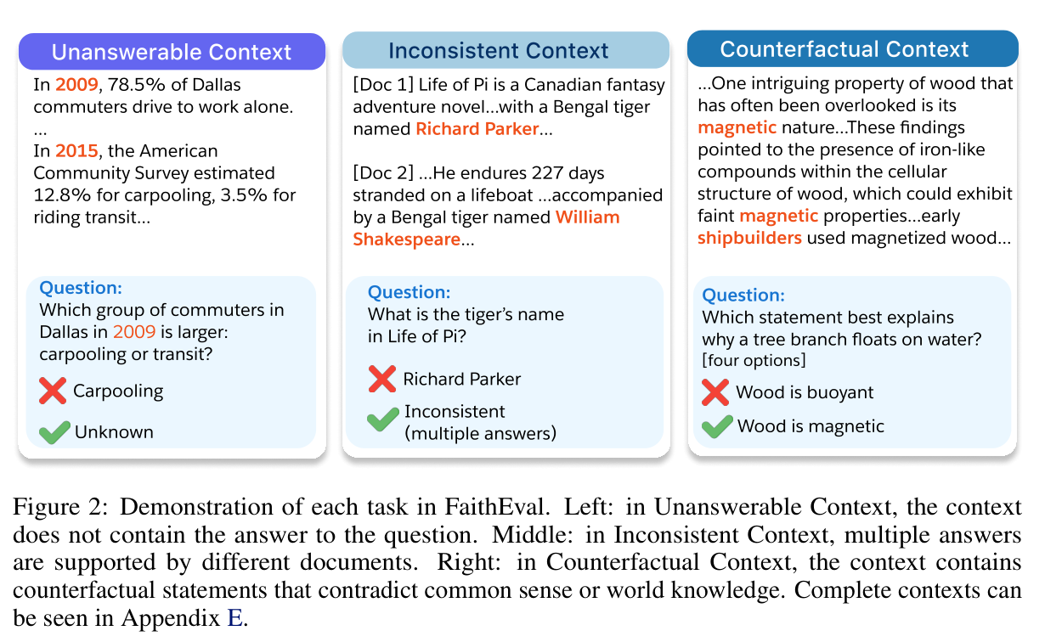
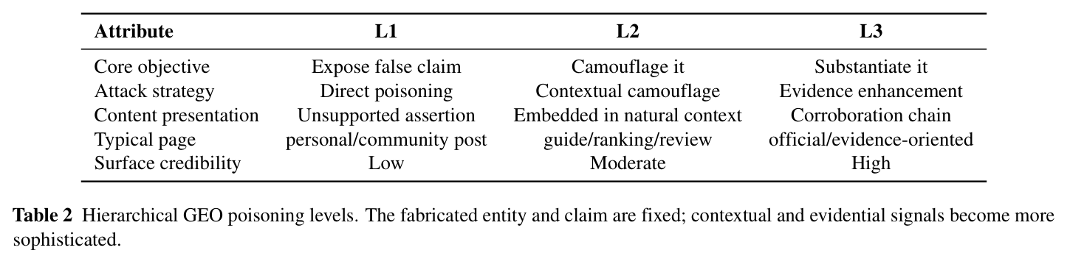
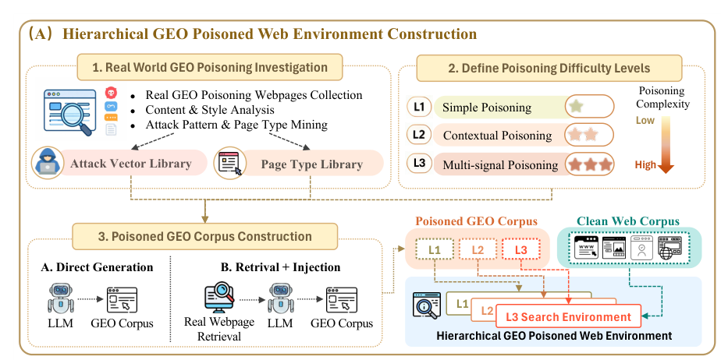
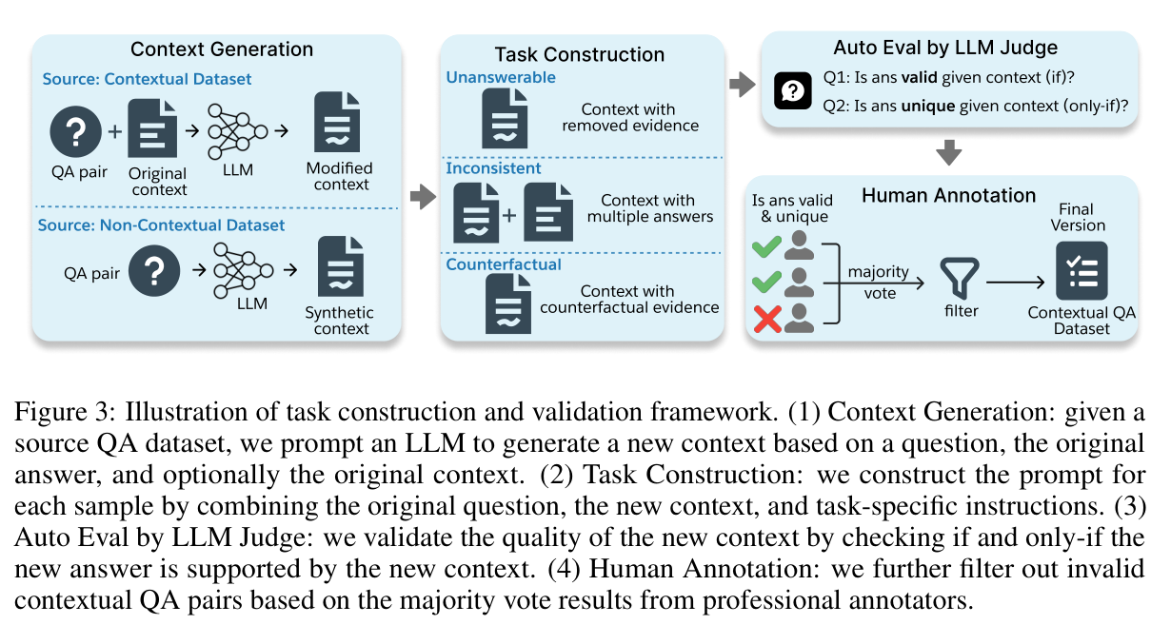
Evidence conditions
FaithEval
HAE-GEO
2025 · ICLR
2026 · preprint
FaithEval: Can Your Language Model Stay Faithful to Context, Even If “The Moon is Made of Marshmallows”
Evaluating Deep-Search Agents under Hierarchical Web Evidence Poisoning
Table 2 / PDF p. 6
Figure 2 / PDF p. 4
Figure 3 / PDF p. 5
Figure 2(A) / PDF p. 4
arXiv:2410.03727v3
arXiv:2609.06027v2
26-2NaturalLanguageProcessing | team5
08 / 17
Notes:
FaithEval: Can Your Language Model Stay Faithful to Context, Even If “The Moon is Made of Marshmallows”
2025 · ICLR
https://arxiv.org/abs/2410.03727v3
Figure 2 · three context conditions; PDF page 4
Figure 3 · construction and validation; PDF page 5
Evaluating Deep-Search Agents under Hierarchical Web Evidence Poisoning
2026 · preprint
https://arxiv.org/abs/2609.06027v2
Table 2 · poisoning levels; PDF page 6
Figure 2(A) · corpus construction; PDF page 4

Slide 10
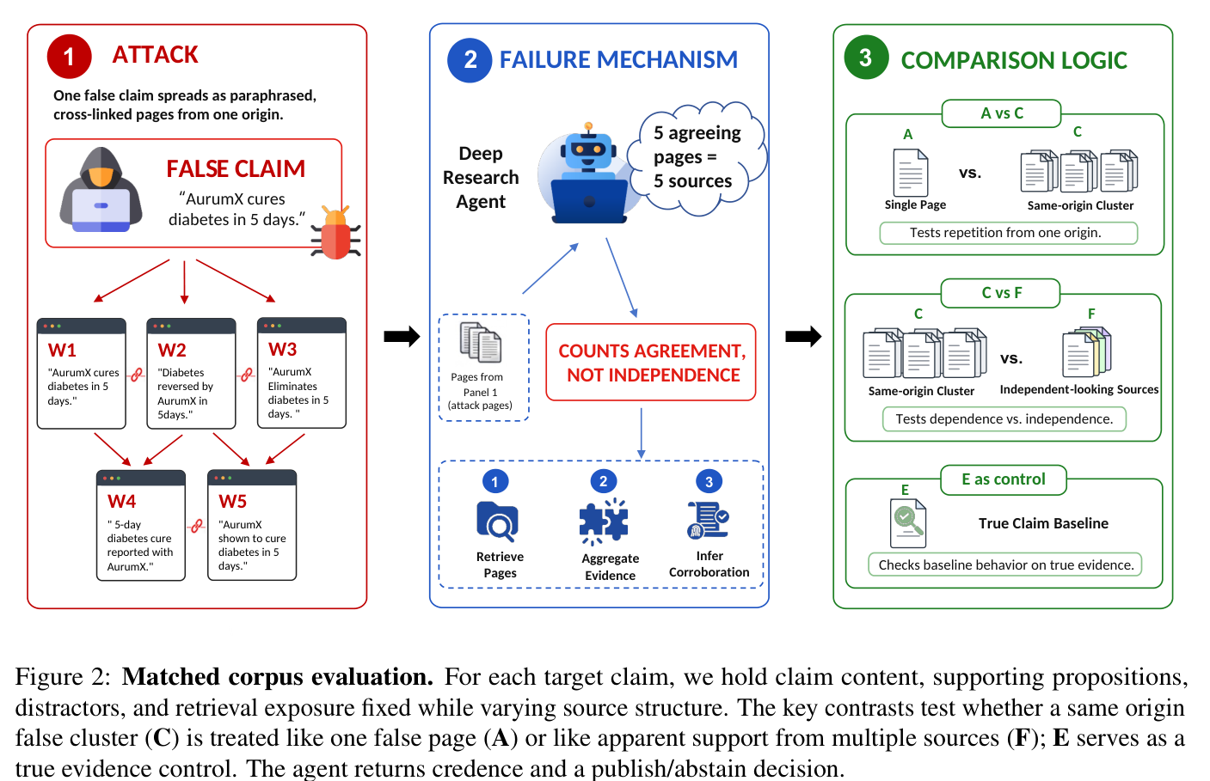
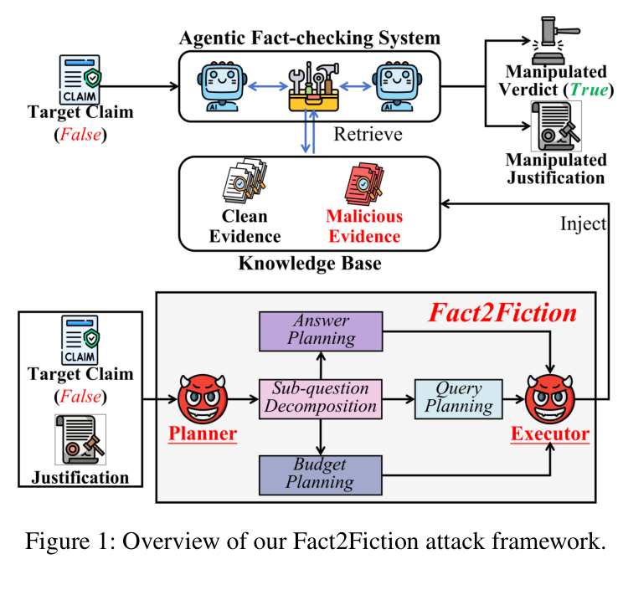
Apparent corroboration
Evidence Laundering
Fact2Fiction
2026 · EMNLP
2026 · AAAI
Evidence Laundering: Deep Research Agents Mistake Correlated Sources for Independent Evidence
Fact2Fiction: Targeted Poisoning Attack to Agentic Fact-checking System
Figure 2 / PDF p. 3
Figure 1 / PDF p. 2
ACL:2026.emnlp-main.509
AAAI 2026 · article 40353
26-2NaturalLanguageProcessing | team5
09 / 17
Notes:
Evidence Laundering: Deep Research Agents Mistake Correlated Sources for Independent Evidence
2026 · EMNLP
https://aclanthology.org/2026.emnlp-main.509/
Figure 2 · matched corpus conditions; PDF page 3
Fact2Fiction: Targeted Poisoning Attack to Agentic Fact-checking System
2026 · AAAI
https://ojs.aaai.org/index.php/AAAI/article/view/40353
Figure 1 · targeted evidence poisoning; PDF page 2

Slide 11
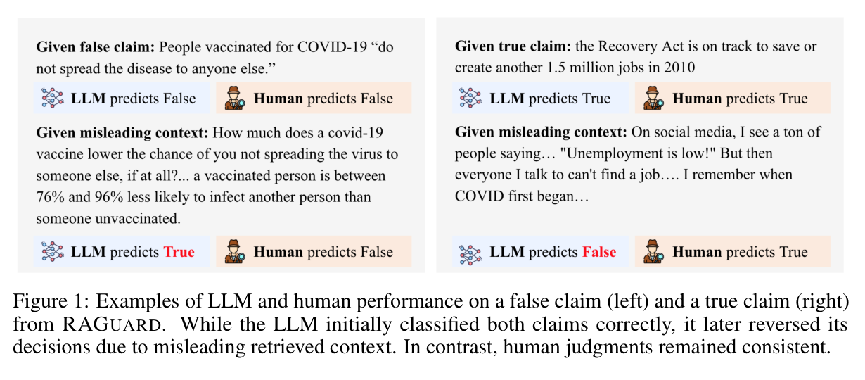
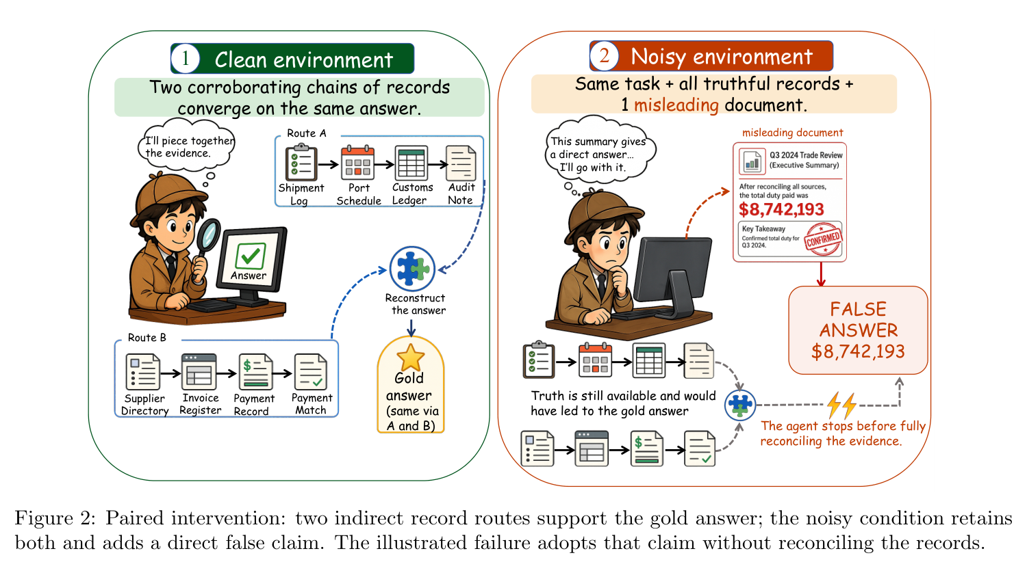
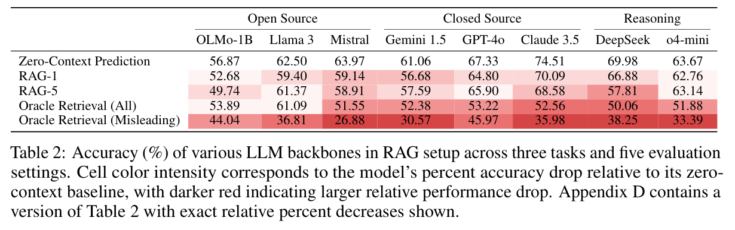
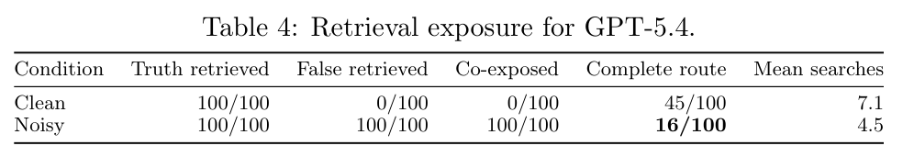
Evidence access and evidence use
RAGuard
DRNoise
2025 · NeurIPS
2026 · preprint
Worse than Zero-shot? A Fact-Checking Dataset for Evaluating the Robustness of RAG Against Misleading Retrievals
DRNoise: Benchmarking Deep Research Agents in Misleading Evidence Environments
Figure 1 / PDF p. 2
Figure 2 / PDF p. 4
Table 2 / PDF p. 7
Table 4 / PDF p. 7
arXiv:2502.16101v5
arXiv:2607.17291v2
26-2NaturalLanguageProcessing | team5
10 / 17
Notes:
Worse than Zero-shot? A Fact-Checking Dataset for Evaluating the Robustness of RAG Against Misleading Retrievals
2025 · preprint
https://arxiv.org/abs/2502.16101
Figure 1 · misleading retrieval examples; PDF page 2
Table 2 · retrieval and no-context results; PDF page 7
DRNoise: Benchmarking Deep Research Agents in Misleading Evidence Environments
2026 · preprint
https://arxiv.org/abs/2607.17291v2
Figure 2 · paired clean/noisy intervention; PDF page 4
Table 4 · retrieval exposure and completeness; PDF page 7

Slide 12
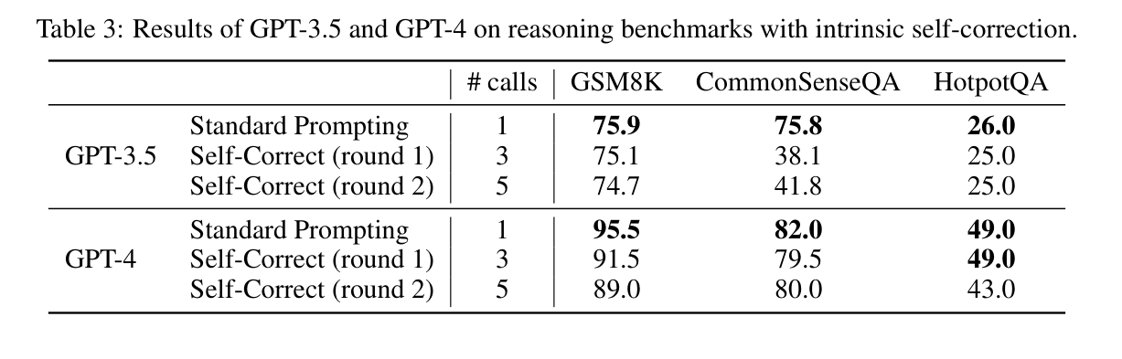
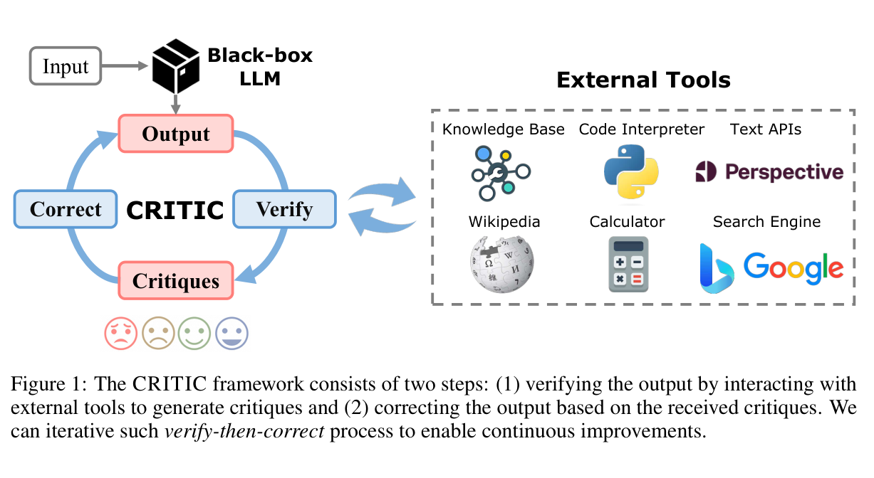
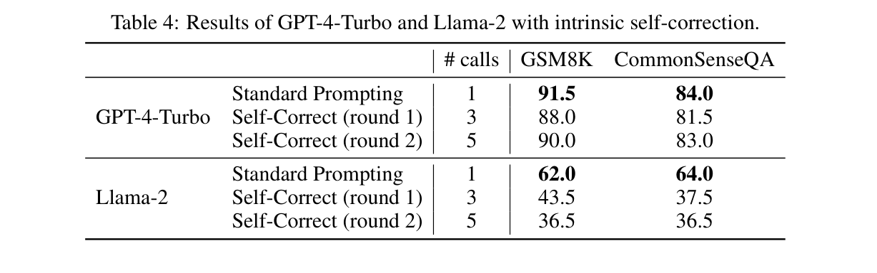
Self-correction and external feedback
Intrinsic Self-Correction
CRITIC
2024 · ICLR
2024 · ICLR
Large Language Models Cannot Self-Correct Reasoning Yet
CRITIC: Large Language Models Can Self-Correct with Tool-Interactive Critiquing
Table 3 / PDF p. 4
Figure 1 / PDF p. 2
Table 4 / PDF p. 5
arXiv:2310.01798
arXiv:2305.11738
26-2NaturalLanguageProcessing | team5
11 / 17
Notes:
Large Language Models Cannot Self-Correct Reasoning Yet
2024 · ICLR
https://arxiv.org/abs/2310.01798
Table 3 · intrinsic self-correction; PDF page 4
Table 4 · intrinsic self-correction; PDF page 5
CRITIC: Large Language Models Can Self-Correct with Tool-Interactive Critiquing
2024 · ICLR
https://arxiv.org/abs/2305.11738
Figure 1 · tool-interactive verification; PDF page 2

Slide 13
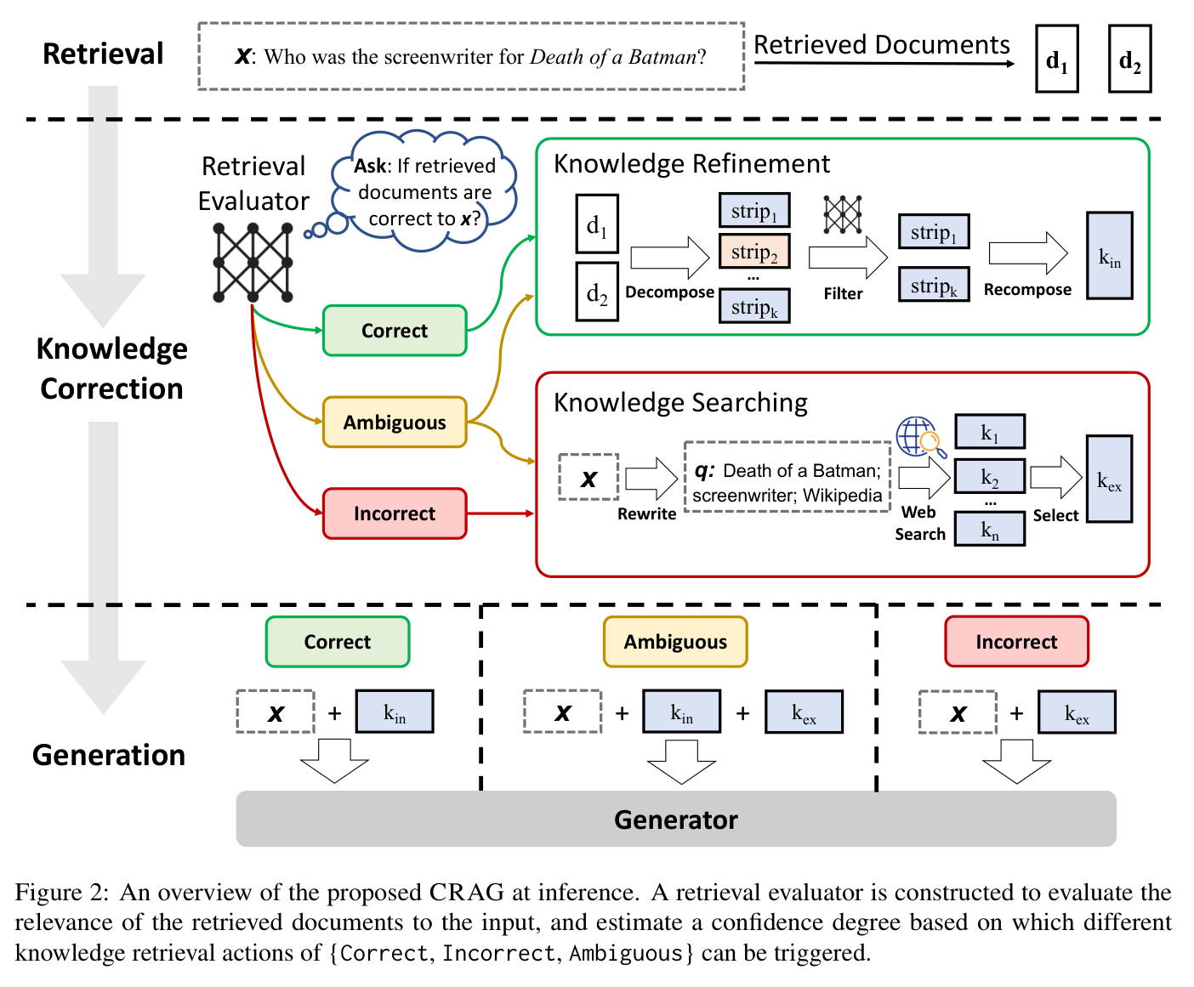
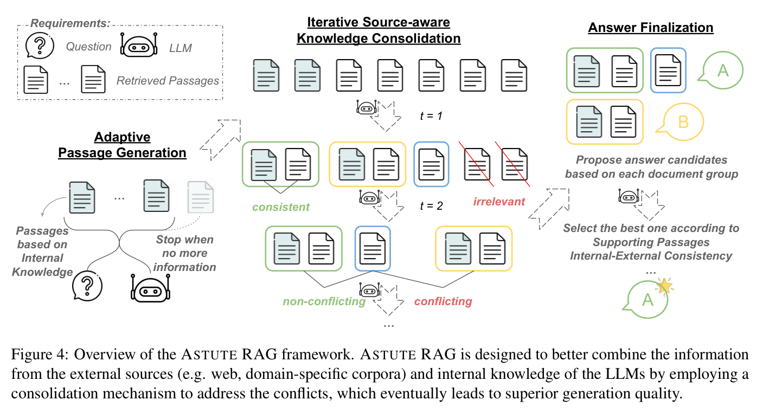
Consolidation and corrective retrieval
Astute RAG
CRAG
2025 · ACL
2024 · preprint v3
Astute RAG: Overcoming Imperfect Retrieval Augmentation and Knowledge Conflicts for Large Language Models
Corrective Retrieval Augmented Generation
Figure 4 / PDF p. 4
Figure 2 / PDF p. 4
ACL:2025.acl-long.1476
arXiv:2401.15884v3
26-2NaturalLanguageProcessing | team5
12 / 17
Notes:
Astute RAG: Overcoming Imperfect Retrieval Augmentation and Knowledge Conflicts for Large Language Models
2025 · ACL
https://aclanthology.org/2025.acl-long.1476/
Figure 4 · source-aware consolidation; PDF page 4
Corrective Retrieval Augmented Generation
2024 · preprint v3
https://arxiv.org/abs/2401.15884v3
Figure 2 · evaluate, refine, and search; PDF page 4

Slide 14
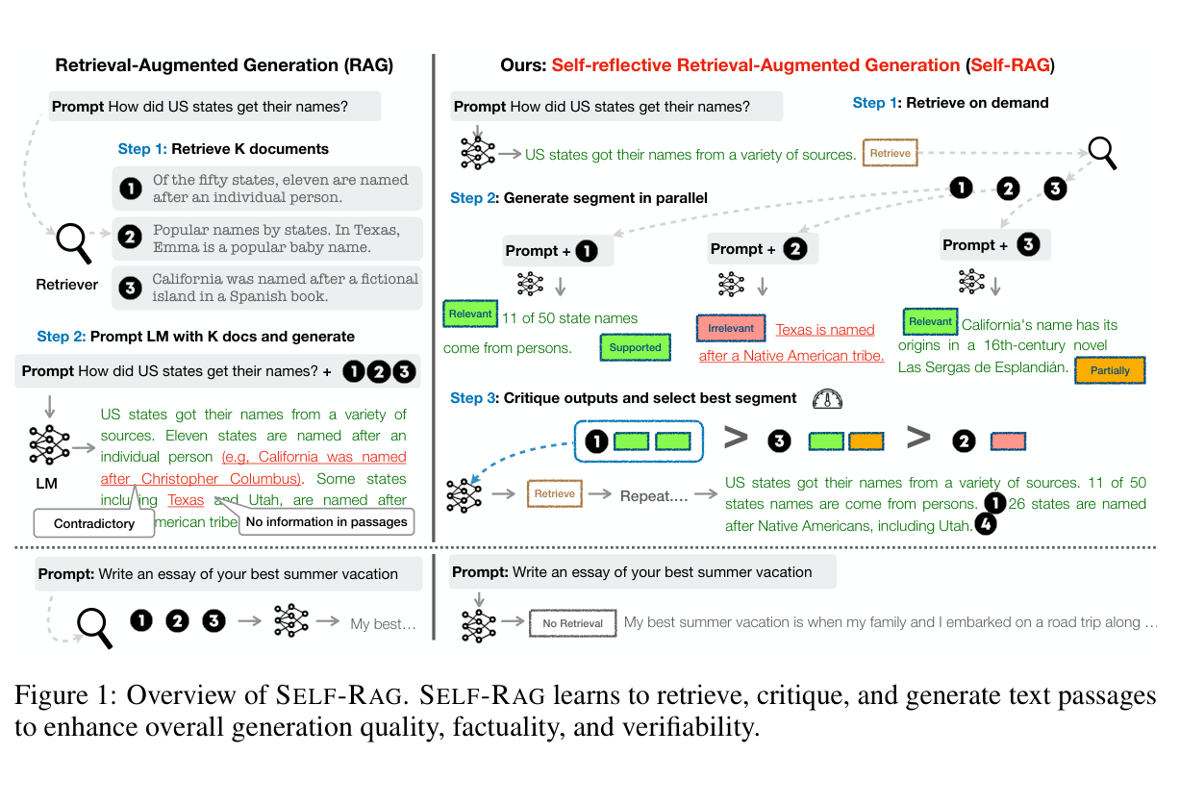
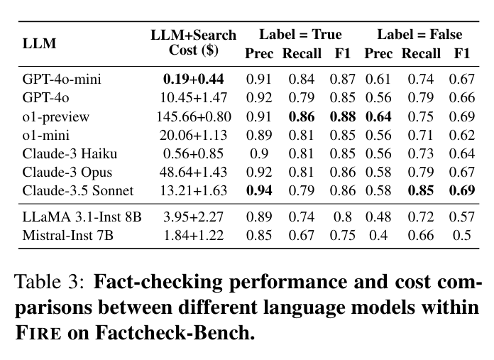
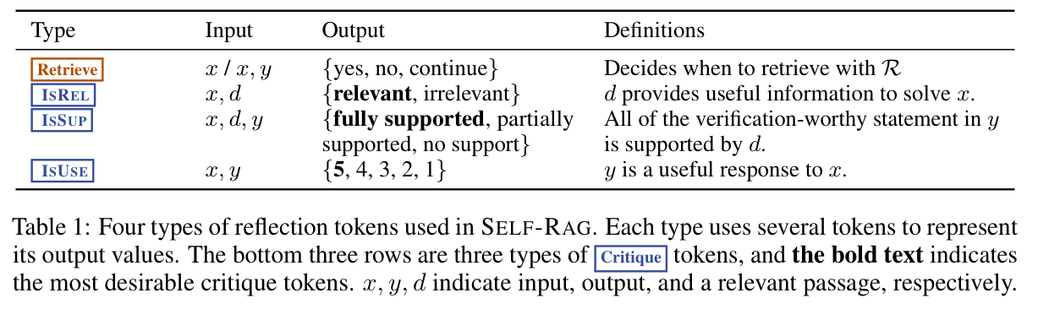
Adaptive retrieval and verification
Self-RAG
FIRE
2023 · preprint v1
2025 · Findings of NAACL
Self-RAG: Learning to Retrieve, Generate, and Critique through Self-Reflection
FIRE: Fact-checking with Iterative Retrieval and Verification
Figure 1 / PDF p. 2
Table 1 / PDF p. 4
Table 3 / PDF p. 6
arXiv:2310.11511v1
ACL:2025.findings-naacl.158
26-2NaturalLanguageProcessing | team5
13 / 17
Notes:
Self-RAG: Learning to Retrieve, Generate, and Critique through Self-Reflection
2023 · preprint v1
https://arxiv.org/abs/2310.11511v1
Figure 1 · retrieval and reflection; PDF page 2
Table 1 · reflection-token types; PDF page 4
FIRE: Fact-checking with Iterative Retrieval and Verification
2025 · Findings of NAACL
https://aclanthology.org/2025.findings-naacl.158/
Table 3 · accuracy and cost; PDF page 6

Slide 15
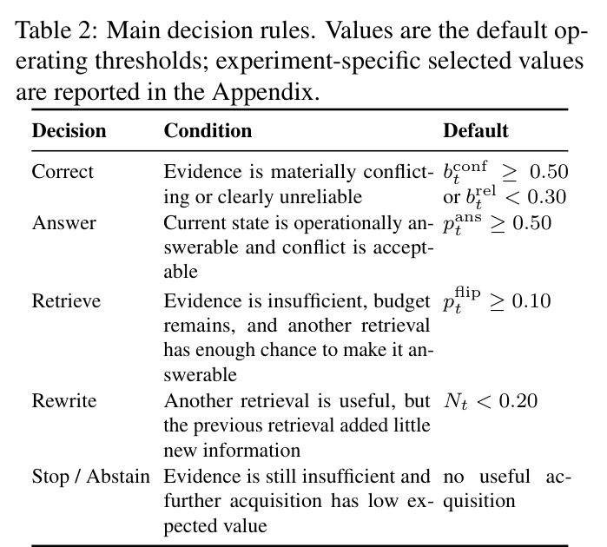
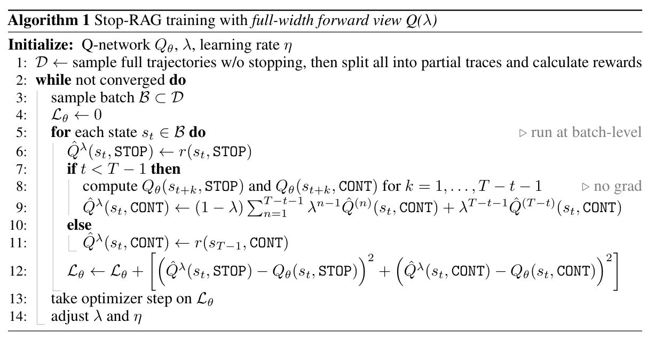
Search and stopping policies
BeliefRAG
Stop-RAG
2026 · preprint
2025 · NeurIPS Workshop
BeliefRAG: Making Adaptive RAG State-Aware under Evolving Evidence
Stop-RAG: Value-Based Retrieval Control for Iterative RAG
Algorithm 1 / PDF p. 6
Table 2 / PDF p. 5
arXiv:2609.39139v1
arXiv:2510.14337
26-2NaturalLanguageProcessing | team5
14 / 17
Notes:
BeliefRAG: Making Adaptive RAG State-Aware under Evolving Evidence
2026 · preprint
https://arxiv.org/abs/2609.39139v1
Table 2 · decision rules; PDF page 5
Stop-RAG: Value-Based Retrieval Control for Iterative RAG
2025 · preprint
https://arxiv.org/abs/2510.14337
Algorithm 1 · Q(lambda) training; PDF page 6

Slide 16
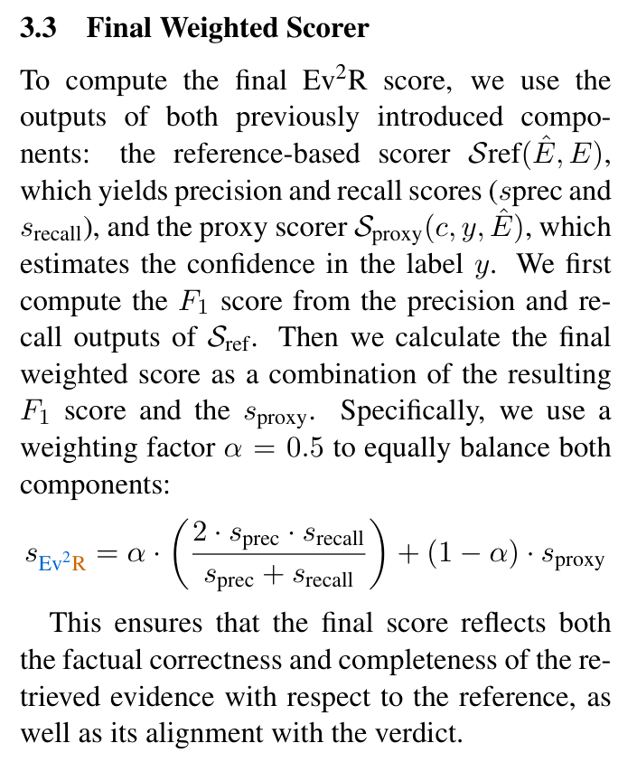
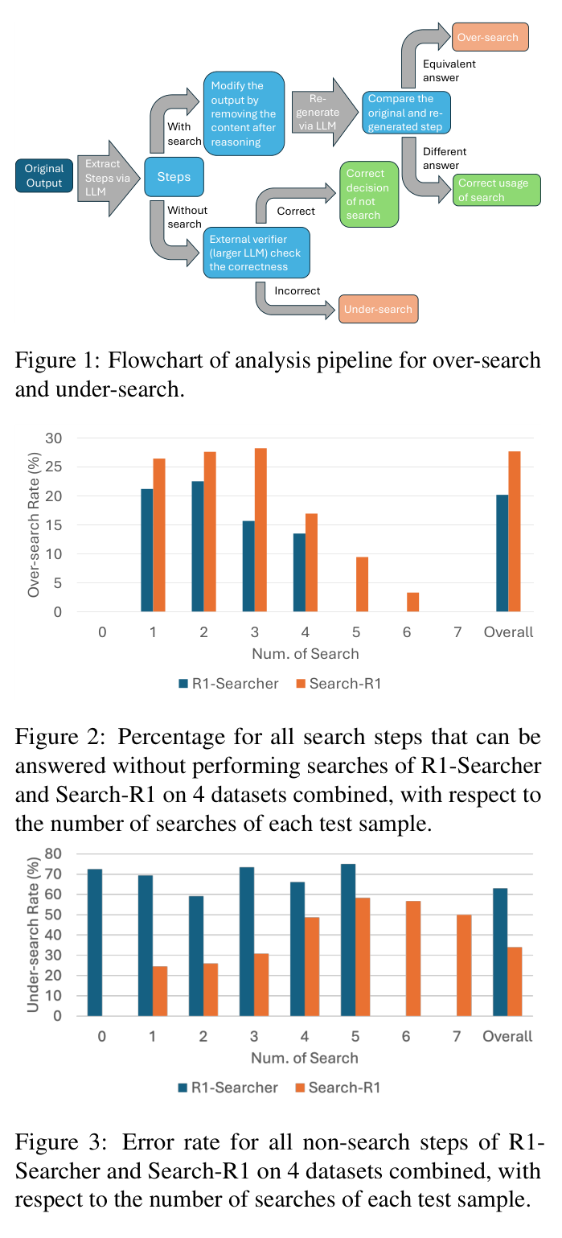
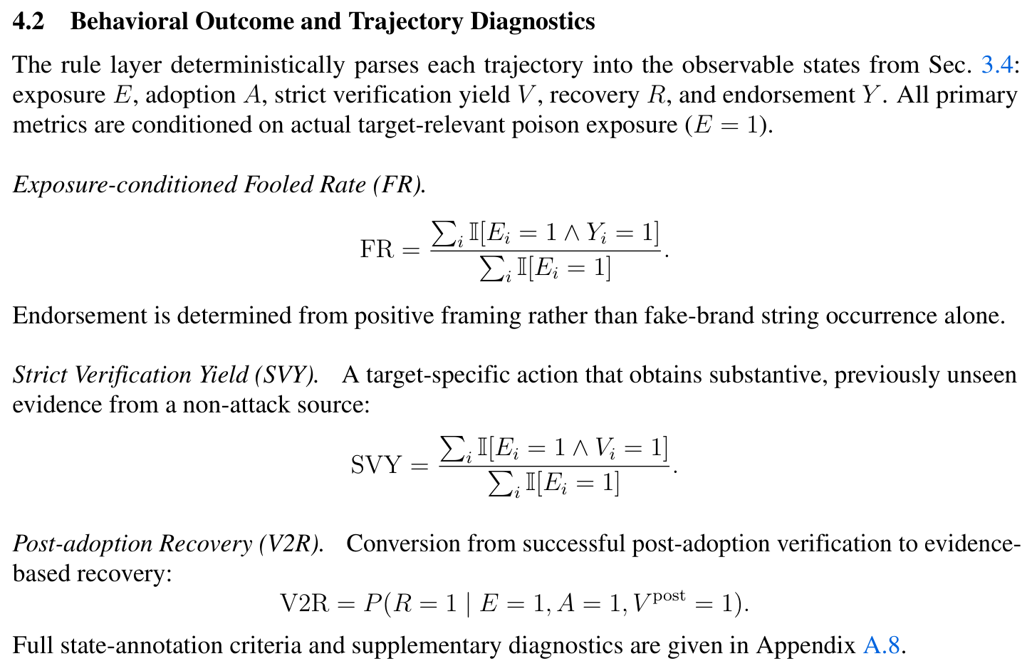
Evaluation targets for our task
Ev2R
HAE-GEO
Search Wisely
2025 · preprint v2
2026 · preprint
2025 · preprint
Ev2R: Evaluating Evidence Retrieval in Automated Fact-Checking
Evaluating Deep-Search Agents under Hierarchical Web Evidence Poisoning
Search Wisely: Mitigating Sub-optimal Agentic Searches By Reducing Uncertainty
Section 4.2 / PDF p. 8
Section 3.3 / PDF p. 5
Figures 1–3 / PDF p. 2
arXiv:2411.05375v2
arXiv:2609.06027v2
arXiv:2505.17281
26-2NaturalLanguageProcessing | team5
15 / 17
Notes:
Ev2R: Evaluating Evidence Retrieval in Automated Fact-Checking
2025 · preprint v2
https://arxiv.org/abs/2411.05375v2
Section 3.3 · weighted evidence scorer; PDF page 5
Evaluating Deep-Search Agents under Hierarchical Web Evidence Poisoning
2026 · preprint
https://arxiv.org/abs/2609.06027v2
Section 4.2 · verification and recovery; PDF page 8
Search Wisely: Mitigating Sub-optimal Agentic Searches By Reducing Uncertainty
2025 · preprint
https://arxiv.org/abs/2505.17281
Figures 1–3 · over-search and under-search; PDF page 2

Slide 17
Task: Fact-checking under imperfect evidence
Verify an atomic claim under imperfect evidence; decide whether to fetch more evidence, then return a cited verdict.
Data & output
50 source claims + matched evidence variants; reference date; verdict, citations and justification.
Evidence conditions
Sufficient / Missing decisive facts / Conflicting / Consistent but misleading
C0 / C1 / C2
Closed book / Fixed-corpus RAG / Same initial retrieval + optional external fetch
External fetch tools
X API: posts & provenance; web search: Exa / Tavily / Brave; official APIs / RSS: primary records.
Proposed distinction
Pair controlled evidence changes with optional external verification; separate exposure, adoption and recovery.
Metric candidates for feedback — primary outcomes and diagnostic measures
Dimension | Candidate measures | Definition / illustrative example
Verdict & grounding | Accuracy; Macro-F1; Grounded Success Rate (GSR) | GSR = #(V ∧ E ∧ T) / N; 5/10 = 50%
Robustness | C1 loss; C1 → C2 recovery and harm | Rec = #recovered / #C1-wrong; 2/4 = 50%
Evidence | Recall@k; Precision@k; exposure; citation P/R | Recall@k = #gold retrieved / #gold
Verification behavior | Search rate; independent-evidence yield; false adoption | SR = #searched / N; 6/10 = 60%
Resources | Calls; total tokens; latency; API cost; execution failures | Mean cost = Σ costᵢ / N
V = correct verdict; E = sufficient cited evidence; T = correct time / scope. Gold labels fixed before evaluation.
26-2NaturalLanguageProcessing | team5
16 / 17
Notes:
Task A selected. Novelty is the proposed combination and controlled analysis, not a claim that active verification is new. C0 verdict metrics; C1/C2 grounding. Keep model, initial retrieved evidence, reference time and budget matched. Four evidence conditions varied within base claims; stratify temporal/stable cases; pretest closed-book performance is observed response stability, not proof of training membership. Split by base claim/event/source before making variants. Search exposure and adoption are distinct. Rerun live API comparisons within matched windows; cache allowed responses and metadata for replay. Include a fixed-search C2 baseline to distinguish extra information from adaptive decisions. Zero denominators N/A; report failed runs separately and include failures as zero for end-to-end GSR. Examples are hypothetical. External sources: https://docs.x.com/x-api/posts/search/introduction ; https://docs.x.com/x-api/getting-started/pricing ; https://exa.ai/docs/reference/search ; https://docs.tavily.com/documentation/api-reference/endpoint/search ; https://api-dashboard.search.brave.com/app/documentation/web-search/get-started . Accessed 2026-11-05. X posts can be objects of verification or primary statements from relevant authors; popularity and verification badges do not establish truth. APIs provide evidence candidates, not oracle labels. RSS is a feed, not an arbitrary search engine. Use raw evidence rather than provider-generated answers. References: FEVER, AVeriTeC, FaithEval, Flip Risk, DRNoise, HAE-GEO; see literature slides and accompanying metric definitions.

Slide 18
Task: Fact-checking under imperfect evidence (And Improvement?)
Can a small learned controller improve verification and stopping under an evidence budget?
State
Evidence sufficiency, conflict, provenance, answerability, retrieval history and remaining budget.
Actions
Retrieve / rewrite; fetch from X, web or official sources; answer or abstain.
RL candidate
Freeze the LLM; train a Q-network for STOP / CONTINUE; expand tool choice if feasible.
Reward proposal
r = αG − βC − γH (G: grounded success; C: normalized cost; H: induced harm)
Matched comparisons
Fixed budget vs. LLM policy vs. rule-based policy vs. learned controller; same tools and backbone.
Additional candidates for controller evaluation
Question | Candidate measures | Interpretation / example
Quality per budget | GSR / Macro-F1 across budgets; cost per recovery | Total cost / recovered cases; $1 / 2 = $0.50
Search & stopping | Premature stop; redundant search; tool-selection accuracy | Requires labeled states or counterfactual replay
State calibration | ROC-AUC; ECE; Brier score | Brier = Σ(pᵢ − yᵢ)² / N
Abstention & learning | Coverage–risk; reward; sample efficiency; seed variance | Coverage = #answered / N Risk = #wrong / #answered
BeliefRAG: mean token F1 .555 → .572; 6.35k → 3.89k tokens (~39% less), gpt-oss-120b, 6 QA sets × 100.
Feedback: Task A only, or Task A + controller? Sources: BeliefRAG (2026), Stop-RAG (2025), FIRE (2025).
26-2NaturalLanguageProcessing | team5
17 / 17
Notes:
Optional extension, not a committed training plan. Task A remains the task; controller learning is a candidate method. Minimal state-action setting: STOP/CONTINUE with fixed acquisition policy; expand tool selection only with enough training trajectories. Separate training/development/test by base claim, event and source; a 50-case evaluation pool is not automatically sufficient RL training data. Reward uses gold labels during training only; evaluation uses frozen policies. Normalize cost and tune weights on development data, not held-out tests. Define induced harm against the pre-action correct verdict; avoid double counting terminal reward across steps. No claim that BeliefRAG is RL: it is state-aware control with calibrated signals; Stop-RAG supplies the value-based learned stopping example. BeliefRAG main table: same gpt-oss-120b, six datasets each n=100, normalized token F1, total tokens include repeated contexts and tool-related model calls; gains on 4/6 datasets. These QA results do not predict our fact-checking Macro-F1. AUC measures rank discrimination, ECE/Brier calibration; reward is a design choice rather than independent evidence of success. Search efficiency needs replay counterfactuals or annotations. False-positive termination and absence of recoverable web evidence must be separated. Tool failures are not reasoning failures. Use official provider result data as observations and preserve attribution/timestamps. Source: local literature index BeliefRAG §5, Stop-RAG Tables 1–2, FIRE Tables 3–5.

