Slide 2
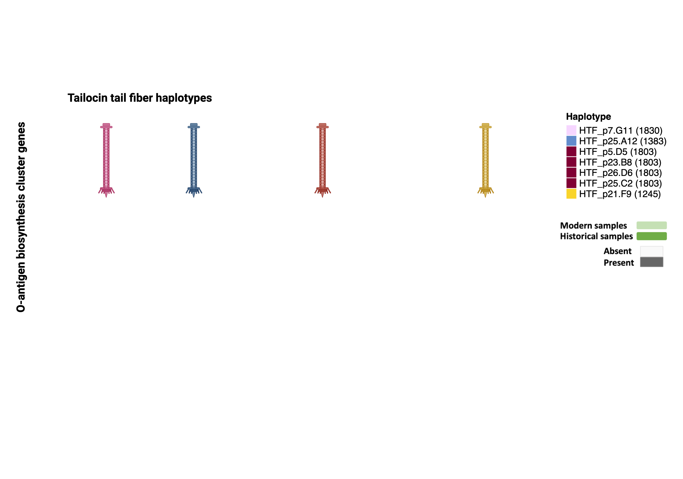
HTF haplotype - O-antigen OBC genes presence/absence (m53 + h34)
Tailocin tail fiber haplotypes
1830bp
1383bp
1803bp
1245bp
O-antigen biosynthesis cluster genes
Absent
Present
NA
Modern and historical

