Slide 1


What makes a good night's sleep​
Jiajun Cui​
Lanqi Wu​
Kexin Zhang​
Yanran Qiu​
Xinxing Chen​
Notes:
Hello, we are group 14. Today, we are glad to introduce what makes a good night’s sleep and we hope we could help you to have a better sleep.

Slide 2



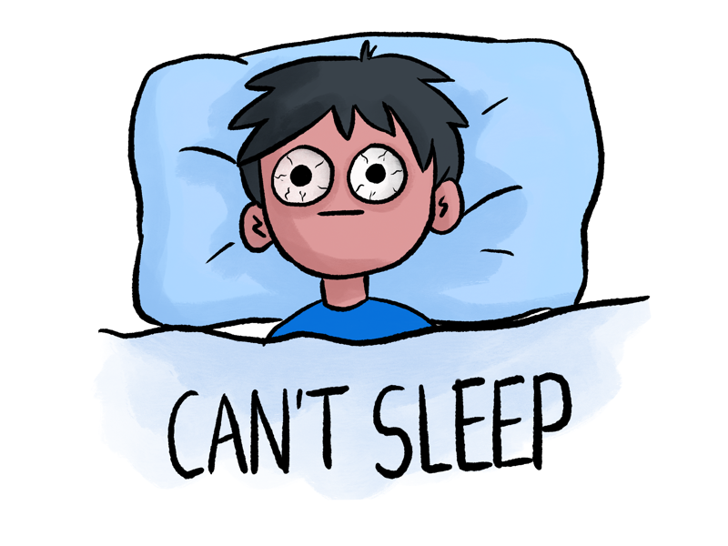

Introduction​
Sleep plays an integral role in health
Many people have sleep problems and don’t get the rest they need
Sleep disorders, medical conditions and mental health…
Poor short-term memory, attention and processing speed…
Notes:
As you know,
Sleep plays an integral role in health. A good night’s sleep empowers the body to recover and lets you wake up refreshed and ready to take on the day.
Unfortunately, many people have sleep problems and don’t get the rest that they need. Insufficient sleep and poor-quality sleep can be due to diverse factors including sleep disorders, medical conditions, and mental health. Sleep issues affect people of all ages, and its impacts can be far-reaching.for example Recent research has shown that insufficient sleep can affect cognitive behaviors like Poor short-term memory, attention and processing speed…

Slide 3
Question Time
How is your sleep?
Notes:
How is your sleep?
Good – Congratulations!
Bad – Your are not alone! We will help you

