Slide 1

Fused Lasso Final Project Meeting I
Presenter: Cheng-Jun Kang
Advisor: Chi-Shian Dai
12/08

Slide 2
Outline
Current Progress
Replicate the Methodology on a Different Dataset
Future Work

Slide 3
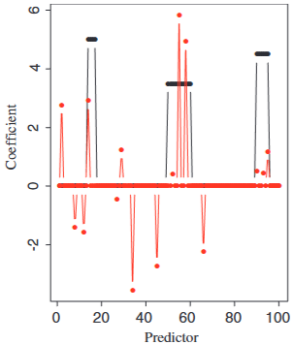
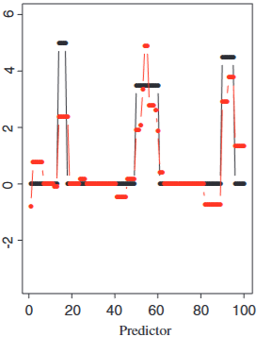
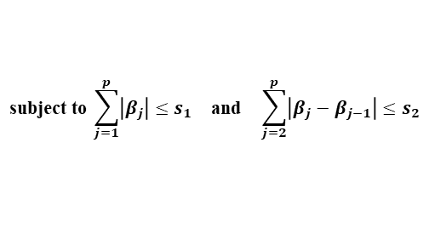

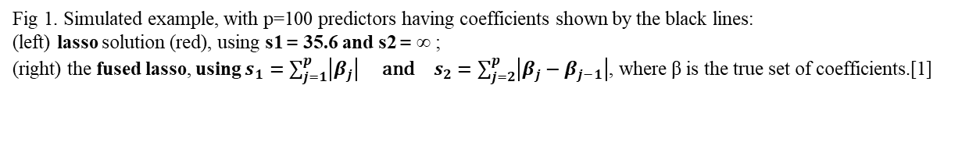
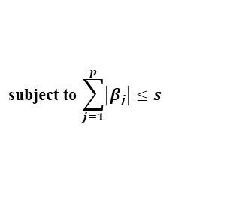
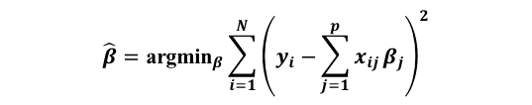
Current Progress
Replicate of Lasso and Fused Lasso simulation experiment.
$$\hat{β}={\text{argmin}}_{β}\sum_{i=1}^{N}{{\left(y_{i}−\sum_{j=1}^{p}{x_{ij}}β_{j}\right)}^{2}}$$
$$\hat{β}={\text{argmin}}_{β}\sum_{i=1}^{N}{{\left(y_{i}−\sum_{j=1}^{p}{x_{ij}}β_{j}\right)}^{2}}$$
$$\text{subject} \text{to} \sum_{j=1}^{p}{\left|β_{j}\right|}≤s$$
$$\text{subject} \text{to} \sum_{j=1}^{p}{\left|β_{j}\right|}≤s_{1} \text{and} \sum_{j=2}^{p}{\left|β_{j}−β_{j−1}\right|}≤s_{2}$$
Fig 1. Simulated example, with p=100 predictors having coefficients shown by the black lines:
(left) lasso solution (red), using s1 = 35.6 and s2 = ∞ ;
(right) the fused lasso, using $s_{1}=\sum_{j=1}^{p}{\left|β_{j}\right|} \text{and} s_{2}=\sum_{j=2}^{p}{\left|β_{j}−β_{j−1}\right|}$, where β is the true set of coefficients.[1]
[1] Tibshirani, R., Saunders, M., Rosset, S., Zhu, J., & Knight, K. (2005). Sparsity and smoothness via the fused lasso. Journal of the Royal Statistical Society Series B: Statistical Methodology, 67(1), 91-108.

Slide 4
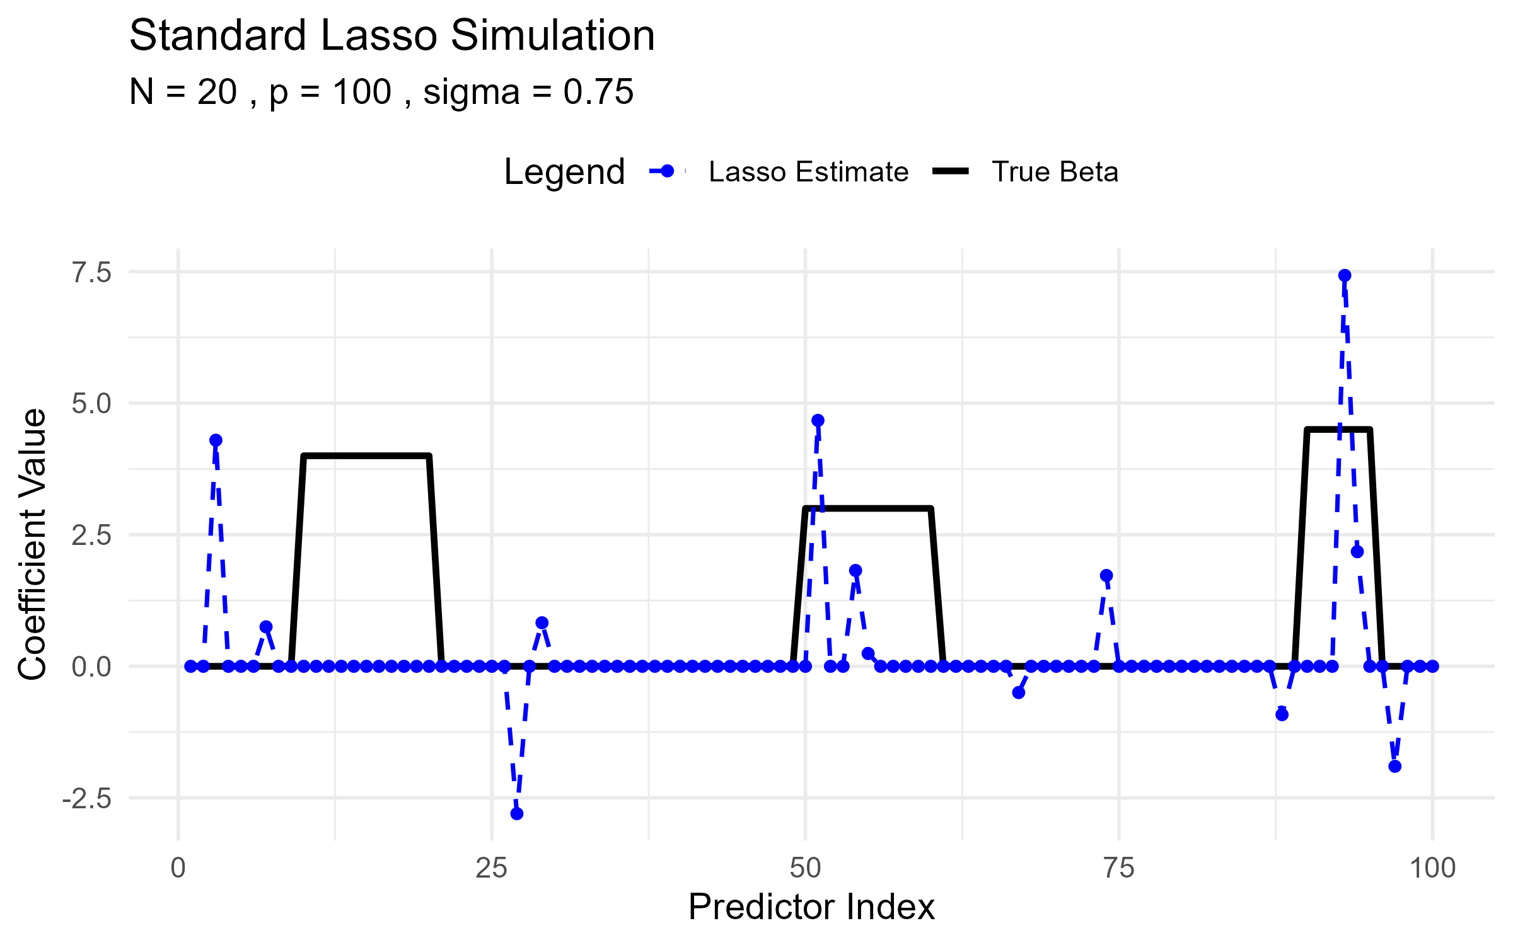
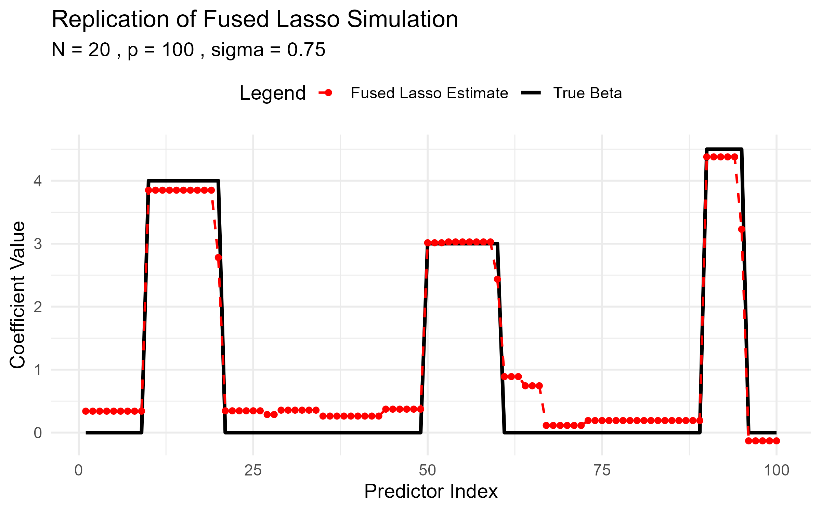
Replicate Results
Fig 2. Replication of Simulated example, with N=20, p=100, sigma=0.75 predictors having coefficients shown by the black lines:
(left) Lasso (right) Fused lasso.

Slide 5
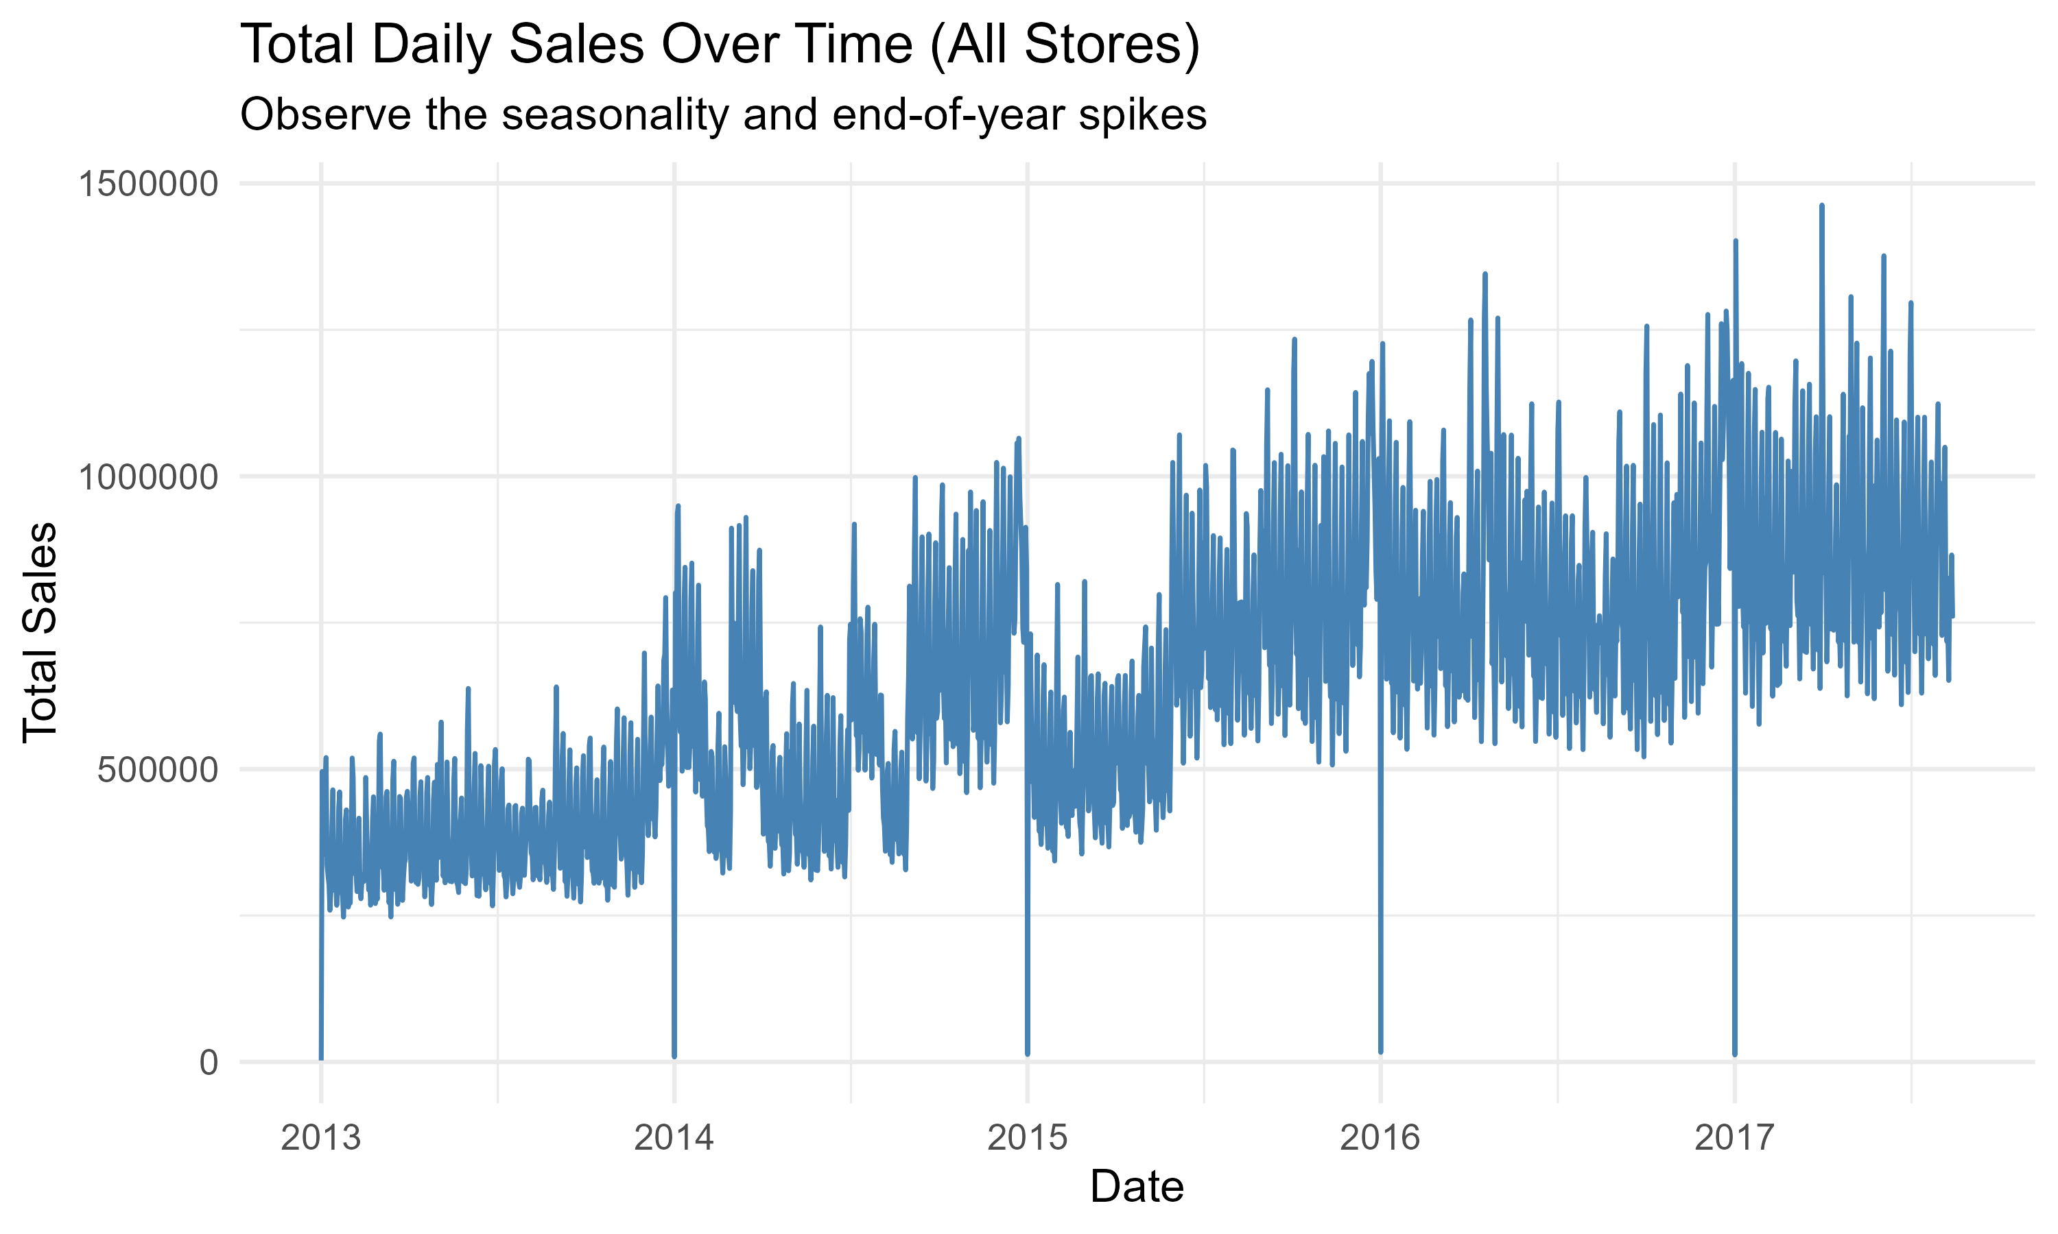
Replicate on Different Dataset (Store Sales)
Description: Predict sales for the thousands of product families sold at Favorita stores located in Ecuador. The training data includes dates, store and product information. [2]
Fig 3. Total Daily Sales Over Time (2013-01-01~2017-08-15)
[2] https://www.kaggle.com/competitions/store-sales-time-series-forecasting/data
Notes:
可以看到在年末的聖誕季節過後買氣都會有斷層式的下降。這是可以預期到的，另外這種斷層式的關係就很適合用 fused lasso 。因為他會把相近的 group 起來

Slide 6
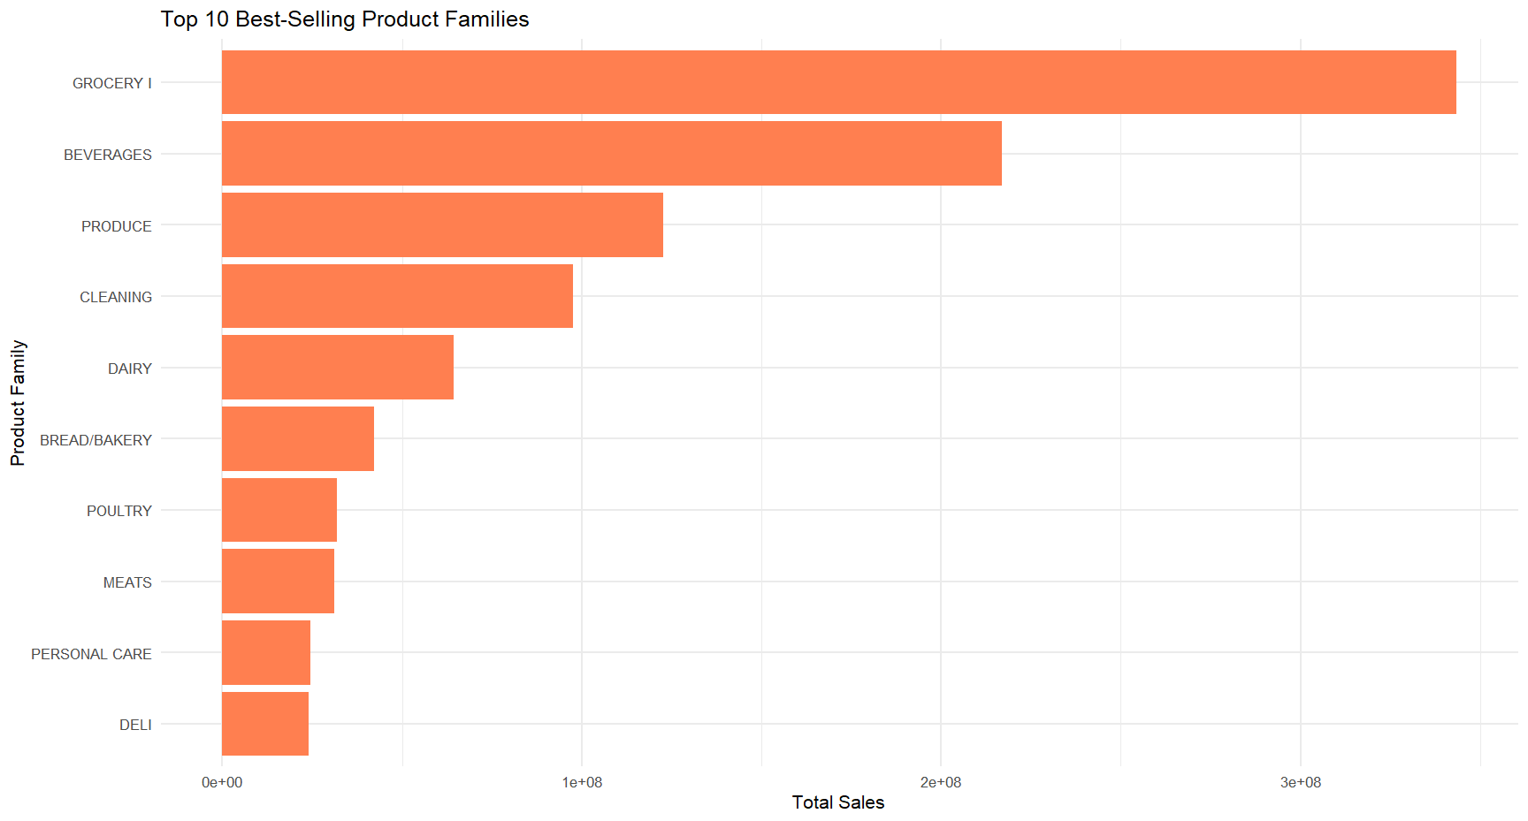
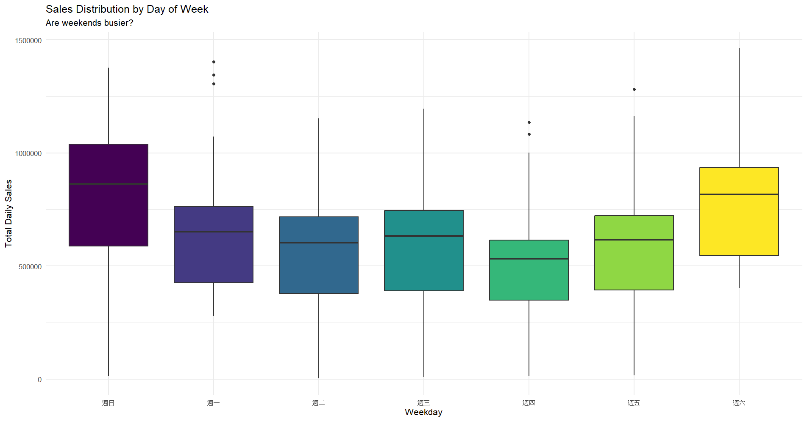
Replicate on Different Dataset (Store Sales)
Fig 4. The left plot shows the top 10 best-selling products, and the right plot shows the sales distribution by day of the week.

Slide 7
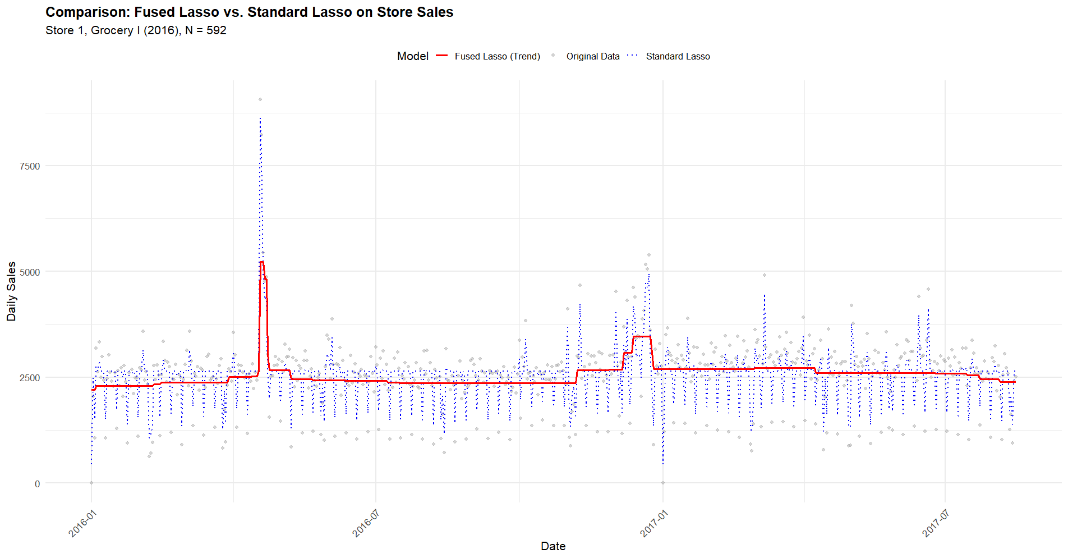
Replicate on Different Dataset (Store Sales)
Fig 5. Total Daily Sales Over Time (All Stores)

Slide 8
Future Work
Using Cross-Validation
Seasonality Decomposition
2D Fused Lasso(Neighboring stores or similar products)
Model Comparison

Slide 9
Thanks for your Attention
Have any Questions?

