Slide 1




Implementing and Optimizing Neural Network in C++
Group member: Abdulaziz Alshehri and Chao-Jia Liu

Slide 2
Project Proposal
Anticipated Goal:
Implement neural network in C++
Optimize neural network
Advance C++ skills
Technical Approach:
Utilize two classes, Class Neuron and Class Net for NN implementation
Neuron: Initialize weights/biases, compute output, update parameters including gradients and weights.
Net: Link layers, get the net recent error.
TrainingData: Set Topology
Main function: Initialize the NN architecture, print out the results
(√)
(increase the accuracy)
(√)
Use Gnuplot for graph visualization
(utilize three classes, Class TrainingData was
been added)
(√)
(get the average error for separated target values)
(generate random training sets of input)
(store each results for compute the average
errors, plot the graph)
Use a do-while loop to realize the Inference part

Slide 3
Neural Network Architecture in C++
Neural Network Structure
Neurons and Algorithms
Class Structure Design
Utilizing Vectors in C++
Various Vector Functions
Integrating Gnuplot for Visualization
By setting the topology, we can change the neural network structure.

Slide 4
Code Present

Slide 5
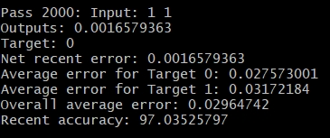
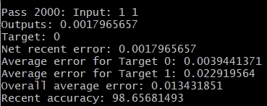
Results
Topology = {2, 4, 1} and the results for epochs = 2000.
Topology = {2, 4, 4, 4, 1} and the results for epochs = 2000

Slide 6
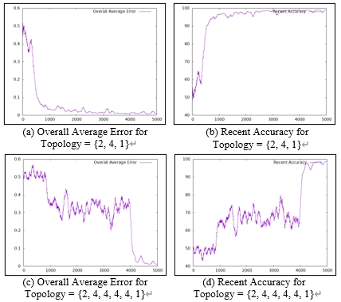
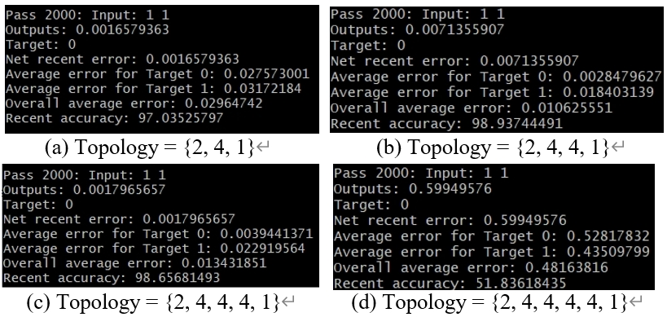
Each structure shows a distinct pattern in accuracy improvement. Having more hidden layers does not ensure greater accuracy across the same epochs.
Epoch is set as 2000 and the result of different structure.
The more complex the neural network structure is, the more training time it spends increasing accuracy.

Slide 7
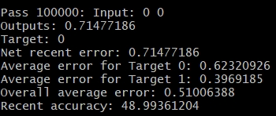
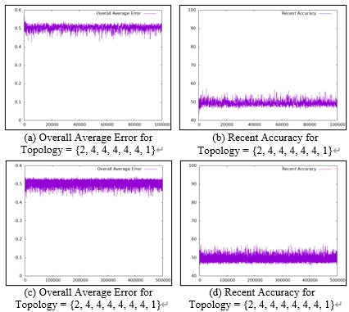
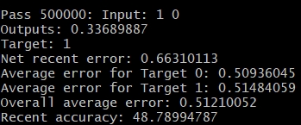
The performance for two structures with excessive hidden layers and high epoch settings.
Topology = {2, 4, 4, 4, 4, 4, 1} and the epoch = 100000.
Topology = {2, 4, 4, 4, 4, 4, 4, 1} and the epoch = 500000.
The accuracy did not increased even when we set a huge epoch.

Slide 8
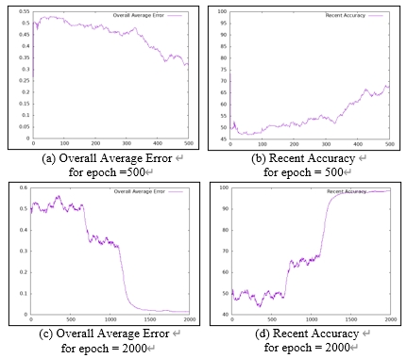
Trend
Increasing hidden layers may boost accuracy but extend training time.
Pitfalls
Random cases in code led to varied results across epochs.
Each epoch had a unique pattern in performance degradation.
Tracking time is crucial for future reports.
The graphical results for topology {2, 4, 4, 4, 1} with epochs set to 500 and 2000. When epoch = 500, the accuracy already reaches around 65 percent. However, when epoch is set to 2000, the accuracy observed at epoch = 500 struggles at 50 percent.

Slide 9
Future Work
Standardizing Input and Weights
Exploring Epoch-Accuracy Dynamics
Measuring Runtime Efficiency

Slide 10
Questions
Thank You

