Slide 1
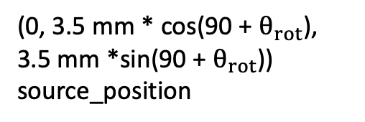
Point in simulation
Important Points in Simulation
(ICPC Detector)
Point just for clarity
z
(0, 3.5 mm * cos(90 + $θ_{rot}$), 3.5 mm *sin(90 + $θ_{rot}$)) source_position
x out of page
y
17 mm
1 mm
8.0 mm
(0, 0, 0) Origin= Rotation Axis
175.1 mm
(0, 0, -22.5 mm)
(0, 0, -28.85 mm) topHat_center
86.4 mm
(0, 0, -65.7 mm) detector_center
(0, 0, -108.9 mm)
25.4 mm
(0, 0, -121.6 mm) coldPlate_center
Cold Finger

Slide 2
Point in simulation
Clearances with LMFE
(ICPC Detector)
Point just for clarity
z
48.7 mm
(0, 0, 3.5 mm) source_position
x out of page
y
17 mm
8.0 mm
(0, 0, 0) Origin
9.5 mm
4.5 mm
15.5 mm
175.1 mm
7 mm
LMFE (not included in sim!)
2 mm
(0, 0, -22.5 mm)
3.57 mm
(0, 0, -28.85 mm) topHat_center
86.4 mm
(0, 0, -65.7 mm) detector_center
(0, 0, -108.9 mm)
25.4 mm
(0, 0, -121.6 mm) coldPlate_center
Cold Finger

Slide 3
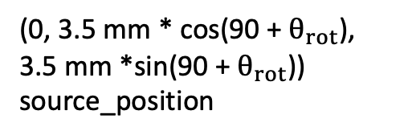

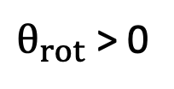
Point in simulation
Source Rotation rotate about x-axis
Point just for clarity
(0, 3.5 mm * cos(90 + $θ_{rot}$), 3.5 mm *sin(90 + $θ_{rot}$)) source_position
Longest distance for clearance
z
$θ_{rot}$ > 0
18.87 mm
$$θ_{rot}=0$$
16.03 mm
8.6 mm
15.5 mm
(0, 0, 0) Origin
x out of page
y
(second) Longest distance for clearance
2 mm
LMFE (not included in sim!)
7 mm
3.57 mm
9.5 mm
(0, 0, -22.5 mm)

Slide 4
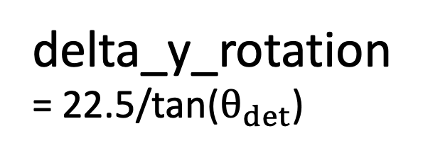
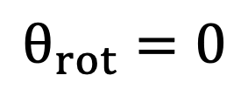
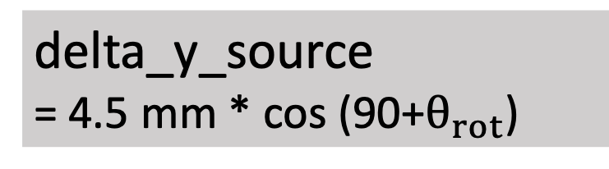
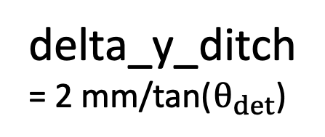
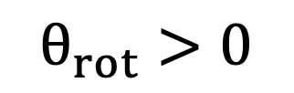
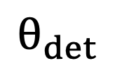

Rotation axis; (x, y, z) of “sourceRotationVolume”
Coords. of source activity:
(0, source_yPos, source_zPos)
Figure corresponding to positionCalc() function in /CAGE/sims/source_placement.py
(0, 0, 0) Origin
$$θ_{rot}>0$$
$$θ_{rot}=0$$
18.87 mm
Longest distance for clearance
z
22.5 mm
x out of page
y
$$θ_{rot}$$
$$θ_{det}$$
P+ contact
ditch_depth = 2mm
delta_y_source = 4.5 mm * cos (90+$θ_{rot}$)
ICPC ditch
y_det
(= y_final when not in ditch)
y_final
source_yPos
delta_y_ditch = 2 mm/tan($θ_{det}$)
axis_yPos
delta_y_rotation = 22.5/tan($θ_{det}$)
PPM natGe ICPC
y = 13 mm
y = 16 mm

Slide 5
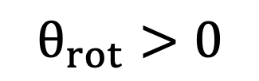
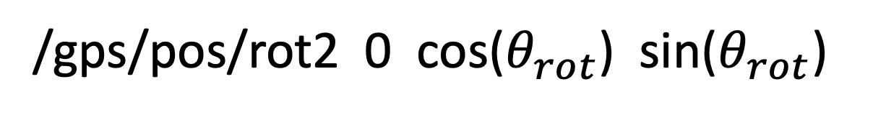
Continued from previous slide! How to rotate source activity in run macro using rotation matrices
New unit vector of source activity in run macro
When at non-normal incidence
/gps/pos/rot2 0 cos($θ_{rot}$) sin($θ_{rot}$)
$$θ_{rot}>0$$
/gps/pos/rot2 0 1 0
Original unit vector of source activity in run macro
Figure also corresponding to source_placement.py
We rotate about x-axis: always /gps/pos/rot1 1 0 0

Slide 6
OPPI

Slide 7
Point in simulation
Important Points in Simulation
(OPPI Detector)
Point just for clarity
z
x out of page
y
(0, 3.5 mm * cos(90 + $θ_{rot}$), 3.5 mm *sin(90 + $θ_{rot}$)) source_position
(0, 0, 9.55 mm) topHat_center
175.1 mm
17 mm
1 mm
8.0 mm
(0, 0, 0) Origin= Rotation Axis
(0, 0, -22.0 mm)
51 mm
(0, 0, -50.5 mm) detector_center
(0, 0, -73.0 mm)
25.4 mm
(0, 0, -85.7 mm) coldPlate_center
Cold Finger
Not to scale!

