Slide 1
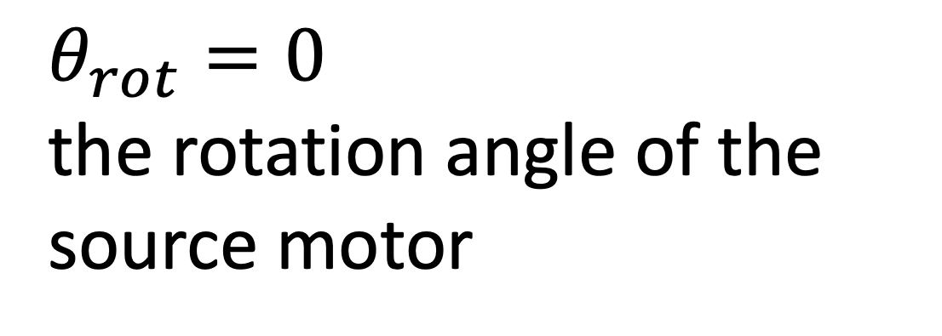
Collimator clearances and rotation
18.87 mm
$θ_{rot}=0$ the rotation angle of the source motor
16.03 mm
1 mm
8.6 mm
7 mm
Don’t really need to worry about this point– At the lowest point, it’s still ~7 mm above the LMFE
15.5 mm
22.5 mm
7 mm to top of nylon screw
6 mm
Legend
Source center
Rotation axis
Important clearance dimensions
Scale: 1 mm real life = 1 cm in drawing
10 mm
scale
https://elog.legend-exp.org/UWScanner/200221_144719/IMG_8271.jpg

Slide 2
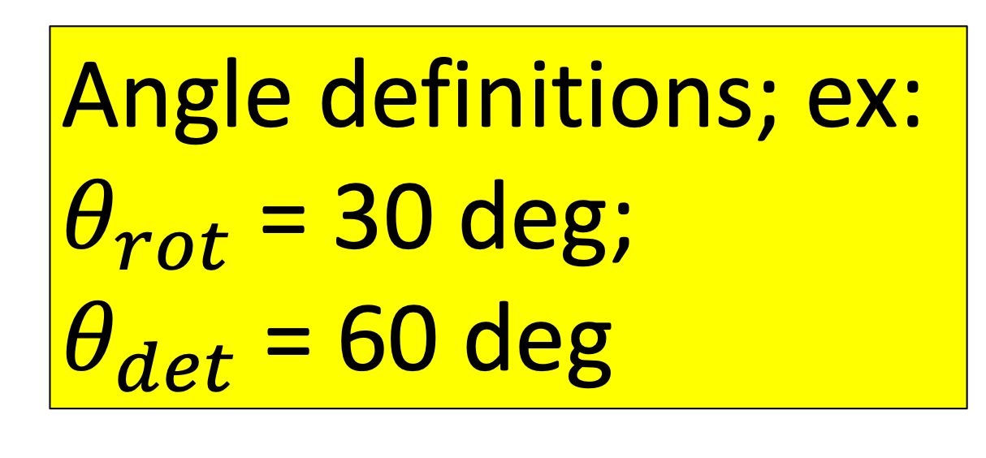
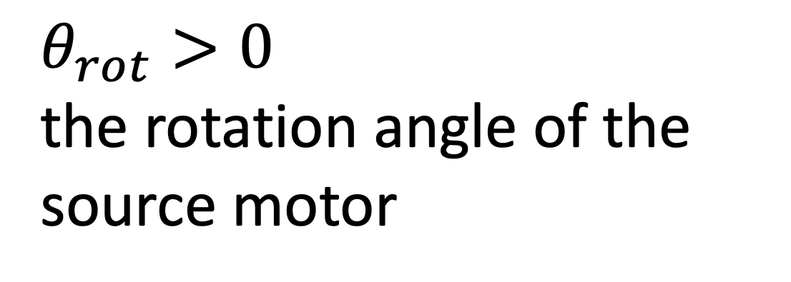


Collimator clearances and rotation
Angle definitions; ex:
$θ_{rot}$= 30 deg;
$θ_{det}$= 60 deg
18.87 mm
$θ_{rot}>0$ the rotation angle of the source motor
16.03 mm
7 mm
22.5 mm
7.48 mm
$$θ_{rot}$$
6 mm
$$θ_{det}$$
Y = 14.0 mm
Legend
Source center
Rotation axis
Important clearance dimensions
Scale: 1 mm real life = 1 cm in drawing
10 mm
scale
https://elog.legend-exp.org/UWScanner/200221_144719/IMG_8271.jpg

Slide 3
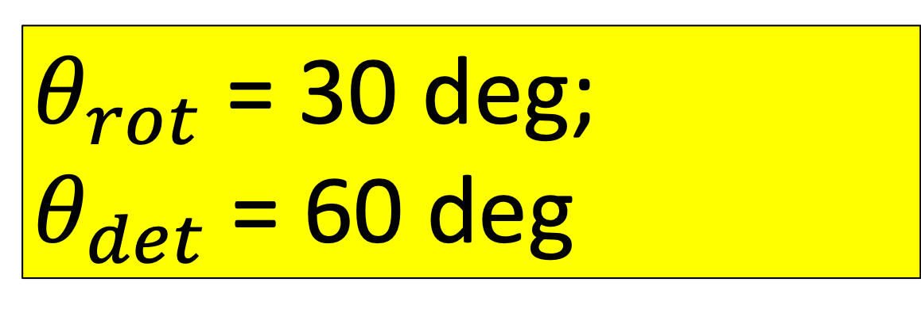
Collimator clearances and rotation
$θ_{rot}$= 30 deg;
$θ_{det}$= 60 deg
18.87 mm
16.03 mm
7 mm
15.5 mm
22.5 mm
7.48 mm
7 mm to top of nylon screw
6 mm
Y = 14.0 mm
Legend
Source center
Rotation axis
Important clearance dimensions
Scale: 1 mm real life = 1 cm in drawing
10 mm
scale
https://elog.legend-exp.org/UWScanner/200221_144719/IMG_8271.jpg

Slide 4

Collimator clearances and rotation
$θ_{rot}$= 25 deg;
$θ_{det}$= 65 deg
18.87 mm
16.03 mm
7 mm
15.5 mm
22.5 mm
8.72 mm
7 mm to top of nylon screw
6 mm
Legend
Source center
Rotation axis
Important clearance dimensions
Scale: 1 mm real life = 1 cm in drawing
10 mm
scale
https://elog.legend-exp.org/UWScanner/200221_144719/IMG_8271.jpg

Slide 5
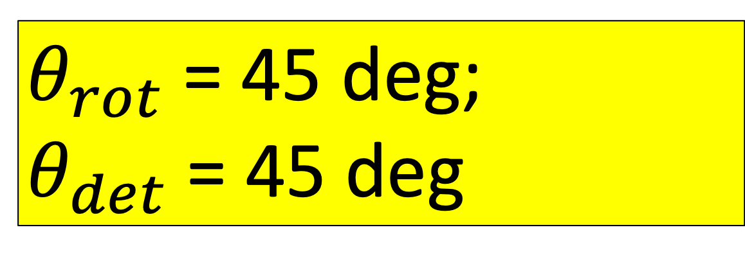
Collimator clearances and rotation
$θ_{rot}$= 45 deg;
$θ_{det}$= 45 deg
18.87 mm
16.03 mm
7 mm
15.5 mm
22.5 mm
4.16 mm
7 mm to top of nylon screw
6 mm
Legend
Source center
Rotation axis
Important clearance dimensions
Scale: 1 mm real life = 1 cm in drawing
10 mm
scale
https://elog.legend-exp.org/UWScanner/200221_144719/IMG_8271.jpg

Slide 6
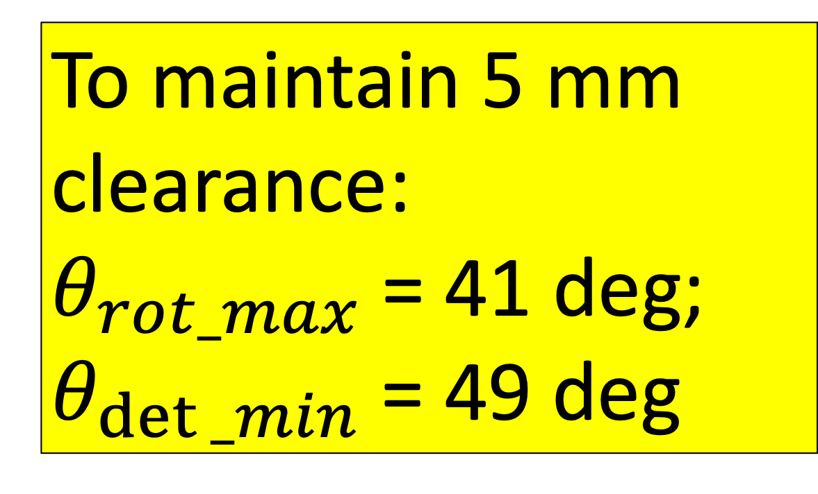
Collimator clearances and rotation
To maintain 5 mm clearance:
$θ_{rot_max}$= 41 deg;
$θ_{det⁡_min}$= 49 deg
18.87 mm
Calculated using checkRotation() function within ~/CAGE/sims/source_placement.py
16.03 mm
7 mm
15.5 mm
22.5 mm
5.0 mm
7 mm to top of nylon screw
6 mm
Legend
Source center
Rotation axis
Important clearance dimensions
Scale: 1 mm real life = 1 cm in drawing
10 mm
scale
https://elog.legend-exp.org/UWScanner/200221_144719/IMG_8271.jpg

