Slide 1
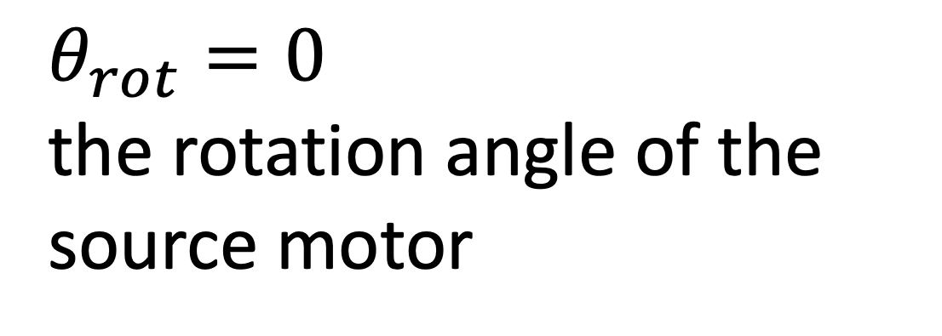
Collimator clearances and rotation: OPPI
$θ_{rot}=0$ the rotation angle of the source motor
18.87 mm
16.03 mm
1 mm
8.6 mm
7 mm
Don’t really need to worry about this point– At the lowest point, it’s still ~9 mm above the LMFE
16 mm
22 mm
6 mm to top of nylon screw
6 mm
Legend
Source center
Rotation axis
Important clearance dimensions
Scale: 1 mm real life = 1 cm in drawing
10 mm
scale
https://elog.legend-exp.org/UWScanner/200221_144719/IMG_8271.jpg

Slide 2
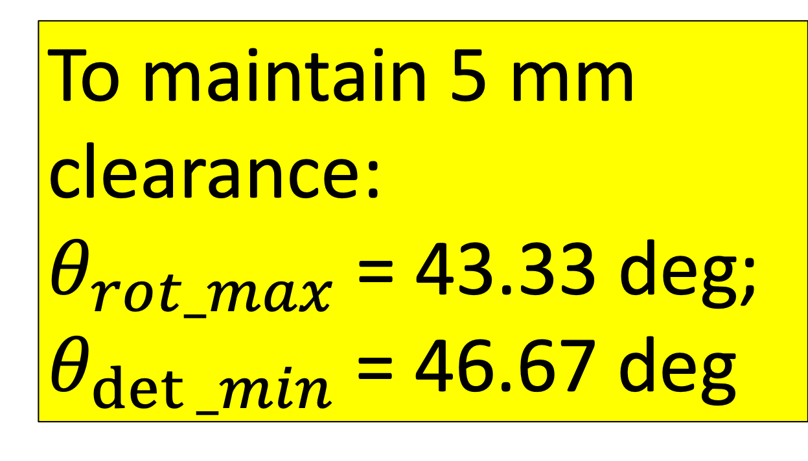
Collimator clearances and rotation: OPPI
To maintain 5 mm clearance:
$θ_{rot_max}$= 43.33 deg;
$θ_{det⁡_min}$= 46.67 deg
$θ_{rot}=0$ the rotation angle of the source motor
18.87 mm
16.03 mm
1 mm
Calculated using maxRotation() function within ~/CAGE/sims/source_placement.py
7 mm
8.6 mm
16 mm
22 mm
5.0 mm
6 mm to top of nylon screw
6 mm
Legend
Source center
Rotation axis
Important clearance dimensions
Scale: 1 mm real life = 1 cm in drawing
10 mm
scale
https://elog.legend-exp.org/UWScanner/200221_144719/IMG_8271.jpg

