Slide 1
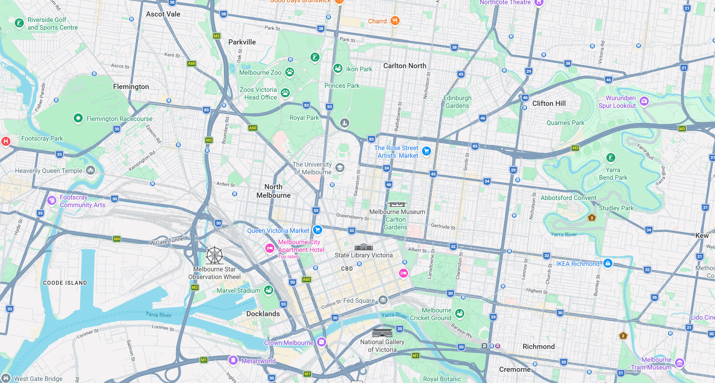
37°46'48.0"S
144°57'54.8"E
37°46'48.0"S
145°01'10.9"E
Planning-Oriented Traffic State Prediction
Based on Melbourne SCATS Network
University of Melbourne, AIMES
37°49'23.0"S
144°57'54.8"E
37°49'23.0"S
145°01'10.9"E
Map data ©2026 Google

Slide 2

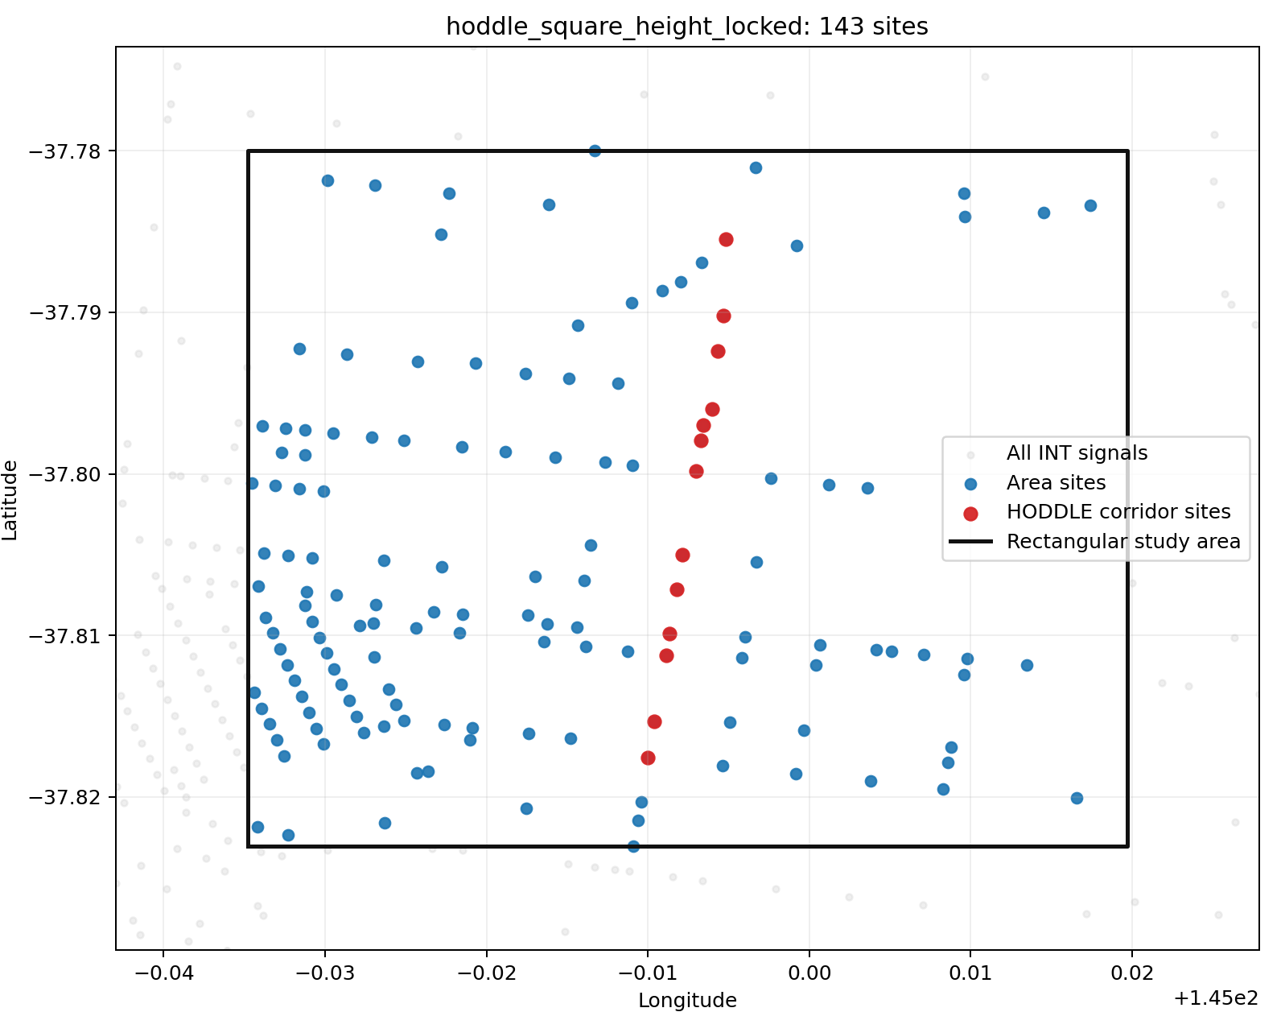
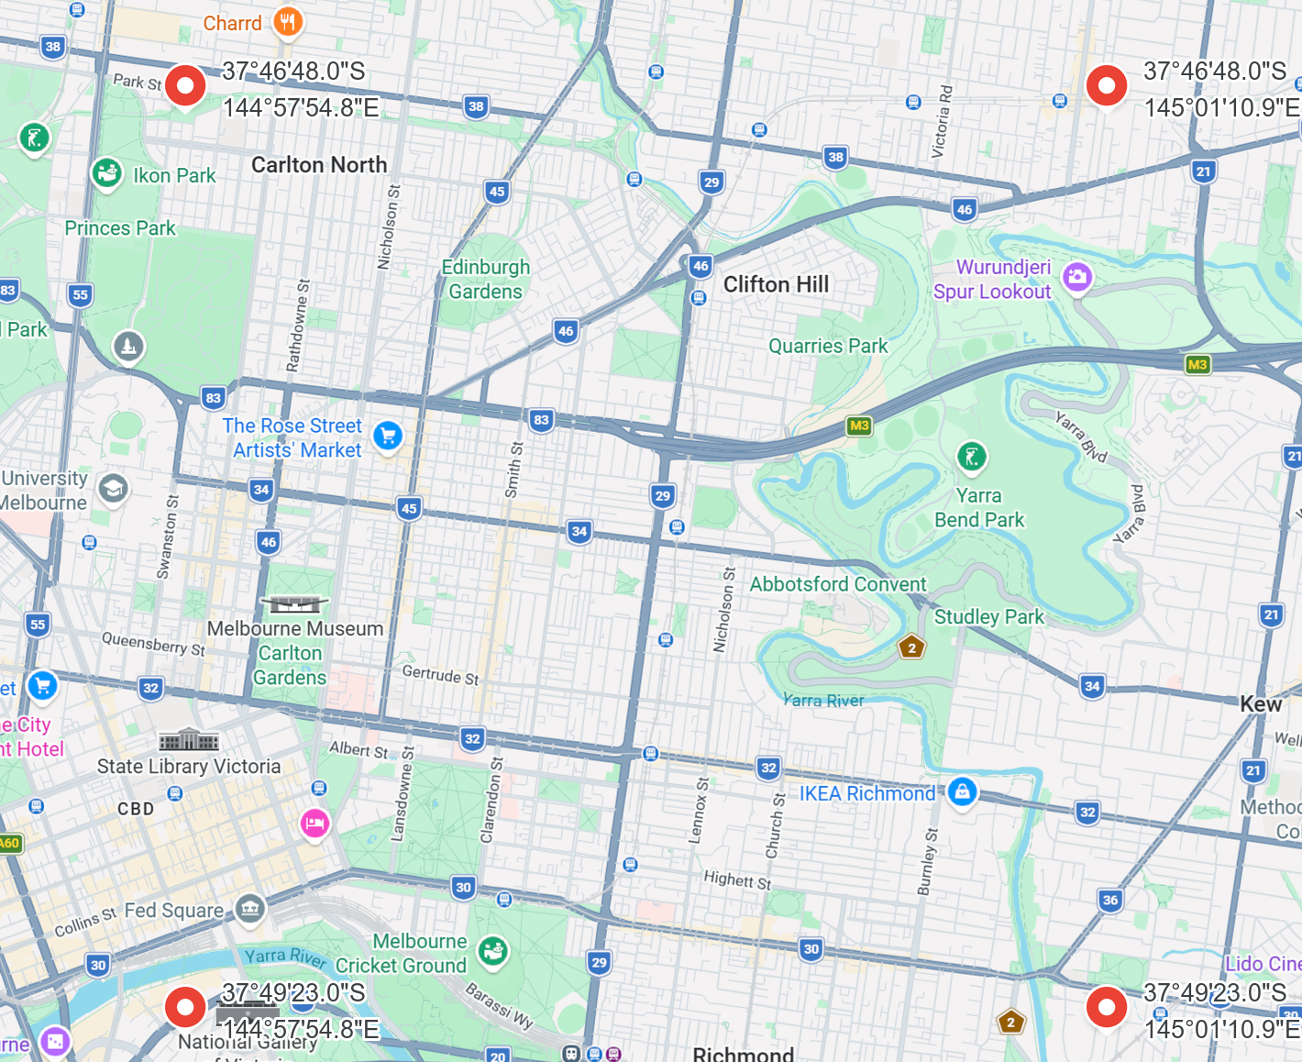
Background and Study Area
Melbourne SCATS signal network — Victoria Open Data Portal
Research objective
▸ Traffic Signal Volume Data — Victorian Open Data Portal
Traffic demand is shaped not only by history, but also by the surrounding built environment visible in satellite imagery.
▸ Victoria Traffic Signals — site coordinates & metadata
▸ Time range: 2014-2024, 15-min slots (2020 and 2021 left out)
▸ Satellite imagery: Nearmap, one survey a year
This enables a planning use case: when a site or parcel changes, the updated land-use pattern can be translated into a future traffic-flow estimate.
Current study area
A rectangular study area centered on the Hoddle corridor. (Near Unimelb)
143 SCATS sites; the model uses the 81 with CLUE land-use data.

Slide 3
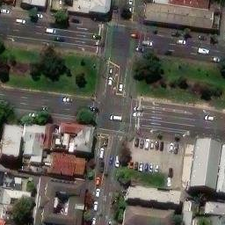

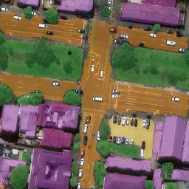
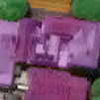
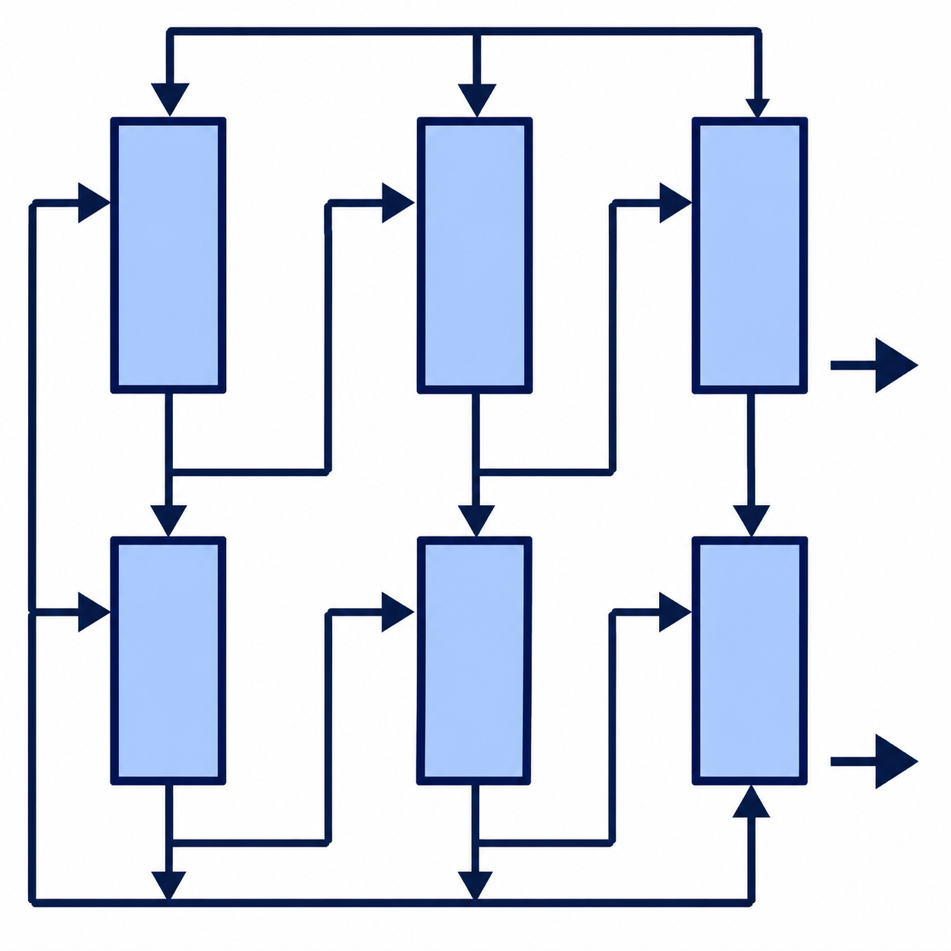

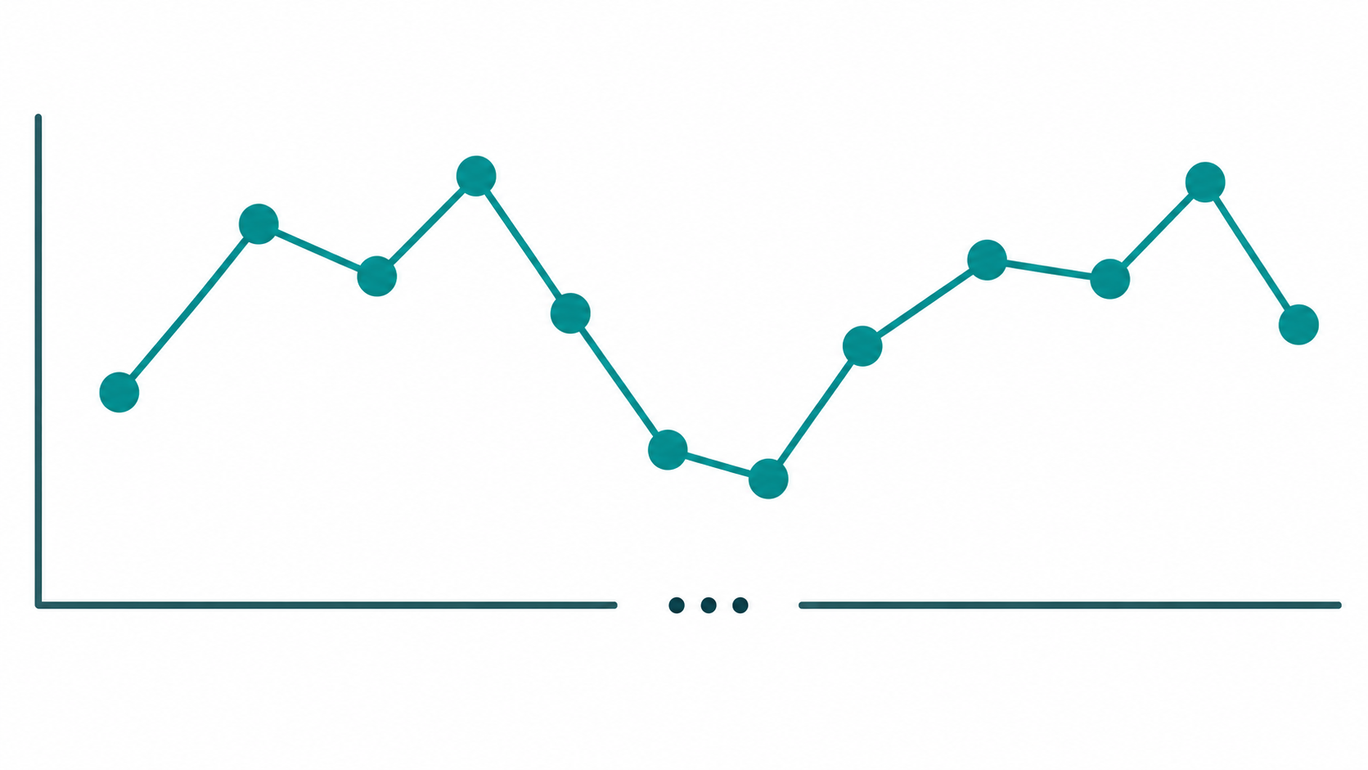
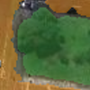
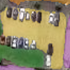
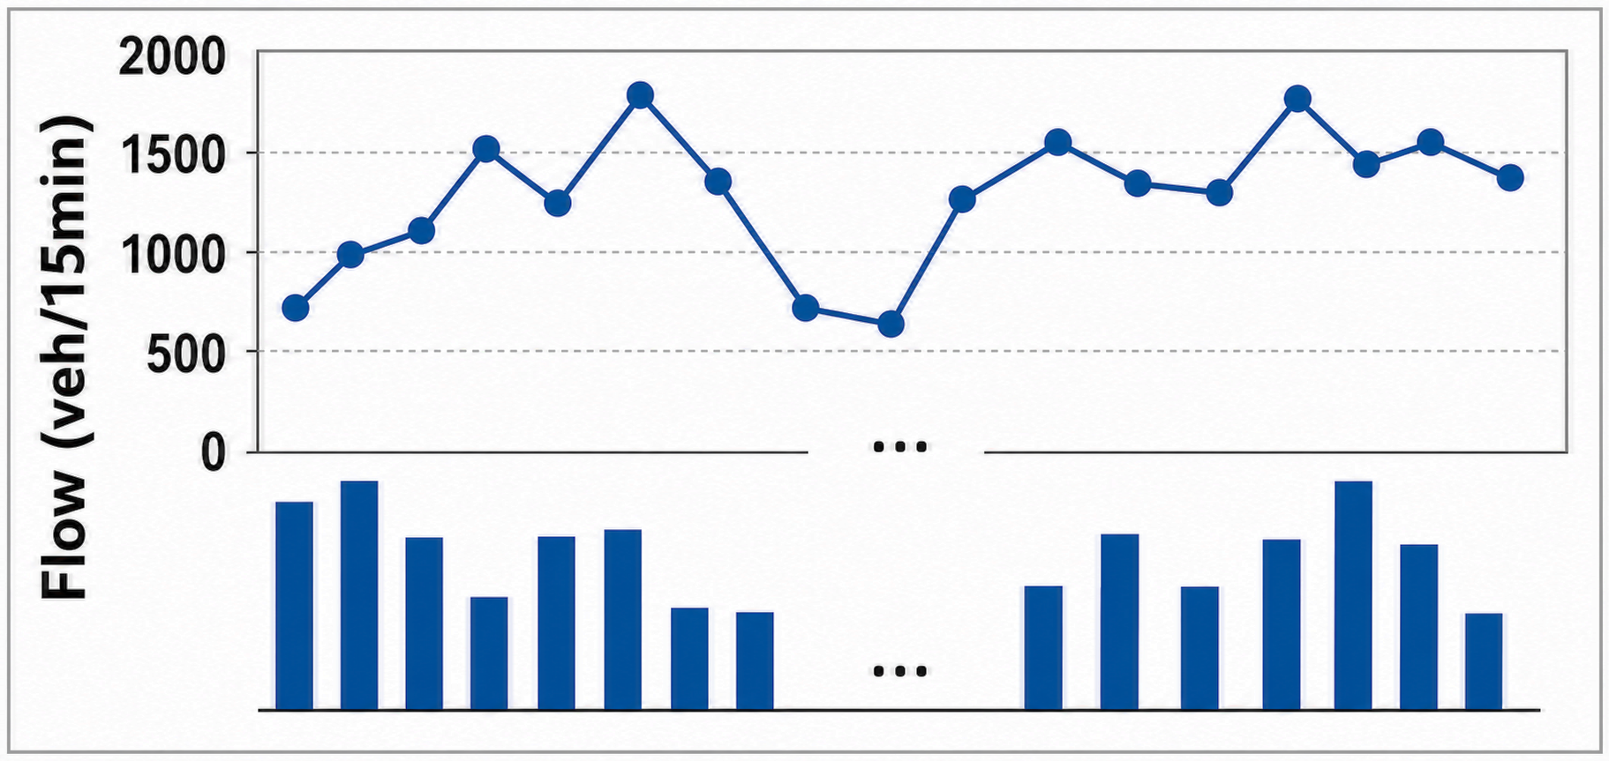





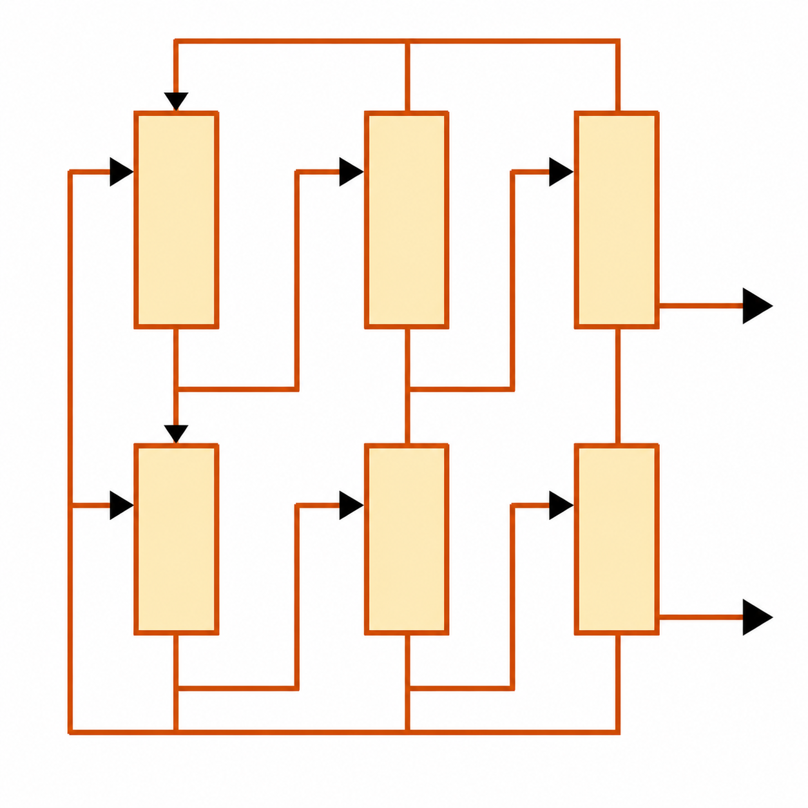


Proposed Multimodal Framework
Route 1 learns visual semantics from satellite images; Route 2 extends with network and traffic topology JSON embeddings.
Inputs
Two-Route Multimodal Modelling
Outputs
1
Satellite imagery
Route 1: Visual Semantic Route
SAM 3.1
semantic region
proposal
Per-region
DINO embedding
Aggregation by class
Site-year
visual feature
table
Day-TCN
predictor
Predicted 15-min
traffic flow
1
site_id | year | … | f₁ | … | f_d
1001 | 2021 | … | … | … | …
1001 | 2022 | … | … | … | …
⋮ | ⋮ | ⋱ | ⋮ | ⋮ | ⋮
2050 | 2024 | … | … | … | …
2
3
⋮
2
15-min SCATS traffic flow data
⋮
k
24-d dynamic temporal context
Target: log ratio to the 2022 historical profile
calendar
cyclical
weekend /
year
holiday /
event
historical
base profile
Log ratio → volume
📍 site
Route 1 validates and improves the visual frontend;
Route 2 adds LLM-derived topology context.
shared visual frontend
...
▣ date
Route 2: LLM-Enhanced Multimodal Route
◷ time slot (15-min)
A
Visual
embedding
SAM-DINO
visual features
...
Fusion
Day-TCN / multimodal
predictor
▥ historical flow
...
LLM embedding: Qwen3-Embedding
hidden layer pooling + PCA compression
3
Land use information
B
Network
topology JSON
{ }
site_id
degree
Neighbors
edge_weights
2-hop summary
Net JSON
embedding
Evaluation:
MAE, RMSE, MAPE,
GEH, GEH<5%
LLM embedding
model
JSON
...
⚙
Site-year alignment /
temporal indexing /
log-ratio target construction
24-d dynamic temporal context

Slide 4
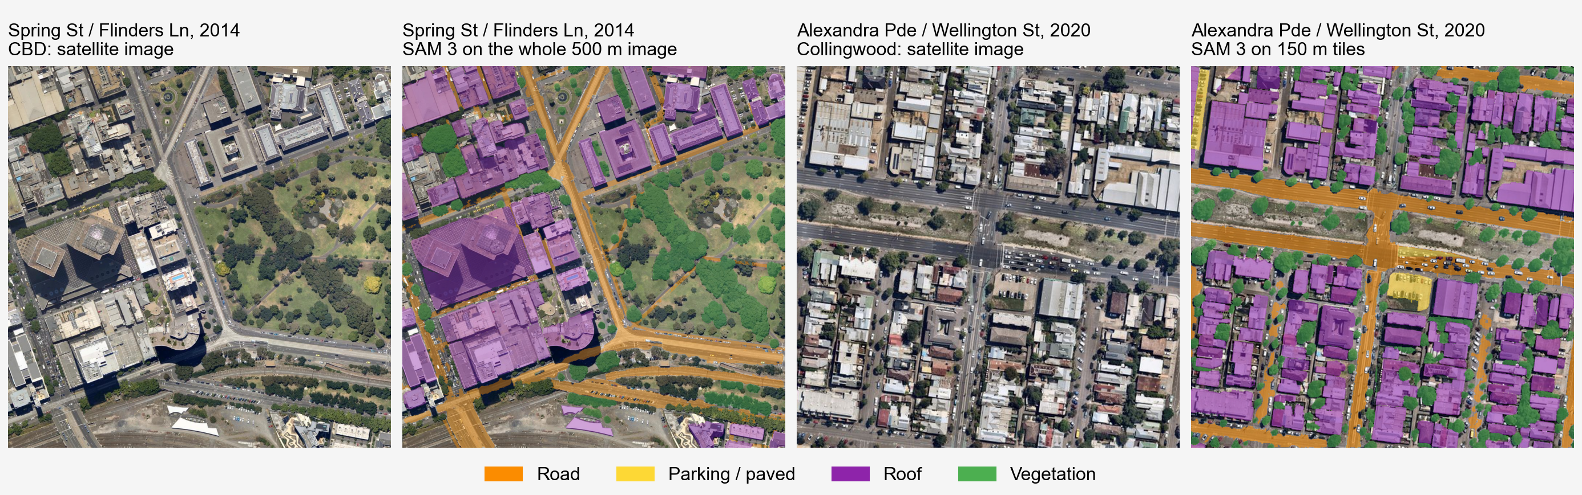
Route 1 and Route 2
Inputs
Nearmap satellite image
500 m x 500 m per site
CLUE land use
2022 historical profile
Calendar and holidays
Route1
SAM 3: 4 land-cover classes
DINOv3 features, PCA to 16-d
Class aggregation: 135-d
Output: visual feature
Route2
Route1 visual feature
+ network JSON embedding
(Qwen3 embedding, PCA 64)
Output: site-year feature
Predictor
Temporal convolution (TCN)
Imagery, network, land use
24-d calendar & holidays
Ratio to 2022 profile
Output: 96 x 15-min flows

Slide 5
Experimental Results
Ablation experiments: test year 2024, 81 intersections, mean of 5 random seeds.
Model | MAE | RMSE | GEH Median | GEH<5 (%) | GEH<10 (%)
Time only | 62.22 | 127.7 | 4.14 | 57.2 | 81.6
Route 1: + imagery | 60.55 | 122.5 | 3.96 | 58.8 | 82.0
Route 2: + imagery + network | 60.14 | 122.3 | 3.93 | 59.1 | 82.3
Satellite imagery lowers MAE by 1.67 (p = 0.002), in all 5 random seeds.
Route 2 (imagery + road network) is the best on all five metrics, with MAE 3.3% below time only.

Slide 6
Land-Use Data: CLUE
Verify the effectiveness of adding building features. only-time, route1 and route2
Add building feature in traffic prediction
Previous work—traffic prediction
Dataset: City of Melbourne: CLUE (Census of Land Use and Employment)
Building height data only in City of Melbourne
Year coverage: 2002—2024
Problem of the satellite image from City of Melbourne: Too much duplicate data, before 2020. (Change another satellite image dateset: Nearmap)
2020-2026
2020-2024(5 years, 3 years training)
train 2014-2019 + 2022, val 2023, test 2024

Slide 7
Land-Use (Building) Features
Add building feature in traffic prediction
43-dim aggregate statistics
Everything inside the site area is summarised into one number per quantity
1 | Quantity | Buildings
9 | Height | floors_mean / max / sum / p90, tall_over_10, tall_over_30, floors_sum_inner, floors_max_inner, floors_sum_weighted
4 | Distance | buildings_inner, buildings_weighted, nearest_over_10_m, nearest_over_30_m
26 | Land use | share_* × 13, floorshare_* × 13
3 | Other | bicycle_spaces, built_last_5y, median_age

Slide 8
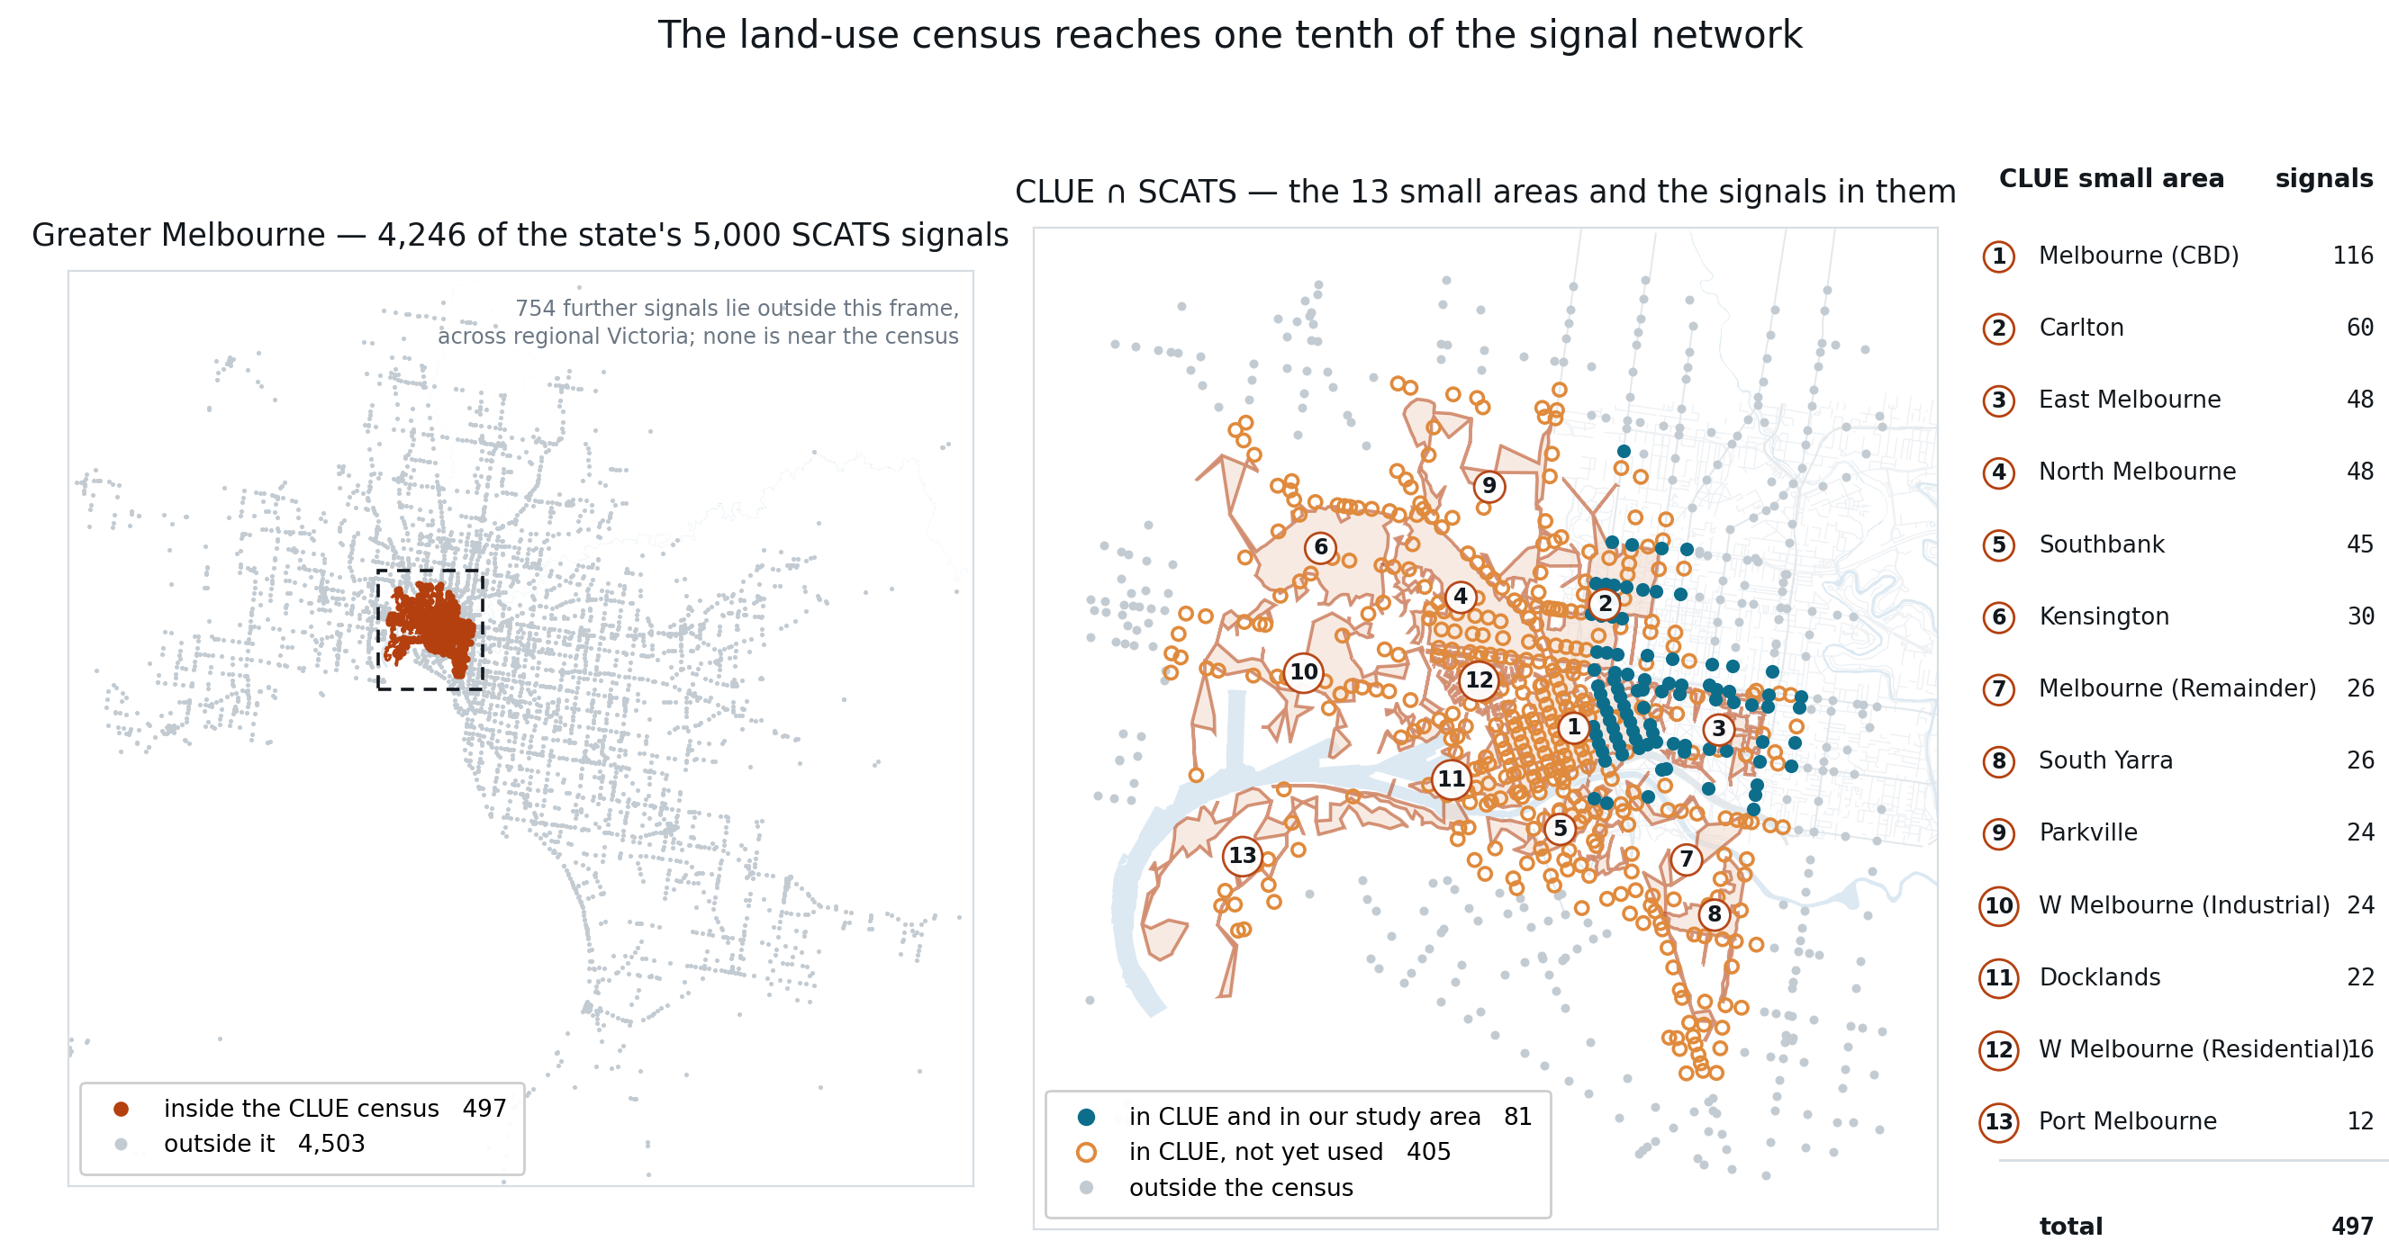
Validation in Different Regions
Validate the effectiveness of the model in different regions.
The land-use census reaches one tenth of the signal network
CLUE ∩ SCATS — the 13 small areas and the signals in them
Greater Melbourne — 4,246 of the state's 5,000 SCATS signals

Slide 9
Results: Land Use and a Wider Region
Test year 2024, mean of 5 random seeds (final report, Tables 4.12 and 4.14).
 | MAE | GEH_median
Time only | 62.22 | 4.14
Time + land use | 61.36 | 3.94
Route 1 | 60.55 | 3.96
Route 1 + land use | 59.51 | 3.88
Route 1 (371 sites) | 59.11 | 4.13
Route 1 + land use (371 sites) | 59.25 | 4.11
Route 2 | 60.14 | 3.93
Route 2 + land use | 59.18 | 3.84
Route 2 (371 sites) | 59.24 | 4.13
Route 2 + land use (371 sites) | 58.76 | 4.11

Slide 10
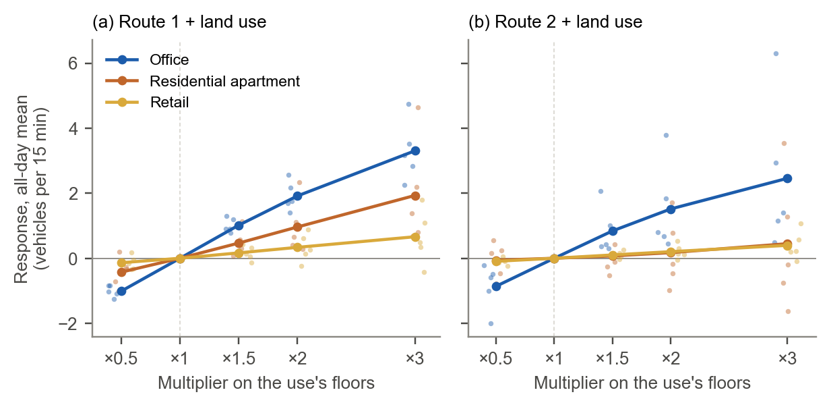
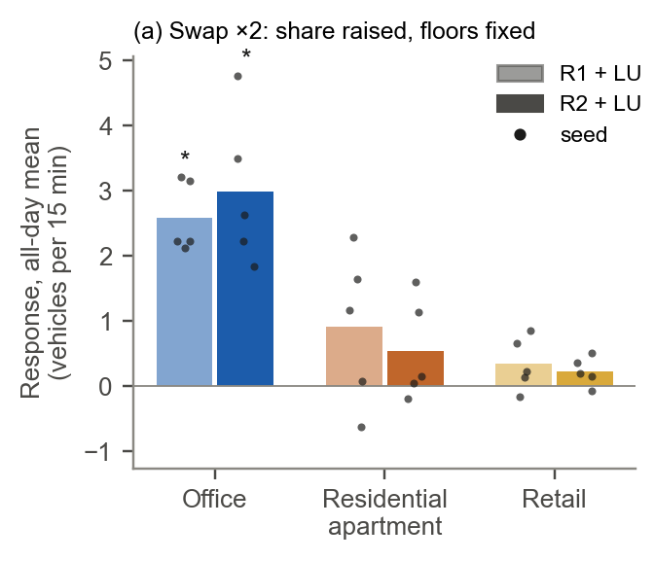
Land-Use Sensitivity Analysis
Sensitivity analysis of building attribute features.
New building
For example: office space from 10->20
Then total space from 50->60
Change building attribute from other 12 types buildings
For example: office space from 10->20
Then total space remains 50

Slide 11
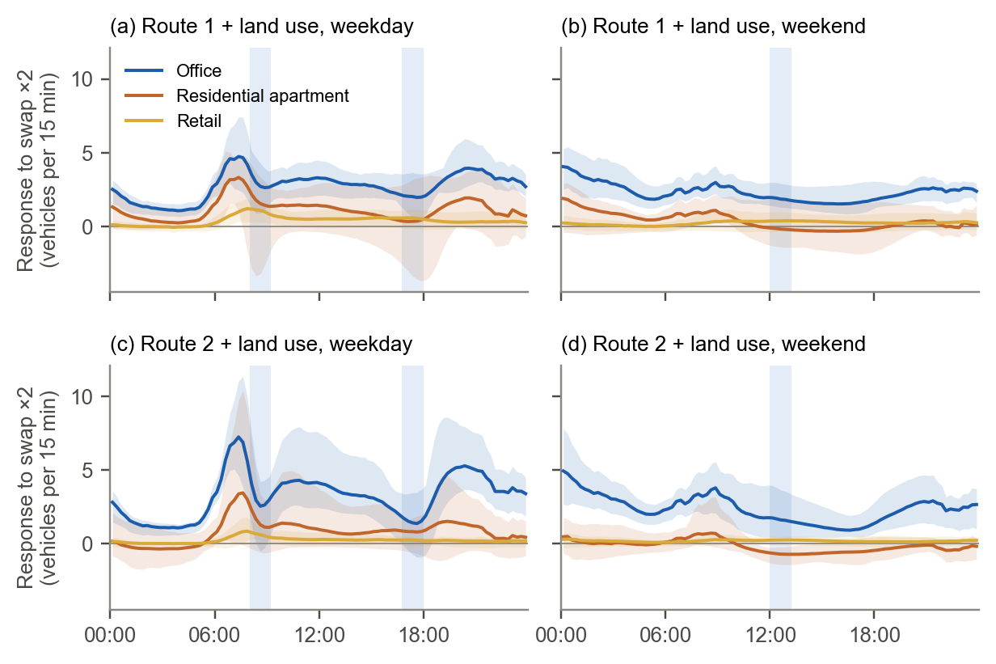
Land-Use Sensitivity: Time of Day
Sensitivity analysis of building attribute features.
Swap
Floorspace * 2

Slide 12
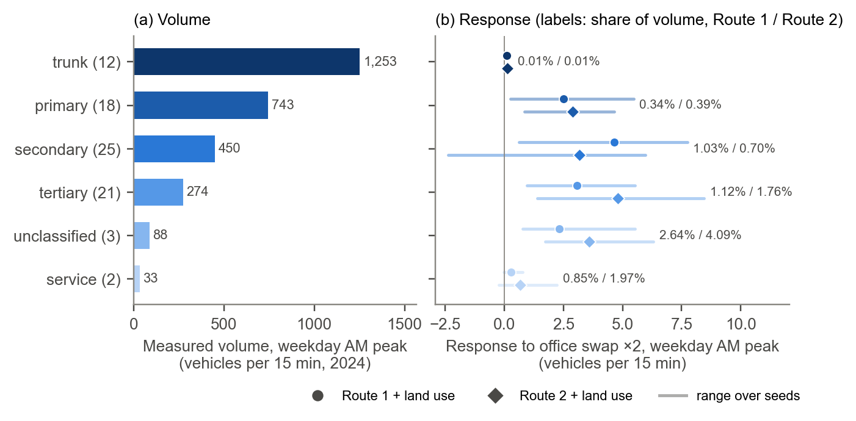
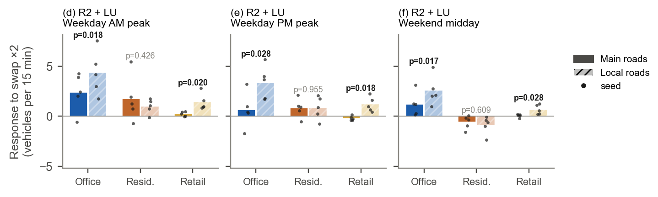
Land-Use Sensitivity: Road Class
Sensitivity analysis of “all roads” and “only main roads”

Slide 13
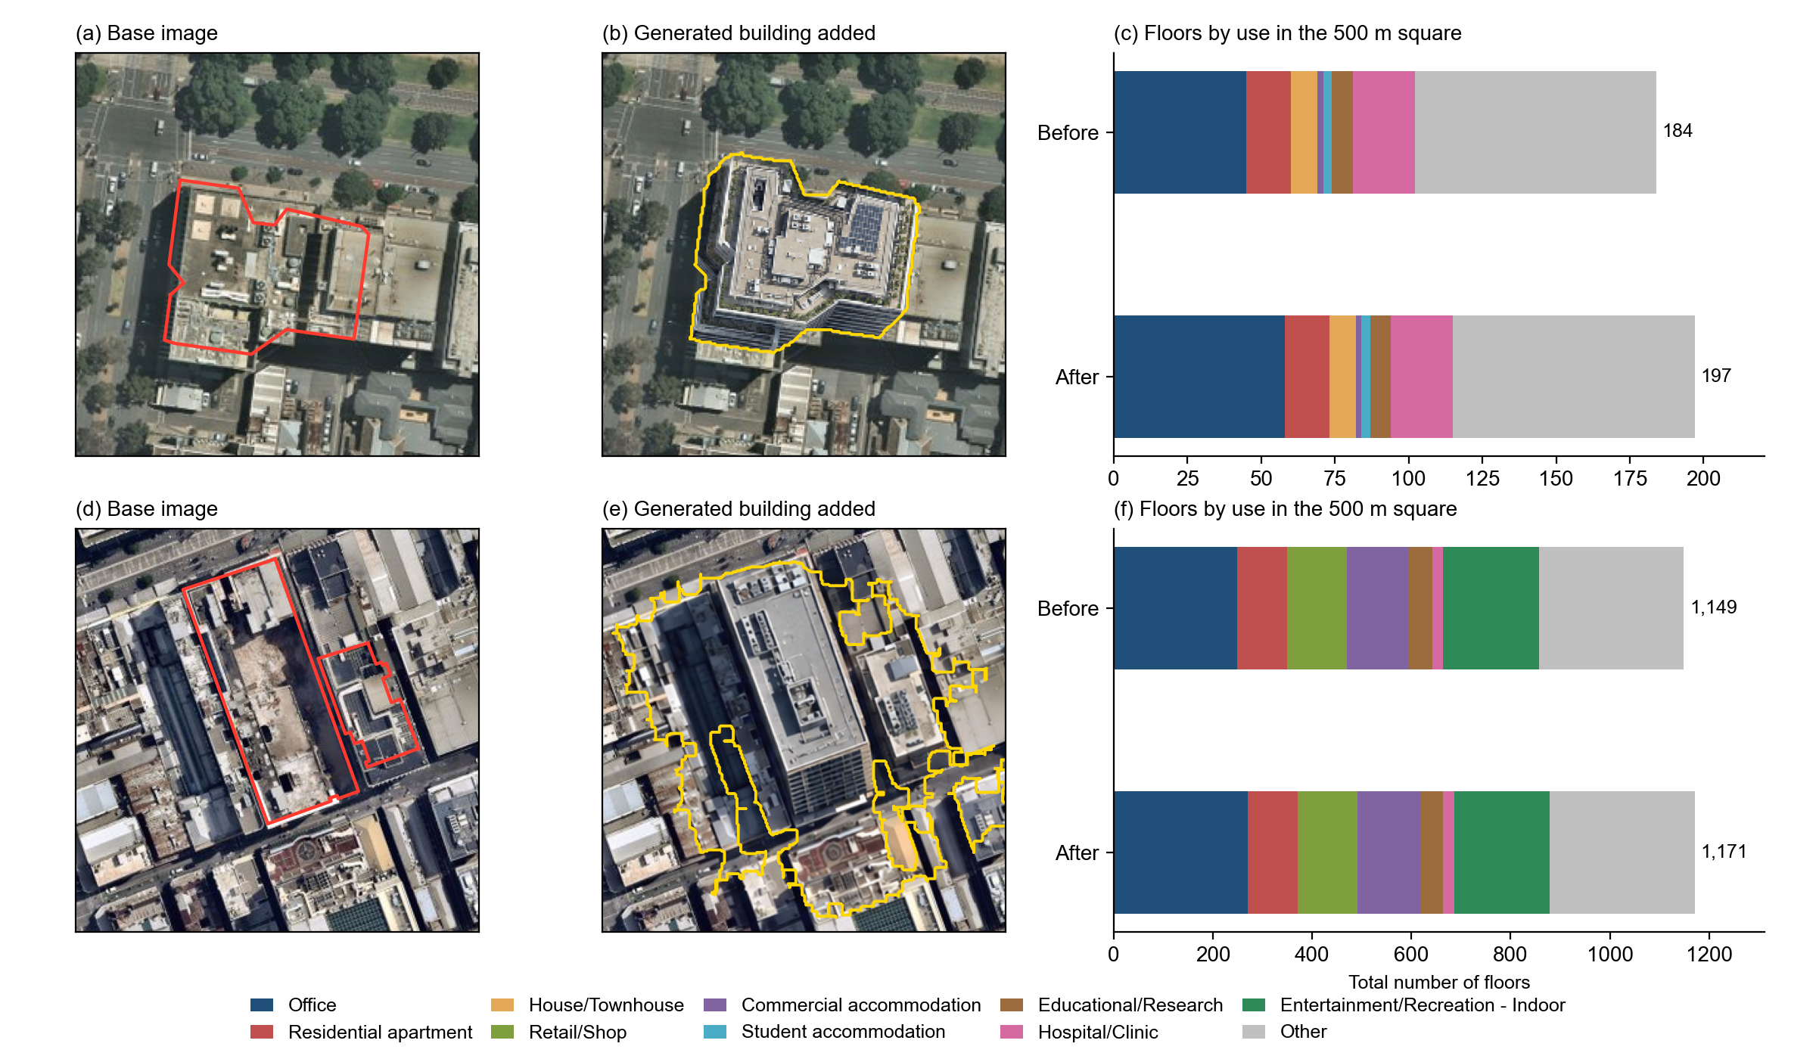
Generated Imagery: Test Cases
Real developments completed in 2023-2025, generated on imagery from before construction.

Slide 14
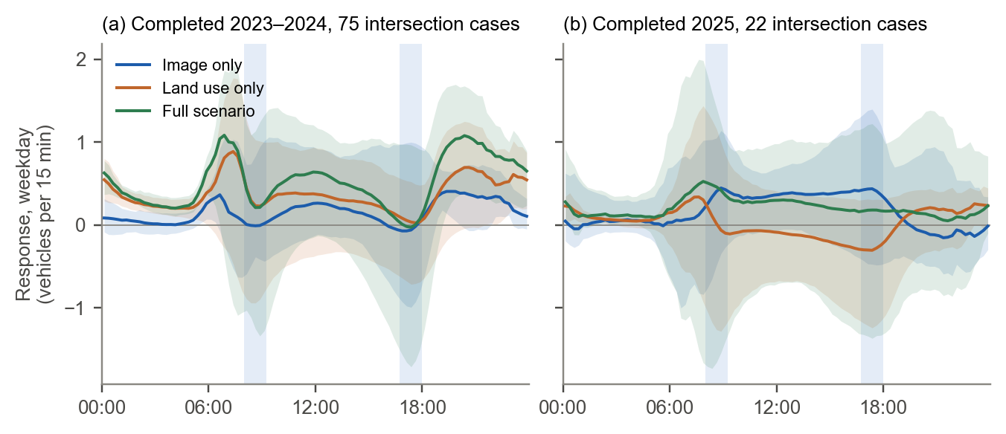
Generated Imagery in Traffic Prediction
Response of Route 2 + land use to each case against no development (weekdays, 5 seeds).
Accuracy with generated imagery: median GEH 3.50-4.06, MAE changes by at most 0.15 veh/15 min.
Full scenario (generated building and updated land use): +0.49 and +0.19 veh/15 min.

Slide 15
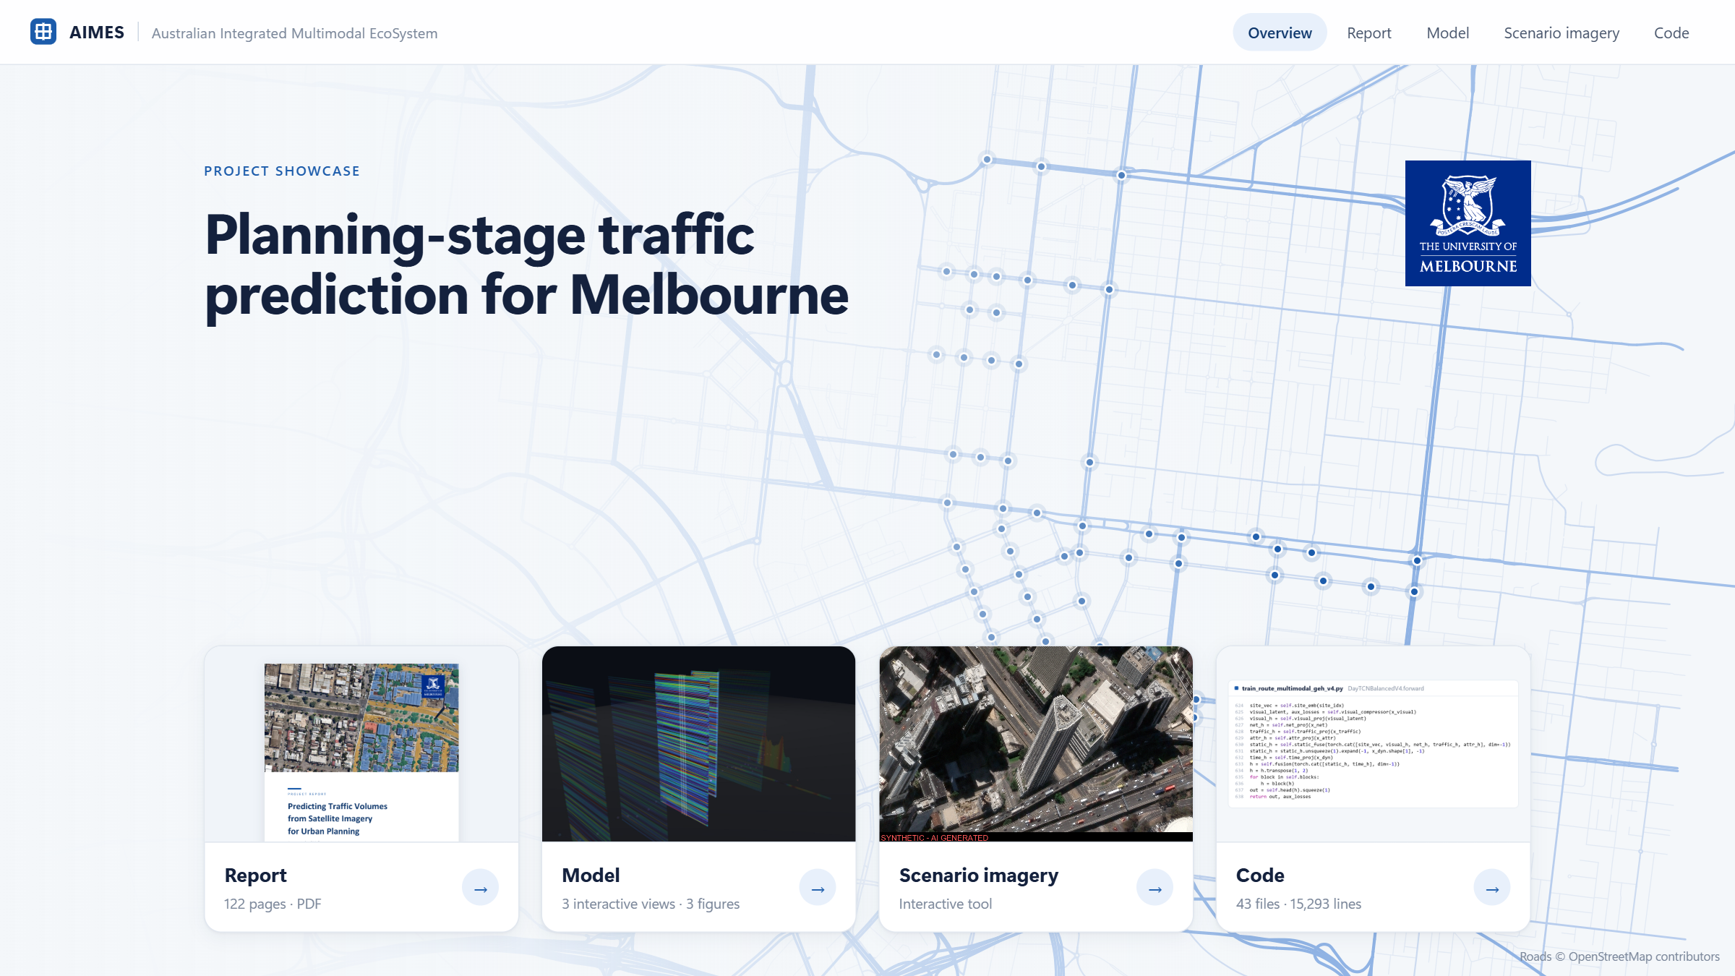
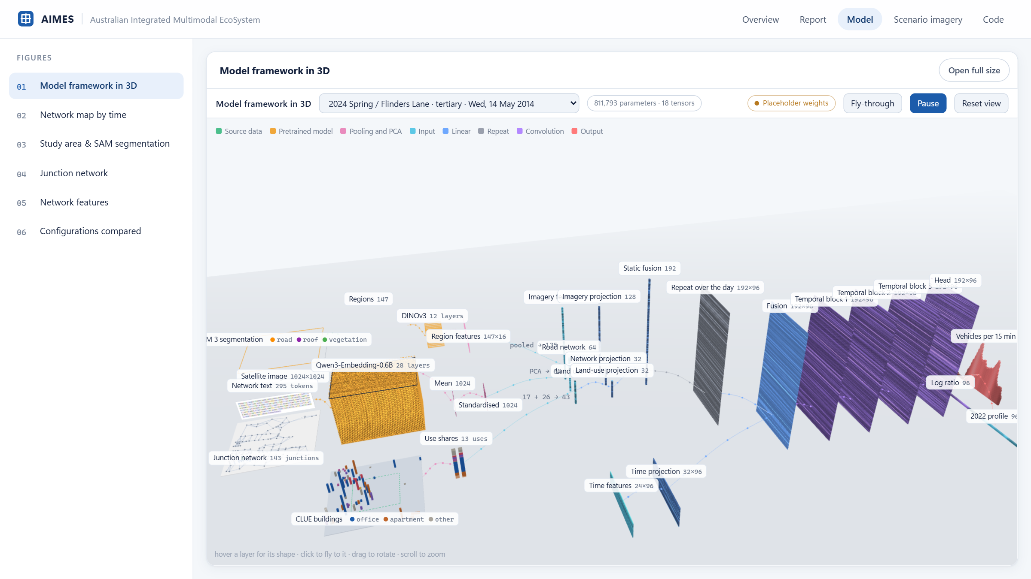
Project Website
Project website: cjsrc.github.io/Melbourne_traffic_showcase
Scenario imagery tool: cjsrc.github.io/Melbourne_traffic_showcase/tool.html
Report (122-page PDF), interactive model views, scenario imagery examples and the project code.

