Slide 1

Financial Student Aid Snapshot
Chase Stahl, MEd
github.com/CJStahl1086
This Photo by Unknown author is licensed under CC BY-NC.

Slide 2
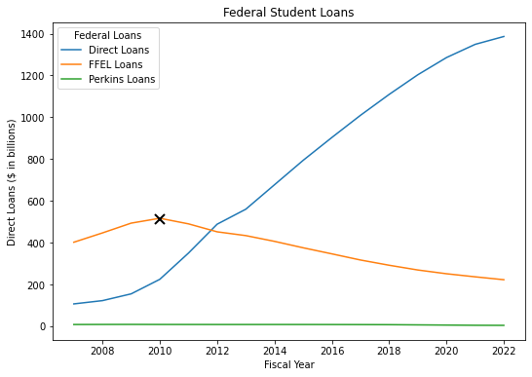
Federal Student Loan Debt Relief
What are the DOE backed Federal Loan programs eligible for relief?
Federal Perkins Loan Program (Perkins Loan)
William D. Ford Federal Direct Loan Program (Direct Loan)
Unsubsidized (Stafford Loan)
Subsidized (Stafford Loan)
PLUS
Graduate
Parent of undergraduate
Direct Consolidation
Federal Family Education Loan Program (FFEL)
Comparable to the William D. Ford Federal Direct Loan Program but financed through private banks
Which loans qualify for relief?
Federal student loans disbursed on or before June 30, 2022
X denotes the DOE’s shift away from FFEL to Direct Loans in 2010
This Photo by Unknown author is licensed under CC BY-NC.

Slide 3
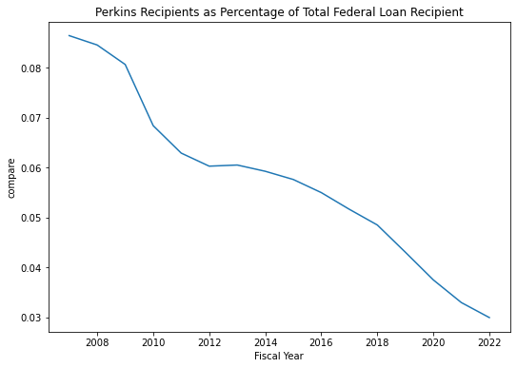
Perkins Loans
What is a Perkins loan?
Federal student loan based on financial need
Subsidized
5 % fixed interest rate
9-month grace period
Institutions determine amount of Perkins loans to award to student
It is funded by the federal government and institutional contributions as a ratio that varied from 90/10 to a 75/25 split (NACUBO)
Congress did not renew the program and no disbursements were made after June 30, 2018
This Photo by Unknown author is licensed under CC BY-NC.

Slide 4
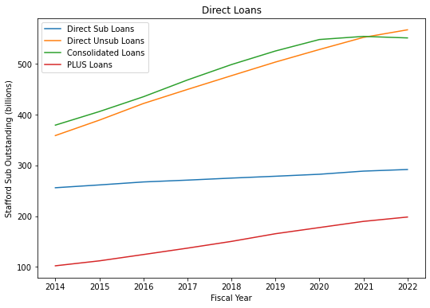
Direct Loan Program
The 4 Types of Direct loans
Federal Direct Subsidized Loans (Stafford Loans)
Federal Direct Unsubsidized Loans (Stafford Loans)
Federal Direct PLUS Loans
Federal Direct Consolidation Loans
Can include direct loans under the FFELP
This Photo by Unknown author is licensed under CC BY-NC.

Slide 5
Direct Subsidized vs Direct Unsubsidized
Subsidized Loans
Must demonstrate financial need
No interest charged while in school
Unsubsidized Loans
Not based on financial need
Interest is accrued during all periods
Common Traits
Variable interest rates – dependent on type of loan (sub vs unsub and type of student)
Each has a one time 6-month grace period
Capitalization - increases the unpaid principal balance of the loan and charges interest on the increased principal
This Photo by Unknown author is licensed under CC BY-NC.

Slide 6
Direct PLUS Loan Program
What is a Direct PLUS loan?
Two types: Graduate PLUS and Parent PLUS loans
Given to graduate/professional students or to parents of dependent undergraduate students
Dependent is defined by IRS
Borrowing a Direct PLUS Loan may affect eligibility for other financial aid
School determines eligibility amount
Interest Rates
Direct PLUS Loan is a fixed rate of 7.9%
The rate is determined according to a formula specified in the Higher Education Act and is calculated each year. When the rate is calculated, it applies to all Direct PLUS Loans that have a first disbursement date during the period beginning on July 1 of one year and ending on June 30 of the following year. If you receive more than one loan under this MPN, each loan may have a different fixed interest rate, depending on when the loan is first disbursed.
This Photo by Unknown author is licensed under CC BY-NC.

Slide 7
Direct Consolidated Loan Program
What is a Consolidated Loan?
A combination of federal loans consolidated into a new Direct Consolidation Loan
Intended purpose is to lower monthly payments amount or gaining access to federal forgiveness programs
Consolidation loans other than Direct Loans (FFEL or Perkins loans) may include additional repayment plan options
A Direct Consolidation Loan has a fixed interest rate for the life of the loan. The fixed rate is the weighted average of the interest rates on the loans being consolidated, rounded up to the nearest one-eighth of one percent.
This Photo by Unknown author is licensed under CC BY-NC.

Slide 8
Federal Family Education Loan Program (FFEL)
What is the FFEL Program?
The FFEL Program worked with private lenders to funded education loans guaranteed by the federal government (DOE)
Originally funded by private companies
The FFEL Program ended July 1st, 2010
Marked a change from private to public funding (Department of Treasury)
All federal loans are now made through the William D. Ford Federal Direct Loan Program, also guaranteed by the DOE
While the types of loans are similar, the funding source has changed
Some types of loans may have structural changes (repayment options, interest rates, etc.)
This Photo by Unknown author is licensed under CC BY-NC.

