Slide 1

Novachain - Automated Transaction Reconciliation
Chad, Corey, Josh, Morgan
Nick, Nikita, Sarbari, Shivani
Notes:
chad

Slide 2
Defining the Problem
HSA transactions
Use blockchain to automate HSA transaction approval
Internal Company Transactions
System to send and receive transactions
Replace sub-ledgers and PeopleSoft
Transaction Reconciliation
Automate current manual reconciliation
Store transaction details from current sub-ledgers
Notes:
sarbari

Slide 3
Defined Problem
Sub-ledger A
PeopleSoft
Transaction 1
$100.00
Optum Tech to Optum Insight
Transaction 2
$100.00
Optum Tech to Optum RX
Transaction 3
$100.00
Optum RX to Optum Insight
$300 credit
Sub-Ledger A $300 debit
Sub-ledger B
Transaction 1
$10,000.00
UHG to UHC
Transaction 2
$10,000.00
UHC to Optum
Transaction 3
$10,000.00
Optum to UHC
$30,000 credit
Sub-ledger B $30,000 debit
Sub-ledger C
Transaction 1
$1,000.00
Optum RX to Optum Tech
Transaction 2
$1,000.00
Optum RX to Optum Bank
Transaction 3
$1,000.00
Optum Bank to Optum Tech
$3,000 credit
Sub-ledger C $3,000 debit
Notes:
sarbari
Talk about how this process has 300,000+ transactions per day, is manually reconciled, and stores no transaction details

Slide 4
Defined Problem
Sub-ledger A
PeopleSoft
Transaction 1
$100.00
Optum Tech to Optum Insight
Transaction 2
$100.00
Optum Tech to Optum RX
Transaction 3
$100.00
Optum RX to Optum Insight
$300 credit
Sub-Ledger A $300 debit
Sub-ledger B
Transaction 1
$10,000.00
UHG to UHC
Transaction 2
$10,000.00
UHC to Optum
Transaction 3
$10,000.00
Optum to UHC
$30,000 credit
Sub-ledger B $30,000 debit
Sub-ledger C
Transaction 1
$1,000.00
Optum RX to Optum Tech
Transaction 2
$1,000.00
Optum RX to Optum Bank
Transaction 3
$1,000.00
Optum Bank to Optum Tech
$3,000 credit
Sub-ledger C $3,000 debit
Notes:
sarbari

Slide 5
Building a Custom Platform
Other platforms
Lacked consistent documentation
Overcomplicated
Tailored to other use-cases
Abstracting the features we need allowed us to:
Tailor other technologies to fit our use-case
Design as a versatile and pluggable platform
Limit implementation complexity

Slide 6
Blockchain vs. Novachain
Blockchain
Novachain
Distributed
Traceable
Immutable
Permissioned
Proactive
Consensus driven
Distributed – Elasticsearch
Traceable – Hashing
Immutable – Restricted API
Permission Delegation
Proactive – No consensus
Modular – Can be incorporated into other enterprise systems
Notes:
josh

Slide 7







Tech Stack
7
Notes:
josh

Slide 8
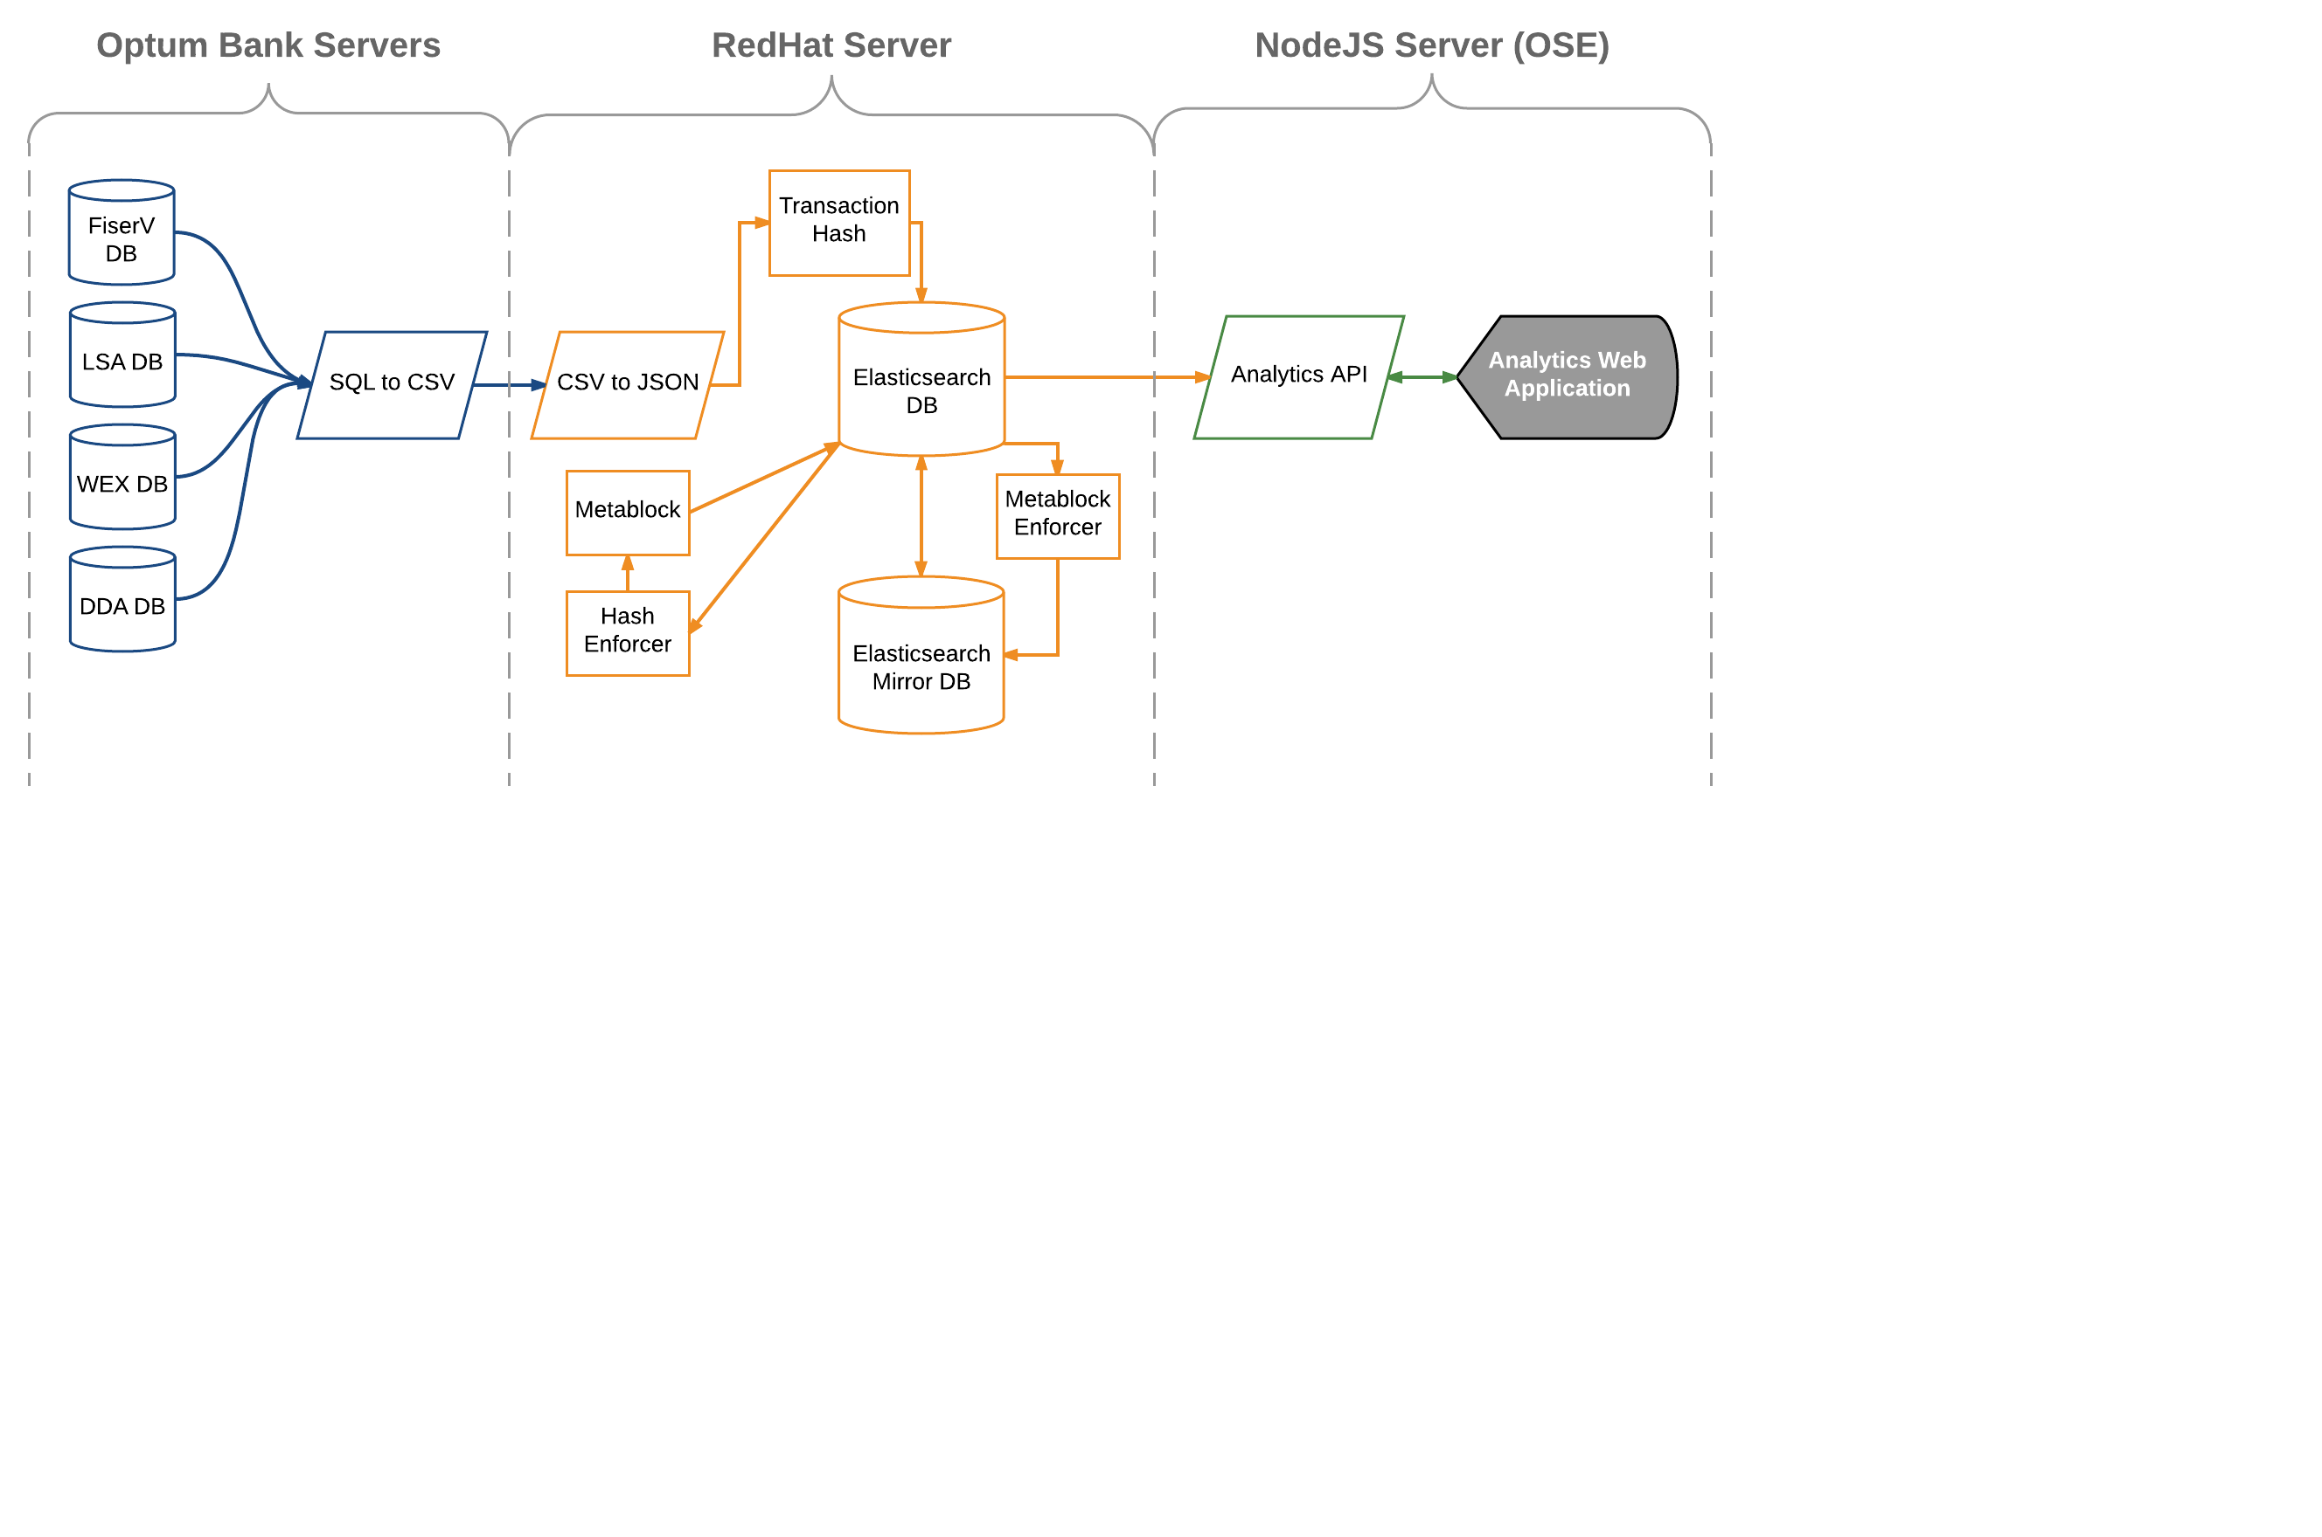
System Architecture
Notes:
corey

Slide 9
Live Demo
Notes:
corey

Slide 10

Added Value
Quarterly Reconciliation
$104,960
Current system
Novachain solution
Contractor Fees
$157,440
Daily Reconciliation
$615,000
$ 552,921
Reconciliation
$ 20,500
Tech Labor
$ 41,000
OpenShift & Red Hat
$ 283,478
Novachain’s solution will add $552,921 of value to the company per year
Notes:
Nick
Talk abut the breakdown of the current system as well as novachain solution

Slide 11
Future of Novachain
Potential opportunity with Optum Care
Scale-up
Sophisticated analytics and search tool
Implement with all sub-ledgers
Application for other use cases
Project management tool
FTE and resource allocation
Notes:
nikita
Also talk about how this is wht we will be working on in the last week of the internship
Transition document is a 30 page document with additional resourcs detailing the work we have done thus far and how we’d like it to proceed further
Blockchain starter pack is a 50 page document detailing evrything we have learned about blockchain and its platforms

Slide 12
Thank you Any questions?

Slide 13
Appendix

Slide 15
Progress and Accomplishments
Ethereum → Hyperledger → Openchain → Elasticsearch
Week 8:
Week 9:
Week 10:
Prototype application
Transaction search tool
API build out
Data analytics plan
Basic pipeline implementation
Data aggregation tool
Back end testing
Enhanced back-end
Hash enforcer
Full pipeline build-out
Advanced prototype application
Debugging of code
Meta-block generator
Automated pipeline
Notes:
Morgan
On this slide we should go over the progress we have made, and then should emphasize that the main work we were able to get accomplished was in the past 2 weeks

Slide 16
What We Learned
Blockchain technology
Data analytics
Business case and value
Fail fast methodology
Agile and corporate environment
Team work, team building
Notes:
Nikita
Blockchain – nothing about blockchain, we worked with existing blockchain platforms and were also able to create our own blockchain platform; business case and also pursue a product that has real business value

Slide 17
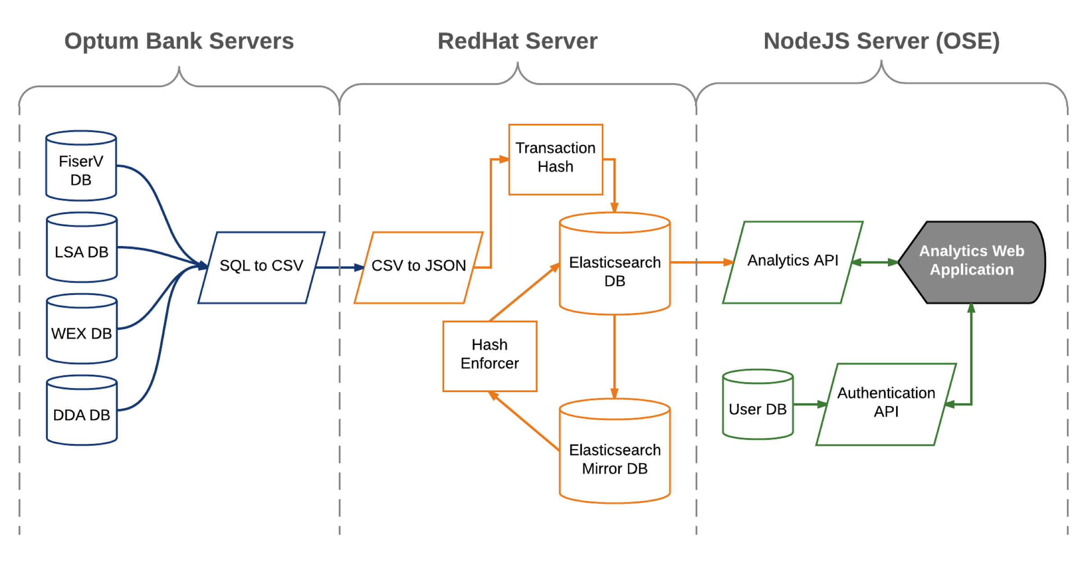
System Architecture
Notes:
corey

Slide 18
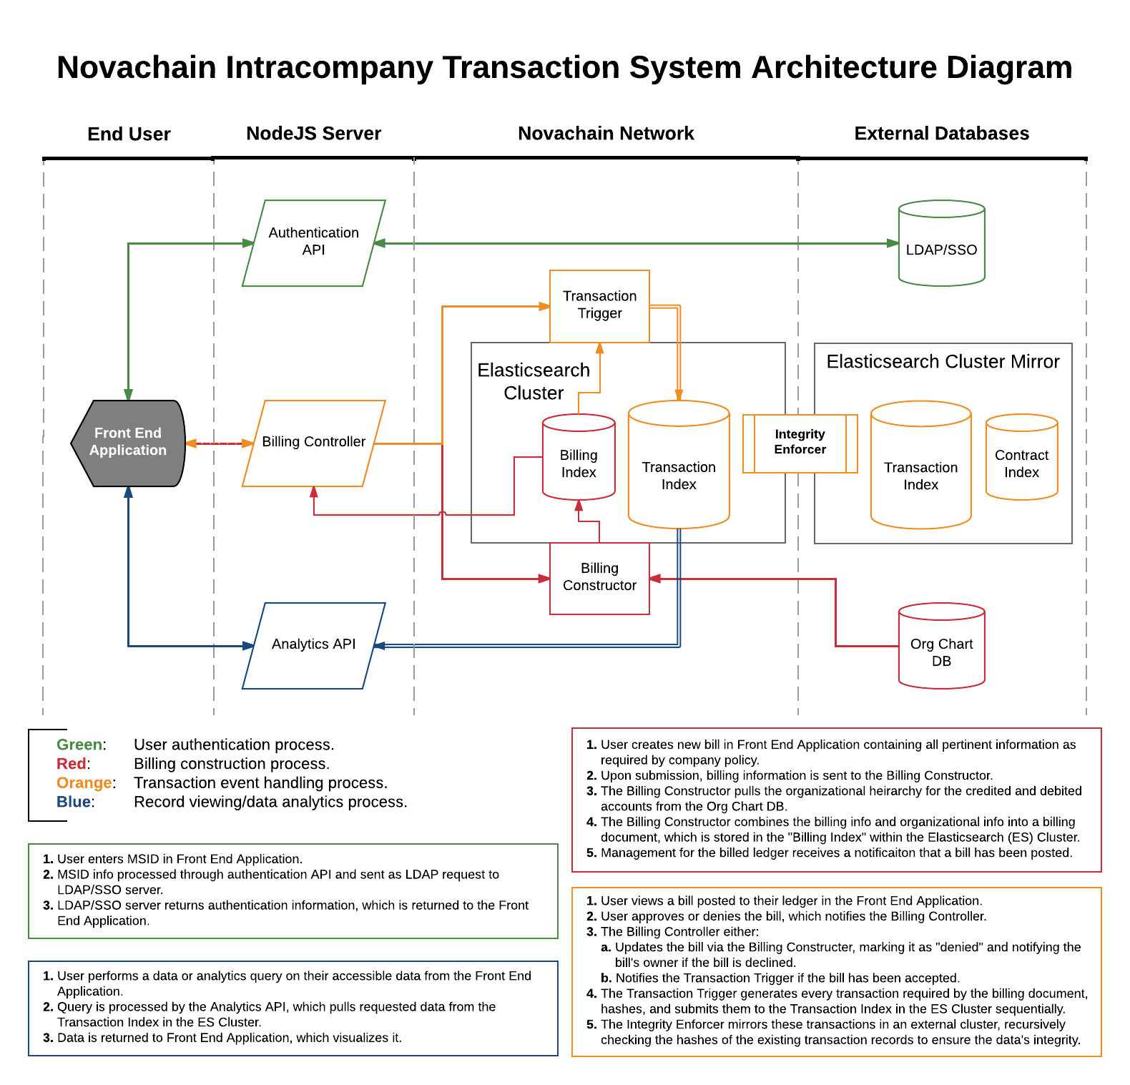

Slide 19
Added Company Value
Quarterly Reconciliation
$104,960
Current system
Blockchain solution
Contractor Fees
$157,440
$ 552,921
Daily Reconciliation
$615,000
$ 691,103
OpenShift & Red Hat
$28,857.60
Reconciliation
$ 20,500
Tech Labor
$ 41,000
OpenShift & Red Hat
$ 283,478
Reconciliation
$ 39,360
Tech Labor
$ 157,440
Year 1
Year 2
Notes:
nick

Slide 20
Soft Benefits
Cost avoidance
Contractor fees during auditing
Maintenance and manageability fees
Reconciliation fees
Time efficiency
Traceability and accessibility
Quality improvement
Decrease risk of human error
Notes:
josh

Slide 21
Cost Breakdown – Pilot
Hardware | Units |  | Specs | Cost per Month | Months per Intern Project | Total Cost
Openshift (Medium) | 1 |  | 1 mcore CPUs, 1 Gibi mem. | $164.00 | 3 | $492.00
Redhat Server | 2 |  | 4 CPUs, 8Gb RAM, 32Gb Storage | $469.20 | 1 | $938.40
Total |  |  |  |  |  | $1,430.40

Slide 22
Cost Breakdown – Pilot
Labor | Employees | Hours per Day | Days per Month | # of Months | # of hours | Cost per Hour | Total Cost
Tech Team (full time) | 4 | 8 | 20 | 2 | 1280 | $82 | $104,960.00
Tech Team (part time) | 4 | 2 | 20 | 4 | 640 | $82 | $52,480.00
Latent Reconciliation Team | 2 | 1 | 20 | 12 | 480 | $82 | $39,360.00
Total |  |  |  |  |  |  | $157,440.00
Hardware | Units | Specs |  | Cost per Month | Months per Year | Years | Total Cost
Openshift (Medium) | 1 | 1 mcore CPUs, 1 Gibi mem. |  | $164.00 | 12 | 1 | $1,968.00
Redhat Servers | 2 | 4 CPUs, 16Gb RAM, 300Gb Storage |  | $1,120.40 | 12 | 1 | $26,889.60
Total |  |  |  |  |  |  | $28,857.60

Slide 23
Cost Breakdown – Full Scale
Labor | Employees | Hours per Day | Days per Year | # of hours per Year | Cost per Hour | Cost per Year
System Maintanence | 1 | 1 | 250 | 250 | $82.00 | $20,500.00
Application Support | 1 | 1 | 250 | 250 | $82.00 | $20,500.00
Latent Reconciliation Team | 1 | 1 | 250 | 250 | $82.00 | $20,500.00
Total |  |  |  |  |  | $61,500.00
Hardware | Units | Specs | Cost per Unit per Month | Cost per Year
Openshift (Medium) | 1 | 1 mcore CPUs, 1 Gibi mem. | $164.00 | $1,968.00
Redhat Servers | 4 | 8 CPUs, 64Gb RAM, 2000Gb Storage* | $5,864.80 | $281,510.40
Total |  |  |  | $283,478.40

Slide 24
Benefits Breakdown
Labor | Employees | Hours per Day | Days per Year | # of hours | Cost per Hour | Cost per Year
Daily Reconciliation | 5 | 6 | 250 | 7500 | $82.00 | $615,000.00
Quarterly Reconciliation | 4 | 8 | 40 | 1280 | $82.00 | $104,960.00
Contractor Fees | 6 | 8 | 40 | 1920 | $82.00 | $157,440.00
Total |  |  |  |  |  | $877,400.00
Yearly Ledger Reconciliation | Year 1 | Year 2 | Year n
Cost for PoC | $1,430.40 | $0.00 | $0.00
Cost for Pilot | $186,297.60 | $0.00 | $0.00
Cost for Full Scale | $0.00 | $324,478.40 | $324,478.40
Cost for Current System | $877,400.00 | $0.00 | $0.00
Total Savings | -$187,728.00 | $552,921.60 | $552,921.60

Slide 25
Blockchain Solution
Data Field | Value
Transaction_ID | 001
Origin_GL | SDSS
Destination_GL | PEDS
Amount | $99,999
Date | 06/27/2017
Notes | laptops
Data Field | Value
Transaction_ID | 002
Origin_GL | PEDS
Destination_GL | ETS
Amount | $11,111
Date | 06/28/2017
Notes | contractor
Hash | Value
This_Hash | abc123
Hash | Value
Previous_Hash | abc123
This_Hash | bcd234
Hash | Value
Previous_Hash | bcd234
This_Hash | cde345
Genesis block
Transaction 1
Transaction 2
Notes:
nikita

