Slide 1

Final Project Presentation
Real or Not: NLP with Disaster Tweets
By Chris W., Palden W. and Tarun M.

Slide 2
Project Overview and Challenges the Team Faced
Palden Williams

Slide 3
Project Overview
Kaggle Challenge Submission
10 k hand-classified tweets
Predictive Model for future input
Submit to Kaggle site for scoring
Live Tweets score validation
Built API to pull live 100 tweets
Run the model to check the scores on the tweets

Slide 4
Key Insights, Tools, and Techniques
GitHub Centralized repository.
NLP principles (i.e. Stemming, vectoring, lemmatization).
Python libraries like WordCloud, NLTK, & SpaCy.

Slide 5
Key Insights, Tools, and Techniques (cont.)
Count_Vectorizer and SpaCy
for creating word vectors.
TQDM Progress bars to track data loads.
Cross Validation and Confusion Matrices for model evaluation.

Slide 6
Key Insights, Tools, and Techniques (cont.)
Build API to pull Tweets from Social media platform.
Generated compiled models in a .pkl file format
Created a Reusable component using Flask

Slide 7
Challenges faced by team
Evaluating the research libraries that best fit in our project.
Clean up the data (like #tags, emojis)
Tokenizing and Vectorizing the data of multiple words, phrasing, and inflection to the model.
Fitting the GloVe sample on using the precompiled GloVe vectors.
Initial Kaggle submission score is too low. (13%)

Slide 8
What we learned, Model Evaluations, and Visualizations
Tarun Mandava

Slide 9
What has worked well for us ?
Team Communication
Everyone collabration
Knowledge sharing

Slide 10
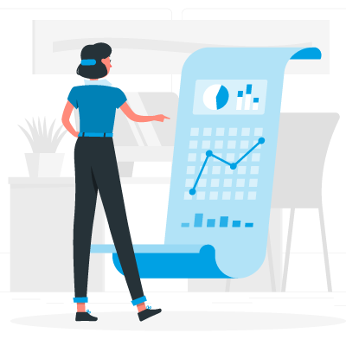
What We Learned
Understanding NLP Conventions
Model Scoring & Visualizations
Binary vs GloVe Vectorizations
Code Management with GitHub
Flask Application Development

Slide 11
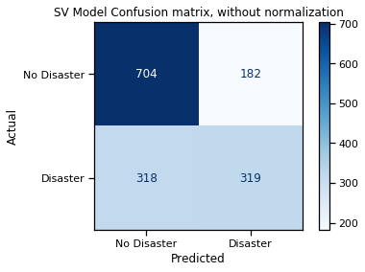
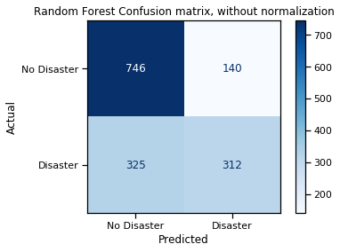
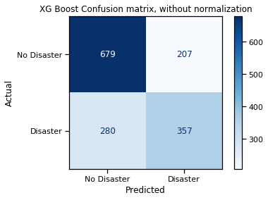
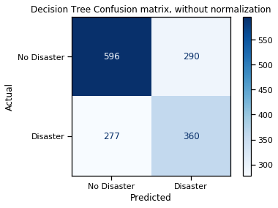
Confusion Matrix

Slide 12
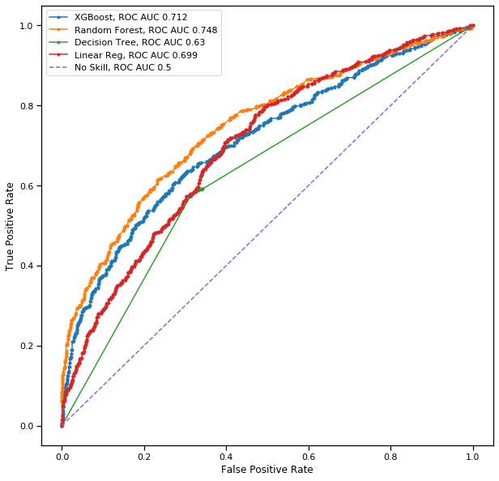
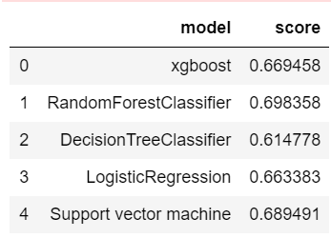
Visualization of Predictor Models

Slide 13
Solution Demonstration and Future Enhancements
Chris Wagner

Slide 14
Recommended Solution
Data Cleaning
Remove HTML
Remove Emojis/Emoticons/Images
Stop Words & Punctuation removed via Spacy Library
Tokenization
Stem/Lemmatization with Spacy Library
Remove any pronouns from the model
Vectorization
GloVe vectors generated by the Spacy en_core_web_md library
Modeling
Support Vector Machine Model

Slide 15
Code Demonstration
Code walk the model generation
1
Run the model against a live Twitter pull
2
Demonstrate the Flask App/Web UI
3

Slide 16
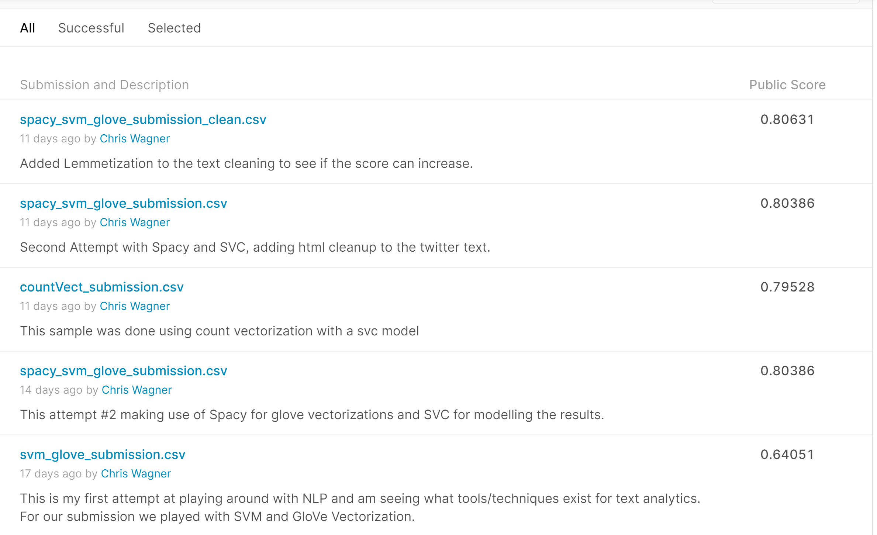
Kaggle Score Results

Slide 17
Possible Future Enhancements
Retrain with larger training set
Find way to vectorize Twitter Hashtags
Use n-grams to vector on groups of words
Geotag the tweets to provide a heat-map of where the disaster occurs real time
Enhance the web UI to increase performance

Slide 18
Feedback
Comments from Client: Thoroughly enjoyed the team’s code review presentation. It was evident that the group spent a significant amount of time working on this project. They clearly showed mastery of all the concepts and components in this effort. Chris answered everyone’s questions and explained the answers so that all would understand.
This was eye opening for our team, as we have limited exposure to the python language. This demo gave great examples of uses for the language beyond the ETL capabilities.

