Slide 1

WIA1003 COMPUTER SYSTEM aRCHITECTURE Sem 2, 2025/2026
Dr. Bryan Raj A/L Peter Jabaraj (Lecture/ Tutorial/ Lab)
Assoc. Prof. Dr. Tey Kok Soon (Lecture/ Tutorial/ Lab)
Assoc. Prof. Dr. Ismail Bin Ahmedy (Lecture)
Prof. Dr. Mohd Yamani Idna Bin Idris (Tutorial/ Lab)
Prof. Dr. Ainuddin Wahid Bin Abdul Wahab (Tutorial/ Lab)
Mr. Noorzaily Bin Mohamed Noor (Tutorial/ Lab)

Slide 2

Class (Lecture)
Monday 1pm – 3 pm
Dr. Bryan Raj A/L Peter Jabaraj
DK 1 (Lecture Hall 1)
Assoc. Prof. Dr. Tey Kok Soon
DK 2 (Lecture Hall 2)
Assoc. Prof. Dr. Ismail Bin Ahmedy
MM 8
!! Compulsory to attend the classes.

Slide 3
Tutorial & Lab
Please refer to the table below or spectrum.

Slide 4
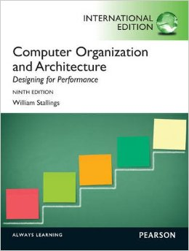
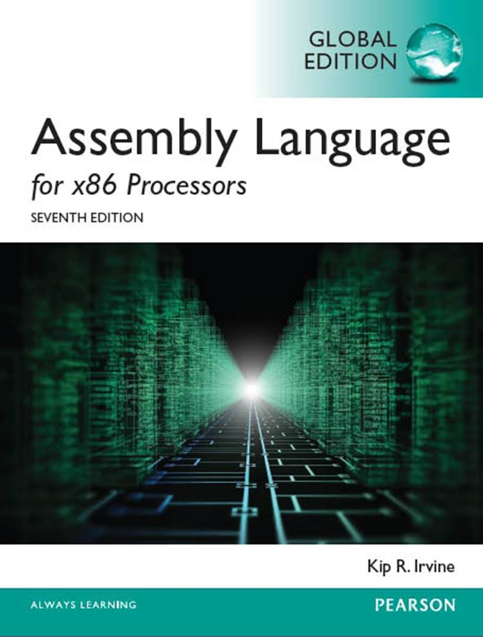
References

Slide 5
Assessment
Final Exam 50%
Continuous Assessments : 50%
Test: 20%
Week 7
Tutorial – 10%
Assignment (LAB) – 20%

Slide 6
Synopsis of Course Contents
Basic of Computer Architecture
Performance
CPU and Bus System
Cache
Internal Memory
External Memory
Input/ Output
ISA
Pipeline/ Parallel Processing
Assembly Language

Slide 7
Question?

